Slide 1
Using mail to drive commercial outcomes for your business
How mail gets customers to take action on entertainment offers
May 2020
YOUR LOGO HERE

Slide 2
The entertainment and attractions market has obviously been badly hit

Slide 3
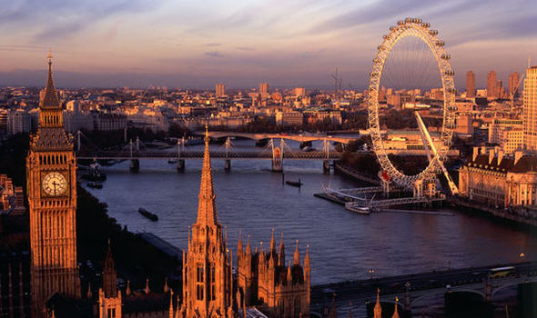
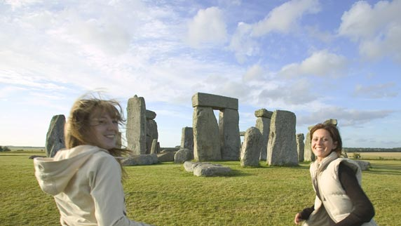
Prior to covid, staycations were driving good business
The total number of visits to UK attractions was estimated to reach 340 million in 2019, an increase of 3.7% on the previous year
This was fueled by continuing ‘staycation’ habits, the draw of creative attractions and sector-wide investment in technology
In England, those utilising digital platforms reported a 2% increase in admissions from 2018 to 2017, compared with those who did not
Britons’ interest in history is highlighted by the repeated position of museums (39%), gardens (38%) and historic buildings (37%) as the most visited attractions, with all three showing a four percentage point increase in attendance in 2019 compared to the previous year
Source: Mintel, Visitor Attractions - UK - October 2019
Notes:
Staycations were doing well before Covid. This was driven by both Britons travelling in the UK but also overseas visitors.

Slide 4
What’s changed in buying behaviour
And what’s likely to continue after covid-19
Bought for the first time due to Covid-19
If you bought for the first time, how likely are you to buy again in the next 12 months
Source: Nielsen Covid-19 Dipstick in March 2020

Slide 5
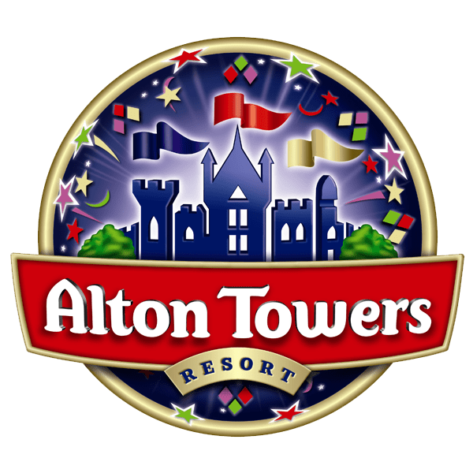


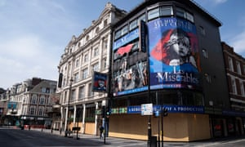






Some of the headlines
The entertainment industry is responding in various ways to covid
Cinemas are dark. Offering a blog to keep you entertained.
Re-open further shops across and outside London for takeaway and deliver – 100+ stores now open
Closed but taking amended bookings for later in the year and ride tickets honoured whenever you want to use them
Will probably be one of the last to re-open their doors because social distancing difficult
Pubs are closed to customers. Lorries helping supermarkets. Some hotels open to NHS staff.
Offering vouchers buy now and get more when they re-open
Opens small number of drive throughs near large hospitals, order via Uber Eats
English Football League looking at widening access to view games live
Epsom Oaks running behind closed doors 31 May - televised
Went to delivery only through Deliveroo
Notes:
There are lots of things brands are doing to keep their business open or ready for when they are back.

Slide 6







Businesses need to innovate to survive
Lots of businesses are thinking up radical solutions
Communicating to sports fans how you will now be bringing them access to view sporting events
Offering a different service, home deliveries will remain key in the sector
Looking for support from theatre goers to keep the theatre going at a pressured time
Sending out advance vouchers that consumers can redeem at a later date
Cinemas offering new online content to keep their cinema goers entertained and informed
Communicating with those who have bookings or attracting business to your attraction in future
Notes:
These are just some of the ways that they are innovating to survive in different entertainment sectors.

Slide 7


Industry support to get back to visitor numbers
“
Whilst we can’t actively promote travel to Britain, we’re working hard to plan our response to COVID-19 across the business. This means that when the time comes for us to promote travel to Britain once more, we will have maintained a warm dialogue with consumers to ensure Britain remains top of mind.
“
Visit Britain

Slide 8
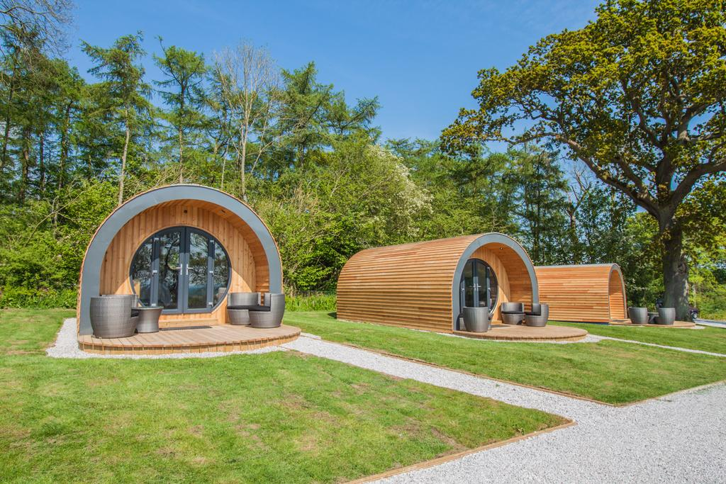

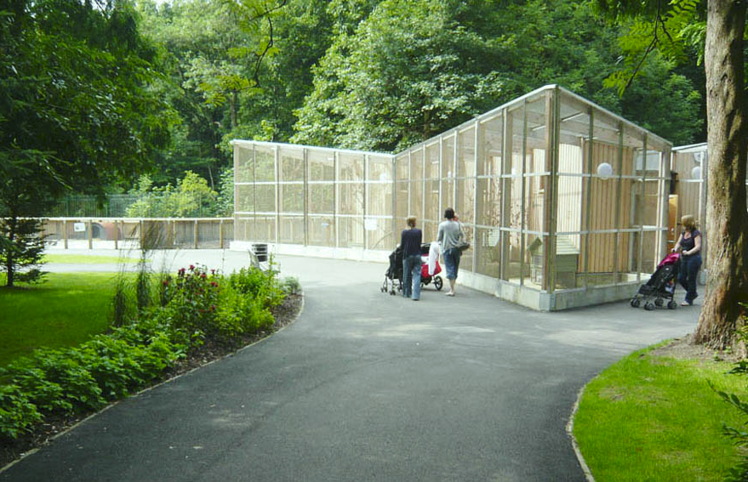
Some things may experience boom
Some sectors are expecting to be busy, including camp sites and some geographical areas
Glamping benefited from increased visitors during the last recession
Places like Cornwall with beaches may well benefit
Regional and local parks like Ouseburn where you can social distance
Tourism Economics forecasts a 26% drop in domestic arrivals this year, compared to a much sharper 30% drop in international arrivals in the UK. However it expects domestic travel to bounce back to its peak much faster to previous levels in 2021-22 compared to 2023-34 for international arrivals.
Source: Advantage Travel Partnership, sample size 4,228, May 2020
Notes:
After the last recession in 2008 some sectors reported above average business, things like camp sites and tourist attractions at home were some of those that benefited.
The glamping industry is expecting a potential boom as they are uniquely placed to offer a safely social distanced environment.

Slide 9
How mail can drive commercial value to you

Slide 10

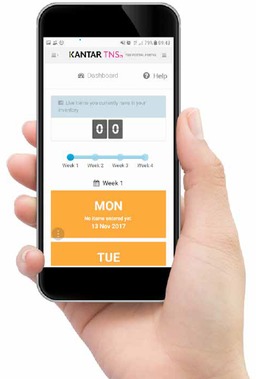
Jicmail gives us gold standard data
That shows exactly how consumers interact with
Entertainment and attractions mail
Mail is collected in the first week and recorded, then that week’s mail is tracked over 28 days
People record what they do with their mail physically
They tell us the type of mail, i.e. is it addressed or unaddressed to them or someone else.
Opened it
Read / looked at / glanced at it
Put it on display e.g. fridge / noticeboard
Passed it on / left out for the person it’s for
Put it aside to look at later
Threw it away / recycled
Took it out of the house e.g. to work
Used / did something with the information
Put it in the usual place
They capture what business sector the mailing or door drop comes from.
They record the contents; is it information, special offer, etc. You can tick all that apply here.
Notes:
JICMAIL data has been available since the second quarter of 2017, it now contains over 92,000 individual mail packs across all the main industry sectors. It has been designed to create Gold Standard for the industry so that mail and door drop can be planned alongside other media in exactly the same way as all other channels.
A panel of 1,000 households each month collect their mail and door drop for the first 7 days of each month. They then track that content over a full 28 day period and tell us what they did with it physically ie opened, read and passed it on. But in addition they record any commercial actions, such as going online, calling the sender or using a voucher or discount code.

Slide 11
Engagement rates with entertainment mail
High across the board
93% of all entertainment mail is engaged with ie mail is processed in some way (opened, read, sorted, put aside)
69% of all entertainment mail read / looked at / glanced at
62% of all entertainment mail is opened (a postcard doesn’t need to be opened)
Source: JICMAIL Q2 2017 – Q1 2019 Addressed or Business Mail, Travel/tourism/attractions, n=3483
Notes:
The average engagement with mail is 91% so entertainment mail does well.
It has high readership rates. Open rates may well be lower as entertainment and attraction businesses often use postcards, which won’t require opening.

Slide 12
What are entertainment co’s sending?
They are mainly sending information about products and services, but more likely to contain a broader range of contents than other sectors
Source: JICMAIL Q2 2017 – Q1 2019 Addressed or Business Mail, Travel/tourism/attractions, n=3483
Any type of content with 1% or less has been removed
Notes:
Entertainment businesses tend to contain more types of content than for other sectors.
For example in Financial Services over 50% of mail contains a financial statement / bill or update and for charities the main volume is a request for a donation.
Entertainment mail contains the biggest volume for information about products and services but has a broader spread of other content like information about entertainment/activities, special offers and news.

Slide 13
physical actions
Physical interactions with entertainment mail is strong
Source: JICMAIL Q2 2017 – Q1 2019 Addressed or Business Mail, Travel/tourism/attractions, n=3483
Any type of content with 1% or less has been removed
Notes:
Physical actions are the things that people do with their mail when the mail is actually in their hand or right there in front of them – so we call these physical actions.
The frequency we talk about in the presentation is based on just the physical actions.
The highest of all are opening and reading, open rates are high and read rates. Entertainment mail scores strongly for being put aside to look at later / put in the usual place.
Recycling looks high but this will be done after a lot of the actions have been taken.
Respondents tick all the things they do.

Slide 14
MAIL DRIVES COMMERCIAL ACTIONS
When it contains different content it drives different levels of commercial interaction
%
Commercial actions particularly high for vouchers/coupons, financial statements and administrative information
Resulting commercial actions with entertainment mail
1,908
655
130
400
69
821
424
155
Source: JICMAIL Q2 2017 – Q1 2019 Addressed or Business Mail, Travel/tourism/attractions, n=3483
Notes:
Commercial actions are what people go on to do beyond physical actions.
This is the % of people taking any form of commercial action with their mail. Overall 28% of people receiving entertainment mail go on to take some form of commercial action. But if the content includes a voucher or coupon or financial statement or administrative information these rise to over 40%.

Slide 15






All SORTS OF GROUPS ENGAGE WITH MAIL
Entertainment mail is engaged with by all types of consumer
FREQUENCY OF EXPOSURE
AGE 55-64
HOUSEHOLD
CHILDREN 17-34
SOCIAL GRADE C2
TV REGION: MERIDIAN
OWN HOME 6-10 YRS
4.43
4.07
4.83
5
4.8
ADVERTISING & BUSINESS MAIL MAIL
Source: JICMAIL Q2 2017 – Q1 2019 Addressed and Business Mail, Travel/tourism/attractions, n=3483
Notes:
The average frequency for all mail is 4.1. We’ve looked at some other audiences to see if this varies and it does.
Those aged 55-64 have a frequency ie return to mail 4.43 times.
Those with a social grade of C2 engage at higher rates with a frequency of 4.83.
Those in the Meridian TV region engage at a significantly hither rate of 5.
And those with a tenure of 6-10 years achieve a frequency of 4.8.

Slide 16
All age groups engage with mail
Frequency - older age groups engage at slightly higher rates
Source: JICMAIL Q2 2017 – Q1 2019 Addressed and Business Mail, Travel/tourism/attractions, n=3483
Notes:
All age groups engage with mail although it is true to say that younger people engage less frequently with their mail, they get less of it. Those in the 55-64 age group have the highest engagement levels.

Slide 17
frequency above average
Mail drives high frequency but varies by type of content
If the content has a voucher or coupon, news/update or is a financial statement or administrative information then the frequency is significantly higher than the average.
Base: 1,908
Base: 1,908
Base: 655
Base: 130
Base: 400
Base: 69
Base: 821
Base: 424
Base: 155
Source: Kantar TNS, JICMAIL, Addressed and Business Mail, Travel/tourism/attractions, n=3483
Notes:
But when you look in more detail there is a different between the types of mail sent and frequency. So anything containing a voucher/coupon gets higher frequency rates, alongside administrative information, news and financial statements. More general pieces like information about products and services or information about entertainment/events fair slightly less well on frequency.

Slide 18
Content type drives all sorts of actions
Look how the inclusion of a voucher gets people to do something commercial like use the voucher, plan a large purchase or discuss with someone else
Actions per thousand by mail type
Source: Kantar TNS, JICMAIL, Advertising and Business Mail, Travel/tourism/attractions, n=3483
Notes:
Of the 28% of people taking a commercial action, JICMAIL can show you how many people in that group go on to do something that might drive business.
If you send a voucher for example 322 people per thousand will go on to plan a large purchase. Administrative information drives 377 people to discuss it.
Think carefully about the content you send and how you want your consumers to interact with it commercially.

Slide 19
Entertainment mail in action

Slide 20

The Glendale show used door drop to boost visitor numbers
Background:
In its 122nd year, the annual Glendale Show in Northumberland brings together the town and countryside to showcase farming and rural industry. With 15,000 visitors each August Bank Holiday they wanted to build visitor numbers to the borders-based event.
Solution:
Royal Mail’s Door to Door suggested geo-demographic targeting combinations to target addresses within easy travelling distance of the event. Timing also played an important role with the event on a UK public holiday.
Results:
The organisers saw visitor footfall rise significantly with Royal Mail Door to Door service to the marketing mix. Previously they relied on visitors picking up leaflets but now can be confident that leaflets are being delivered to their audience, who read and retain them. 2014’s Door to Door cost approximately £6,400 including design, print and distribution, just over 10p per leaflet delivered. Capturing visitor demographics at the Show will help them plan even more effectively for future years.
Source: The Glendale Show 2015

Slide 21

A MAIL MADE EASY PARTNERSHIP HELPED LAUNCH A NEW ART FAIR
Background
Windsor Events had used a mix of press, door drops and mail to drive people to their art fairs. When they launched Contemporary Arts Fair – Surrey they were seeking a more targeted way to reach a cold audience to drive awareness and footfall.
Solution
Royal Mail profiled Windsor Event’s database to give a more detailed understanding of their customers. This led Windsor Events to test cold mail using profiled names and addresses of look-a-like customers. A Mail Made Easy partnership with Document Dispatch – a full service agency in Berkshire - helped Windsor Events navigate all elements of the mailing from accessing the data from Royal Mail, to printing and mailing the artwork.
Results
The mailing received a 2% response rate and drove new customers to Contemporary Art Fairs - Surrey.
Source Deborah James Director Windsor Events Limited

Slide 22

Using door drop to relaunch their business after a big refurbishment
Following a £5m renovation, Old Down Country Park near Bristol chose door drop as the ideal way to let prospective customers in the local area know what their new offer was
They had an estimated return on their investment of 7:1 in the first 2 months
They sent an A5 postcard to 40,000 local addresses using Royal Mail’s geo-demographic targeting and went to households within a five mile radius of the park
An email competition to win a meal for two at the Bistro enabled them to collect more than 200 names and addressee
The total cost of the door drop campaign including production of the postcard was £3,470
Best of all they received 50 enquiries about their wedding venue
Source Old Down Country Park

Slide 23
TO SUM UP – door drop
UNIQUE TIMES
The entertainment and attractions sector has suffered turbulent times
INNOVATING
But the sector is coming up with innovative ways to survive and flex
ENGAGED WITH
Mail and door drop has the ability to engage and has high levels of interactions
COMMERCIAL ACTIONS
If you make sure the contents are right you can ensure higher commercial interactions
USE IT IN MANY WAYS
You can use it in many ways to support your activity at this time

Slide 24
YOUR LOGO HERE

