Slide 1
Price Plan Benchmarks explained

Slide 2

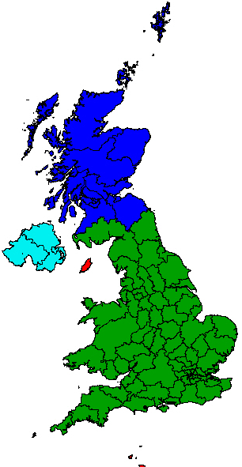

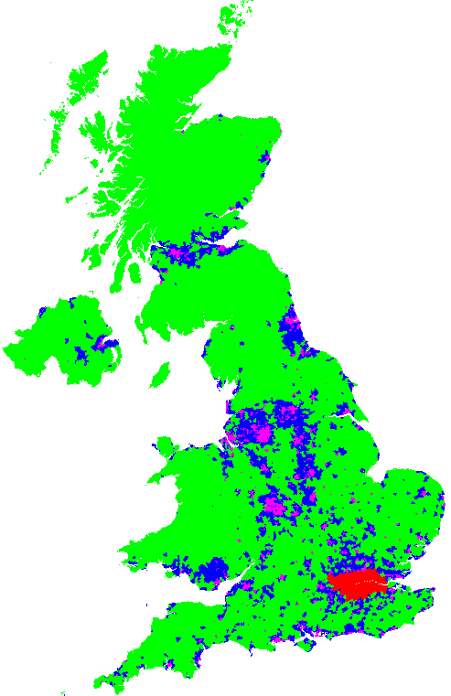




Profile creation at a glance
Building blocks and process
Postcode sectors allocated to a zone annually
Profiles calculated, which help determine what customers are required to achieve:
Postcode sector data consolidated into SSCs
Zones:
• Urban • Rural
• Suburban • London
49 SSCs
PP1
National Spread Benchmark
Does the customer proportion of mail in each SSC reflect the national postbag?
11,000 PC
sectors
PP1
Urban Density Benchmark
Does the customer proportion of Urban mail in each SSC reflect the national postbag?
PP2&4
Zonal Posting Profile
Mail volumes
The mail volume going to each zone is measured quarterly
Mail volumes
The mail volume going to each SSC is measured quarterly
Does the customer proportion of mail in each zone reflect the RMG F2E

Slide 3
Allocation of postcode sectors to zones
An important input to UDB & Zonal Posting Profiles
Each year we assess the zone allocated to each postcode sector based on factors such as delivery point density.
London is allocated based on the volume of mail in each SSC that is within the London boundary. Any SSC that straddles the boundary is assessed on the volume inside and outside London.
The change in allocation of postcode sectors to zones each year is minimal*, except where an SSC changes from being classed as London to Urban/Suburban/Rural, or vice versa.
This process ensures changes to delivery points are reflected in the Royal Mail Urban Density Benchmark and Zonal Posting Profiles.

Slide 4
Profile calculations in detail
1
3
2
4
5
PC sector | Zone | SSC | Volume
AB10 1 | A | 310 | 100
HA0 1 | D | 375 | 50
AL2 1 | B | 359 | 75
AL3 6 | C | 359 | 10
… | … | … | …
SSC | A | B | C | D | NSB | UDB
310 |  |  |  |  | % | %
375 |  |  |  |  | % | %
… |  |  |  |  | % | %
Zonal Profile | % | % | % | %
Volume
6
1
Each postcode sector has a zone allocated, and belongs to an SSC
Mail volume is allocated to each postcode sector
Postcode sectors are summarised into SSCs, and volume for each zone within each SSC is summed
PP1 NSB is the SSC volume as a % of total volume (all zones)
PP1 UDB for each SSC is the volume of zone A (urban) / total volume for the specified SSC
Zonal Profiles are the % in each zone for all SSCs combined for PP2 or regional SSCs for PP4
2
3
4
5
6

Slide 5
Profile comparison at glance
Price Plan | Profile measure | Measure level | Zonal allocation input | Volume input period | Royal Mail data Sources for Benchmarks | Customer Contract Monitoring data
PP1 | National Spread Benchmark | SSC volume | O | Dynamic Baseline updated Quarterly using 12 months rolling data | DSA: Dockethub Retail: MCS | Dockethub
 | Urban Density Benchmark | % Urban volume in SSC | P | Dynamic Baseline updated Quarterly using 12 months rolling date | DSA: Mailmark Retail: MCS | Mailmark
PP2 | Zonal Posting Profile | % volume in each Zone (national) | P | Dynamic Baseline updated Quarterly using 12 months rolling date | DSA: Mailmark Retail: MCS | Mailmark or actual data uploaded by Zone
PP4 |  | % volume in each Zone (regional)

Slide 6
Measurement and Permitted Variances
Price Plan | Profile measure | Measure level | How we monitor a customer | Thresholds
PP1 | National Spread Benchmark | SSC volume | We use Dockethub volume per SSC expressed as a % of the overall volume. We then compare the customer SSC % to the Royal Mail SSC % to create a ratio | The SSC passes if the ratio versus Royal Mail is greater than 0.7. We allow 4 SSC failures in Eng & wales and 1 SSC failure in Scot & NI
 | Urban Density Benchmark | % Urban volume in SSC | We use customer Mailmark data to calculate their Urban SSC %. We then compare the customer Urban SSC % to the Royal Mail SSC Urban % | The SSC passed if within the relative permitted variance of 15%. If the Urban SSC % is outside of tolerance the % difference is multiplied by the overall SSC volume to identify the number of items to be surcharged
PP2 | Zonal Posting Profile | % volume in each Zone (national) | We use customer data to calculate their Zonal %. We then compare the customer Zonal % to the Royal Mail Zonal % | There is a permitted variance of 2.8%. This is applied on all of the zones that are more expensive than the national price. If the customers exceeds the Royal Mail Zonal % (plus tolerance) in the more expensive zones we will surcharge the excess items
PP4 |  | % volume in each Zone (regional)

