Slide 1
MACHINEABLE POSTCARDS AND ONE PIECE MAILING GUIDE WITH TEST AND INNOVATE
Wholesale
January 2023

Slide 2
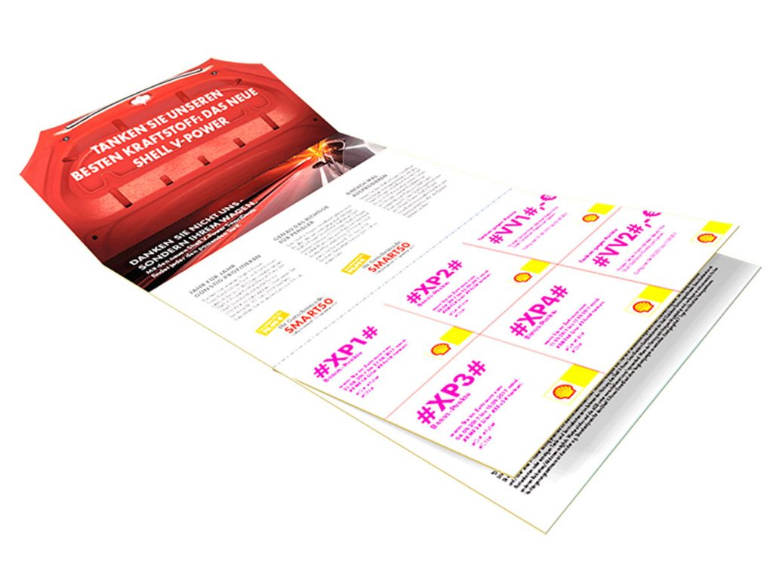
Advertising mail test & innovate
Machinable Postcards and 3 lightweight formats available to use
MACHINEABLE POSTCARD
ONE PIECE PAPER WRAP MAILER
FEATURE MAILER
COUPON MAILER
Source: Zappost.com and YMGroup

Slide 3
Mail gets you noticed
Of mail is engaged with: opened, read, sorted, put aside, put on display or in the usual place.
96%
1.5
Every 100 mail packs sent reach another 15 individuals.
4.4
Each piece of mail is revisited 4.4 times by individuals.
Source: JICMAIL, Addressed Mail, Q2 2017-Q3 2022, n=115,208

Slide 4
Postcards
An impactful and timely way to get your message out
Postcards are a quick and impactful way to retarget someone who has abandoned their shopping basket
You can use them to let customers know about new products
You can use short formats to let people know about local events
What about thanking VIP customers for their business with you, a thank you very often prompts a sales
Select any number of triggers to prompt a programmatic postcard: price drops, added something to their wish list, viewed a product range but didn’t buy
Mailed within 2-3 days of trigger
Source: Zappost.com

Slide 5
Create a customer journey online to physical mail item
Mail connects to all the main automation platforms you already use
Conversion
Acquisition
Engagement
Win back
OMNICHANNEL
Cross-sell
Up-sell
Lapsing
Advocacy

Slide 6
The formats to choose from
MACHINEABLE POSTCARD (2/3PLY)
INSERT | None
SHAPE | 3 ply thickness
FOLDS | 2 folds
REFERENCE / BOTTOM EDGE | To be a fold
DIMENSIONS | Length: minimum 140mm, maximum 240mm Width: minimum 90mm, maximum 165mm
ITEM WEIGHT | Maximum weight 100g
PAPER WEIGHT | 120gsm – 150gsm (150gsm recommended)
PAPER THICKNESS | 2ply = minimum of 0.18mm, 3 ply = minimum of 0.27mm
FLAP SIZES | Not applicable
SEALING | Continuous seal of glue on unfolded edges
FINISH | Matt is preferred
ONE PIECE PAPER WRAP MAILER
INSERT | Paper only
SHAPE | Rectangular or square
FOLDS | Long edges fold, short edges sealed
REFERENCE / BOTTOM EDGE | To be a fold
DIMENSIONS | Length: minimum 140mm, maximum 240mm Width: minimum 90mm, maximum 165mm
ITEM WEIGHT | Maximum weight 100g
PAPER WEIGHT | Minimum 100gsm
PAPER THICKNESS | Not applicable
FLAP SIZES | To be a minimum of 25mm high, less than 40mm from the bottom and can run along the long edge and can be on the front or back
SEALING | Continuous seal if inserts included, spot or continuous if no inserts
FINISH | Matt is preferred

Slide 7
THE FORMATS TO CHOOSE FROM
FEATURE MAILER
INSERT | None
SHAPE | Rectangular or square
FOLDS | Maximum of 2 folds
REFERENCE / BOTTOM EDGE | To be a fold
DIMENSIONS | Length: minimum 140mm, maximum 240mm Width: minimum 90mm, maximum 165mm
ITEM WEIGHT | Maximum weight 100g
PAPER WEIGHT | Minimum 150gsm – 190gsm
PAPER THICKNESS | 0.13mm – 0.175mm recommended minimum
FLAP SIZES | Not applicable
SEALING | Continuous or spot
FINISH | Matt is preferred
COUPON MAILER
INSERT | Paper booklet only, no more than 85mm x 130mm, affixed to the inside
SHAPE | Rectangular only
FOLDS | 3 folds required
REFERENCE / BOTTOM EDGE | To be a fold
DIMENSIONS | 165mm x 145mm (+ / - 5mm)
ITEM WEIGHT | No more than 20g
PAPER WEIGHT | Minimum 115gsm
PAPER THICKNESS | Not applicable
FLAP SIZES | Folded 3 times
SEALING | Continuous seal of glue on unfolded edges
FINISH | Matt is preferred

Slide 8
Specifications
Finish for digitally printed postcards
When digital printing is used for mail the pigment may rub off , transfer to adjacent surfaces, crack and become marked both during the manual and automated handling processes.
The application of an ultra violet (UV) cured varnish has been found to reduce the wear to digitally printed mail items.
This provides a protective coating over the pigment. It should only be applied to the non-addressed side of the postcard, as the characteristics of the varnish may make the mail unmachinable, if applied to both sides.
The pressure exerted on the postcard during automated processing may cause colour offset on digitally printed items. Therefore, it is recommended that there should be no off-set print or colour transfer when the item is exposed to a pressure of 3.43kPa (35g per cm2). This equates to a weight of 8.5kg spread over the surface of a DL envelope, and 13.5kg for C5 envelopes.

Slide 9
THANK YOU

