Slide 1
In uncertain times how brands can build trust

Slide 2
In uncertain times brands need to build trust
We live in uncertain times and this isn’t changing:
Political
Economic
Social
Technological
Legal
Environmental
It is important every message you deliver can be trusted and mail can help build trust
60% OF CUSTOMERS WILL STOP BUYING A PRODUCT IF THEY DON’T TRUST THE COMPANY *
*Source:2019 Edelman Trust Barometer

Slide 3
The value of mail in uncertain times
ADDING MAIL INTO YOUR MARKETING MIX BUILDS TRUST AND GETS YOUR BRAND NOTICED
Research* confirms this and shows that mail is proven to deliver reassurance and credibility, and these are key components to building and maintaining trust
Mail is seen as valued, confidential, important and secure and drives response
* Royal Mail MarketReach Research conducted by Kantar TNS in May 2017: Base 1269 UK adults, nationally representative sample

Slide 4
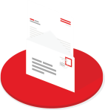
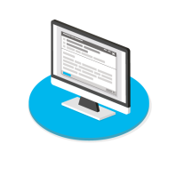
How mail builds trust
MAIL IS VALUED AND MAKES ME THINK BETTER OF THE SENDER
Do the following statements relate mostly
to mail or email you receive from companies?
Mail
Email
It makes me feel valued
It gives me a better impression of the company
* Royal Mail MarketReach Research conducted by Kantar TNS in May 2017: Base 1269 UK adults, nationally representative sample

Slide 5
How mail builds credibility
Now thinking about the mail and email you receive from companies, how would you describe the way they communicate with you?
87%
describe mail as ‘Believable’
(vs. 48% for email)
* Royal Mail MarketReach Research conducted by Kantar TNS in May 2017: Base 1269 UK adults, nationally representative sample

Slide 6
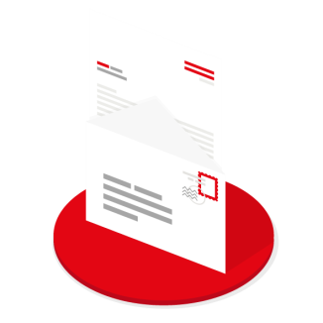
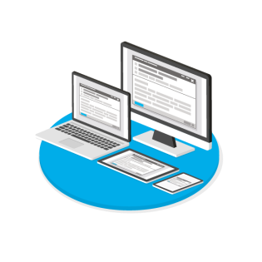
Mail is valued because it is secure
Thinking about how companies or organisations contact you, what is your preferred method of contact for sensitive or confidential account information:
51%
35%
12%
1%
Post
Email
Phone call
SMS alert
* Royal Mail MarketReach Research conducted by Kantar TNS in May 2017: Base 1269 UK adults, nationally representative sample

Slide 7
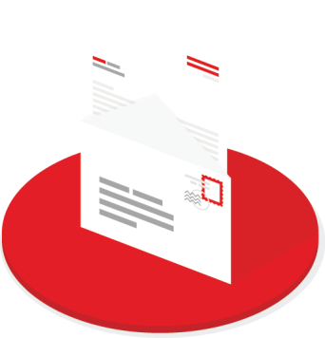
Mail is valued because it is private
To what extent do you agree or disagree with the following...
I am confident that the contents of my mail are private
* Royal Mail MarketReach Research conducted by Kantar TNS in May 2017: Base 1269 UK adults, nationally representative sample

Slide 8
With consumers actively avoiding advertising, mail can get your brand noticed
YoY change
+10
3 in 4 now avoid advertising
74%
+6
+10 pts
+5
Use one or more advertising avoidance strategies
+8
Source: Edelman Trust Barometer Special Report: In Brands We Trust 2019

Slide 9
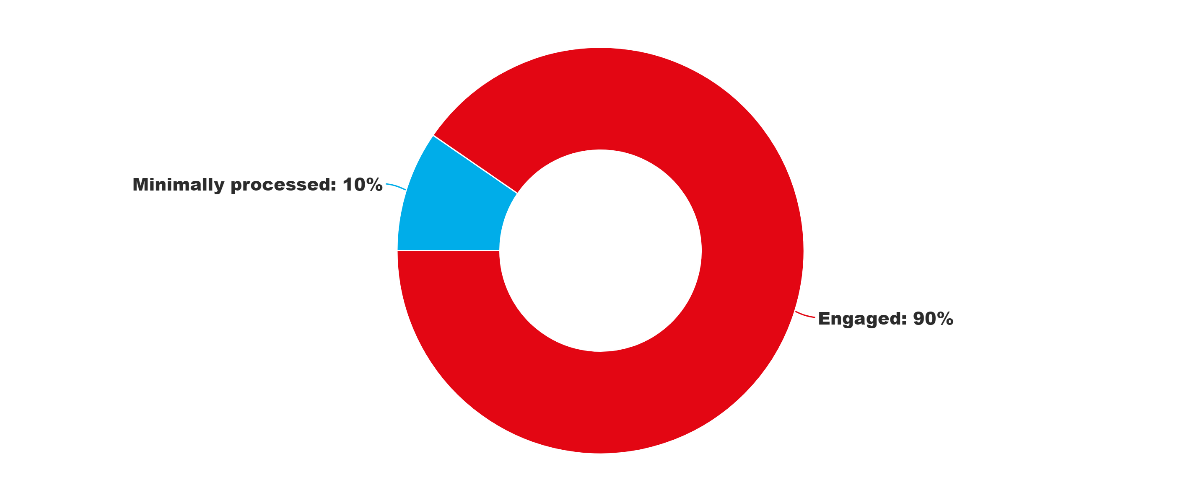
Jicmail proves that mail is engaged with, kept and revisited
Mail Engagement Rate
Reach Frequency
Direct Mail 1.13 4.2
Door Drop 1.05 2.8
Minimally processed 10%
Engaged 90%
7.5 days
Average Lifespan
ENGAGED: % of mail processed in some way including – opening, reading, sorting, put aside for later, filed, put on display, put in the usual place. MINIMALLY PROCESSED: % of mail thrown away only.
Source: JICMAIL 2019, All Mail

Slide 10
People pay more attention to mail
Do the following statements relate mostly
to mail or email you receive from companies
Mail
Email
“I think that’s the thing with post… I personally think there’s some value in it because people actually look at it.”
Jack, mid-20s
I am likely to give it my full attention
Royal Mail MarketReach Research conducted by Kantar TNS in May 2017: Base 1269 UK adults, nationally representative sample
Quote from MarketReach/ Illuminas Local Government Research, 2017

Slide 11
PEOPLE TRUST BRANDS THEY KNOW & Mail makes a longer lasting impression
Average levels of Memory Encoding to study content
Long-term memory encoding was
47% stronger
for content delivered by Mail versus Online
This indicates that people are more likely to remember a brand communication that is delivered by Mail
Source: Royal Mail MarketReach, Neuro-Insight, 2018

Slide 12
From trust to commercial actions
27% of the actions taken with mail are commercial actions
Source: JICMAIL 2019, All Mail

Slide 13
Including mail is an excellent way to build trust
A MEDIUM CAN CONVEY A MESSAGE
Mail’s attributes - tangibility, tactility and longevity help build trust while also driving short term commercial actions. Therefore adding or including mail in the marketing mix is an excellent way to build trust.

Slide 14
How we can help – what are the uncertainties you are facing
Changing behaviours
Changing audiences
Brexit
Corona virus
What’s driving trust

