Slide 1
How mail can support brands during covid-19 and beyond:

Slide 2

a critical time for brands…
“Brand health becomes vulnerable when companies stop advertising.
If they do this for longer than six months it destroys both short- and long-term health.
Brand salience is especially important in times of crisis: strong brands recovered 9 x faster following the financial crisis of 2008. .
Now is an opportunity for brands to change their media, messaging and touchpoints to ensure they are reaching consumers with communications they are most interested in.
Marketers should look at how budgets can be spent most effectively to maintain a presence and key brand metrics if spend does need to be reduced.”
Jane Ostler
Kantar Insights Global Head of Media
Source: Kantar Global Survey March 2020 (35k consumers)
Notes:
Kantar ran a theoretical test on an unnamed, but real beer brand. The team found that if the brand cut all its ad spend during the crisis, this would have a 13% impact on sales in the long run and make market share hard to recover. However, a 50% drop in ad spend would result in just a 1% drop in sales.

Slide 3

64% of the UK agree that how a brand responds to the crisis now will have a huge impact on their likelihood to buy from them in the future
Source: Edelman Trust Barometer March 2020

Slide 4
It’s make or break time about what you say and how you say it …
During the current situation – and beyond…
What is important to consumers
What do they want to hear about from brands
How is the situation affecting media and messaging
What is the role of mail for brands and how can it help

Slide 5
The current landscape for brands

Slide 6
We’ve changed our behaviour and are trying new brands and categories
Online food shopping from supermarkets to fresh fruit & veg boxes, recipe boxes (Gousto, HelloFresh) and take-away food delivery (Deliveroo, JustEat)
Hand sanitiser, antibacterial cleaning products and a spike in toilet paper sales
Digital media streaming services – Launch of Disney Plus and cinema releases direct to live streaming
Online fitness classes – Joe Wicks is the Nation’s PE teacher. Growth in virtual fitness
Home entertainment system upgrades:
Smart TVs, IOT
Social networking platforms: WhatsApp, Skype
House party
Zoom
TikTok
Source: Mintel Coronavirus podcast March 2020

Slide 7
Reprioritised those crucial to daily life…
Critical
Supportive
On hold
Companies who either aren’t central or don’t have relevant messaging for now
Companies that deliver or have adapted to deliver other things I need
Companies who are essential at this time to meeting my needs
Grocery stores, Telco, Entertainment, Financial Services
Home delivered meals, online shopping
Airlines, travel insurance

Slide 8
Switched to more trusted media channels
Live TV
BBC is most trusted Covid-19 news source:
64% see it as the most reliable
Newspapers
32% of all consumers are reading news online and offline
29% of 18-24 year olds are consuming more news brands
Social Media
33% said they are using Facebook more than usual for communication
28% are spending more time on WhatsApp
Consumers prefer brands to communicate virus related issues via traditional media (45%) rather than social media (19-31%)
Source: Havas: “The Covid-19 Media Behaviours Report” – 1500 survey, March 2020/Virgin Media
Notes:
The research found that cross-media consumption has increased as a result of the outbreak, with out-of-home and cinema being the exceptions.
The BBC has become the most-trusted news brand on coronavirus, with 64% of respondents selecting it as a reliable source of information from a list of media brands.
The public-service broadcaster beat Sky News, which was voted for by 29% of participants, followed by The Guardian (15%), according to research from Havas Media Group.
The Covid-19 Media Behaviours Report, which surveyed nearly 1,500 respondents, found that more than half (53%) of Brits are using BBC News more than before Covid-19 hit the UK – more than double the proportion of people for any other channel.
It is an encouraging trend for traditional media owners, whose perceived veracity has taken a hit due to the spread of fake news across social media.
Nearly half (48%) of respondents said they were watching more live TV because of the virus, 40% said they were visiting social media sites more and 39% have increased their streaming consumption.
Younger people are become more engaged with media than before, according to the study. There has been a 60% increase in streaming among people aged 18 to 24 and a 49% increase in live TV viewing.
News brands are benefiting in particular, with 32% of all consumers saying they are reading online or offline newspaper content more often.
Meanwhile, 29% of 18- to 24-year-olds and 31% of 25- to 34-year-olds say they are consuming more news brands.
Unsurprisingly, social media is also benefiting.
Facebook and WhatsApp are gaining the most – 33% said they are using Facebook more than usual and 28% are spending more time on WhatsApp.
Havas Media will conduct the survey on an ongoing fortnightly basis to track consumer media behaviour during the crisis.
Eva Grimmett, Havas Media’s chief strategy officer, said: "This study really highlights the role that trusted, meaningful media play in times of crisis. While most channels have seen an increase in consumption in response to Covid-19, our research reveals a much greater reliance on live TV and a need for trusted news brands such as the BBC. We’re looking forward to seeing how this behaviour develops as the situation evolves in the coming weeks."

Slide 9
people agree that brands need to look after them right now
While only 8% of consumers think brands need to stop advertising during the Covid-19 outbreak, they have a clear expectation of their role:
78%
believe brands should help them in their daily lives
75%
said brands should inform people of what they’re doing
74%
said companies should not exploit the situation
Consumers expect brands to use a reassuring tone, offer a positive perspective and communicate brand values.
Ikea focus on the importance of home and Nike communicate the need to stay indoors – they’re seen as supportive of government messaging and health organisations, while staying true to their brand values.
Source: Kantar Global Survey March 2020 (35k consumers)
Notes:
Consumers are looking for explicit evidence that brands are supporting staff, the government and consumers. Almost 80% believe employee health should be a key priority for companies, while almost two-thirds believe flexible working should be a priority.
Some 45% of consumers want to see companies putting in place plans to protect the supply of services or products, while more than 40% want to see companies making donations of products, such as hand sanitisers or face masks. It’s a very delicate balance at the moment – brands need to be mindful of communicating in a way that supports Government and consumers and is not exploitative.

Slide 10
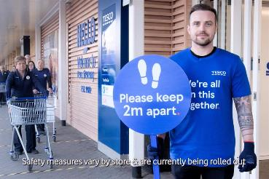

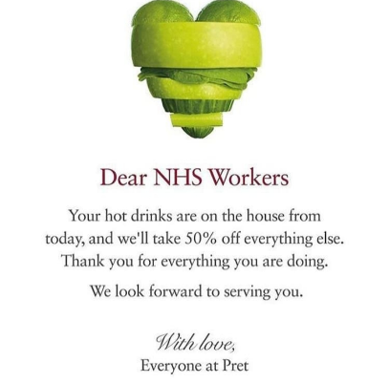

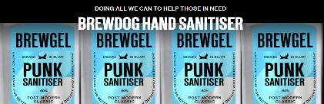
Many are rising to the challenge with new messaging or products…

Slide 11



but those who develop a new genuine purpose are standing out
Iceland were the first supermarket to offer priority shopping times for vulnerable audiences
Premier Inn opened their hotels up to keyworkers. They also offered customers full refunds or the flexibility to rebook for future stays.
Burberry repurposed their trench coat factory in Yorkshire to make non-surgical gowns and masks for patients in UK hospitals.
Heinz is using it’s expertise to ensure schoolchildren still get their much needed free breakfast

Slide 12
What mail can offer at this time

Slide 13
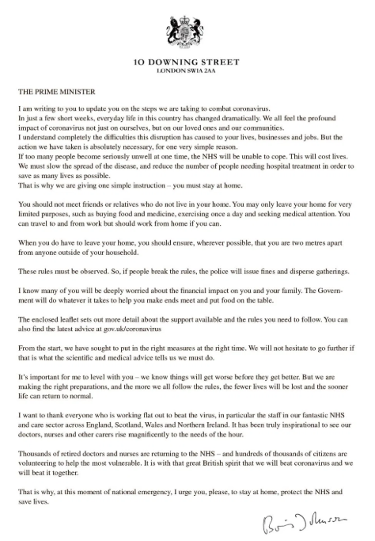
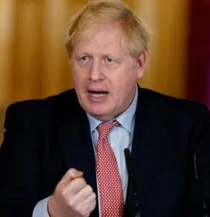
The power of a letter…
Boris Johnson has written to every UK household about the social distancing rules and has included a leaflet detailing support available
Using the power of mail to deliver important messaging that will reach; everyone, those who aren’t otherwise getting the message, non-digital and vulnerable, those who want to spend time with the message

Slide 14
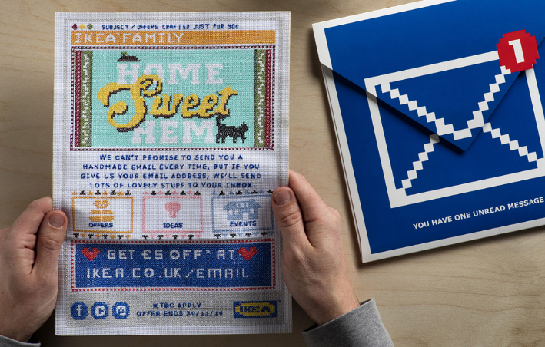
It’s physicality cuts through in the home
Tactility
Long copy
Storytelling
Visual
Physical reminder
Physical offer
Ability to guide response
Personal
Responsive

Slide 15
People value mail and give it their full attention
Do the following statements relate mostly to mail or email you receive from companies?
Mail
With people stuck in the
home they are even more likely
to give mail time and attention
It will be a welcome break from
their digital lives
Email
Source: Royal Mail MarketReach/ Kantar TNS, 2017. Base 1,269 UK adults, nationally representative sample

Slide 16



trusted channel for important messaging
Now thinking about the mail and email you receive from companies, how would you describe the way they communicate with you?
%
Formal
Important
Believable
Personalised
Secure
Quick
Mail
Mail & Email
Email
Source: Royal Mail MarketReach Research conducted by Kantar TNS in May 2017: Base 1269 UK adults, nationally representative sample

Slide 17
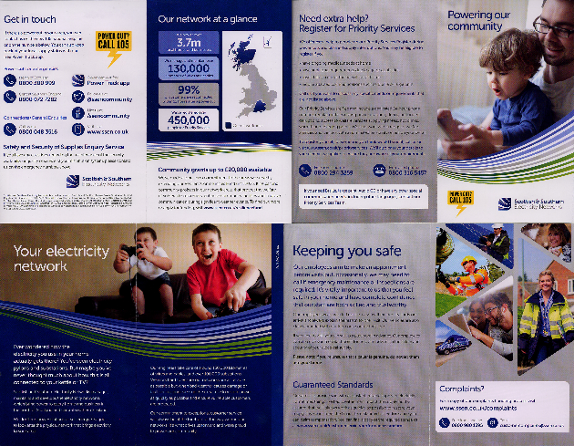
targeted to different areas and hard to reach audiences
SSE sent mail
to encourage vulnerable
customers to sign up for
the Priority Services Register

Slide 18

Highly personalised with relevant messages which impact brand perception
63%
agree that personally relevant content improves how they feel about the brand associated with it
58%
see brands in a more positive light when they provide content that matches their interests
42%
are willing to forgive mistakes if they feel a brand knows them personally
Source: Reuters Marketing Priorities 2017

Slide 19
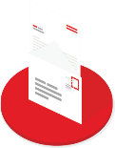
Drives digital behaviour…
70%
As a result of receiving post / mail from a company or an organisation in the past 12 months, have you...
Driven to online activity
18%
49%
Sent company email
Made transactions online
24%
41%
Checked online account
Visited sender’s website
35%
Used voucher online
Source: Kantar TNS/ MarketReach 2017

Slide 20
integrates with other media making messages stronger and more memorable
MAIL MAKES SOCIAL MEDIA MORE MEMORABLE
Brain response to the same social media ads was very different among those who saw mail first. The social ads elicited lower visual attention – but were more strongly encoded into people’s memory
+44% stronger
Source: Royal Mail MarketReach, Neuro-Insight, 2018

Slide 21
Messaging can be tailored to support the brand role
Critical
Supportive
On hold
Customer commitment with an offer for when the crisis is over
Discount voucher, preferential booking,
Communicate what has changed and the benefits
Still open, extended or adapted offer, how to access
Put critical information into people’s hands.
Local information, opening times, support available
Guide people to online support
QR codes, guides for less technical
Remind lapsed audiences
Update on services, catalogue to engage them.
Update on how the brand is responding
Making services available
Deliver targeted messages to key audiences
Benefits for loyal customers, using benefits
Offer a new reason to consider
Home delivery, online content, why donations are needed now
Messages about how you are supporting the community – e.g Easyjet staff helping at Nightingale Hospital

Slide 22
Looking ahead to
Better times… mail will continue to support brands as they move forward

Slide 23
Thinking Beyond covid-19…
You may have acquired new customers
You may have lost customers
You may have customers who felt abandoned
Every category will be different.
Online grocery will have acquired new audiences as over 70s enter the online food market for the first time but will equally have isolated some of their more loyal customers by not being available to them.

Slide 24
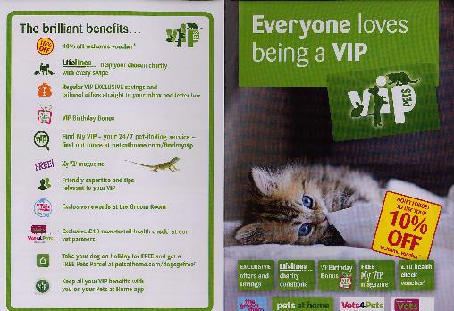
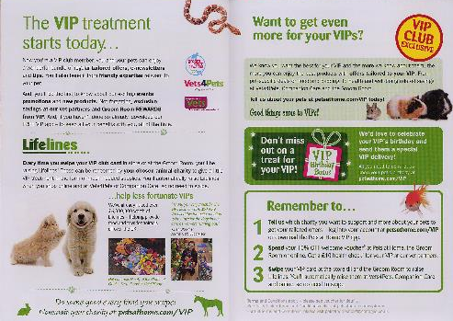
Welcome packs can set out the benefits of a new relationship
Pets at home’ VIP club welcome pack sets what to expect and
how to get the most out out of your ‘Very Important Pets’ membership

Slide 25
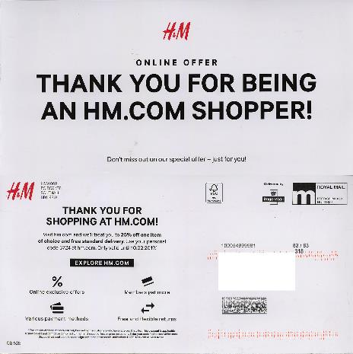
A thank you can go a long way to keep your brand front of mind
60% feel that mail from brands they value keeps the organisation top of mind
57% think it mail from brands they value inspires them to think more positively about it
Source: Royal Mail MarketReach ‘This time it’s personal’

Slide 26
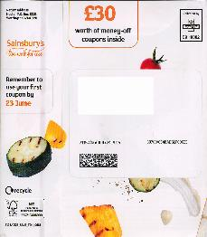
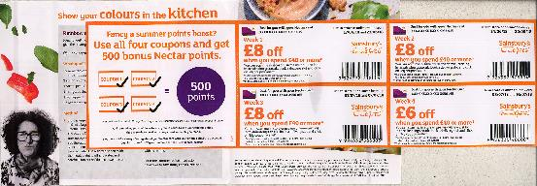
Vouchers and discounts can drive repeat behaviours
58%
Of high internet activity users keep vouchers & discounts sent by mail for more than a week
Source: Touchpoints 2019 Base: High Internet activity

Slide 27
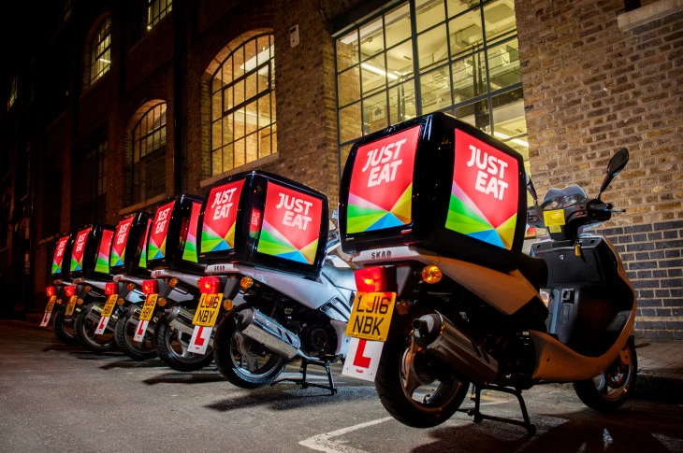
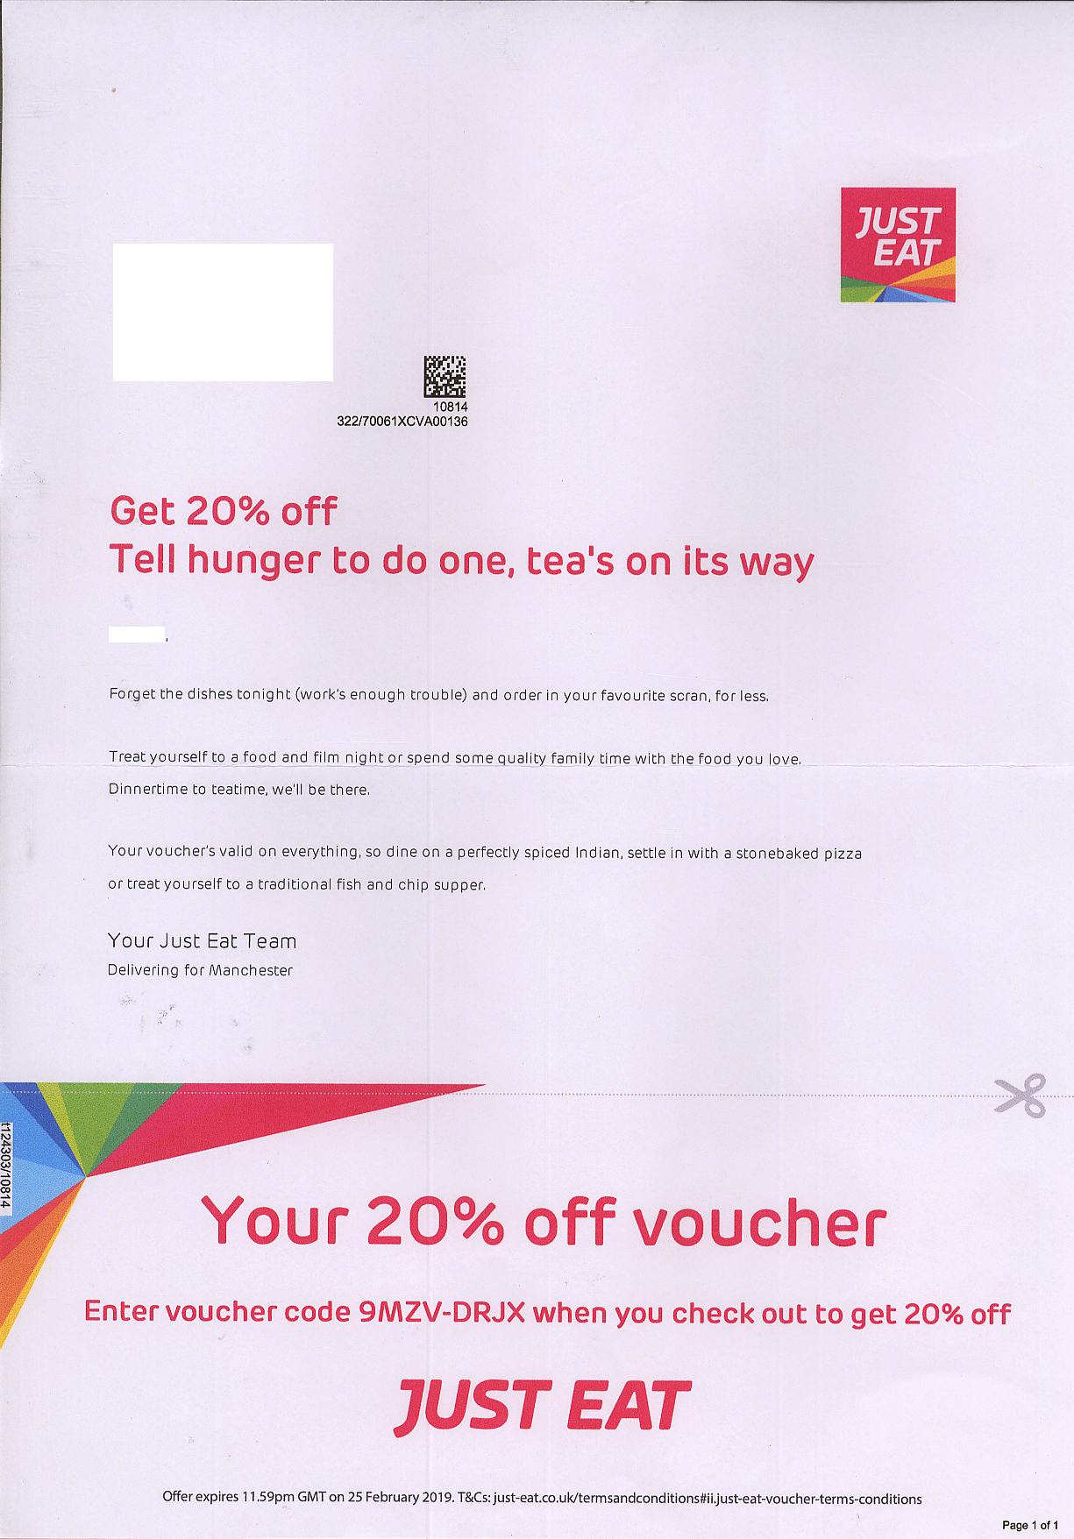
Recognition and tangible value can re-engage as it did for just eat
x10
Higher Conversion Rate
vs digital channels
Source: Paperplanes UK

Slide 28
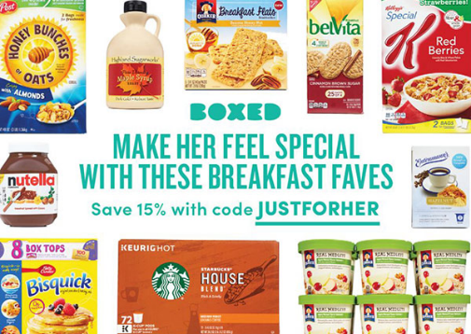
a personalised postcard can reactivate email unsubscribers
Background
Boxed.com – an American wholesaler that delivers bulk products to customer’s doors- wanted to re-engage email unsubscribers.
Solution
The moment a customer unsubscribed from the email progamme they were triggered into a programme that digitally created a personalised postcard built around their favourite items – allowing Boxed.com to continue the conversation after the customer had unsubscribed.
Landing on their doormat within 24 hours of unsubscribing, this personalised postcard – with a 15% discount - was sure to surprise and delight.
Results
The digital postcard made a big impact with 35% of unsubscribed customers responding.

Slide 29
Mail can deliver powerful support in the immediate and the long term
Customers are looking for brands to take the lead, help them in their daily lives and communicate what they are doing to make a difference. Mail gets you into customers homes and hands to deliver real value.
Mail gives you the time and space to get your brand positioning and your the message right – relevant, useful, helpful, clear.
Consumers are expecting a reassuring tone and positive outlook that aligns with your brand values. Taking the time to write says a lot about a brand and its commitment to customers.
While email is quick to update, consider mail for more complex information and brand cut-through – a serious message usually carries more weight in print form.
Mail has the power to be personal, relevant and localise content while also reaching out to vulnerable audiences.
Every brand and sector has been touched by the pandemic. The winners will be those that stayed close to customers by delivering the right messages in the right (not just the fastest) way.

Slide 30
How royal mail can help

Slide 31


Official government Guidance about mail
We continue to follow the guidance of public health authorities.
Public Health England guidance says there are no additional precautions needed for handling post or packages.
Public health authorities have advised people receiving letters and parcels are not at risk of contracting coronavirus. From experience with other coronaviruses, we know that these types of viruses don’t survive long on objects, such as letters or parcels. This complements the highly publicised guidance from public health authorities for people to wash their hands more often than usual using soap and hot water.
Royal Mail takes the health and safety of its colleagues, its customers and the local communities in which we operate very seriously. We have introduced social distancing rules that protect both our colleagues and our customers. We continue to follow public health authority preventative guidance.

Slide 32
How royal mail marketreach can help:
Team Expertise
Data Planning
Media and Communications Planning
Mail Expertise
JICMail
Market leading bespoke research
Research and Insight
Business development
Key industry tools – TGI, WARC, Mintel, Touchpoints
Industry partnerships – DMA, IPA, D&AD
Case studies and creative best practice library

Slide 33
Thank you

