Slide 1
Using mail to communicate & reassure
How TO USE MAIL TO GET CONSUMERS TO comprehend and build trust
May 2020
YOUR LOGO HERE

Slide 2
What’s been happening in financial services

Slide 3
HOW HAS THE FINANCIAL SERVICES INDUSTRY RESPONDED
Lenders offer almost 700,000 payment holidays on credit cards
27 million customers offered option of interest free borrowing for 3 months on first £500 of arranged overdraft
Over 1.6 million mortgage payment holidays for customer facing financial hardship
470,000 on personal loans for customers facing cash flow problems
Contactless payment limit changes to £45 to help consumers shop more safely
Some insurers offering refunds but not across the board
Source: UK Finance, March – April 2020
Notes:
The Government has created the biggest support package for businesses and consumers during Covid.
Here are some of the key headlines.

Slide 4
How have financial services brands responded
Giving customers access to fixed savings accounts
Payment holidays on loans being set up
Not charging interest on first £300 overdraft
Working on credit card repayment holiday
The first to launch an online service to apply for a payment holiday and offering credit card payment holiday
Branches open but operating reduced hours
The first bank to offer mortgage holidays
Gives a £25 refund for each vehicle for not being on the road
Notes:
These are just some of the ways the big brands have been responding to the fast-moving situation.

Slide 5
Many still cutting back spending
But the share of respondents experiencing negative financial
impact has declined
Strongly agree/agree difference since last survey
March then April
+4
-5
-4
-9
-7
+1
-6
+4
Source: McKinsey & Company COVID-19, UK Consumer Pulse Survey 4/30-5/3/2020 n=1,003 4/15-4/19/2020 n=908 sampled and weighted to match the UK’s general population 18+
Notes:
In March concern was more acute than in April.
But 21% agree or strongly agree that they are worried about how they are going to make ends meet, this has gone down 5 points since March.
26% say that their income has been negatively affected, but this has eased by 4 points since April.
Interestingly though 40% say they are cutting back on their spending, which is an increase of 4 points on March. So there is still a lot of uncertainty.

Slide 6
Concerns about the economy
Largest concerns of the united kingdom population related to covid-19
% of respondents who are concerned
or very concerned
Source: McKinsey & Company COVID-19, UK Consumer Pulse Survey 4/30-5/3/2020 n=1,003 sampled and weighted to match the UK’s general population 18+
Notes:
The main thing people are concerned about is the economy, which actually tops public health.

Slide 7
How mail can support consumers and give advice or reassure

Slide 8
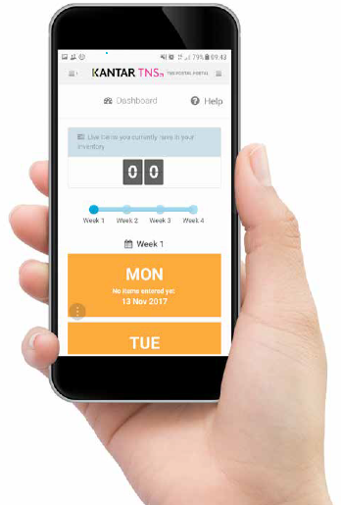
Jicmail gives us gold standard data
That shows exactly how consumers interact with financial mail
Mail is collected in the first week and recorded, then that week’s mail is tracked over 28 days
People record what they do with their mail physically
They tell us the type of mail, i.e. is it addressed or unaddressed to them or someone else.
Opened it
Read / looked at / glanced at it
Put it on display e.g. fridge / noticeboard
Passed it on / left out for the person it’s for
Put it aside to look at later
Threw it away / recycled
Took it out of the house e.g. to work
Used / did something with the information
Put it in the usual place
They capture what business sector the mailing or door drop comes from.
They record the contents; is it information, special offer, etc. You can tick all that apply here.
Notes:
JICMAIL data has been available since the second quarter of 2017, it now contains over 92,000 individual mail packs across all the main industry sectors. It has been designed to create Gold Standard for the industry so that mail and door drop can be planned alongside other media in exactly the same way as all other channels.
A panel of 1,000 households each month collect their mail and door drop for the first 7 days of each month. They then track that content over a full 28 day period and tell us what they did with it physically ie opened, read and passed it on. But in addition they record any commercial actions, such as going online, calling the sender or using a voucher or discount code.

Slide 9
Engagement rates with financial mail
Stronger than average across all measures
98% of all financial mail is engaged with ie mail is processed in some way (opened, read, sorted, put aside)
82% of all financial mail is opened
64% of all financial mail is read / looked at / glanced at
Source: JICMAIL Q2 2017 – Q1 2019 Addressed or Business Mail, Financial and Insurance Services, n=24,267
Notes:
Financial Services mail enjoys one of the highest levels of engagement, behind only Government and Local Councils. Alongside this open rates are above average, although reading rates are about the same as others.

Slide 10
What is the financial services sector sending?
Not surprisingly 51% of contents contain a statement and the next is information about products and services
Source: JICMAIL Q2 2017 – Q1 2019 Addressed or Business Mail, Financial Services n=24,267
Any type of content with less than 1% has been removed
Notes:
By far the biggest content for FS mail is a financial statement / bill / update. Followed by information about products and services. And Administrative information comes in third at 18% of all contents.
Diary respondents tick all of the contents they say that apply. There is less of a broad mix for Financial Services than say for the Trail and Leisure sector.

Slide 11
physical actions
Physical interactions with financial mail are strong with high open and reading rates and filing activity
Source: JICMAIL Q2 2017 – Q1 2019 Addressed or Business Mail, Financial and Insurance Services, n=24,267
Any type of content with 1% or less has been removed
Notes:
Open rates are high, it is clear that people take notice of FS mail. Reading is high but also filing at 39% is higher than nearly all other sectors. Recycle rates are lower at 32%.
Many put aside to look at later or put in the usual place.

Slide 12
MAIL DRIVES COMMERCIAL ACTIONS
Financial mail performs slightly under the average for all sectors – 32%
But certain contents drive much higher commercial action
Overall resulting commercial actions with financial mail
7,781
861
103
1,164
317
12,347
507
359
164
1,952
4,196
Source: JICMAIL Q2 2017 – Q1 2019 Addressed or Business Mail, Financial and Insurance Services, n=24,267
Notes:
Commercial activity is an interesting one with financial services. The physical actions with mail make up the frequency numbers we use to help plan mail as a channel. On top of this, we know that mail drives people to do commercial things, they may not be holding the mail pack but they will take all sorts of actions.
Aligned to this we can see what types of mail drive different levels of commercial behaviour and in financial mail you can see that if a voucher or coupon is included (which is quite rare and we only have a sample here of 103) 60% of the people receiving this will go on to take a commercial action. Notifications and reminders drive 47% of commercial actions and information about local services 44% of actions.
So think about what you send to people and what you want them to do as a result of your communication it could really drive the levels of interaction.

Slide 13
All SORTS OF GROUPS ENGAGE WITH MAIL
financial mail is engaged with by all types of consumer
The average frequency of exposure for all sectors is 4.3
FREQUENCY OF EXPOSURE FOR THESE GROUPS HIGHER THAN AVERAGE
FEMALE
35-54
HOUSE TENURE
6-10 YRS
TV AREA:
MERIDIAN WEST
HH WITH KIDS
PARENTS C2DE
ACORN: COUNTRY COMMUNITIES
4.86
5
5.73
4.9
5.4
ADVERTISING AND BUSINESS MAIL
Source: JICMAIL Q2 2017 – Q1 2019 Addressed and Business Mail, Financial and Insurance Services, n=24,267
Notes:
And interestingly different groups engage with mail at different rates. If you dig a little deeper you ca see that females aged between 35 and 54 interact at above average of 4.86 and those with a household tenure of 6-10 years hit a frequency of 5. If you live in the Meridian West TV area you are looking at financial mail 5.73 times.
Think about your audiences and who is most likely to engage with your mail the most to maximise your frequency exposure.

Slide 14
All age groups engage with mail
Frequency – HAS A SWEET SPOT FOR THOSE AGED BETWEEN 45 AND 64
Source: JICMAIL Q2 2017 – Q1 2019 Addressed Mail, Financial and Insurance Services, n=24,267
Notes:
Younger age groups don’t engage with mail as much as the older cohorts but they do get much less mail and they are likely to keep it longer.
Those perhaps with the biggest financial commitments are more likely to be engaging with financial mail at higher rates, which drops off for those over 65 who have probably largely now got a fixed income.

Slide 15
frequency above average
The average frequency in all sectors is 4.3 (and reach 1.13) so FINANCIAL mail is higher in most instances
Look at how different content drives very different engagement rates, highest levels of engagement is when there is a postal reply and next vouchers and notifications/reminders or local messages.
n=7,781
n=861
n=103
n=1,164
n=137
n=12,347
n=507
n=359
n=164
n=1,952
n=4,196
Source: JICMAIL Q2 2017 – Q1 2019 Addressed and Business Mail, Financial and Insurance Services, n=24,267
Notes:
Average frequency for financial mail goes up to 5.3 if the content contains a postal reply.
Vouchers/coupons, notifications/reminders and information about local services all drive a frequency of 4.8.

Slide 16
Actions PER thousand
For general mail there is considerable discussion and online behaviours
Actions per thousand mail items
Notes:
And finally of the 28% of all consumers who go on to act overall with financial mail we can see what commercial actions they are taking to different types of content.
Note how these more general types of mail are driving a lot of discussion and online behaviours.
When receiving information about local services 214 per thousand will to on to discuss it and 193 will go online.

Slide 17
Actions for thousand
Look what happens if financial services mail contains a voucher or coupon – 363 people per thousand use or do something with the information
Actions per thousand mail items
Notes:
If there is some form of voucher or coupon 363 people every thousand will visit the sender’s shop or office and 205 will discuss and 138 will go online.
Think about how this data might help you hone your attribution models for mail as you may not be accounting for all this behaviour that your mail campaigns are driving.

Slide 18
Actions for thousand
And mail that might sometimes require discretionary action it is driving very high interactions WITH ONLINE ACTIVITY, discussion and account checking
Actions per thousand mail items
Notes:
And finally for those actions that may or may not require a response a notification / reminder is getting 220 people per thousand discussion and the same again going online. 146 are calling, which may help you think about how call centre planning.
A financial statement bill/update drives 181 people per thousand (of the 28% of those who acted) go online.

Slide 19
Who’s mailing right now and what are they sending

Slide 20
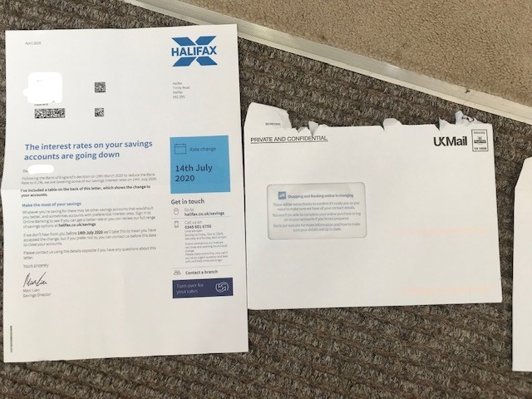
Halifax savings accounts
Useful information about changes to your savings
Halifax writes to savings account holders about changes to interest rates on savings
It has a table on the back to show what this will mean to your savings
It is clear, concise and factual, setting out the dates and all the information you might need

Slide 21
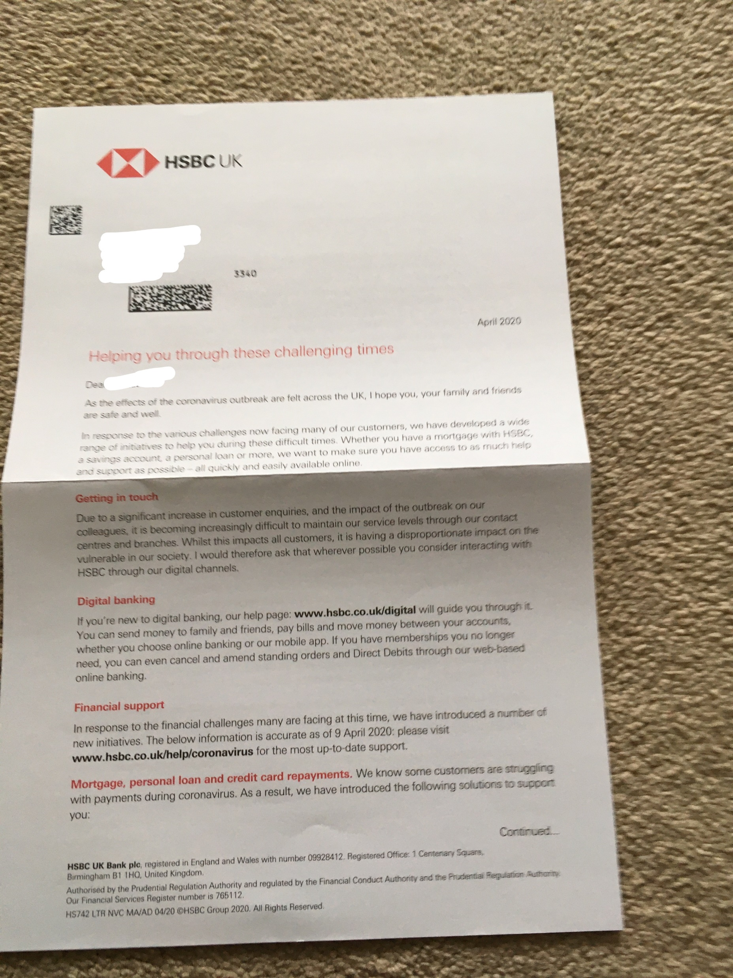
hsbc
Helpful letter
HSBC writes to customers to set out how you can get in touch but warning that lines are really busy
Therefore they’ve directed people to Digital banking if you can self serve
They point people to helpful advice online
And they talk about the solutions available if you are struggling with your mortgage

Slide 22
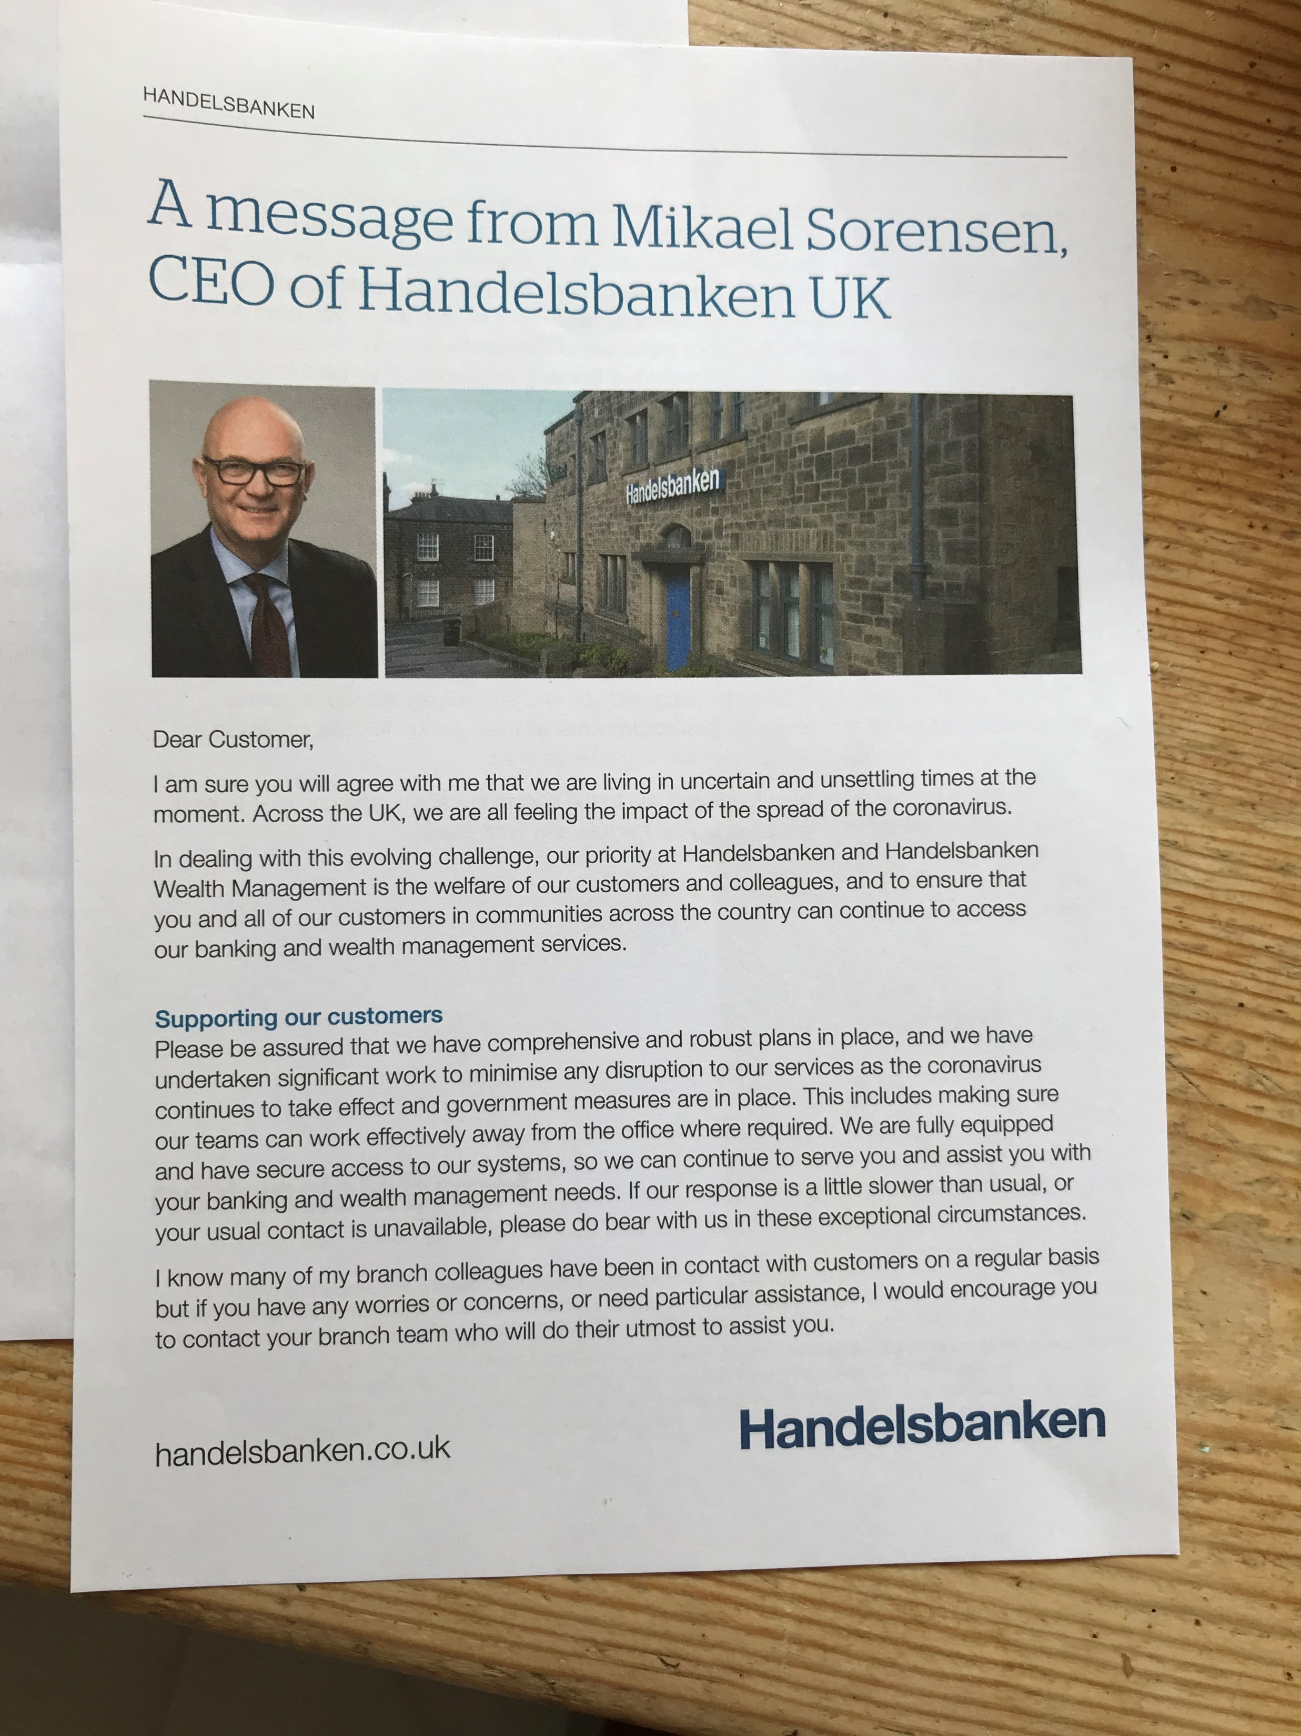
Letter from the ceo
Really reassuring message, nicely written
Send a very clear and reassuring message about how they are carrying on working to ensure that they can continue to service wealth management customers with their needs
They apologise if they take a bit more time to get back to people
They also address how they are looking after staff but they have the infrastructure in place to ensure staff have access to their systems

Slide 23
conclusion
FINANCIAL SERVICES
It is a fast moving picture and people, whilst slightly less worried consumers are still concerned about the economy and their finances
AUDIENCE
There are certain audiences who over-index with mail exposure frequency by a big margin
EXPOSURE FREQUENCY
Some types of mail drive considerably higher physical interactions and are revisited up to 5.3 times
COMMERCIAL ACTIVITY
Some types of mail drive considerably greater commercial interactions than others, so think about what you mail in these times
PHYSICAL
Some brands are using mail to get important customer messages across and reassure their consumers about the situation

Slide 24
YOUR LOGO HERE

