Slide 1
Price Plan Benchmarks explained
16 December 2019

Slide 2


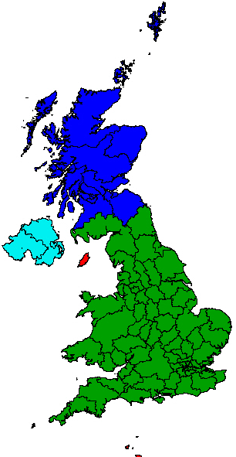
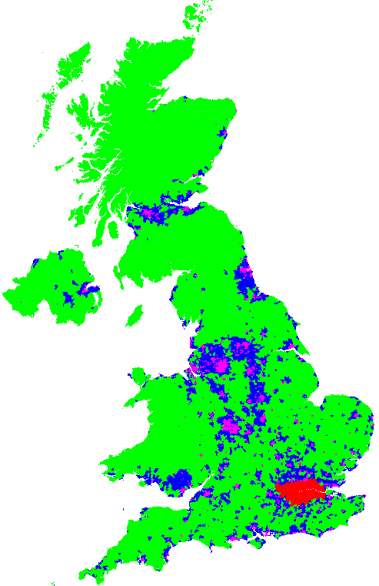




Profile creation at a glance
Building blocks and process
Postcode sectors allocated to a zone with associated mail volume annually
Profiles calculated, which help determine what customers are required to achieve:
Postcode sector data consolidated into SSCs
Zones:
• Urban • Rural
• Suburban • London
PP1
National Spread Benchmark
86 or 48 SSCs
Does the customer proportion of mail in each SSC reflect the national postbag?
11,000 PC
sectors
PP1
Urban Density Benchmark
Does the customer proportion of Urban mail in each SSC reflect the national postbag?
PP2&4
Zonal Posting Profile
Mail volumes:
Baseline Year (PP1); or
Financial Year (PP2 & 4)
*
Does the customer proportion of mail in each zone reflect the RMG F2E
*
Baseline Year is a contractual term applicable to PP1 which uses the actual fall to earth of the national postbag during the baseline year to enable us to determine the Profile that customers need to achieve in subsequent years

Slide 3
Profile comparison at glance
Price Plan | Profile measure | Measure level | Zonal allocation input | Volume input period | How often it is updated | Required notice
PP1 | National Spread Benchmark | SSC | O | Baseline Year | Currently using 15/16. Aspiration annually | 190 days
 | Urban Density Benchmark | Urban zone in SSC | P | Baseline Year | Annually, capturing changes of postcode allocation to zones only | 70 days for changes to zone allocations, or 190 days for changes to Baseline Year
PP2 | Zonal Posting Profile | Zone (national) | P | Latest financial year | Each year, capturing zonal changes and updated volumes | 70 days
PP4 |  | Zone (regional)
Profiles always come into effect at the start of the contract year (April), meaning notice is given in Jan (70 days) or Sep (190 days).

Slide 4
Data sources and key differences in the makeup of the Benchmarks
 |  | Current | Updated (proposed)
 |  | 2019/20 Benchmark (2015/16 baseline volumes) | 2020/21 Benchmark (2018/19 baseline volumes)
PP1 NSB | Source data | DSA DocketHUB declaration and Retail MCS | DSA and Retail Mailmark and MCS
 | Baseline Year volumes | Jul 2015 to Jun 2016 | Apr 2018 to Mar 2019
PP1 UDB | Source data | DSA and Retail MCS | DSA and Retail Mailmark and MCS
 | Baseline Year volumes | Jul 2015 to Jun 2016 | Apr 2018 to Mar 2019
We will utilise Mailmark data for greater assurance on the accuracy in the UDB and align the NSB and UDB source data. In addition, the introduction of the 48-way sort service means the NSB source data has to change from DocketHUB to continue to create an 86-way sort benchmark.
PP2 & PP4 benchmarks’ source data is DSA and Retail Mailmark, and MCS.

Slide 5
Allocation of postcode sectors to zones
An important input to UDB & Zonal Posting Profiles
Each year we assess the zone allocated to each postcode sector based on factors such as delivery point density.
London is allocated based on the volume of mail in each SSC that is within the London boundary. Any SSC that straddles the boundary is assessed on the volume inside and outside London.
The change in allocation of postcode sectors to zones each year is minimal*, except where an SSC changes from being classed as London to Urban/Suburban/Rural, or vice versa.
This process ensures changes to delivery points are reflected in the Royal Mail Urban Density Benchmark and Zonal Posting Profiles.

Slide 6
Profile calculations in detail
1
3
2
4
5
PC sector | Zone | SSC | Volume
AB10 1 | A | 310 | 100
HA0 1 | D | 375 | 50
AL2 1 | B | 359 | 75
AL3 6 | C | 359 | 10
… | … | … | …
SSC | A | B | C | D | NSB | UDB
310 |  |  |  |  | % | %
375 |  |  |  |  | % | %
… |  |  |  |  | % | %
Zonal Profile | % | % | % | %
Volume
6
1
Each postcode sector has a zone allocated, and belongs to an SSC
Mail volume is allocated to each postcode sector
Postcode sectors are summarised into SSCs, and volume for each zone within each SSC is summed
PP1 NSB is the SSC volume as a % of total volume (all zones)
PP1 UDB for each SSC is the volume of zone A (urban) / total volume for the specified SSC
Zonal Profiles are the % in each zone for all SSCs combined for PP2 or regional SSCs for PP4
2
3
4
5
6

