Slide 1
How mail can help banks support customers during covid-19 & beyond

Slide 2
a critical time…
“Brand health becomes vulnerable when companies stop advertising.
If they do this for longer than six months it destroys both short- and long-term health.
Brand salience is especially important in times of crisis: strong brands recovered 9 x faster following the financial crisis of 2008. .
Now is an opportunity for brands to change their media, messaging and touchpoints to ensure they are reaching consumers with communications they are most interested in.”
Jane Ostler
Kantar Insights Global Head of Media
Source: Kantar Global Survey March 2020 (35k consumers)
Notes:
Kantar ran a theoretical test on an unnamed, but real beer brand. The team found that if the brand cut all its ad spend during the crisis, this would have a 13% impact on sales in the long run and make market share hard to recover. However, a 50% drop in ad spend would result in just a 1% drop in sales.

Slide 3
It’s make or break about what you say and how you say it …
During the current situation – and beyond…
Impact on retail banking
What is important to customers
Different audiences will have different financial needs
How can banks prioritise vulnerable audiences
What is the role of mail in banking and how can it help
Brand recovery - planning beyond Covid-19

Slide 4
Impact of Covid-19
on retail banking

Slide 5
How the banking world has changed…
Move away from F2F channels: branch closures and restricted hours.
Impact on vulnerable audiences
Move towards digital services: online banking, contactless payments
New products to ease financial pressure:
3 month mortgage payment holidays
New products to support debt management:
3 month loan/credit card payment holidays
0% overdraft allowances
Access to emergency savings if needed
Source: Moneysupermarket.com

Slide 6
Customers are looking for more support
While only 8% of consumers think brands need to stop advertising during the Covid-19 outbreak, they have a clear expectation of their role:
78% believe brands should help them in their daily lives
75% said brands should inform people of what they’re doing
74% said companies should not exploit the situation
Consumers expect brands to use a reassuring tone, offer a positive perspective and communicate brand values.
Ikea focus on the importance of home and Nike communicate the need to stay indoors – they’re seen as supportive of government messaging and health organisations, while staying true to their brand values.
Source: Kantar Global Survey March 2020 (35k consumers)
Notes:
Consumers are looking for explicit evidence that brands are supporting staff, the government and consumers. Almost 80% believe employee health should be a key priority for companies, while almost two-thirds believe flexible working should be a priority.
Some 45% of consumers want to see companies putting in place plans to protect the supply of services or products, while more than 40% want to see companies making donations of products, such as hand sanitisers or face masks. It’s a very delicate balance at the moment – brands need to be mindful of communicating in a way that supports Government and consumers and is not exploitative.

Slide 7
64% of the UK agree that how a brand responds to the crisis now will have a huge impact on their likelihood to buy from them in the future
Source: Edelman Trust Barometer March 2020

Slide 8
Those rising to the challenge: post office, RBS and Lloyds group supporting the vulnerable
48% of those who rely on cash are over 65
66% have no digital skills
“Being able to easily access cash is a vital service for older people and those self-isolating.
Our Payout Now and Fast Pace services mean people can access cash quickly and securely to repay someone for a helpful service such as shopping, or simply manage their finances, providing peace of mind that cash can be securely sourced
with the help of any trusted helper.”
Martin Kearsley
Banking Director
Post Office
Royal Bank (includes Royal Bank of Scotland, NatWest and Ulster Northern Ireland) and the Lloyds Banking Group (includes Lloyds Bank, Halifax and Bank of Scotland) have dedicated phone services for customers over 70 or those in isolation and a separate telephone service for NHS workers.
Source: Which? April 2020

Slide 9
How can you communicate vital messages? Mail’s strengths in a crisis
REACHES EVERYONE
Mail can be targeted to individuals of any demographic at an individual or household level. It is a good way to reach the vulnerable or key groups of people.
GIVES REASSURANCE
Mail is a trusted and a secure way to deliver important messages from banks
PHYSICAL IMPACT
Financial mail is returned to 4.4 times and 2 out of 3 mail items stay in the home for longer than 1 month
DRIVES INTERACTION
Financial mail gets people to act on the contents with 98% engagement 82% of financial mail is opened
GETS PEOPLE ONLINE
24% of financial mail resulted in a digital interaction (visiting the sender’s website, going online for more information, using a tablet or smartphone or posting a reply to the sender)
Source: JICMAIL Q2 2017 – Q3 2019

Slide 10
HOW MAIL CAN CONNECT BANKING CUSTOMERS DURING CRISIS TIMES

Slide 11
The power of mail…
Boris Johnson has written to every UK household about the social distancing rules and has included a leaflet detailing support available
Using the power of mail to deliver important messaging that will reach; everyone, those who aren’t otherwise getting the message, non-digital and vulnerable, those who want to spend time with the message

Slide 12
cuts through the noise
80%
of UK adults open all or most of their mail
91%
Engage with or process opened mail in some way
87%
of people describe mail as believable – making it trusted
25%
purchased or donated after receiving mail in last 12 months
4.22
average frequency of exposure for mail
7.75
days is the average lifespan of mail in the home
49%
of mail is still present in the home after 28 days
Sources: GB TGI 2020 Q1 - ©Kantar 2020 / IPA TouchPoints 2019 - ©IPA 2019 / Royal Mail MarketReach, The Value of Mail in Uncertain Times, Kantar TNS, 2017 / JICMAIL Q2 2017 – Q4 2019

Slide 13
targeted to different audiences with different needs
Recently unemployed
Furloughed
Self Employed
Focus on maintaining income
Making the household budget work with 80% salary or substantially reduced salary
Financial products to support loss of earnings
Debt management advice
Financial products to support loss of earnings for
Debt management advice
Vulnerable audiences
Finding another job or income support
Signpost Government services
Financial products to support loss of earnings
Debt management advice
How do I manage my day to day banking?
Access to local branch information
Telephone banking access
Help with digital services
Nominate a family member to help
Priority
What they might need from banks

Slide 14
Ideal for reaching Vulnerable audiences with 3 in 10 not online
81% of the most vulnerable open or read all their mail
The trend towards content being shared online has made it harder for vulnerable households to get
the information they need, in a format that is accessible.
29% of over-70s have not used the internet
22% people with disabilities do not use the internet
Source: TGI Q1 2020: Vulnerable Audiences/ONS 2019: Internet Users

Slide 15
Mail targeting got covid-19 messages to vulnerable audiences within 48 hours
Problem
Sandwell Metropolitan Borough Council needed to reach 135,000 vulnerable and older residents and get them to contact the council if they needed help with shopping, accessing medical supplies or general support during the lockdown in Covid-19.
The information needed to be communicated fast and responded to correctly.
Solution
Mail allowed the council to accurately target vulnerable residents without wastage. It had the space to send out detailed information, was secure and could be filed for reference.
The mailing was designed to be easy to read using an accessible font and clear and simple instructions. Residents who needed help were asked to use email as the primary response or a dedicated phone number to avoid overloading the call centre.
Using hybrid print capability, CFH Docmail produced the mailing and mailed it within 48 hours.
“A mailing provided us with the best vehicle to send out very detailed instructions and to give the recipient the chance to read and re-read what they needed to do and to feel as secure as possible that they would receive appropriate help.”
Sandwell Metropolitan Council
Case Study Courtesy of Sandwell Metropolitan Borough Council and CFH Docmail Ltd
Notes:
Background
Waste collection is one of the services provided by the Rotherham Metropolitan Borough that touches every household.
With fortnightly collection cycles and stringent recycling rules, it is important that residents know in which week of the two weekly bin-collection cycle each of their residual bins will be collected and which container to use for their recycling.
Rotherham Metropolitan Borough Council sends an annual waste collection calendar to all households in the borough to advise residents them on which week, in the year ahead, their bins will be collected. The calendar also informs residents what to recycle (and in which container) and of their Christmas collection amendments.
Two versions are printed – one for each week of the fortnightly cycle – and delivered to 116,000 households at the end of November before the Christmas collection amendments start.
To be cost efficient, the calendar had been hand delivered in previous years by a third party. However with increasing numbers of residents – many in the same street - ringing up to complain that they hadn’t received the calendar, or receiving the wrong calendar causing bins to being put out on the wrong week, it was clear that there was an increasing issue with accuracy of delivery.
Calendars not being delivered meant more staff were required to manage complaints and the Council was hit with unplanned costs of posting copy calendars. Even more impactful, was delivery of the wrong calendar – resulting in whole streets having to be re-mailed and bin crews making extra, un-scheduled visits to make collections until the problem was rectified.
Solution
After an extensive service review and cost benefit exercise, Rotherham Metropolitan Borough Council took the decision to switch from hand delivery to mail for the 2015/16 calendar.
Although hand delivery was cheaper, it was anticipated that mail’s other benefits would outweigh the cost savings:
1) Accuracy – with the resident’s address on the envelope, Rotherham were confident that they Royal Mail could guarantee delivery and, ensure that all eligible residents would receive their calendar.
2) Timing – in order for the Christmas service changes to be front of mind the calendar has to be delivered in the last two weeks of November. Hand delivery took a month to complete, meaning that some households received their calendars at the beginning of November – nearly 6 weeks before the Christmas service. With mail, the postal turnaround was completed in two weeks and fitted neatly in the November window.
3) Impact. An unaddressed envelope can be perceived as junk mail and thrown in the bin before opening. Addressing every calendar to each individual property, with wording on the envelope advising them that waste calendar was enclosed, gave Rotherham the confidence that the envelope would be opened and read.
The tangibility of the printed calendar also helped with compliance. The calendar was designed to be kept, hung up in the kitchen and referred to, providing a weekly breakdown of which bin to put out and simple pictorial references of what to recycle. Although this information was held online, not everyone was aware of this, or could access it.
Results
The change had an immediate positive effect, helping to affirm that mail seemed to be the most reliable way to ensure residents of Rotherham were informed about their bins service.
The number of complaints from residents claiming they hadn’t received their calendar dropped dramatically after the switch to mail – this reduced the workload and pressure on resources that usually occurs in November; saving time in managing, monitoring and rectifying the issues previously experienced with the hand delivery service and saving money by eliminating the need to remail or make extra pick ups.
It was also highly efficient, with post returns tracking at less than 1% - all with legitimate reasons such as property being boarded up, no access or automatic re-direction – meaning Rotherham Metropolitan Borough Council could confidently tell every resident who called up with a query or to complain that their calendar had been posted through their letterbox.
“By mailing the calendar with Royal Mail we can be confident that the calendar reaches every household and is opened, read and referred to.”
Paul Hutchinson, Waste Officer, Rotherham Metropolitan Borough Council

Slide 16
Mail drives high responses in the banking sector
“Consumers are most likely to respond to letters from their bank
Letters are most likely to prompt a response from consumers when contacted about a matter relating to their bank account. Letters sent in the post still carry a sense of authority when received from institutions such as banks. They are more likely to be taken seriously, making people more likely to respond to them.”
British Bankers Association

Slide 17
delivers high engagement and lasting brand impact
4.4 frequency
1.2 reach
67% of financial mail is in the home for more than 1 month
98%
of
financial mail is
engaged with
Base: All Financial & Insurance mail; n = 31,220. Source: JICMAIL Q2 2017 – Q3 2019

Slide 18
stands up to brand channels and has more impact than f2f in retail banking
Impact on brand equity by channel, market average
All v Human Channel
TV, Radio,
Cinema,
Press & Outdoor
2,500 interviews, Adults 16+, Household decision makers from a larger nationally representative sample.

Slide 19
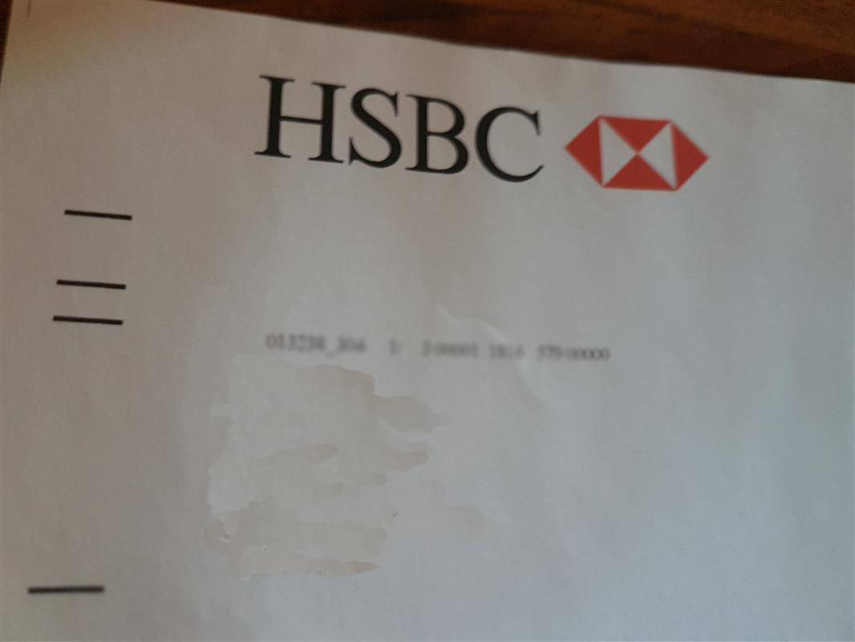
1 hsbc mailing = 8 commercial actions
November 2018
Mon | Tues | Weds | Thurs | Fri | Sat | Sun
05 | 06 | 07 | 08 | 09 | 10 | 11
12 | 13 | 14 | 15 | 16 | 17 | 18
19 | 20 | 21 | 22 | 23 | 24 | 25
26 | 27 | 28 | 29 | 30
08
1
+2
+1
13
17
2
3
Opened it
Read it
Discussed with someone
Information sought online
Looked up account
used a table t/smartphone
Looked up account
used a tablet/smartphone
Read it
Discussed with someone
+3
+2
23 days
Looked up account details
used a tablet /smartphone
30
4
Frequency: 4
direct interactions with item
+1
+1
Reach
household members interacted with item
+2
1 / 3
Immediate Commercial
actions
Follow-up commercial actions
Direct action: physical
Direct action: digital
Deferred action
Sharing item
Purchase caused
Planning & searching
Disposal
Contacting sender
Immediate physical
actions
Follow-up physical actions
19

Slide 20
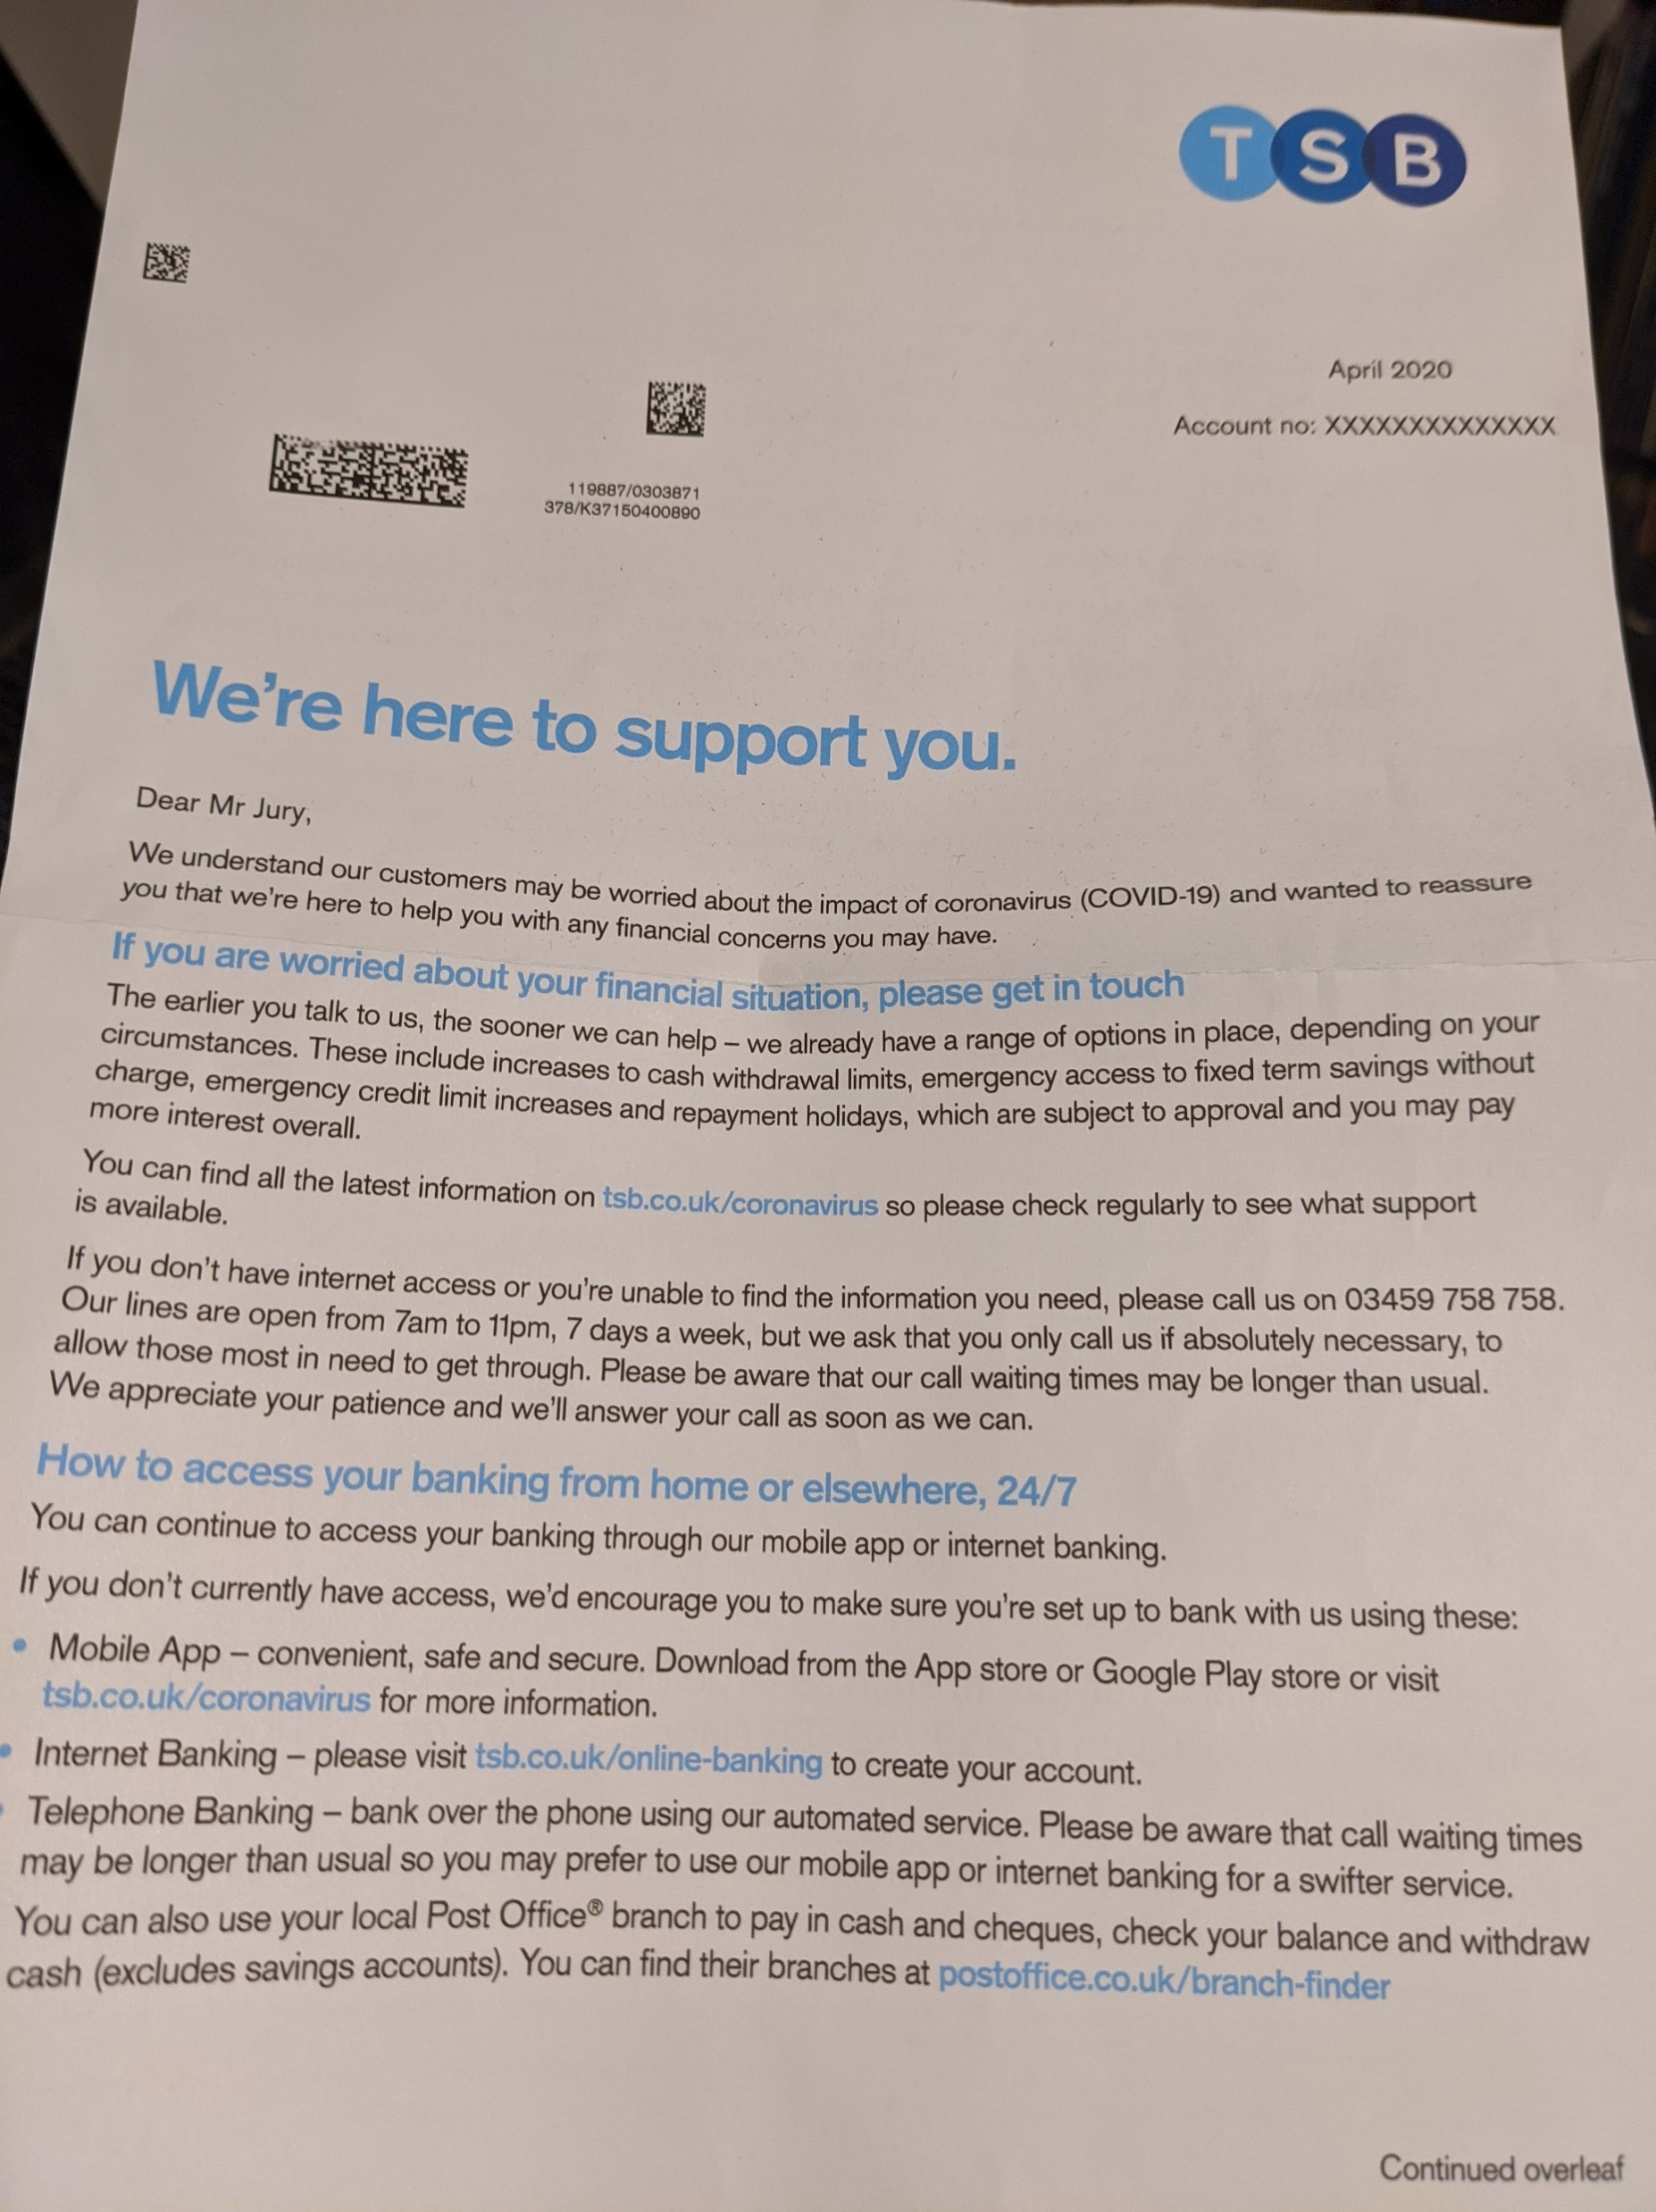
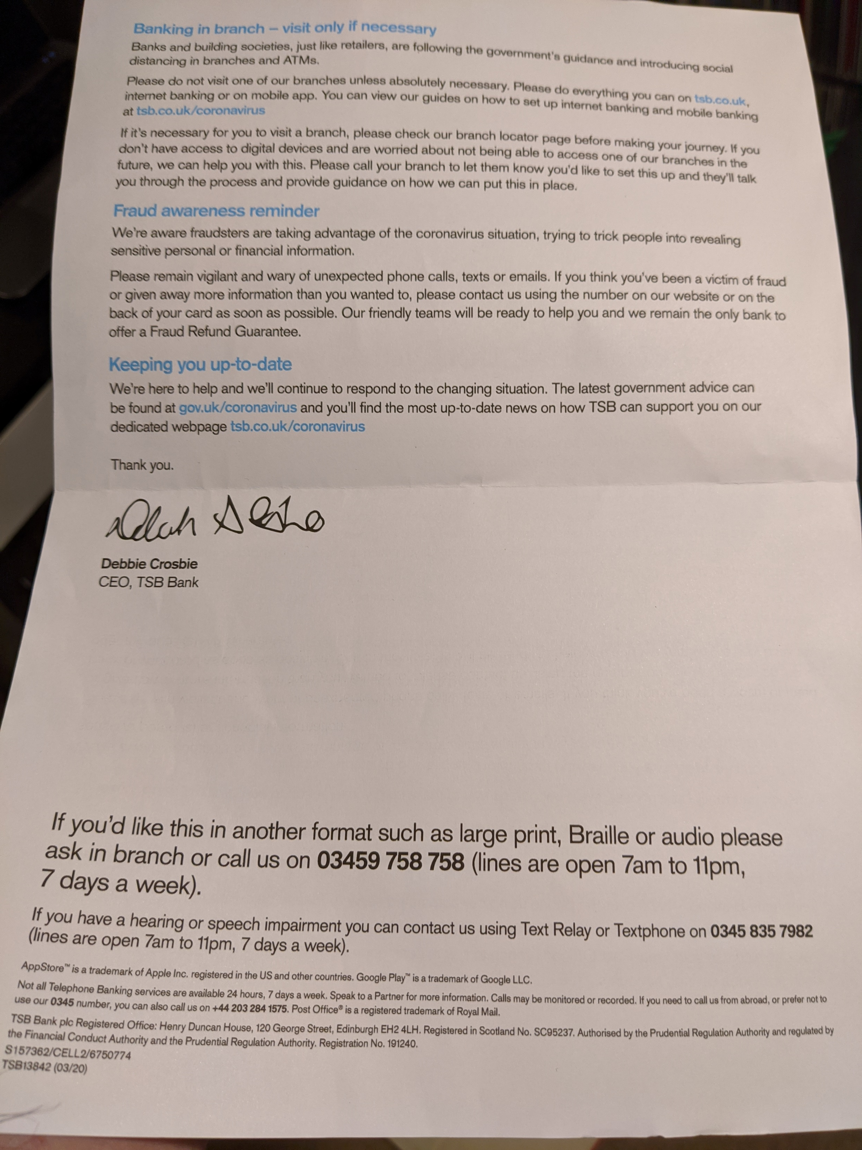
Tsb are writing to customers with messages of support
TSB urge customers to get in touch if they are worried about their financial situation
Messaging addresses fraud awareness and requests that people only go in branch if necessary

Slide 21
How mail can support banks and their customers now…
Reach vulnerable groups who may need information about local branch opening hours, support with online banking/signpost telephone support
Help people access new financial products such as mortgage holidays, loan and credit card breaks and savings accounts
Support with debt management
Serve as a brand reminder in the home which people will refer to again and again
Promote online and trusted social media channels
A mailing can serve as a positive brand piece to demonstrate what banks are doing to help people in the community

Slide 22
Looking ahead to
Better times… mail will continue to support brands as they move forward

Slide 23
covid-19 will create different banking behaviours and needs
Customers may require ongoing debt management support
Branches may see less footfall
Customers may feel unsupported so you may be at risk of losing them
Digital banking might become more popular but customers could still need support

Slide 24
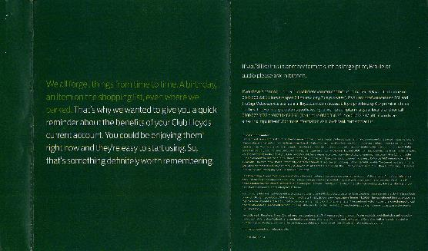
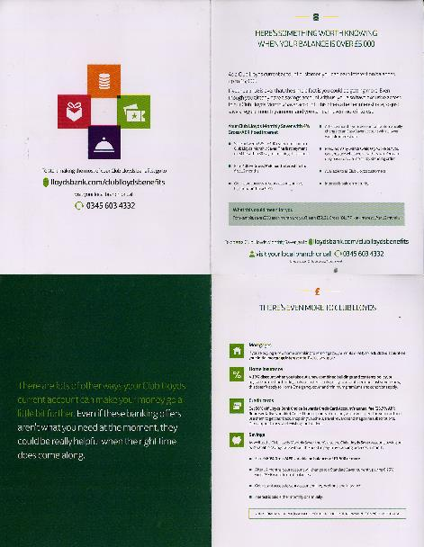
Mail can reignite the relationship and actively drive customer behaviour…
First Direct are not selling anything here - they are merely thanking customers for banking for them.
A really nice touch to support brand and relationship building.
Lloyds remind customers of the benefits of Club Lloyds. Membership schemes may change as banks prioritise financial recovery over reward

Slide 25
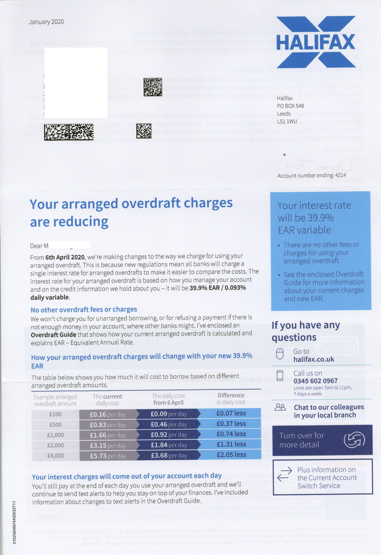
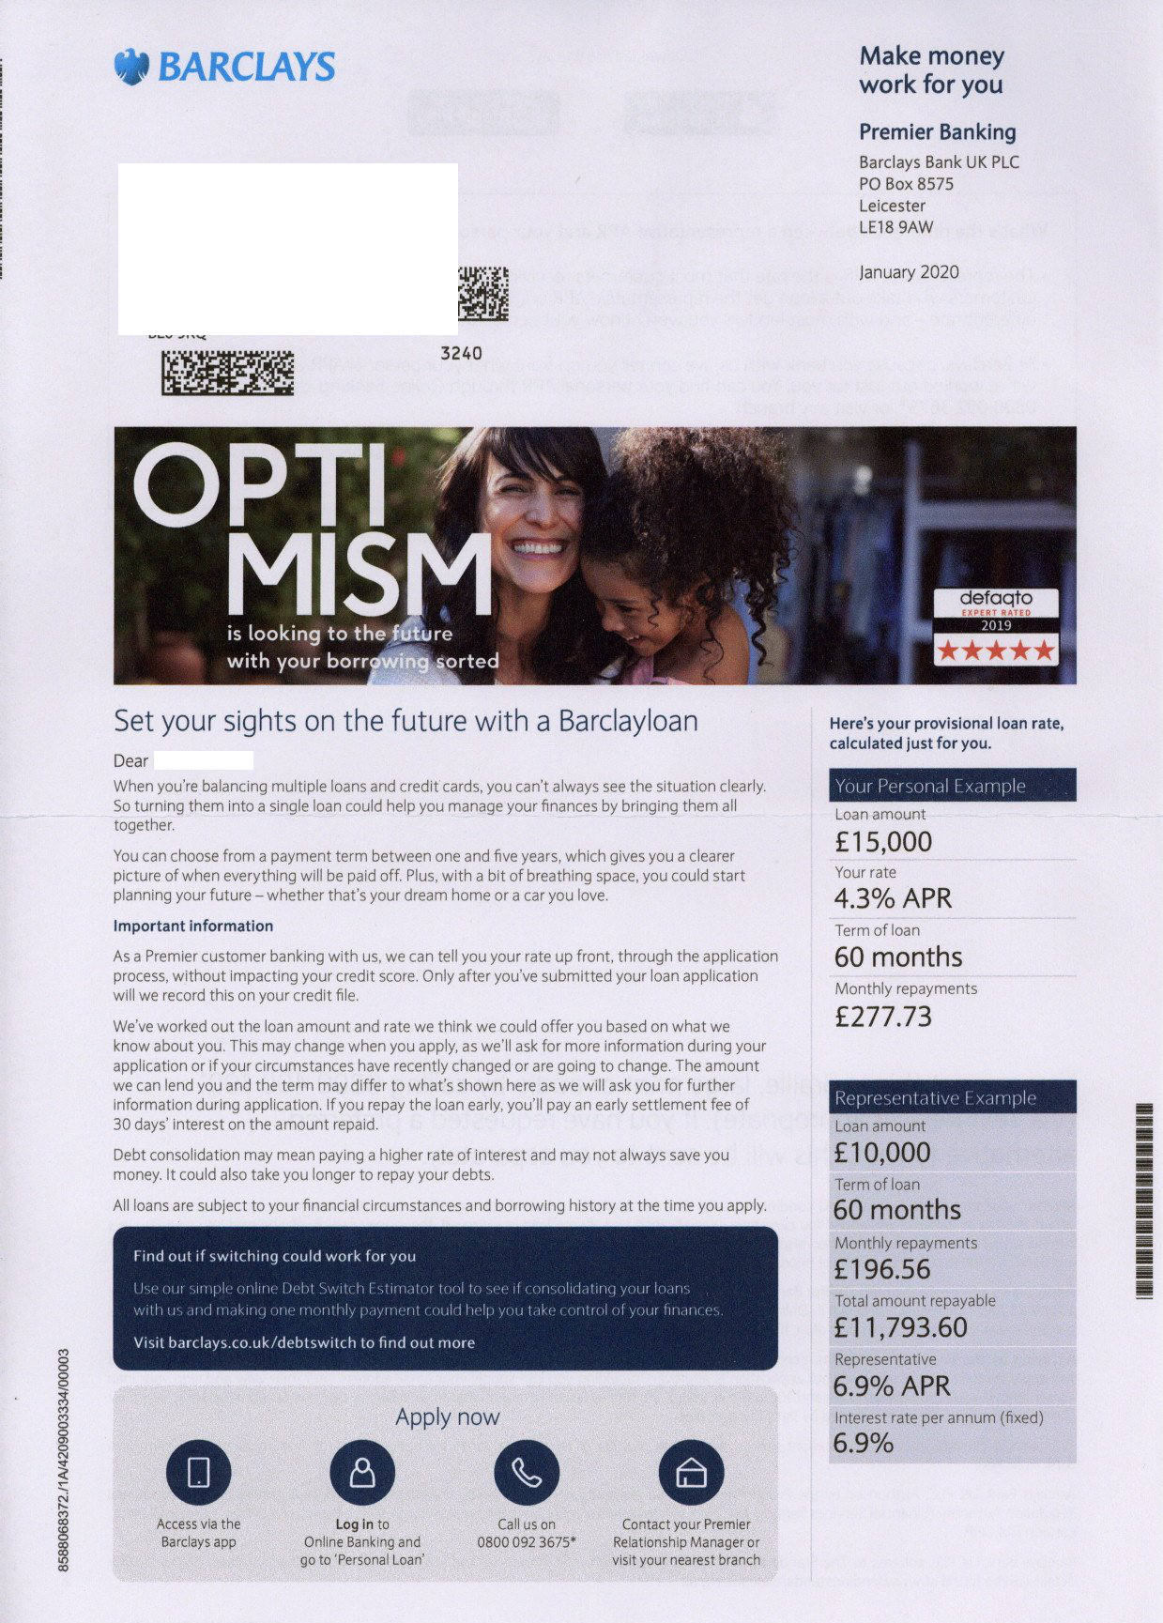
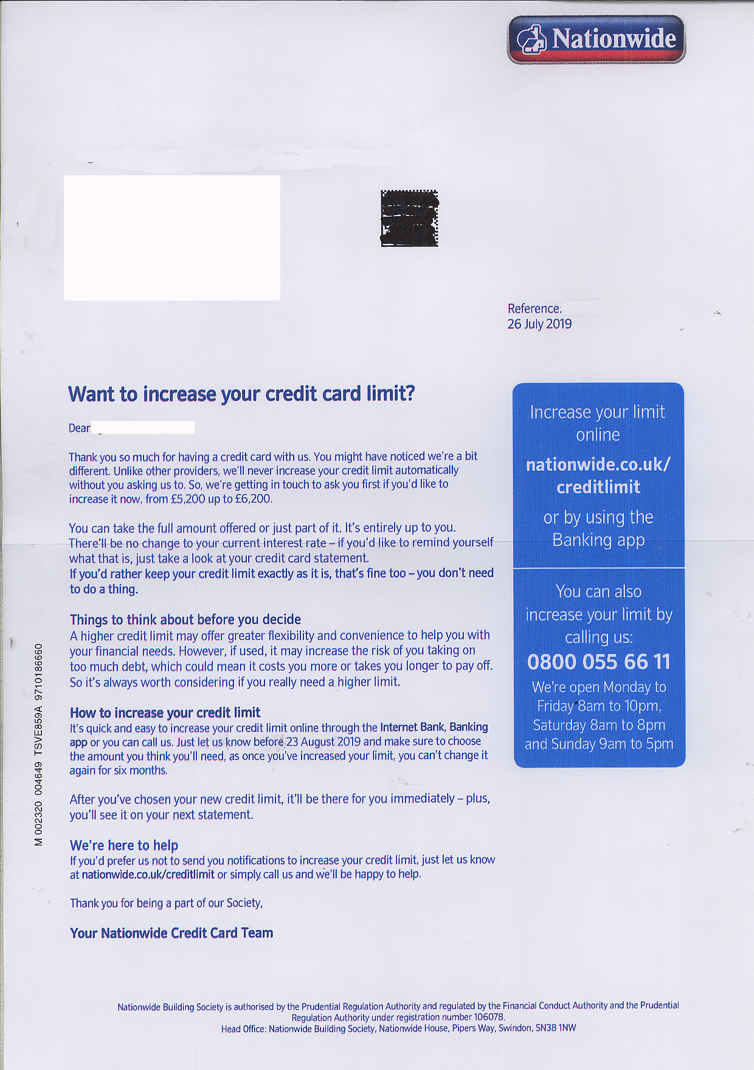
Support with targeted and relevant services and products

Slide 26
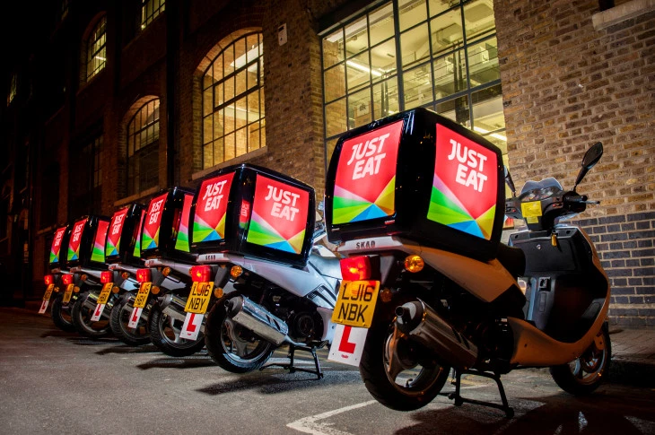
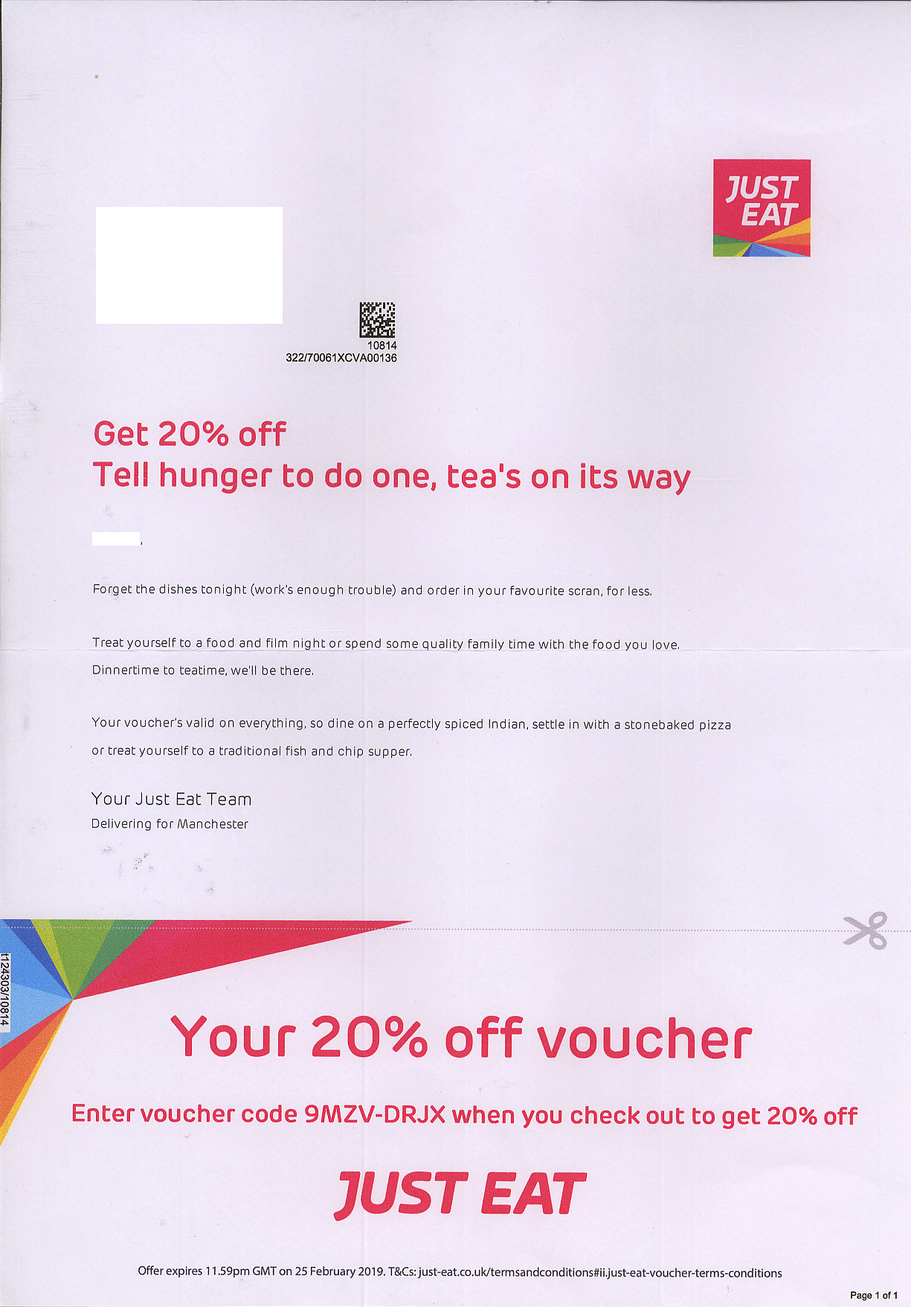
Programmatic mail can offer somewhere new: re-engage customers as it did for just eat
x10
Higher Conversion Rate
vs digital channels
Source: Paperplanes UK

Slide 27
Qr codes drive a variety of online ACTIVATIONS
Letters & Mailings
Statements
Postcards
Door Drops / Leaflets / Flyers
Brochures & Catalogues
Sample Packs & Packaging
Books & Guides
Posters & Banners
Magazines
Tickets
Business Cards
GAMES
VIDEO
WEB / PRODUCT PAGE
APP / APP STORE
AR
GEO-LOCATION
AUDIO / MP3
COUPON
PAYMENTS
DATA CAPTURE
FEEDBACK
PDF / DOCS
SOCIAL / ADVOCACY
RATINGS
IMAGES
CONTACT / VCARD
EMAIL
TEXT / SMS
CALL CENTRE
RSVP

Slide 28
Official government Guidance about mail
We continue to follow the guidance of public health authorities. Public Health England guidance says there are no additional precautions needed for handling post or packages.
Public health authorities have advised people receiving letters and parcels are not at risk of contracting coronavirus. From experience with other coronaviruses, we know that these types of viruses don’t survive long on objects, such as letters or parcels. This complements the highly publicised guidance from public health authorities for people to wash their hands more often than usual using soap and hot water.
Royal Mail takes the health and safety of its colleagues, its customers and the local communities in which we operate very seriously. We have introduced social distancing rules that protect both our colleagues and our customers. We continue to follow public health authority preventative guidance.

Slide 29
Where Mail can add value to future plans
Mail to help those with debt management
Targeted to audience
Relevant messaging to support different audiences –financial needs may be more complex and require more tailored advice or products
Support local audiences
Door drops for reaching local areas or audiences about branches reopening or services offered
Programmatic mail to follow up
Personalised letter is official - gives weight about how you responded to the crisis and helped customers. Reassure that they are in safe hands – outline detail specific measures being taken
CRM mailing thanking for loyalty
Support vulnerable audiences
Support vulnerable audiences as they navigate different ways of banking, promote business as usual services at branches
Telephone or online service follow-up with tailored products or advice
Business Mail
Outline any changes to terms and conditions and interest rates
Consider including mail QR codes to create a more seamless and integrated customer experience

Slide 30
Talk to us about next steps
Team Expertise
Data Planning
Media and Communications Planning
Mail Expertise
JICMail
Market leading bespoke research
Research and Insight
Business development
Key industry tools – TGI, WARC, Mintel, Touchpoints
Industry partnerships – DMA, IPA, D&AD
Case studies and creative best practice library

Slide 31
Thank you

