Slide 1
BUSINESS MAIL TEST AND INNOVATE INCENTIVE
Wholesale
January 2024

Slide 2
BUSINESS mail
Test and Innovate Incentive
30%
WHO IS IT FOR?
CREDIT
TO QUALIFY
TO APPLY
For when you try something new with your advertising mail activity.
A postage credit is available on eligible Business Mail.
The minimum volume is 4,000 items. The maximum test period is 6 months. We may extend if appropriate to support for up to 12 months.
For more information and to apply go to www.royalmailwholesale.com
Full terms and conditions apply

Slide 3
BUSINESS MAIL HAS HIGH ENGAGEMENT
% of mail which is processed in some way, which includes: opening, reading, sorting, putting aside, filing, putting on display or in the usual place
99%
83%
vs
25%
Open rate for
business mail
Open rate for
financial services email
Source: JICMAIL Q2 2017-Q4 2020, Business Mail, n=67,309, Campaign Monitor, 2021

Slide 4
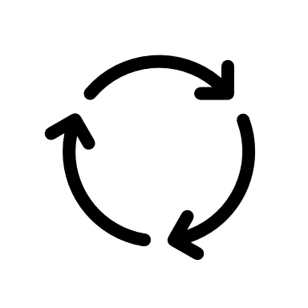
Mail gets you noticed
Drives some form of commercial action – buying, discussion, online activity or contacting the sender
38%
1.17
Every 100 mail packs sent reach another 17 individuals.
4.8
Each piece of business mail is revisited 4.8 times by individuals.
Source: JICMAIL, Business Mail, Q2 2017-Q4 2020, n=67,309

Slide 5
Mail drives high engagement
COMMERCIAL ACTIONS
Bought something, made a payment or donation
Used a voucher or discount code
Planned a large purchase
Discussed with someone
Ordered a catalogue
Visited sender’s shop/office
Visited sender’s web site
Went online for more information
Looked up my account details
Used a tablet or smartphone
Called the sender
6%
18%
Buying behaviour
Discussed with another
31%
6%
Combined online behaviours
Contacted the sender
Source: JICMAIL, Business Mail, Q2 2017-Q3 2022, n+99,958

Slide 6
Entry requirements
Test addressed Letters or Large Letter format items sent using Business Mail services.
We will award postage credits to support a suitable test if it’s a one-off campaign, or a series of mailings over 6 months.
Post a minimum of 4,000 test items to qualify (up to a maximum of 10 million items).
1
3
5
Put in place a suitable process to measure the performance of the test and be able to share the results with us.
2
4
If your test is successful and you wish to roll out beyond the 6-month test period we will support some tests for a further 6 months.
6
Send items using Royal Mail Mailmark®.
Full terms and conditions apply

Slide 7
Postage credits
Postage credit rates vary depending on the type of test you undertake.
We will offer postage credits at the standard rate unless they qualify as an “Exceptional” test.
Standard Test = 10% credit
Exceptional Test = 30% credit
+ 10% roll out
Full terms and conditions apply

Slide 8
Always On Exceptional tests qualify at a higher rate
EXCEPTIONAL TESTS | EXAMPLES
A brand new or incremental mailing | A brand new communication using mail that you have not tried before or an extension of an existing mailed communication to reach a brand new audience.
Increase to your postage costs | Increasing the size of your item from Letter to Large Letter format or material increased weight as a result of additional pages.
New use of emerging technology | Test the use of voice activation or use augmented reality with your mailing.
We normally expect to support up to 100k items for an individual test. However, dependent on the details provided we will support up to a maximum of 10m items.
TEST VOLUME | EXAMPLES
Up to 100k | Testing a new campaign or change to existing campaign.
Up to 200k | Test linked to reactivating a campaign that has been removed from your mailing plan.
Up to 10m item | Test includes new incremental volume and is based solely on the use of the incentive and not pre planned volume prior to the submission of your application.
Full terms and conditions apply

Slide 9
Here’s what some sectors Have tested
They’ve reduced churn, built relationships or changed behaviours
Business Mail helped a pet retailer generate incremental revenue and an ROI of 367%.
Communicating rewards with mail in a multi-media campaign helped a telco reduce churn and delivered ROMI of 179:1.
A well known catalogue retailer introduced a welcome pack which received a 22.5% response rate, generating an extra £3million in sales.
A credit card company mailed card holders to help come out of persistent debt, delivering a 5.9% increase in repayments.
82% of customers agreed it was easy to understand changes to TSB’s T’s&C’s following a letter.
A water company changed the habit of 70% of people who were pouring fat down sinks, resulting in 26% reduction in sewer blockages.
An insurance underwriter saved £270,000 through a letter that helped people with the sign up process and reduced inbound calls.
A Government department mailed an activity pack to get 700,000 children get moving every day.

Slide 10
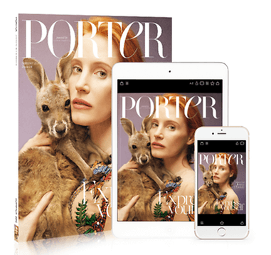
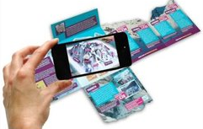
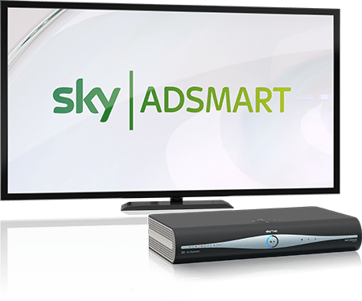
Test new technology to get the higher incentive rate
Test image recognition technology which takes a consumer from physical to digital.
One drinks company made their print edible so you could sample their new flavor by tearing a piece of paper off and eating it!
Test the use of voice activation in your mailing to drive people to online content/data capture.
Use augmented reality or near–field reality to create a truly immersive customer experience.
Test programmatic mail where you can re-target someone visiting your web site with a timely mail piece to remind them to buy.
Use smell, a pet insurer used smelly mail to reach dog or cat owners with packs their pets could literally smell.
Test mail with addressable TV.
Make the most of developments in Artificial Intelligence, use it to tailor your mail to different audiences.

Slide 11
The APPLICATION AND CREDIT process
Offer open until March 28th 2025
Go to the application form here
GET IN TOUCH
Speak to your Account Manager to make sure you are applying for the best incentive for your needs and to check that you meet the requirements.
WE’LL GET IN TOUCH
To discuss your application and check all the detail with you.
VOLUME NOTIFICATION
When you have completed your activity you will need to apply to Royal Mail for your credit.
REDEEM YOUR
CREDIT
Receive your credit as a voucher or have it paid into a Royal Mail postage account. Credit vouchers are valid for 12 months.
APPLY ONLINE
Use the link to the online application. Your application can also be completed by an agent.
POST YOUR MAILINGS
Start posting your volume.
Full terms and conditions apply
Notes:
This template was inserted from Power-user, the productivity add-in for PowerPoint, Excel and Word.
Install Power-user to access thousands of templates, icons, maps, diagrams and charts with Power-user.
Visit https://www.powerusersoftwares.com/
©Power-user SAS, terms of license: https://www.powerusersoftwares.com/terms

Slide 12
The more detail the better!
The more information you can provide will help us process your application
Why are you testing?
What are the details of the test?
How are you measuring the results?
Can you tell us about the objectives and strategy for your new mailing activity
Could you explain how this is something new to your marketing plan
Outline the strategic thinking on why you are including mail in your plans now and how it is different from previous activity
Who are you targeting and why?
What targeting strategy have you used e.g. profiling? existing customer base
What test cells are in your plan?
Are you testing different creative routes and if so why?
If you have a test matrix please do include it.
Please tell us the volumes you are testing
What are the main KPIs for this campaign – predicted response rate, sales, ROI
Is there anything else you want to achieve with the campaign? Drive to digital, QR code use or other softer brand measures, for example?

Slide 13
FREQUENTLY ASKED QUESTIONS
Can I send Standard Business Mail Mailmark and qualify for postage credits?
You can use Standard Business Mail Mailmark for items that at are Large Letter format. By exception, we may support Standard Business Mail Mailmark Letter format. For more details, please contact groupincentive@royalmail.com.
Can I use postcard formats?
Traditional postcards are not eligible please see the Machinable Postcard and One Piece Mailer Guide for options to use with incentives at www.royalmailwholesale.com/incentives.
What will happen if my actual TIS volume is less than 4,000 items?
You will not receive any postage credit if your actual TIS volume is less than 4,000 mailing items.
What is the roll out period for Business TIS?
If you qualify for the “Exceptional” test we offer an additional incentive to encourage you can continue the test for a further 6 months to ensure you are able to measure the outcome of your test.
How long will my postage credit vouchers be valid for?
Postage credit vouchers are valid for 12 months from date of issue.
What is a Timebound test?
A timebound test will link to a specific type of mailing test. Full details of eligibility, the volume supported, and credit rates available will be shown in the TIS Eligible Services and Credit Document.
Full terms and conditions apply

Slide 14
THANK YOU

