Slide 1
GDPR
INCENTIVE PROPOSITION
Royal Mail

Slide 2
OUTLINE
This deck provides some testing propositions for how customers can use mail in a post GDPR world to communicate to their customers. All new tests will qualify for one of our incentives.
Full details of these can be found towards the back of this deck.
Summary
12 ways mail could help you thrive in the GDPR world
Summary of GDPR Test Propositions
Test Propositions with Case Studies
GDPR Postage Incentives
Download: The GDPR Opportunity with Mail
Appendix. Case studies and GDPR creative examples

Slide 3
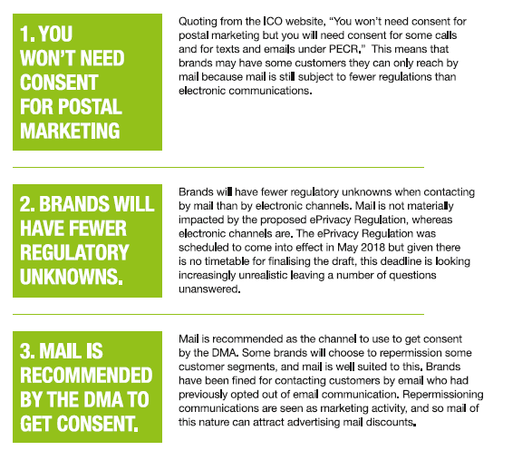
12 ways mail could help you
Thrive In the gdpr world
Quoting from the ICO website, “You won’t need consent for postal marketing but you will need consent for some calls and for texts and emails under PECR.” This means that brands may have some customers they can reach by mail because mail is subject to fewer regulations than electronic communications
Brands will have fewer regulatory unknowns when contacting by mail than by electronic channels. Mail is not materially impacted by the proposed ePrivacy Regulation, whereas electronic channels are. The ePrivacy Regulation was scheduled to come into effect in May 2018 but given there is no timetable for finalising the draft, this deadline is looking increasingly unrealistic leaving a number of questions unanswered.
Mail is recommended as the channel to use to get consent by the DMA. Some brands will choose to repermission some customer segments, and mail is well suited to this. Brands have been fined for contacting customers by email who had previously opted out of email communication. Repermissioning communications are seen as marketing activity, and so mail of this nature can attract advertising mail discounts.
Notes:
This is one of the key chapters from the Royal Mail Guide.
PLEASE NOTE
It is not advisable to read all the text aloud (too onerous for audience). If you wish, delete text and/or highlight the key ones that will resonate the highest with the organisation you are presenting to. However the first is the most important.

Slide 4
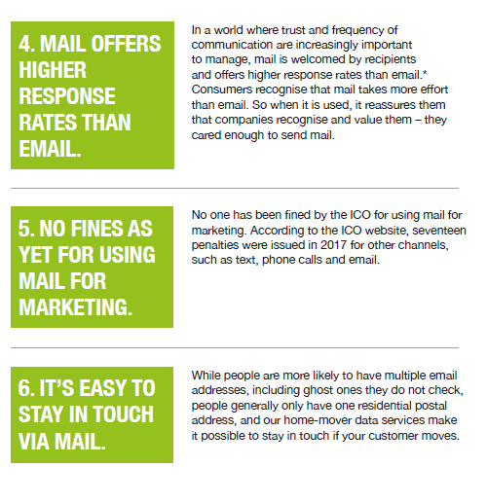
12 ways mail could help you
Thrive In the gdpr world
In a world where trust and frequency of communication are increasingly important to manage, mail is welcomed by recipients and offers higher response rates than email.* Consumers recognise that mail takes more effort than email. So when it is used, it reassures them that companies recognise and value them – they cared enough to send mail.
No one has been fined by the ICO for using mail for marketing. According to the ICO website, seventeen penalties were issued in 2017 for other channels, such as text, phone calls and email.
While people are more likely to have multiple email addresses, including ghost ones they do not check, people generally only have one residential postal address, and our home-mover data services make it possible to stay in touch if your customer moves.
Notes:
PLEASE NOTE
It is not advisable to read all the text aloud (too onerous for audience). If you wish, delete text and/or highlight the key ones that will resonate the highest with the organisation you are presenting to.

Slide 5
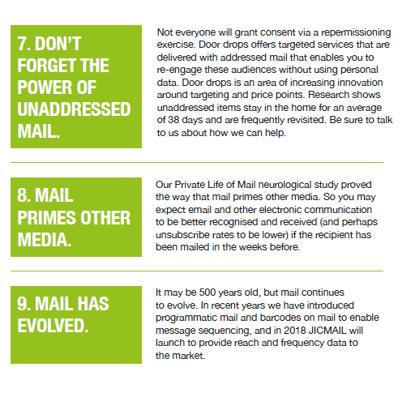
12 ways mail could help you
Thrive In the gdpr world
Not everyone will grant consent via a repermissioning exercise. Door drops offers targeted services that are delivered with addressed mail that enables you to re-engage these audiences without using personal data. Door drops is an area of increasing innovation around targeting and price points. Research shows unaddressed items stay in the home for an average
of 38 days and are frequently revisited. Be sure to talk to us about how we can help.
Our Private Life of Mail neurological study proved the way that mail primes other media. So you may expect email and other electronic communication to be better recognised and received (and perhaps unsubscribe rates to be lower) if the recipient has been mailed in the weeks before.
It may be 500 years old, but mail continues to evolve. In recent years we have introduced programmatic mail and barcodes on mail to enable message sequencing, and in 2018 JICMAIL will launch to provide reach and frequency data to the market.
Notes:
PLEASE NOTE
It is not advisable to read all the text aloud (too onerous for audience). If you wish, delete text and/or highlight the key ones that will resonate the highest with the organisation you are presenting to. However the first is the most important.

Slide 6
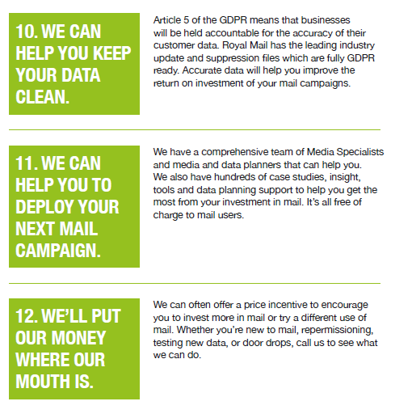
12 ways mail could help you
Thrive In the gdpr world
Article 5 of the GDPR means that businesses will be held accountable for the accuracy of their customer data. Royal Mail has the leading industry update and suppression files which are fully GDPR ready. Accurate data will help you improve the return on investment of your mail campaigns.
We have a comprehensive team of Media Specialists and media and data planners that can help you. We also have hundreds of case studies, insight, tools and data planning support to help you get the most from your investment in mail. It’s all free of charge to mail users.
We can often offer a price incentive to encourage you to invest more in mail or try a different use of mail. Whether you’re new to mail, repermissioning, testing new data, or door drops, call us to see what we can do.
Notes:
PLEASE NOTE
It is not advisable to read all the text aloud (too onerous for audience). If you wish, delete text and/or highlight the key ones that will resonate the highest with the organisation you are presenting to. However the first is the most important.

Slide 7
Gdpr testing proposition EXAMPLES
Communicating your updated privacy policy using mail
Use mail to increase opt in’s of other channels
Re-permission your database
Reassure your customers
Test D2D & DM together
Reactivate your lapsed database
Test Personalisation
Test D2D as an acquisition tool

Slide 8
1. Communicate your updated
privacy policy via mail
Choose mail to communicate your updated privacy policy to your existing customers.
People feel valued and have a better impression of the brand when using mail
The emotional impact of mail versus email
MAIL
EMAIL
63%
I am more likely to take it seriously
18%
57%
It makes me feel more valued
17%
25%
55%
It gives me a better impression of that company
(% True of Mail vs. True of Email)

Slide 9
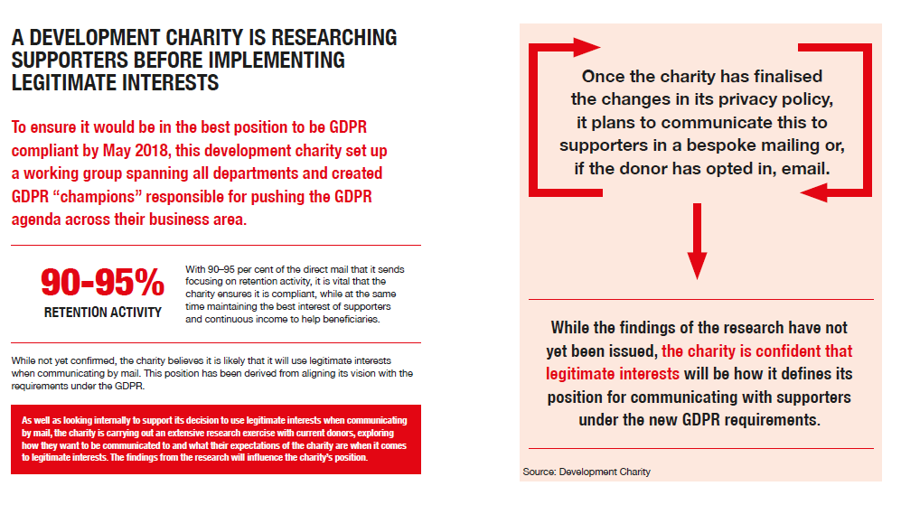
CASE STUDY – UPDATED PRIVACY POLICY

Slide 10
2. USE MAIL TO INCREASE OPT IN’S
OF OTHER CHANNELS
Use mail to increase your multi-channel communications.
See case studies on next few slides for some ideas.
Up to
15% off
postage for any new test*

Slide 11
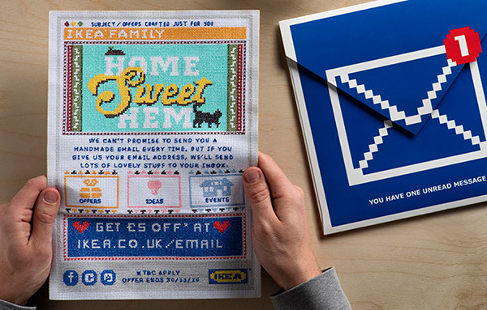
AN EMBROIDERED EMAIL SENT MEMBERS ONLINE TO
OPT IN FOR REAL EMAIL
Background
IKEA’s most valuable FAMILY club members spent £35 more if they had opted in for both mail and email.
The brief : ‘send an email without an email address’ to the 1.3 million members who were only contactable by post and encourage them to sign up for email.
Solution
IKEA mailed Family Members a blue envelope with the email icon on the outer. Inside was a beautifully crafted fabric ‘email’ – that mirrored a digital email -created entirely out of embroidery.
A £5 incentive persuaded Family Members to go online and opt in with their email address.
Results.
Opt-in rates for members mailed exceeded expectations by over 3%, with over 13% of recipients opting in to email as a marketing channel.
Source: DMA Award Winner (Mail) Bronze , designtaxi.com
Notes:
All headlines appear in uppercase and are always out of the blue text boxes, up to a maximum of 2 lines. Single headline master is available in the theme.

Slide 12
3. REPERMISSION YOUR DATABASE
Up to
15% off
postage for any new test*
It’s all about trust.
See case studies on next few slides.
Are they competent enough to hold my data securely?
Trust
+
Consent
Do they intend to respect my privacy?
Creating confidence about data security and privacy will build trust and increase permission rates

Slide 13
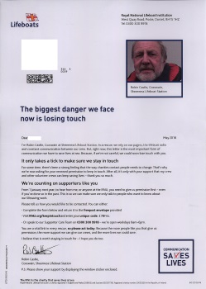
GETTING DONORS TO OPT-IN DIDN’T
LEAVE RNLI OUT TO SEA
Background
RNLI was the first charity to move to opt in only communications. From 1 January 2017 it committed to stop contacting individuals by telephone, email or post unless they had actively given their consent to RNLI – a move predicted to cost £36m in donations.
Solution
From March - November 2016, 900,000 of RNLI’s most engaged supporters were asked to opt-in through a 3 wave multi-channel campaign called ‘Communication Saves Lives’.
Results
388,000 people - 44% of the 900,000 engaged supporters - opted in to receive communications. Significantly more than the 225,000 predicted. Mail was most popular - 66% said RNLI could contact them by mail (vs. 53% by email and just 7% by telephone).
The August 2016 campaign was mailed to opted-in supporters only. 32.8% of those mailed responded - 3x the10.4% rate achieved in 2015. Average donation was £8.39 - nearly 3x the £2.94 average donation for 2015.
Source: Third Sector, Marketing Week, Civil Society, fundraisingregulator.org
Notes:
All headlines appear in uppercase and are always out of the blue text boxes, up to a maximum of 2 lines. Single headline master is available in the theme.

Slide 14
4. Reassure your customers
Communicate using mail to your existing database that you will not share their details to third parties.
The role of mail in building trust:
See case studies on next few slides.
Drives Action
Achieves Cut Through
Delivers Impact
Proven to be highly effective at driving multi-channel response
Customers feel they receive too many emails
Mail gets opened
Customers say mail:
Makes them feel valued
Gives a better impression of your company
Is trustworthy

Slide 15
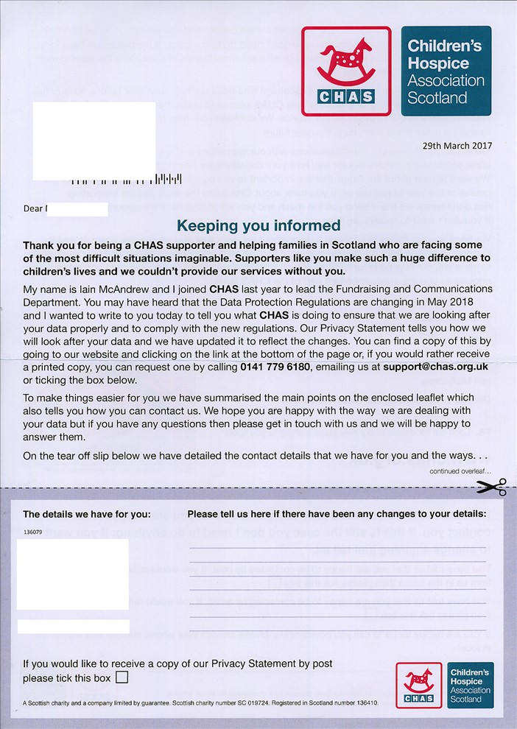
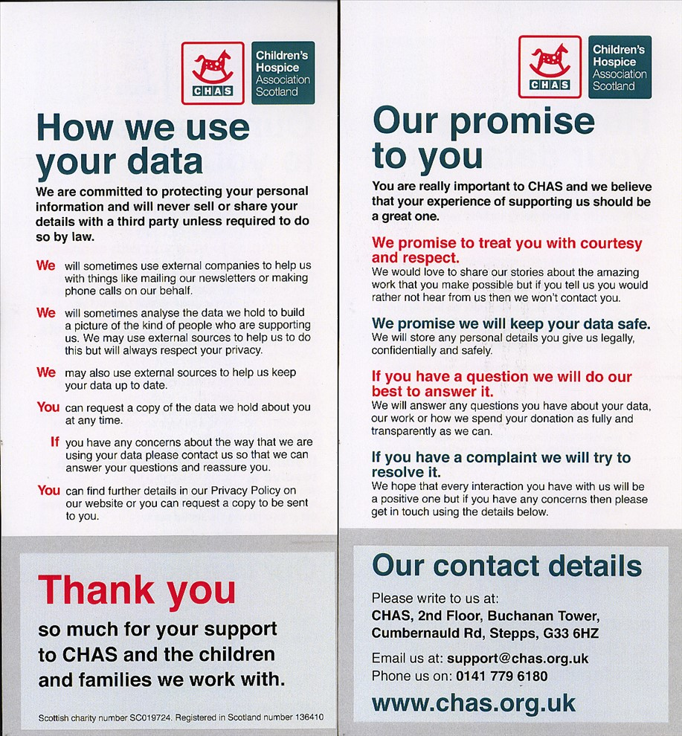
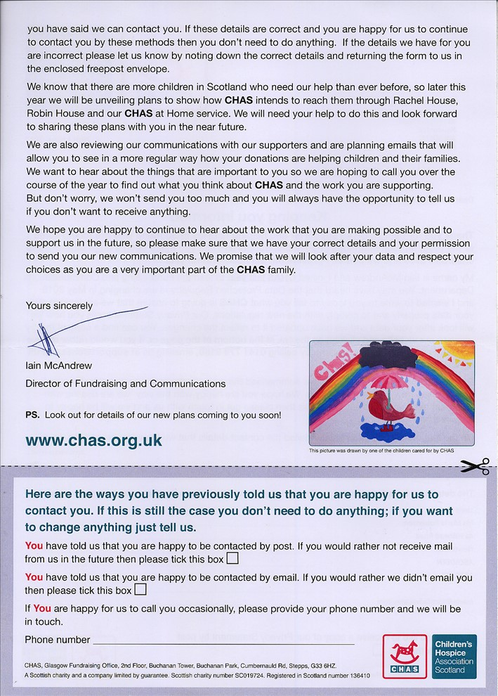
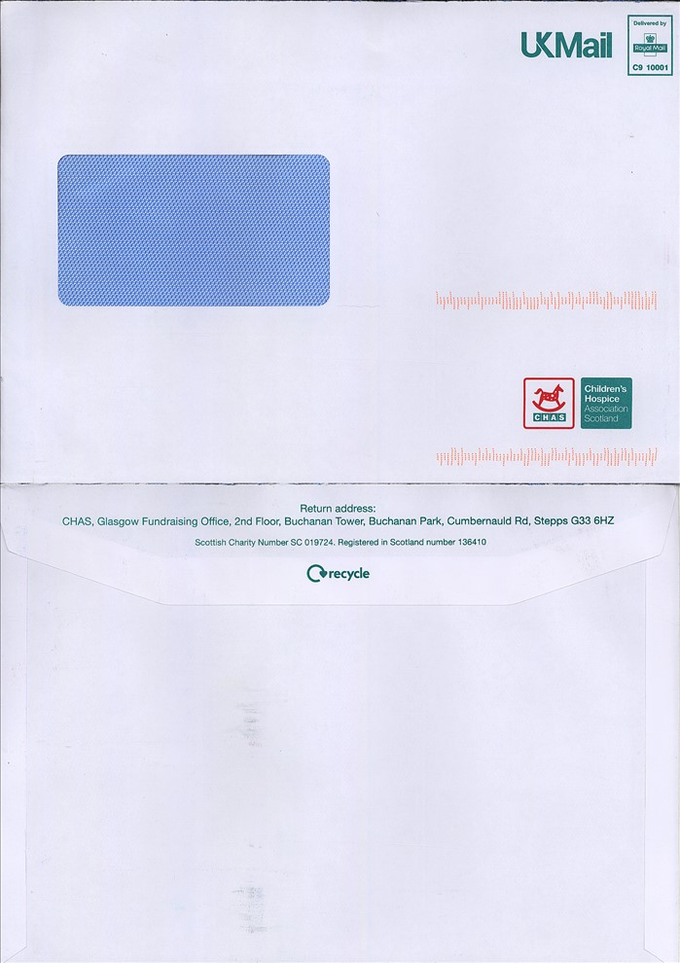
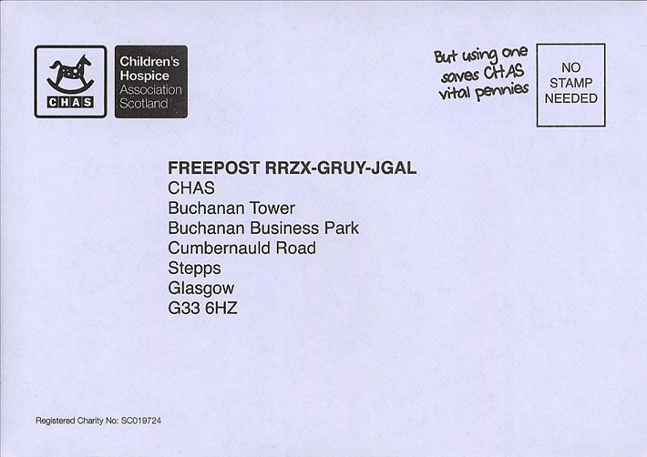
CHILDREN'S HOSPICE ASSOCIATION SCOTLAND
Keeping you informed

Slide 16
5. Optimise acquisition by combining
Door drops with direct mail
Compliant third-party data will exist post GDPR however in all probability, the volumes of contacts available will be lower than present, and the costs per thousand much higher.
To optimise the effectiveness of your acquisition campaigns, we recommend combining direct mail with door drops as this combination has proven highly effective.
Recent analysis of campaigns illustrated:
40%
The average increase in Direct Mail response, pre to post Door Drop Campaign for a leading retail client
38%
The average increase in response rates when DM & door drops were combined for a financial services client
25%
The average increase in response rates when DM & door drops were combined for a major telecoms client
Source: idoordrop/whistle
Notes:
Speaker Notes:
While door drops are the most appropriate tool for acquisition in the short term, we don’t forget about direct mail. As the market adapts and GDPR compliant third party lists begin to emerge, its important to remember the ability of DM to recruit effectively.
And new analysis in indication that the combination of the Direct Mail and Door drops is exceptionally potent, with the door drops creating awareness that is harvested by DM. So don’t dismiss the value fo DM for acquisition, once appropriate lists are available.

Slide 17
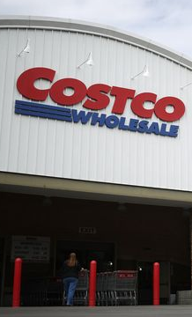
COSTCO UPLIFTED RESPONSE BY 28% WITH A
HIGHLY TARGETED MAIL AND DOOR DROP PLAN
Background Costco was opening its 26th UK membership warehouse club in Hayes. They knew the success of the launch relied on optimising mail and Door Drop with a highly targeted media plan that would maximise membership.
Solution The launch plan combined two years of test and learn insight on geographic, demographic, behavioural and timing strategy to develop the ideal audience targeting and integrated mail and Door Drop media plan.
Experience had confirmed increased communication frequency raised response rates. Thus, prospects were mailed twice while lapsed customers from nearby stores were mailed once. Door Drops covered both audiences with a second or third communication as well as bringing in the non-mailed audience.
Results Hayes was the most successful UK Costco opening to date. First day ROI is a key target for Costco. The mail and Door Drop campaign generated a first day ROI of 3.74:1. 63% of new members were recruited before opening day.
The optimum contact frequency uplifted mail response by 28%. The programme brought together over two years of test and learn insight and ultimately led to Costco increasing its investment in mail and door drop by 12% annually.
Data IQ, Winner Award for Best Data-Driven Direct Mail Advertiser(s), 2015. data Storytelling Awards, Shortlisted for Innovation in Direct Marketing, September 2015

Slide 18
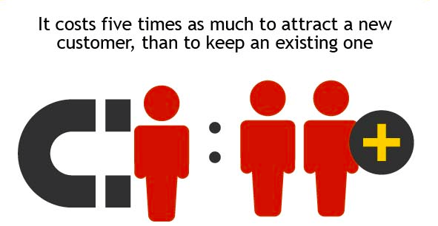
6. REACTIVATE YOUR
LAPSED DATABASE
Lapsed customers have demonstrated a need for your product
Far better prospects than random names on a cold-call list.
They are familiar with your company
No need to create brand awareness and educate them about your offering
Reduces the cost of marketing to them.
Technology allows you draw information on how they have use your product to create successful win-back offers.

Slide 19
STEP AWAY FROM THE GENERIC TO INCREASE
BRAND ENGAGEMENT

Slide 20
7. Test personalisation
Personalisation using digital marketing is a powerful way to communicate to your customers. You can apply data about your customers’ demographics and buying habits to create a catalogue just for them. Products you know they’ll respond to can take centre stage, with plenty of cross-sell and up-sell opportunities.

Slide 21
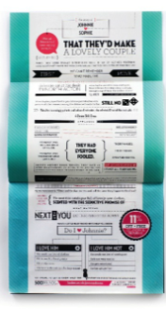
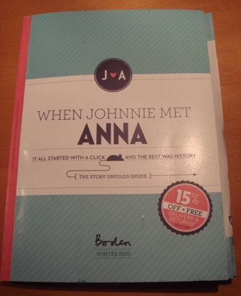
BODEN USED MULTI-LEVEL
PERSONALISATION TO DRIVE REPEAT SALES
Background:
Boden wanted to remind people about how good it felt to shop with them and remind lapsed customers to come back.
Solution:
They sent a very personalised targeted DM piece to lure customers back and elicit repeat business.
The back of the mailing featured personal product recommendations based on analytics.
An online landing page was also created so that customers could voice what they thought of the brand.
Results:
Drove a near 30% uplift in response.
Source: MarketReach, 2011

Slide 22
8 .Test door to door to Acquire
new Customers
Door drops are not regulated by GDPR as the statistics that are used to generate postcode profiles are from aggregated data
Geodemographic tools can profile the postal codes and indicate’ areas that are desirable for your organisation
Royal Mail has a range of incentive schemes that:
Reduce the cost of testing door drops for the first time
Reduce the cost of testing new door drops
Increase the scale of their current door drop programmes at a discount
New services are also being tested and rolled out including:
A late booking service for available capacity with exceptional discounts
A designated day service
Notes:
Speaker Notes
Door Drops can be exceptionally powerful and provide a strong ROI. While used a great deal by Fast Food chains they offer a lot more than perhaps are given credit. Firstly, MarketReach has proven through comprehensive research that door drops are valued by consumers, are passed on, displayed in the home provided they are relevant.
Relevancy comes with targeting and over the past few years, door drop targeting has evolved into a science that can focus campaigns based on more than just geography. There are a variety of consumer attributes and targeting techniques that avoid wastage and can deliver breakeven or above for brands in their customer acquisition.
Door drops are as versatile as mail and they don’t have to be product-led, some brands use them to purely to drive customer registration online to then continue 121 communications

Slide 23
STICKERS CREATED A ‘BUCKET LIST’
FOR TRAVELLERS ON GREAT WESTERN RAILWAY
Background
Great Western Railway wanted drive more journeys by persuading people to take the train for different, more inspiring, unusual experiences than their usual daily grinds.
Solution
Royal Mail research shows that successful door drops have long life span (38 days), with 39% of people saying they have a dedicated area for display of mail, usually in the kitchen. Based on this insight Great Western Railway created a 'keepable' door drop, with a 'stick it on the fridge' factor that was key to the campaign's success.
Stickers – to be peeled off and re-stuck on suggested destinations that had been 'ticked off the bucket list' – were added to the door drop prompting a longer stay on the fridge, integrating Great Western Rail into the home and family discussions. And of course, heightening the chance of repeat custom.
Results
Geo-location was used to measure effectiveness across the pre and post-campaign periods. From the 3 key drop regions of Penzance, Cardiff and Oxford, there was a transactional uplift of 23%, 7% and 20% respectively over a period of 42 days after the door drop.
Source: DMA Award Winner (Door Drop) Silver

Slide 24
TEST ANY GDPR PROPOSITION & SAVE
15 – 30% off for testing new used of business mail or advertising mail
THE DEAL
30% discount on business mail tests and 15% discount on advertising mail tests carried out over a period of 1 – 6 months
10% discount in months 6 – 12 for business mail tests that roll out
Discounts paid retrospectively in the form of postage credits
WHO’S ELIGIBLE
Anyone testing a new mail activity, and sending a minimum of 10,000 items in a test (limited to 10m items for business mail and 1m items for advertising mail tests)
For postings sent directly with Royal Mail or an Access Operator
TEST
IDEAS
New letter content
Re-design of letter layout
Envelope changes

Slide 25
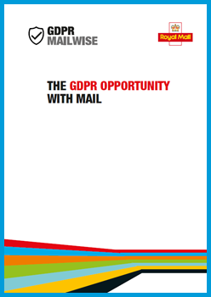
For more information on GDPR download
THE GDPR opportunity with mail guide
FREE to download from:
www.mailmen.co.uk/gdpr
Notes:
Ask audience to note and download!

Slide 26
Thank you.

Slide 27
APPENDIX

Slide 28
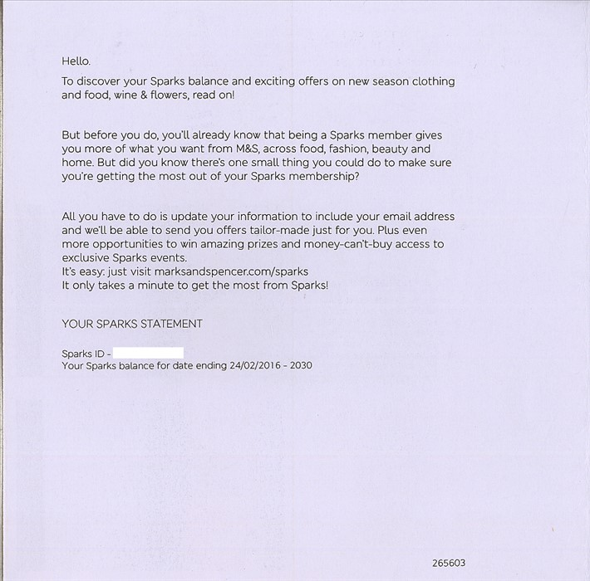
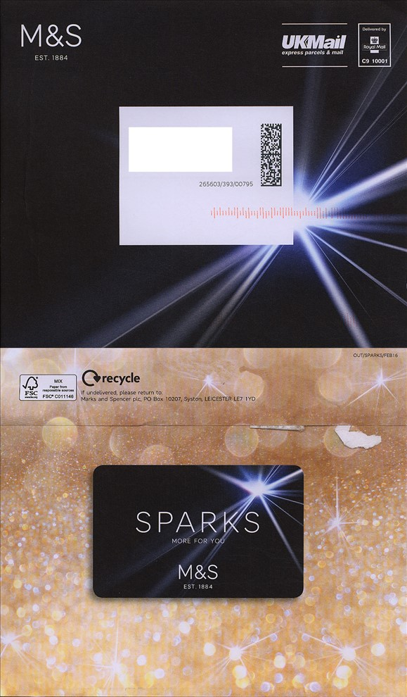
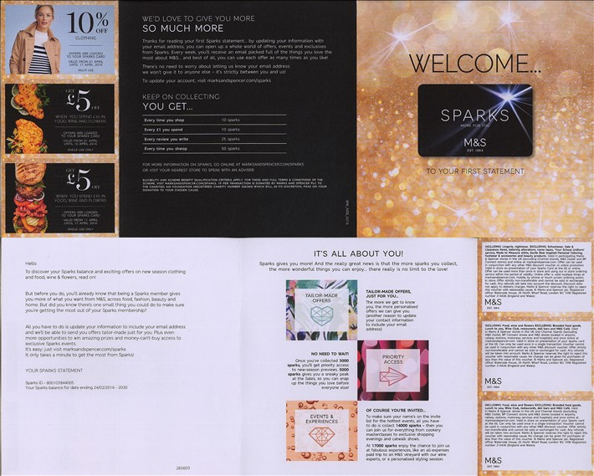
MARKS & SPENCER
We’d love to give you more…all you have to do is update your information to include your email address

Slide 29
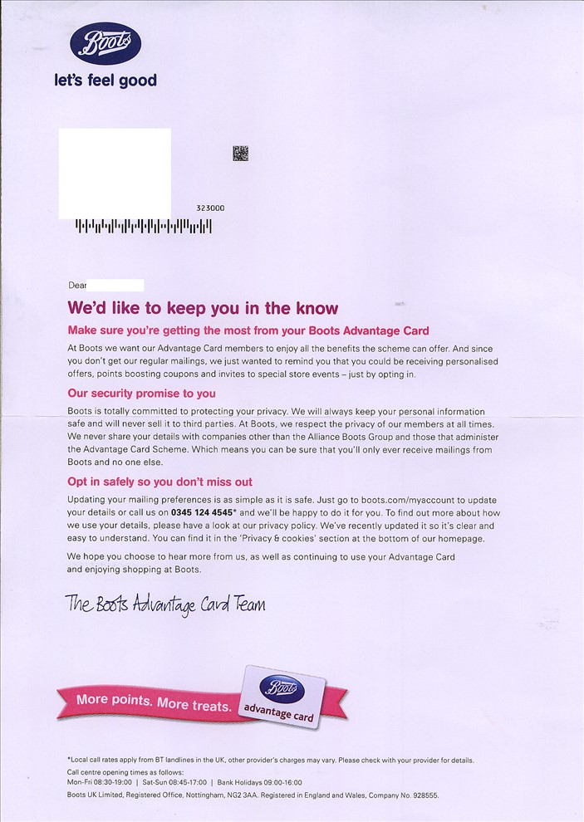
BOOTS
We’d like to keep you in the know?

Slide 30
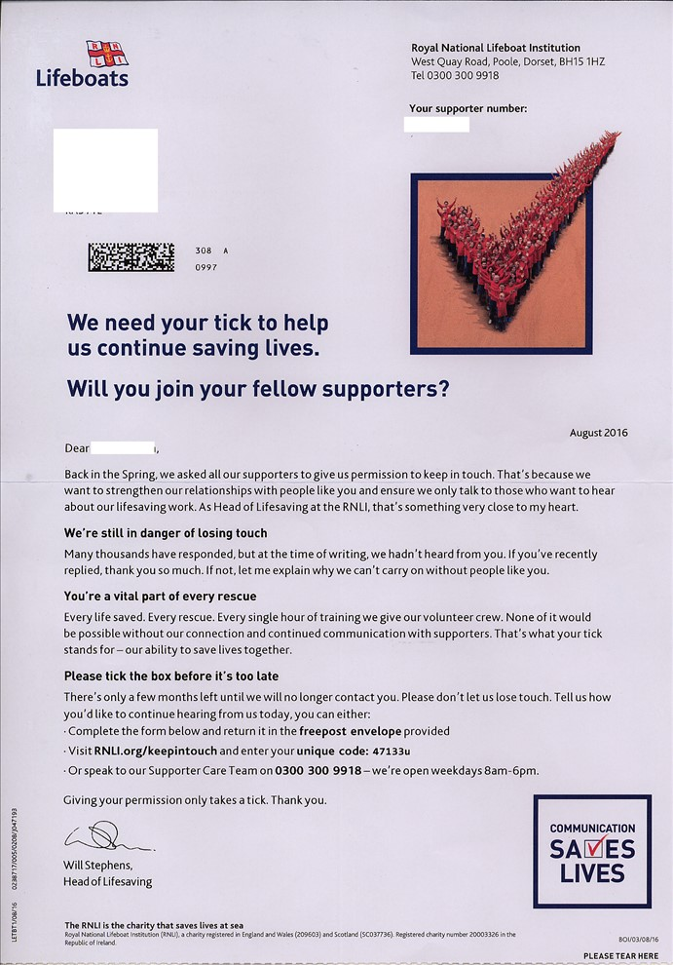
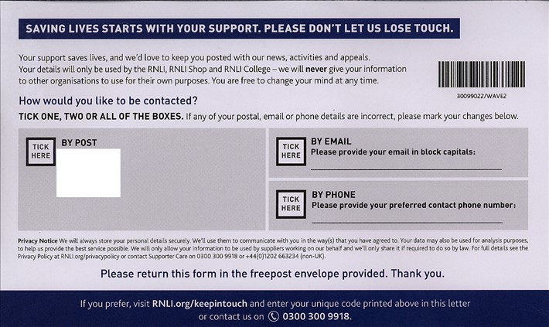
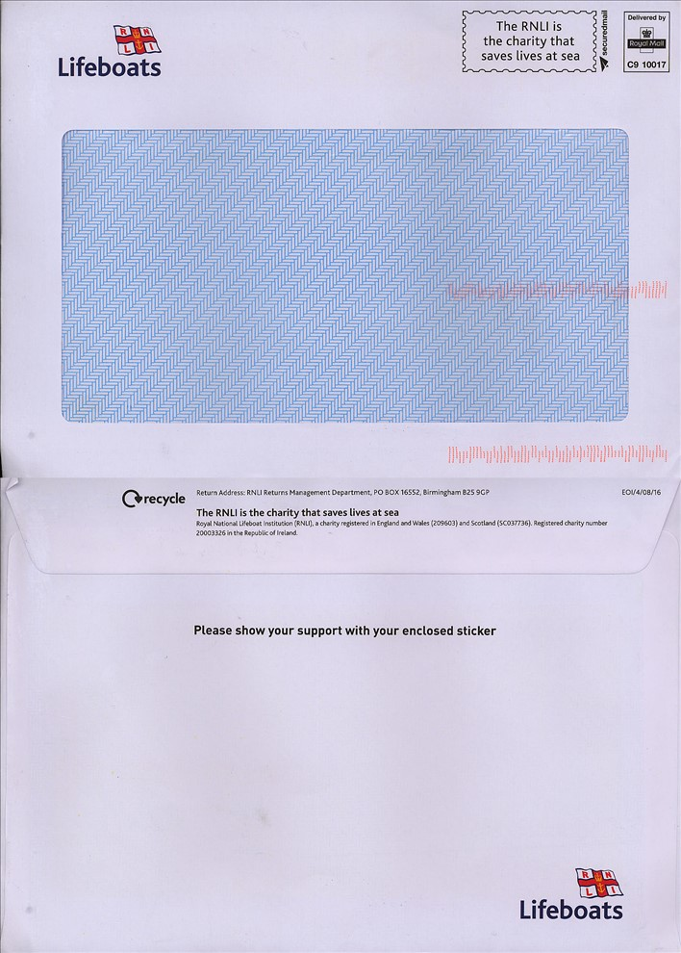
ROYAL NATIONAL LIFEBOAT INSTITUTION
We need your tick to help us to continue to save lives

Slide 31
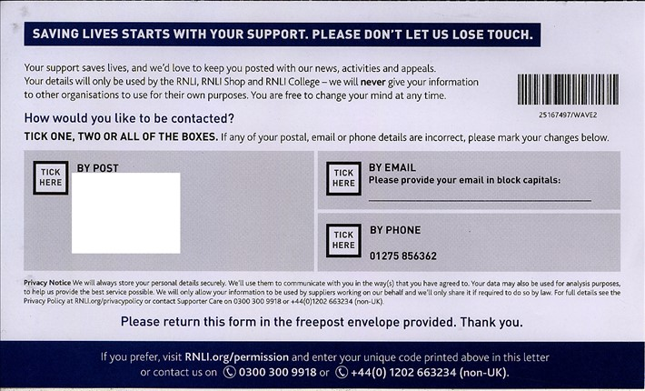
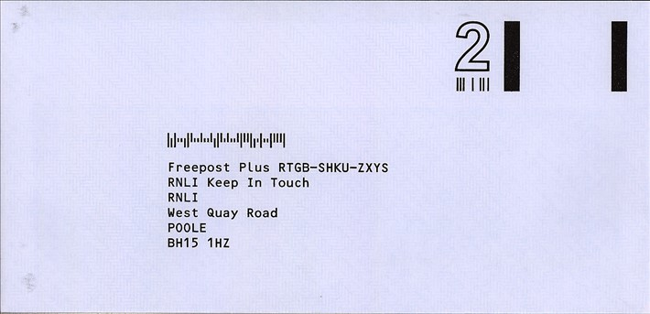
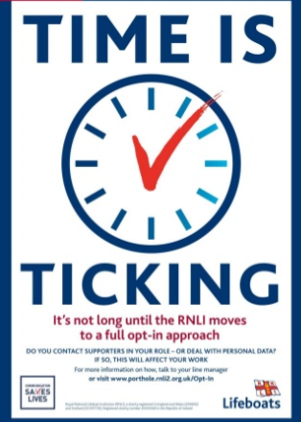
And can show support
Ran across multiple media touchpoints including mail to gather consent
Mail was the best performer in this campaign
Mail was the top channel chosen by donors to receive marketing
66% said RNLI could contact them by mail vs. 53% by email and just 7% by telephone
Notes:
This consent campaign shows how the RNLI has associated consent with support to saving lives.
This campaign was across all media touchpoints with mail coming out as the strongest.
Full details are in the Case Study on SharePoint.

Slide 32
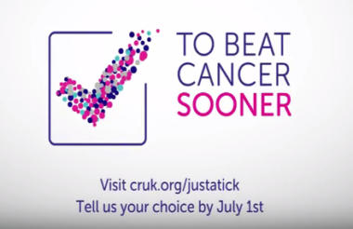
CANCER RESEARCH UK NEEDED ‘ONE TICK’
TO BEAT CANCER SOONER
Background
In 2016 Cancer Research UK took the decision to change to an ‘opt-in’ model for marketing – a decision driven primarily by the desire to change the way it talks to supporters and, one that would put them ahead of GDPR requirements
Solution
Cancer Research UK used a phased approach to move to opt in, initially prioritising new or returning supporters.
A major campaign using the message ‘Your tick beats cancer sooner’ was deployed across press, mail, social media, YouTube advertising and PR to create awareness of the drive.
Results
In the first three months, over 100,000 new supporters completed a new marketing permissions form with opt-in to mail tracking around 20%.
The charity became opt-in for all supporters on 1 July 2017.
Source: Cancer Research UK, Third Sector, Marketing Week, Civil Society, fundraisingregulator.org
Notes:
All headlines appear in uppercase and are always out of the blue text boxes, up to a maximum of 2 lines. Single headline master is available in the theme.

Slide 33
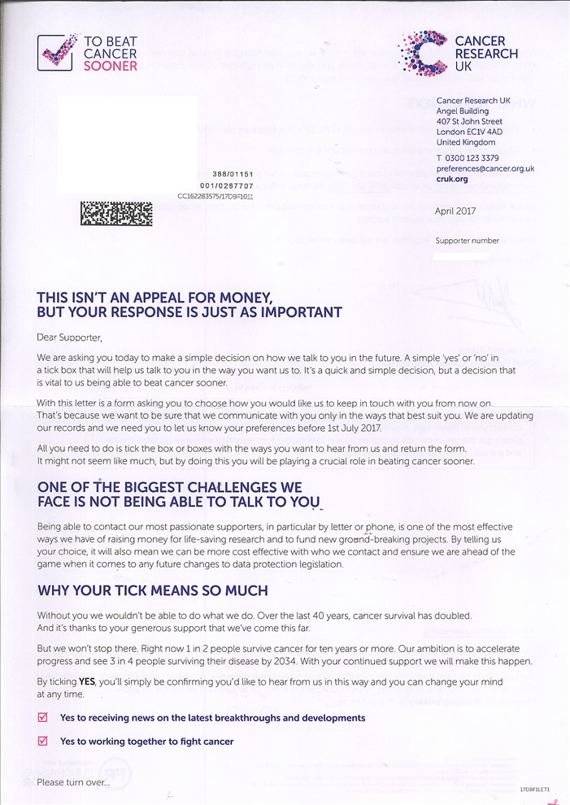
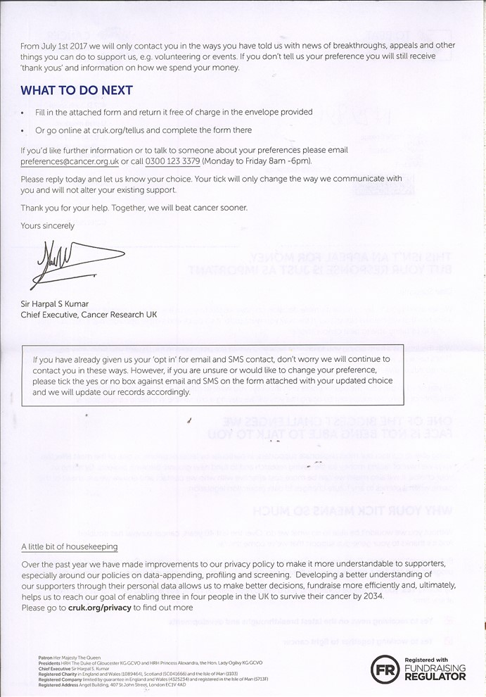
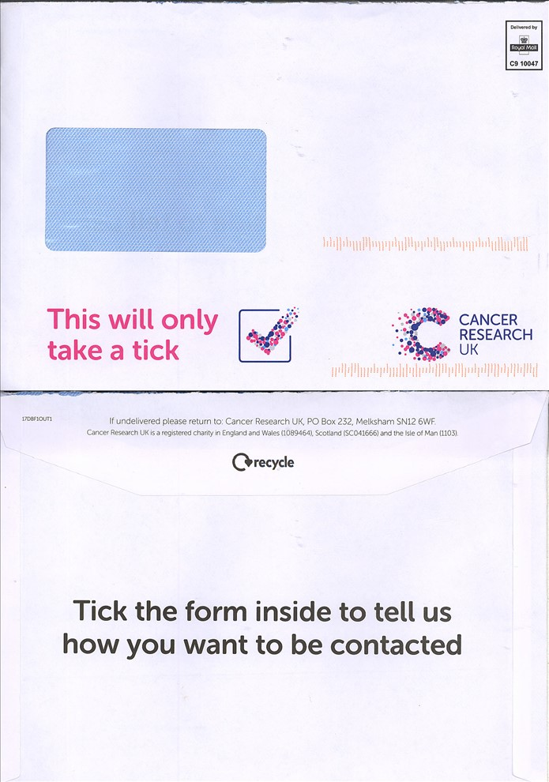
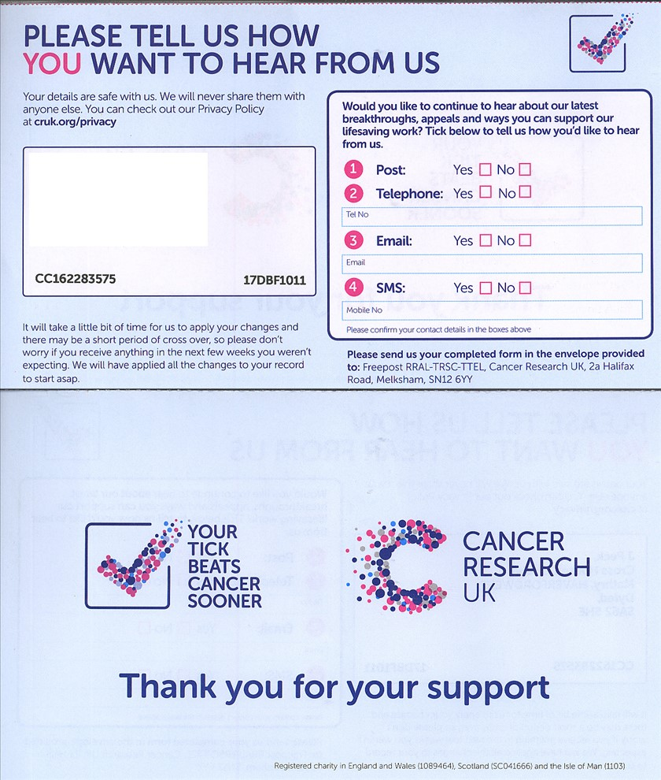
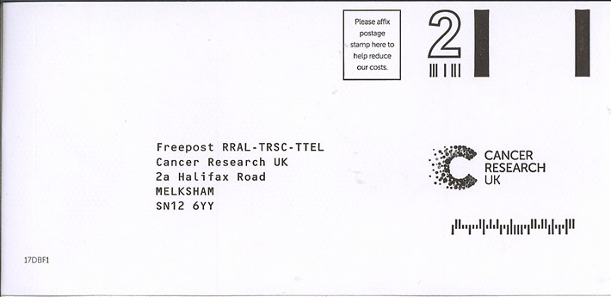
CANCER RESEARCH UK
This isn’t an appeal for money, but your response is just as important

Slide 34
MIND
Notes:
Not all legal text needs to be dry. There are creative and engaging ways – this example is one of Royal Mails chosen charities – MIND.

Slide 35
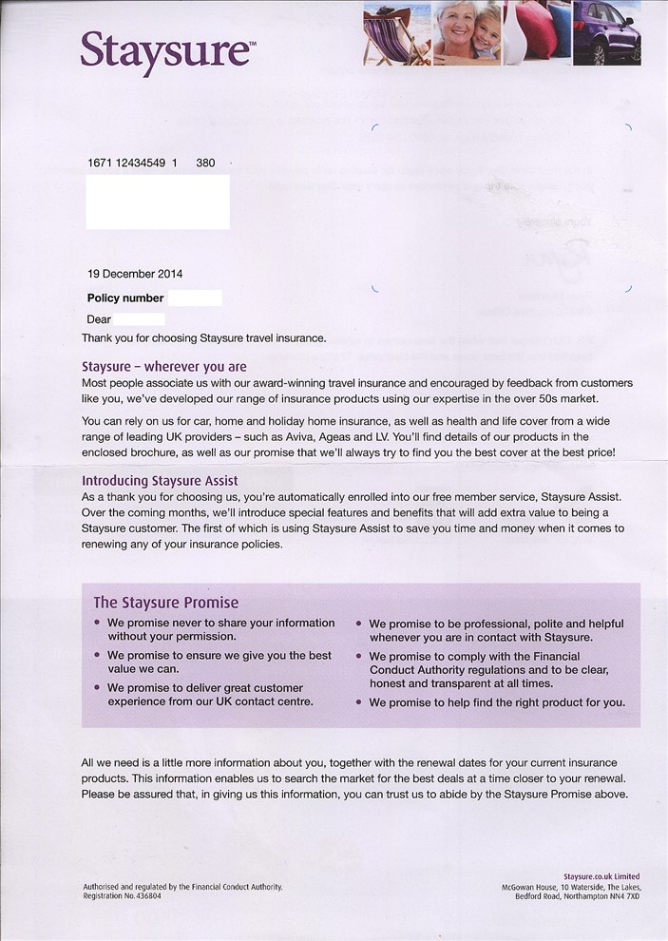
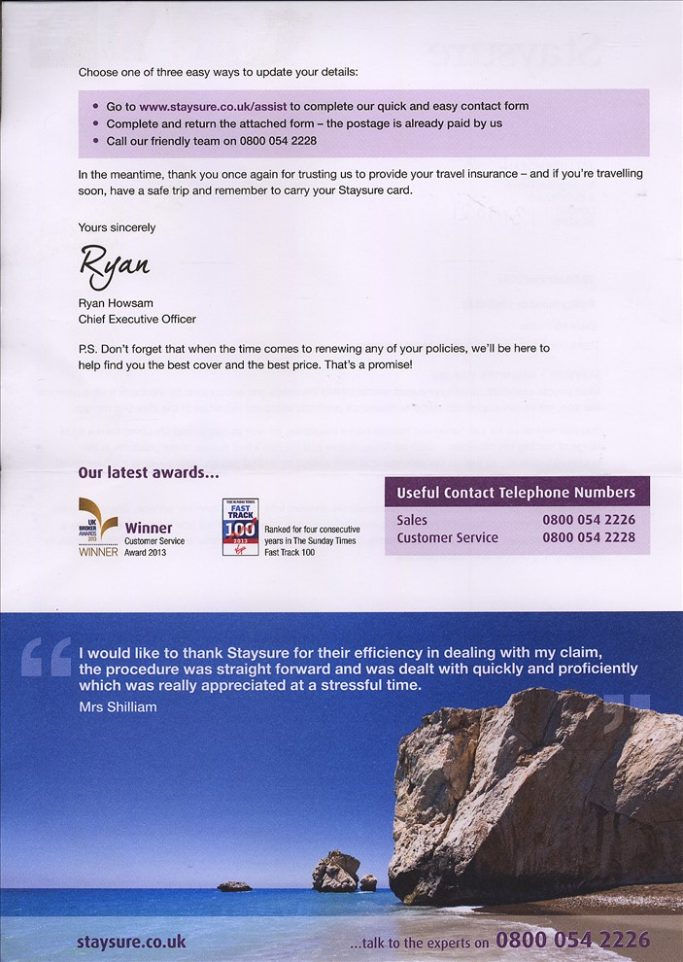
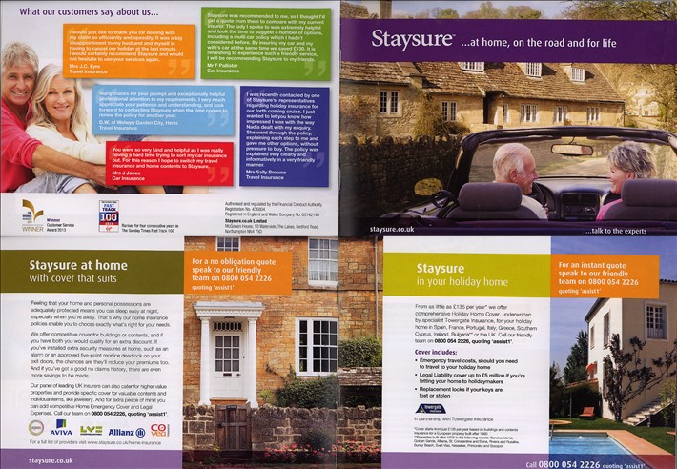
STAYSURE.CO.UK
All we need is a little more information about you….

