Slide 1
Introducing a new access service for publishers - Magazine Subscriptions
June 2018

Slide 2
Content
The Proposition
Publishing Market overview
Our discussions with customers
The service - magazine subscription service
Qualification process
Key Dates

Slide 3
The proposition
We are pleased to announce the launch of a new magazine subscription service exclusive to magazine publishers from January 2019
The over-riding aim of the service is to enable publishers to grow your number of subscribers and launch more subscription based titles, particularly at a time when supermarkets are reducing shelf – space available to magazines
Making use of the latest barcoding technology, our high quality service allows publishers to get the magazines to subscribers before the magazine appears on the newsstands
This new cost effective service caters for high volume circulation as well as for niche and growing titles. It provides publishers with the price certainty they need to grow subscriptions
To demonstrate our long-term commitment to supporting the needs of publishers, we discussed how the market was changing and requirements with customers, and built in features to the new service which respond to the challenges facing the industry.
The new service :
  Provides competitive and stable pricing
  Takes advantage of Royal Mail’s investment in technology to provide data which ensures quality of service and a cost effective service
  Allows publishers to grow subscriptions
  Incentivises publishers to invest in new titles and grow their subscriber base
  Recognises the importance of editorial content in maintaining subscriber loyalty
  Will be aligned to industry standards for environmentally sustainable packaging

Slide 4







Publishing: The market for magazine distribution
Whilst the overall volume of print magazines is declining, subscriptions have grown share versus newsstands and high street sales.
Publishers are grappling with digital, The digital world is impacting on advertising revenue as circulations dip. Free content online is impacting propensity to pay for content.
Publishers are looking at new revenue streams beyond print. Some are entering e-commerce and stretching the brand to grow revenue per customer.
Market Segments
Customer Issues
Consumer: Total market cC870m copies declining at c10% , of which 24% sold on subscription.300 titles launches 2017. Print still provides strong margin for publishers.
Print v Digital
When digital versions first emerged, the expectation was that print would fall quicker. In some segments this has not happed as expected
High Street (Newsstand) v Subscription
Publishers attract subscribers with discounted pricing in exchange for commitment to every edition. Still a strong desire to grow subscriptions. Supermarkets are reducing shelf space.
Cover Price v Advertising Revenue
A trade off between revenue streams. Circulation attracts advertising.
Core Business v Diversification
Shifting mindset from ‘Readers’ to ‘Customers’
Business: as above but with many copies being sent to the recipient free of charge to optimise ad revenues. Strong impact of digital.
Membership: Consumer and professional – as part of membership to an association a magazine may be part of the benefits
Customer \ Brand – where the brand owner is using the magazine as part of its overall marketing mix.

Slide 5
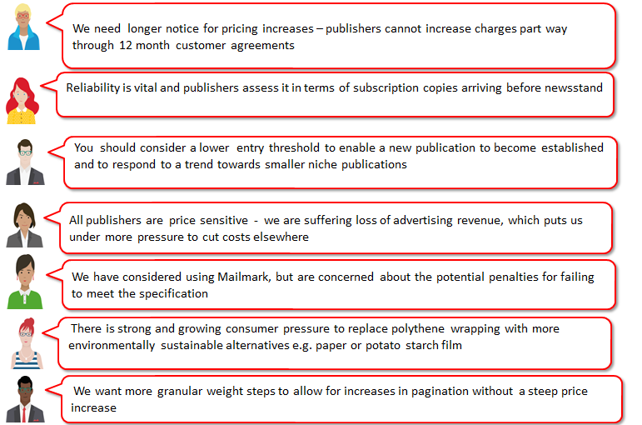
Customer views – a summary of our discussions

Slide 6
Magazine Subscription service – listening to customers
Format: Large Letter only | Simpler service with only one format. Publications are typically Large Letter format. If a publisher needs to send a one off edition as a parcel they can use Business Mail.
30% editorial content | This requirements provides for a good mix of advertising content and editorial.
Sortation: 70 way | Low sortation level enables publishers and their producers to achieve economies of scale in production, critical given the low margins and cost pressure they are under.
Machineability: Mailmark only | Publishers told us that quality of service is fundamental - subscriptions need to arrive before the items are displayed in the newsstands. With barcoding, publishers can see the performance of their mailing and work with suppliers to improve performance, whilst using our lowest priced service.
Container: Tray and bag | Carriers and producers need a choice of container type.
Price plans: NPP1, APP2, Regional and Zonal | Publication titles have specific audiences with different geographic delivery profiles (eg the Horse and Hound has a different audience from The Economist). Price plans need to cater for all posting profiles.
2k entry + >10 items per container | Publishers asked for a lower entry level to cater for their smaller titles, and, unlike other mail streams it is not practical to consolidate posting and this would mean delaying some titles, risking delaying delivery beyond the date it is available on newsstand .
1k entry for 1st year for new launches | Publishers asked for lower entry level to support new launches where the take up of subscriptions can be slow and they need the time to grow them.
Vol. commit incentive | Incentive already available uniquely to publishers
Price certainty - 12 month notice of price change | Publishers typically sell subscriptions on an annual basis and unforeseen changes to postage cost impact on the profitability of that subscription. To help publishers have greater confidence in subscriptions we will provide 12 months’ notice of any price change affecting this new service only.
Granular weight steps (101-250g LL) | Publishers asked for the flexibility to add pagination (additional advertising) or inserts without incurring steep price increase. We will consider this for future development.
Environmentally friendly solution | The industry is innovating to respond to the readers’ concerns around the use of plastic. We are working with the PPA Sustainability Action Group and SMP to shape an appropriate response and our spec will evolve

Slide 7
Qualifying for the Magazine Subscription service
From October 1st, contract holders can submit titles to DSACC to ensure they meet the entry requirements for the service
The updated Access User Guide, Contract Schedule and Application Form for the new service has all the details requirements
Customers can find all the documents at www.royalmailwholesale.com
To qualify for the service, the publication must:
  Contain at least 30% editorial content, not including advertising material. The front and back covers are not included in calculating editorial content;
  The front cover of each publication must bear its title and date, month or season of publication; and
  The title must be posted on a regular basis, at least twice a year.

Slide 8
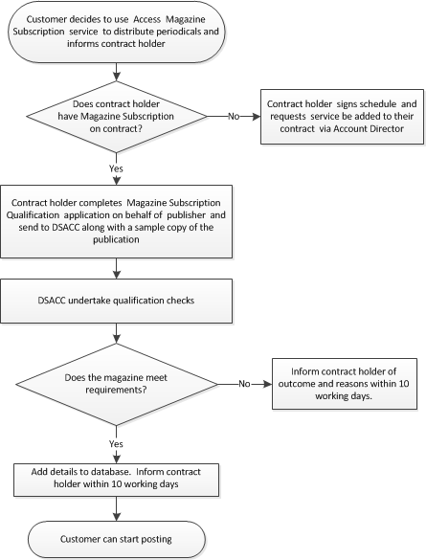
Magazine Subscription service – Qualification

Slide 9
Key Dates
25 June | Customer notification, publication of user guide update and contract schedule
1 October | Contract holders can submit applications to use the new service
October | Royal Mail publishes prices
2 January 2019 | Access Magazine Subscription service goes live

Slide 10
Using Mailmark to post Magazine Subscription Mail
PROCESS 1
Does the publisher have a Mailmark participant ID?
Publisher registers their contact details on royalmail.com and requests to be set up as a Mailmark participant.
ONE OFF PROCESS
Mail producer or mail provider sets up a Supply Chain ID with the publisher set as the “Mail Originator” (SCID).
Each time a participant in the supply chain changes, a new SCID will need to be set up.
Publisher
PROCESS 2
Has the Publisher or Access provider registered the Magazine title with Royal Mail?
Register each magazine title with us by completing the application form on the Website [insert link]; and
Send a sample of the magazine with the form to:
RM Sample (Magazine Subscription Mail)
Royal Mail Wholesale [immediately followed by the relevant Mailmark SCID number],
2nd Floor
206 Whitechapel Road
London
E1 1AA
Register magazine
PROCESS 3
Has the Campaign Name field been populated?
For each posting, mail producer or mail provider to denote the full name of the magazine in “Campaign Name” field.
If you upload by “batch” to the eManifest, you must not mix different titles within a batch.
E-MANIFEST
E-MANIFEST
E-MANIFEST

