Slide 1
Public
ROYAL MAIL
Mailmark Reporting is changing
8 October 2020

Slide 2
Mailmark Reporting is changing from 10th December 2020
Public
Why is Mailmark Reporting changing?
Royal Mail has a timing opportunity:
  The Mailmark Direct Data trial has developed a data set that represents a good baseline
  RM’s is moving it’s Mailmark Data warehouse to the cloud
  Mailmark’s older technology is not Cloud compatible without investment and change
  The retirement of the Adobe Flash Player requires a full rebuild of existing reports to achieve a like for like capability – and our IT suppliers have said that there is no guarantee that some of the existing limitations can be resolved
Fixing the current challenges with Mailmark Reporting does not therefore provide a cost effective path when enhanced reporting is being tested through MDD. Migrating the existing reporting platform would not resolve:
  Access to Mailmark Reports – difficult to access all SCIDs
  Functionality – speed of response etc
  CSV data – now not the best way of accessing data
What is Mailmark Reporting changing to?
There will be two levels of Mailmark Reporting functionality:
PDF Reporting: accessed daily via the current eBusiness portal
Mailmark Direct Data: accessed daily via a data transfer system (SFTP based technology)

Slide 3
PDF Reporting
Public
What is it?
A series of PDFs presented through the Royal Mail eBusiness portal in the same way as current Mailmark Reporting. These PDF’s provide summary information on:
  Predicted delivery
  Volumes
  Mailing performance
This reporting is ideal for customers with light to medium use of Mailmark information who are interested in:
  The performance of their important mailings
  Want to monitor their mailings but do not require item level detail
What are the benefits?
Simple to use Mailmark Reporting refreshed daily
Reports use familiar Mailmark metrics and presentational style
Accessed via Royal Mail’s eBusiness portal in the same way as Mailmark Reporting is currently accessed
Limited if any staff training required if current Mailmark Reporting is used

Slide 4
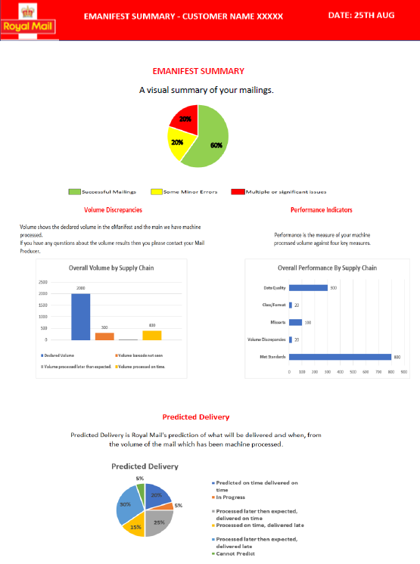
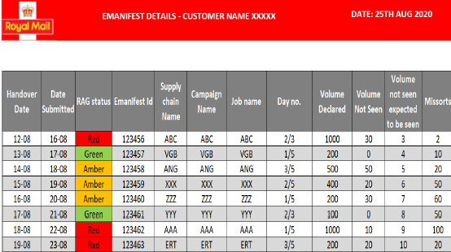
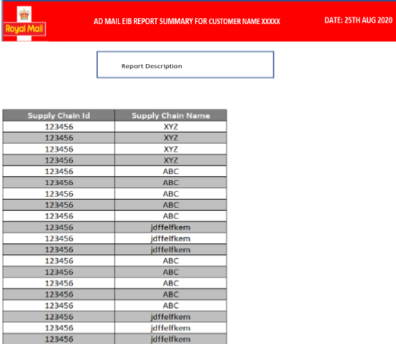
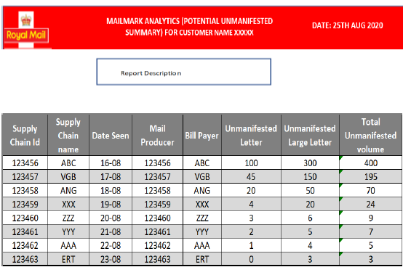
Simple PDF Reporting – Example daily report
- Ideal for customers with light to medium use of Mailmark information
Public
Summary level report
High-level performance report
Gives a quick overview of how all your eManifests are performing
Shows a breakdown of eManifests and how they are performing
Provides a summary of how many items have been seen, not seen and not expected to be seen
Details the performance of your mailings (Data quality, class/format, missorts, volume discrepancies, met standards)
Unmanifested report
Predicts when your mailings are going to be delivered
Shows the Supply Chains that have items which are unmanifested

Slide 5
Mailmark Direct Data
- Ideal for customers who want to integrate Mailmark Data into their systems
Public
What is it?
An item level data set with fixed fields detailing key information on mail items.
  Unlike current Mailmark Reporting the data set includes all ‘Active’ mailed items
This information can be blended with other information held by the customer and used to:
  Enhance existing Customer Relationship Management systems
  Trigger additional customer action including programmatic mail and e-channels
  More efficiently manage the mail supply chain
  Measure the performance of important customer communications
  Integrate mail into multi channel customer communications strategy
What are the benefits?
    Automated access via new automated Secure File Transfer Protocol (SFTP) system
    System to system data transfer, enabling
    Automated blending of the data set (or parts of) it with other systems for subsequent action by customer teams
    Increased amount of item level data to analyse

Slide 6
Mailmark Direct Data – Example Data Set
- Ideal for customers who want to integrate Mailmark Data into their systems
Public
Summary level data set
Item level data set

Slide 7
Mailmark Direct Data – Next Steps
Public
Training
    Royal Mail is developing:
      Detailed Reporting documentation
      On-line webinar training packages for customers and their supplier teams
    Provision of technical specifications to assist in solution development
Adoption
    Royal Mail is working with industry groups such as; Wholesale Access Group and Strategic Mailing Partnership to:
      Communicate the changes
      Gather industry feedback
    Customers who want to be part of the User Testing will have earlier access to the Beta systems from late November 2020.

Slide 8
Next Steps - Plan
Public
Timeline for change
w/c 9th November – Technical Guide available
w/c 20th November – User Guides available
w/c 25th November to 4th December – User Acceptance testing
10th December – Start of customer roll out
Feedback from users welcome throughout
Next steps
Talk to your Royal Mail Account manager about;
Receiving the new reporting documentation and Direct Data specifications
Being added to the PDF reporting solution
Adopting the new Direct Data solution
Arranging a web-based training session

Slide 9

This document contains Network Access information and is intended only for review by the EBB Portfolio team and must not be used for any other purpose. If you are not the intended recipient you should return this paper to John Kitchen – Commercial Programme Manager

