Slide 1
Using mail to build loyalty in general insurance
April 2020
YOUR LOGO GOES HERE

Slide 2

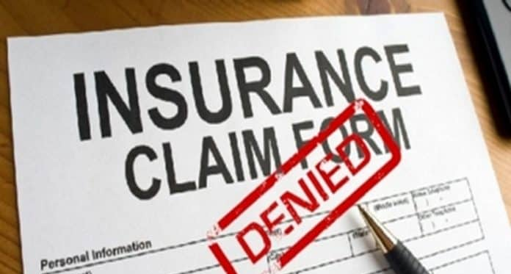
Customers believe they deserve…
Customers don’t feel that they are being rewarded for their loyalty: 43%¹ of consumers perceive the General Insurance sector to be particularly bad at rewarding loyalty with only 9% perceiving the sector to be good
Customers don’t trust their insurer to pay out if they make a claim: 54%² of adults aged 18+ think that insurance companies will always try to get out of paying a claim and this is even higher amongst the younger age groups with 60% of under 45s agreeing
Sources: 1. Mintel: Relationship Building Research 2016. 2. Mintel: Consumer and General Insurance UK, Dec 2019.
Notes:
Loyal customers represent the greatest value to any brand. However only 30% claim to feel loyal towards their insurance provider with only 19% say they feel valued. (Mintel Home Insurance 2017).
The so called loyalty penalty has become a big issue for the insurance sector following a complaint by Citizens advice and subsequent investigations in to the market by the FCA due to providers offering price deals for new customers and penalising existing customers through higher premiums. There seemed to be no reward for being a loyal customer. 71% think insurers should focus more on rewarding loyalty than offering discounts for new customers*. (*Mintel: Consumer & General Insurance UK December 2019)
Quote: Christopher Woolard Executive Director for strategy at the FCA “While a large number of people shop around, many loyal customers are not getting a good deal, we believe this affects around 6m consumers.”
Some companies are now offering beneficial and fairer pricing:
Saga who have introduced a three year fixed price policy for home and motor insurance targeting the over 50s.
Aviva has launched AvivaPlus, a subscription service that allows customers to pay monthly at no extra cost and guarantees that when their renewal comes round, they wont pay more than new customers.
Direct Line has launched a new InsurTech brand, Darwin Insurance, using cloud technology to offer targeted pricing for policies that is designed specifically to appeal to price savvy insurance buyers who usually buy through a price comparison site. Its systems allow the provision of quotes that are truly personalized, enhancing the customer experience.

Slide 3
CUSTOMER Loyalty is a key battleground
INEVITABLY loyal customers create great value for your brand
ACQUISITION
VALUE
REPEAT BUSINESS
RETENTION
Price is a top priority for 37% of customers & price sensitive customers have a defection rate of 2.6 times that of other customers.¹
Around 6m motor and home insurance policyholders are paying as much as £1.2bn more than they need due to “loyalty penality”.²
Loyalty higher among consumers who value “peace of mind” over and above price alone.³
64% of consumers used a comparison site at renewal and 50% of general insurance policy holders have switched providers in the past year.⁴
Acquiring a new customer is anywhere from 5 to 25 times more expensive than retaining an existing one
Sources: 1. Bain & Company: Customer Behaviour and Loyalty in Insurance 2016. 2. FCA, Oct 2019. 3. Bain & Company: Admiral Insurance insured more than 3m cars through family multi-policy in 2005 alone.
4. Mintel: Consumer and General Insurance UK, Dec 2019.
Notes:
Price is a top priority for 37% of insurance policy holders whilst 61% put it in the top three. (Mintel: Consumer & General Insurance UK December 2019).
Price Guarantees: Price guarantees are most likely to improve retention. Brands that make longer term price promises will not only benefit from increased perceptions of trust / transparency but should also have a greater chance of improving customer retention levels. Over half (56%) of policyholders say they would be more likely to renew with an insurer if offered a price fix guarantee (e.g. for 2 years). (Source: Mintel Consumers and General Insurance 2017).
Price comparison websites are a first port of call for most consumers with 60% of people having used a price comparison website in the last 12 months to search for insurance and 32% visited a competitors website for a quote. Car insurance is the most commonly sought product (44%) followed by home insurance (41%). Conversion rates from researching to purchasing products through a PCW are highest for insurance. (Mintel: Consumer & General Insurance UK December 2019)
Depending on which study you believe, and what industry you’re in, acquiring a new customer is anywhere from five to 25 times more expensive than retaining an existing one. It makes sense: you don’t have to spend time and resources going out and finding a new client — you just have to keep the one you have happy. If you’re not convinced that retaining customers is so valuable, consider research done by Frederick Reichheld of Bain & Company (the inventor of the net promoter score) that shows increasing customer retention rates by 5% increases profits by 25% to 95%.
Customer loyalty leads to profits. Increasing customer retention by just 5 percent boosts profits by 25 to 95 percent, according to the advisory firm Bain & Co.
Consumers are most interested in being rewarded for their loyalty:
When asked “Which of the following extras would you most like an insurance provider to offer? Please rank up to 3 with 1 being the extra you would most prefer.”
Consumers answered: Specific rewards for continuous renewal 54%. Introductory offers 37%. Ongoing rewards redeemable at retail / leisure outlets 35%
(Source Mintel Lightspeed Base: 1,951 internet users aged 18+ Consumers and Insurance Innovation - UK - December 2018)

Slide 4

A personalised customer approach, fairly new in insurance
Technology is rapidly reshaping how insurance is delivered and consumers relationships with insurers
Customers are open to hear from insurers about added value services such as car check ups and security and these additional benefits allow the insurers to engage with consumers at a deeper and more frequent level during the policy life¹
The companies that are getting it right have lowered acquisition costs, increased customer satisfaction and gained a corresponding competitive advantage²
Sources: 1. Bain and Company: Customer Behaviour and Loyalty in Insurance. Global edition 2017. 2. PwC Top issues: an annual report 2019.
Notes:
Personalised and fair insurance is perhaps still a pretty new concept.
Customers now increasingly expect that insurers will know something about them at the first point of contact – before they had to fill out a fifty question application – and be able to quickly suggest a variety of products and services that improve their quality of life. Insurers are making investments in data analytics to gain better insights into all aspects of their business and the market. The companies that are getting it right have lowered acquisition costs, increased customer satisfaction and gained a corresponding competitive advantage (PwC Top Issues: an annual report 2019). In addition…..The Open Finance Initiative…
Open FINANCE Initiative: If the FCA decides to extend the implementation of the Open Finance initiative and allow consumers to access and share their data with third party providers who can use that data to develop more personalised products and services, this presents an opportunity for those more innovative Brands when armed with more data about their customers enable them to provide even more personalised and flexible products that are more suited to their customers changing needs and circumstances throughout a policy’s life and at renewal and may help differentiate the Brand from swathes of others.
This presents an opportunity for a more individual and customer focused approach and for insurers to present a solution that is tailored to the individual needs, offering more than a ‘commoditised’ service. Concentrate on specific segments, offering more than just a single product, enabling providers to differentiate thier offering. Customers are ready and willing to hear from their insurers about services that reach beyond core insurance. Products attached to their policies such as security, car check ups and more to increase ‘touch’ and ensure brands aren’t speaking to their customers ONLY once a year. Customers place importance on personalised services. (Bain & Company: Customer Behaviour and Loyalty in Insurance: Global edition 2017).

Slide 5
MAIL IS still THE 2ND most invested in CHANNEL IN THE INSURANCE INDUSTRY
579
MAIL PRESENTS AN OPPORTUNITY TO DELIVER HIGHLY PERSONALISED MESSAGES
83
(14%)
Source: Nielsen Ad Intel/Mintel Sept 2019.
Notes:
TV accounted for half of all above-the-line online display and direct mail advertising on general insurance in the year to 30 September 2019. The amount allocated to TV has increased over the past two years from 41% in the year to 30 September 2017. A number of brands have opted to shift their advertising focus away from specific products and towards more general brand building techniques, in an attempt to achieve greater cut through in a crowded marketplace.
However, in contrast to TV, some of the other channels are better at targeting specific groups with home insurance evenly split between TV and direct mail, while 48% of spending on home emergency cover came through direct mail channels compared to 31% on TV. This shows how it can be easier to target homeowners in particular through direct mail channels.
Under 35s find it particularly difficult to know what insurance policy is right for them – they are at a stage of their life where their needs are more likely to be in flux. They could be buying their first home, having children or getting married, whilst those who are living in rented accommodation are likely to move home more frequently. The expectations of this age group around speed and flexibility have been formed by their experience of other sectors like retail or the media. Mail presents the opportunity to deliver highly personalised policy messages to distinct groups of customers or prospects when they need it. The greater sharing and provision of data will allow this to happen.

Slide 6








A MORE PERSONALISED CUSTOMER JOURNEY
It has relevance at all points of the customer journey
SEASONALITY
Identify gap in policy holding. Opportunity to sell additional cover e.g. winter sports or summer holiday, etc
RENEWAL
Provide quote with discount for loyalty.
Use opportunity to reduce churn and / or win back
POLICY / WELCOME DOCUMENTS
Welcome/policy documents score highly for quality and recognition¹
CLAIM
As part of making it a good claims process for customers
TERMS & CONDITIONS CHANGES
Clear & transparent to avoid disappointment with a claim. Use opportunity to sell in benefits of changes. Opportunity to cross / up sell
REWARDS
Rewards redeemable at retail or leisure outlets. Money off next product take up or at renewal
ACQUISITION / CONSIDERATION
Using mail to drive acquisition and consideration
RETENTION / CROSS SELL / UP SELL
Additional products: travel, home contents, buildings, car, gadget, phone, other
¹Mail and Other Media, Kantar TNS,2017.
Notes:
Most consumers have little or no dealing with their insurer’s customer service team and/or the claims department during the course of their annual policy, giving insurer’s little opportunity to engage with or impress their customer base.
Whilst longer term price promises/guarantees will help insurers to extend customer lifecycles, insurers need to establish more regular touchpoints and a better customer experience with consumers who may even have more interaction with price comparison websites than they do with their eventual policy providers.
There are potential touchpoints where a customer may engage with the brand – allowing ongoing communication to engage with the customer and to establish the brand. Such a communication strategy may differentiate the brand from the competition in a market where there is little or no engagement.
More customer data may allow cross and upsell of products during the policy lifetime - multiple holdings may further tie the customer in at renewal time.
More customer data will also help build a picture of customers life stages providing further opportunities to present innovative new products at a particular time such as when the customer is buying their first home, having children or getting married.
Seasonality may also provide important opportunities for insurers armed with customer data where insurers could offer summer or winter holiday single or family travel cover or car cover for example depending on the customers lifestyle or family circumstances. A knowledge of a customers sport activities may also allow additional sales opportunities.
The provision of rewards such as money off may engender loyalty at renewal time and can be communicated during the policy lifetime rather than just at renewal when perhaps the customer is looking around for a better deal.
There are now companies such as Gobsmack (https://gobsmack.co.uk/) which have launched a market leading reward and loyalty platform for clients including MORE TH>N and Admiral Insurance. Helping to combat the increasing dominance of the PCWs.
Even the communication of changes in Terms and Conditions plays an important role in customer experience. Only 57% of insured people say they read the detailed T&Cs. Lack of engagement is the key reason. Shorter T&Cs with less jargon would improve customer engagement and it is in the best interests for insurers that customers understand their T&Cs to avoid disappointment when a claim is made. Disappointment with a claim erodes trust and impacts customer satisfaction. An insurer that manages to come up with a simplified solution will definitely stands out from the crowd. .
Several leading insurers have made customer service/experience a strategic priority, as they look to reduce high levels of customer churn. Many, such as Admiral, have pointed out that a positive claims experience results in higher levels of customer retention (95% of Admiral’s customers having renewed following a claim).

Slide 7

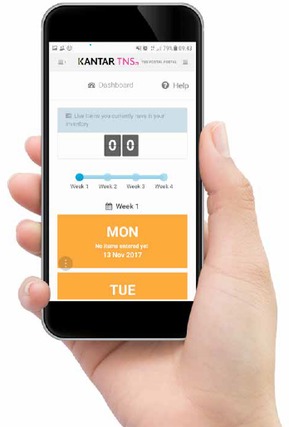
A SOURCE OF GOLD STANDARD DATA
Jicmail data comprehensively gathers all mail activity
Mail is collected in the first week and recorded, then that week’s mail is tracked over 28 days
People record what they do with their mail physically and commercially
They tell us the type of mail, i.e. is it addressed or unaddressed or business mail.
Opened it
Read / looked at / glanced at it
Put it on display e.g. fridge / noticeboard
Passed it on / left out for the person it’s for
Put it aside to look at later
Threw it away / recycled
Took it out of the house e.g. to work
Used / did something with the information
Put it in the usual place
They capture what business sector the mailing or door drop comes from.
They record the contents; is it information, financial statement. You can tick all that apply here.
Notes:
JICMAIL launched in January 2018. It is the Joint Industry Committee for Mail, supported by the buy and sell side of the industry
Data is collected by a consumer panel of 1000 households monthly.
Consumers collect all their mail packs received in the first seven days – categorise them and take a picture. We categorise the mail between advertising mail, business mail, partially addressed and door drop.
Once they have logged all their mail pieces they are then asked to track that mail for a full twenty-eight day period.
Not only do they record what they do with the mail physically i.e. open it, read it, put it aside for later and so on. They also then capture what they do with the mail as a result of getting it, this is things like going online, calling the sender, checking their account details and so on.
Whilst JICMAIL is designed to predominantly support the advertising industry and provide metrics for mail that can be bought and planned in the same way as other channels like TV, radio and digital we also capture what we call “business mail” or what might have been known as transactional mail, things like bills and statements, account updates and notifications and reminders. This data gives a rich insight into how consumers interact with these items of mail which generally are not measured by brands sending them.

Slide 8
MOST GI MAIL IS FIRST DEALT WITH BY A WOMAN
71% of gi mail is dealt with the hhc first and 71% of them are women
56% of all physical actions are undertaken by the HHC
They also undertake 67% of all commercial interactions
Source: JICMAIL Q3 2018 – Q2 2019. Sample: General Insurance 579
Notes:
In the JICMAIL study there is a self-appointed Household Co-ordinator. HHC’s are the person in the household who generally take responsibility for sorting the mail and passing it on to other members of the household.
The majority of household co-ordinators are also women. So you might want to think about this in your communications.

Slide 9
Business & Ad mail drive highest interactions
Business mail and items that are both business and advertising mail drive higher RE-VISITS
831
116
(14%)
Source: JICMAIL Q3 2018 – Q2 2019, Sample: General Insurance 828.
Notes:
The JICMAIL data also allows us to look at reach, i.e. the number of people who see the mail piece and frequency; the number of times it is returned to. So for every 100 mail packs that are being sent just over one person (1.16 for Advertising Mail) will see the mail and interact with it in some way.
Frequency is the number of physical interactions each person has with their mail. The average frequency for all mail is 4.3, so you can see for Business Mail for example, it is read 4.48 times so performs slightly higher than this average.
General Insurance mail is revisited. Business Mail and mail that is recorded as both Business and Advertising Mail are re-read more than the average mail items (4.3 times) with Business Mail being re-read 4.48 times and Business Mail and Advertising Mail being revisited 4.79 times

Slide 10
Mail content drives different frequency
GENERAL INSURANCE MAIL PERFORMS ABOVE AVERAGE FOR MOST CONTENTS
AVERAGE FREQUENCY ALL SECTORS = 4.3
n=391
n=222
n=209
Source: JICMAIL Q3 2018 – Q2 2019, Sample: General Insurance 828.
Notes:
And what’s more, following on from the previous chart it is important to note that some General Insurance mail is also revisited more times than the average for all mail when GI mail contains different types of information such as 1. financial statement/bill/update (26% of GI mail contains statement/bill/update information) which is revisited 4.7 times or 2. Administrative information (25% of GI mail contains administrative information) which is revisited 4.8 times.

Slide 11
physical actions
High opening rates (80%), reading and filing also high
Filing across all business sectors is just 19%¹.
But for all financial services mail items filing is 39%¹.
Source: JICMAIL Q3 2018 – Q2 2019, Sample: General Insurance 828.
¹Source: JICMAIL Q2 2017 – Q1 2019, Addressed and Business Mail. Sample: All sectors: 72595 Financial Services: 24,267.
Notes:
Physical actions are what the recipient actually does with the mail when they receive it, have it in their hand, such as opening it, reading or glancing at it or doing something with the information after reading it.
General insurance mail has high opening rates of 80% with 70% of it being read, so it is perceived as being important. GI mail is mostly opened by the household coordinator and 71% of HHCs are female.
37% of GI mail is then filed for future reference which is just a little lower than the average for all financial service items 39%.

Slide 12
COMMERCIAL ACTIONS
Gi MAIL DRIVES DISCUSSION BUT ISN’T MOTIVATING much OTHER ENGAGEMENT
OF PEOPLE RECEIVING
FS MAIL DO SOMETHING COMMERCIAL
Commercial actions with General Insurance mail are not as high as other sectors, maybe not surprisingly because of the regularity of contact.
Source: JICMAIL Q3 2018 – Q2 2019, Sample: General Insurance 828
*Source: JICMAIL Q2 2017 – Q1 2019, Addressed and Business Mail. Sample: All sectors: 72595 Financial Services: 24,267
Notes:
28% of those receiving mail from financial services go on to take a commercial action. Of these actions and within the bigger insurers these are the types of actions they are taking. 24% of them have a discussion with someone else about the mail content.
10% of them visit the sender’s web site and 10% call the sender.
You don’t necessarily have to be physically handling the mailing pack when you do these things with the mailing.

Slide 13
65% of gi mail is dealt with in first 7 days
37% of GI mail is filed
But 68%¹ of all financial Services mail is still live in the home after 28 days, so it is retained and kept for future reference.
Source: JICMAIL Q3 2018 – Q2 2019, Sample: General Insurance 828
1. Source: JICMAIL Q2 2017 – Q1 2019, Addressed and Business Mail. Financial Services: 24,267.
Notes:
65% of General Insurance mail is looked at and dealt with quite quickly after it arrives, between 1 and 7 days. And it spends time in the home with 24% still live in the home from 15 days up to 28 days.
68% of financial services mail is retained and kept beyond 28 days over which the mail is tracked.

Slide 14
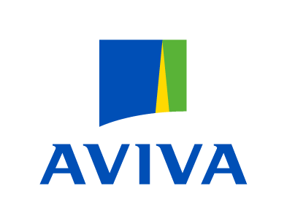












Exclusive invitation
Gets the other half involved in buying
JULY 2019
C2
MERIDIAN SOUTH
8
10
ITEM ARRIVES
FEMALE
45-54
HHC
22
REACH = 1
FREQUENCY = 8
COMMERCIAL ACTIONS = 4
Source: JICMAIL Examples Database Q2 2017 – Q4 2019
Notes:
This appointment mailing, recorded by a household no the JICMAIL panel arrived on the 21st August.
On the first day it arrived it was opened, put aside to look at later, read, discussed with the male of the household, was used to do something and was filed.
On the 23rd of August it was opened, read, put in the usual place, discussed again and put on display.
And then finally in the 3rd of September it as read twice, put in the usual place, opened, used it to do something with the information, looked up their account details, discussed with someone and taken out of the house.
That amounts to 2 people in the household being exposed to the message and physically interacting with it 15 times and 4 times doing something more than physical ie more commercial like discussing it, looking up account details, which JICMAIL log as commercial actions.

Slide 15
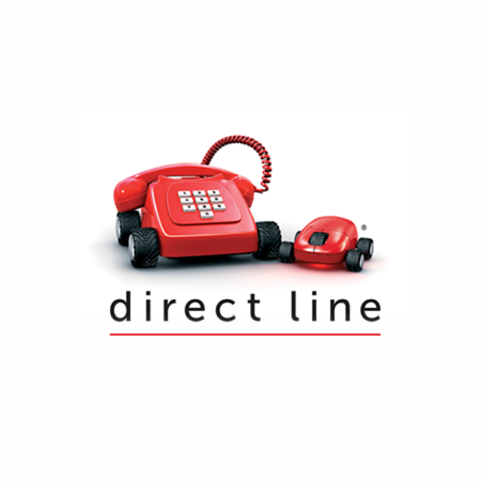



Exclusive invitation
Gets the other half involved in buying
C
MARCH 2019
DE
CENTRAL SCOTLAND
11
13
14
ITEM ARRIVES
FEMALE
55-64
HHC
MALE
55-64
REACH = 1
FREQUENCY = 10
COMMERCIAL ACTIONS = 12
Source: JICMAIL Examples Database Q2 2017 – Q4 2019
Notes:
This appointment mailing, recorded by a household no the JICMAIL panel arrived on the 21st August.
On the first day it arrived it was opened, put aside to look at later, read, discussed with the male of the household, was used to do something and was filed.
On the 23rd of August it was opened, read, put in the usual place, discussed again and put on display.
And then finally in the 3rd of September it as read twice, put in the usual place, opened, used it to do something with the information, looked up their account details, discussed with someone and taken out of the house.
That amounts to 2 people in the household being exposed to the message and physically interacting with it 15 times and 4 times doing something more than physical ie more commercial like discussing it, looking up account details, which JICMAIL log as commercial actions.

Slide 16
YOUR LOGO GOES HERE

