Slide 1
ROYAL MAIL ACQUISITION INCENTIVE
2025-2026
Introducing an incentive to trial new acquisition
February 2025

Slide 2














Advertising
LANDSCAPE
transformed
350K
TWEETS SENT
16.2M
TEXTS SENT
174K
APPS DOWN-LOADED
13.2K
ACTIVE ON SPOTIFY
2.1M
PEOPLE ACTIVE ON FACEBOOK
6.3M
GOOGLE SEARCHES
4K
PEOPLE READING YELP REVIEWS
66K
PHOTOS & VIDEO SHARED ON INSTAGRAM
66K
PHOTOS AND VIDEOS ON INSTAGRAM
EVERY
Minute
OF THE DAY
20.8K
ACTIVE USERS ON LINKEDIN
6M
SHOPPING ONLINE
115.7K
SEARCHES ON PINTREST
452K
HOURS OF CONTENT STREAMED
231M
EMAILS SENT
3.47M
YOUTUBE VIDEOS WATCHED
625M
VIDEOS WATCHED ON TIKTOK
3.5B
SNAPCHATS CREATED
44M
VIEWING FACEBOOK LIVE
Source: LocaliQ, 2023
Notes:
It's becoming harder for advertisers to see who they’re talking to, measure the reaction, and plan for the future

Slide 3




There are good reasons to use mail
Four of them…
INTERACTIVE
Tactile, touch creates an experience - the feel of the paper, weight, shape, texture, finish and visual appeal.
MEMORABLE
More personal than any other channel it is highly memorable and gets disproportionate attention.
BIG REACH
Not everyone uses every digital channel but everyone gets mail. Young people get less so when they do…
LESS COMPETITION
Digital is fighting to be seen, letterbox marketing much less crowded space – with just 3.5 letters a week.

Slide 4
What people want from brands
Which of the following types of communication do you like to receive from brands you don’t know?
THE TANGIBLE TOUCH OF DIRECT MAIL
51% of respondents say direct mail is an important way for brands to build relationships with them
52% of respondents say that receiving direct mail from a brand feels more important than receiving an email from a brand
Nearly half of respondents say the tangibility of direct mail makes it feel more special than an email or digital ad
Direct mail can be a great first step to building trust with consumers, and this brand awareness subsequently will make digital outreach more effective
Source: Lob, State of Direct Mail, 2024

Slide 5
Customer acquisition more challenging than ever
60%
67%
60%
The cost of acquiring new customers in the last few years
Marketers say that mail provides the best ROI above other channels
Of consumers say they get the right amount of mail only 46% say that’s true of email
Sources: Profitwell.com, Lob Guide to Acquisition, 2022, State of Mail Consumer Insights, 2024

Slide 6
Typical cold response rates
Will vary across different sectors, you can access the full data source at JICMAIL Discovery
Source: JICMAIL, Response Rate Tracker, 2024

Slide 7
TYPICAL LIFETIME VALUES
Take a look at your own data and the lifetime values to your different acquisition channels
Brands will typically see that whilst direct mail acquisition isn’t the cheapest route to acquiring a new customer lifetime value will almost certainly be greater than other channels
This is also true of door drop and partially addressed
And will perform at better lifetime value outcomes than more main stream broadcast channels
The channels that tend to be least “sticky” will be the ones where it is easiest to drop out of the relationship that a consumer might have signed up to, which is why F2F tends to yield lower LTV
COLD MAIL ACQUISITION
PARTIALLY ADDRESSED
DOOR DROP
LIFETIME VALUE
TV & RADIO
DIGITAL
F2F

Slide 8
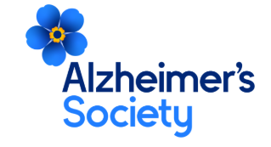

ALZHEIMER’S SOCIETY’S ‘FORGET ME NOT’ CAMPAIGN BROUGHT MEMORABLE RESULTS
Background
Alzheimer's Society wanted to optimise their multi-channel integrated campaign aimed at stimulating donations for their annual Forget Me Not Appeal from both new and existing donors.
Solution
Research showed that most supporters had a close connection to the cause – either from knowing/caring for someone living with dementia or knowing someone who had passed away with dementia This insight prompted Alzheimer’s Society to show the close relationships between people with dementia and their loved ones. This was captured in the core message 'Who will you wear your badge for?’.
The campaign ran across a diverse mix of channels including mail, door drop and Partially Addressed Mail. Creative synergy across all channels maximised the campaign’s impact.
Results
Alzheimer’s Society’s optimisation strategy led to the 2023 campaign being the most successful Forget Me Not Appeal yet.
Source: DMA Award Entry, Charity, 2023

Slide 9

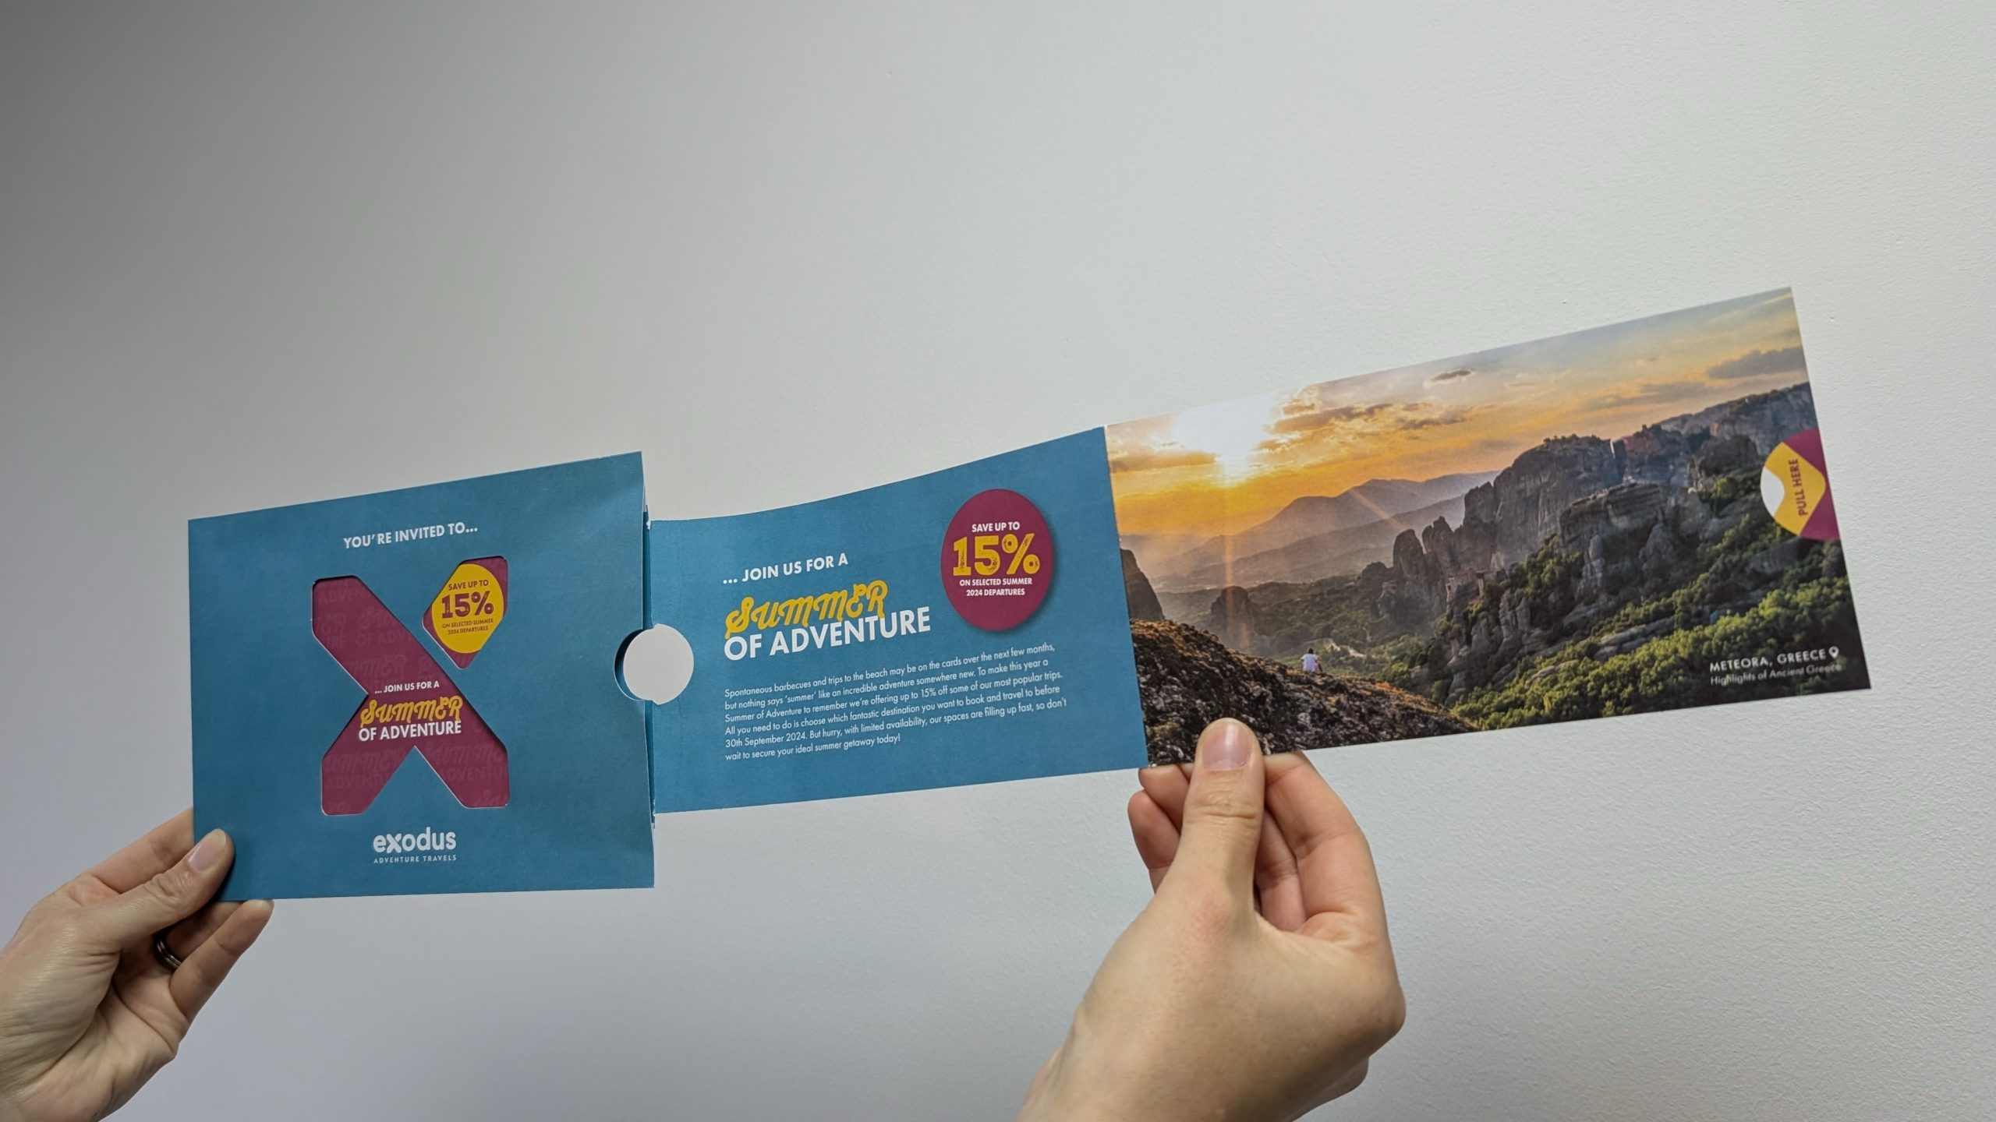
AN INNOVATIVE FORMAT DROVE LATE SUMMER BOOKINGS
Background
Exodus Travels launched their Summer of Adventure campaign in April 2024. They aimed to stand out in a competitive market and driving bookings by offering a 15% discount on bookings made and travelled before September 30th, 2024.
Solution
Partnering with Webmart, Exodus created a unique, interactive mailer. The design featured a die-cut logo and a sliding bangtail element revealing the special offer. Inside, a pull-out spread showcased trips and campaign details, with clear calls-to-action. The mailer was envelope-enclosed to qualify for Mailmark rates, saving over £15,000.
Data cleansing ensured only compliant data would be used, reducing wastage. JICMAIL insights guided the strategy. The campaign was made carbon-neutral through carbon-calculation and climate-positive postage.
Results
The campaign drove 25.7% of all late bookings in the 4 weeks following the mailing. It accounted for 22.85% of all revenue during that period, achieving an impressive +2,600% ROAS.

Slide 10


Catalogues bedded in new, high-quality customers
Background
Piglet In Bed needed to diversify beyond paid digital channels, which were offering limited growth potential, to continue its growth trajectory. They sought to expand its customer base through new channels.
Solution
Partnering with Epsilon, Piglet in Bed tested a catalogue for both new customer acquisition and deeper engagement with existing customers. Look-a-like modelling identified optimal prospects and mailing times.
Piglet In Bed embraced continuous testing and learning, conducting A/B testing across various areas in early campaigns (e.g. 90-day free returns policy, showcasing the hero product) to optimise campaign effectiveness and enhance customer lifetime value (LTV) as well as drive immediate web traffic.
The output was a high quality, ‘lifestyle’ catalogue that used higher quality paper stock (validated through testing).
Results
Early results showed a 25% higher average order value (AOV) and a 35% higher lifetime value (LTV) compared to digital channels over the first six months.
Source: www.epsilon.com

Slide 11
Some more compelling reasons…
Direct Mail is easier to understand and more memorable than digital media. It requires 21% less cognitive effort to process and elicits a much higher brand recall.
Direct mail is far more persuasive than digital media. Its motivation response is 20% higher – even more so if it appeals to more senses beyond touch.
Direct mail is visually processed quicker than digital media. When considered in concert with its higher motivation and lower cognitive load, this suggests it gets the message across faster.
Direct mail is more likely to drive behaviour than digital media. Surpassing the important motivation-to-cognitive load ratio threshold of 1.
Direct mail requires 21% less cognitive effort to process than digital media, says a study by market research firm True Impact. Therefore, it’s easier to understand and more memorable.
In 2021, only 11.9% of fundraising came from online donations, according to data in the most recent Blackbaud Institute Charitable Giving Report. This means that 88% of giving comes from offline sources – like mail.
Source: Mailing.com

Slide 12
Incentive details

Slide 13

Advertising mail
Test and Innovate Incentive for new Acquisition Mail
20%
WHO IS IT FOR?
CREDIT
TO QUALIFY
TO APPLY
For when you try new acquisition advertising mail activity.
A postage credit of up to 20% is available on eligible Advertising Mail.
The minimum volume is 4,000 items. The maximum test period is 6 months.
For more information and to apply go to www.royalmailwholesale.com
Full terms and conditions apply

Slide 14
Entry requirements
1
2
3
4
Test addressed Letter items sent using Advertising Mail.
Measure the performance of the test and share the results with us so we can understand whether the tests we invest in achieve their objectives.
To qualify, test mailings must include a minimum of 4k advertising mail items and a maximum of 500k items over a 6 month period.
Submit your application form 10 days before the start date of your test.

Slide 15
Offer dates
31 March
2025
14 March
2026
28 March
2026
Applications open
Last application
Last posting date

Slide 16
Postage credits
20%
Get postage credit of:
20% for the first 250k incremental advertising mail items; and
10% for the next 250k incremental items
Full terms and conditions apply

Slide 17



The APPLICATION AND CREDIT process
Offer open for postings mailed by 28th March 2026
Go to the application form here
GET IN TOUCH
Speak to your Account Manager to make sure you are applying for the best incentive for your needs and to check that you meet the requirements.
WE’LL GET IN TOUCH
To discuss your application and check all the detail with you.
APPLY FOR YOUR POSTAGE CREDIT
When you have completed your activity you will need to apply to Royal Mail for your credit
REDEEM YOUR
CREDIT
Receive your credit as a voucher or have it paid into a Royal Mail postage account. Credit vouchers are valid for 12 months.
APPLY ONLINE
Use the link to the online application. Your application can also be completed by an agent.
POST YOUR MAILINGS
Start posting your volume
Full terms and conditions apply

Slide 18
The more detail the better!
more information you can provide will help us process your application
Why are you testing?
What are the details of the test?
How are you measuring the results?
you tell us about the objectives and strategy for your new acquisition activity
Could you explain how this is something new to your marketing plan
Outline the strategic thinking on why you are including mail in your acquisition now
Are you returning to mail for acquisition after a break?
Who are you targeting and why?
What targeting strategy have you used e.g. profiling? existing customer base
What test cells are in your plan?
Are you testing different creative routes and if so why?
If you have a test matrix please do include it.
Please tell us the volumes you are testing
What are the main KPIs for this campaign – predicted response rate, sales, ROI
Is there anything else you want to achieve with the campaign? Drive to digital, push to store or other softer brand measures, for example?

Slide 19
Frequently asked questions
Can I use postcard formats?
Traditional postcards are not eligible, please see the Machinable Postcard and One Piece Mailer Guide for options to use with incentives at www.royalmailwholesale.com/incentives
What will happen if my actual TIS volume is less than 4,000 items?
You will not receive any postage credit if your actual TIS volume is less than 4,000 mailing items.
How long will my postage credit vouchers be valid for?
Postage credit vouchers are valid for 12 months from date of issue.
Full terms and conditions apply

Slide 20
THANK YOU

