Slide 1
MAILMARK CATALOGUE PRODUCT
May 2024

Slide 2
New Mailmark catalogue product
A Mailmark variant of the Advertising Mail Catalogue Service will be introduced from 1st July 2024
Price
Format
Weights
Large Letter
A new and lower price point if you choose to mail using the new Mailmark variant of the Advertising Mail Catalogue
Price is 0.4p lower
Letter and Large Letter formats are eligible
The new product has 10g price steps between 101-150g for Manual Letter and Large Letter formats
Maximum Mailmark Letter weight cap is 100g
Maximum Manual Letter weight cap is 150g and offers 10g price steps between 101g and 150g
Large Letter format has 10g price steps between 101-150g
It provides price steps between 151g-250g and 251g-750g weight bands

Slide 3
CATALOGUES GET NOTICED
Catalogues from all types of retailers enjoy high levels of engagement
CVCV
CVCV
98%
Engagement Rate
Source: JICMAIL, Mail Item Database, Catalogues, n=11,023

Slide 4
Key media metrics by catalogue type
Over two minutes spent with catalogues of all types
Catalogue sector | Frequency | Reach | Attention (minutes:seconds) | Commercial actions
Fashion | 4.08 | 1.14 | 2:8 | 23%
Home | 3.78 | 1.16 | 2:03 | 20%
Food & drink | 3.97 | 1.08 | 2:35 | 22%
Source: JICMAIL, Advertiser Attribution Database, Fashion n=2,213 Frequency/Reach n=359 Attention, Home n=1,004 Frequency/Reach n=130 Attention, Food & drink n=200 Frequency/Reach n=28 Attention

Slide 5
mailmark catalogue PRODUCT benefits
Ideal for retailers sending catalogues
Priced slightly below ad mail price
10g price steps to support customers to generate greater returns from their Catalogue mailings
Gives scope to increase pagination
Option to add additional inserts with small price increments
Potential to improve paper quality

Slide 6
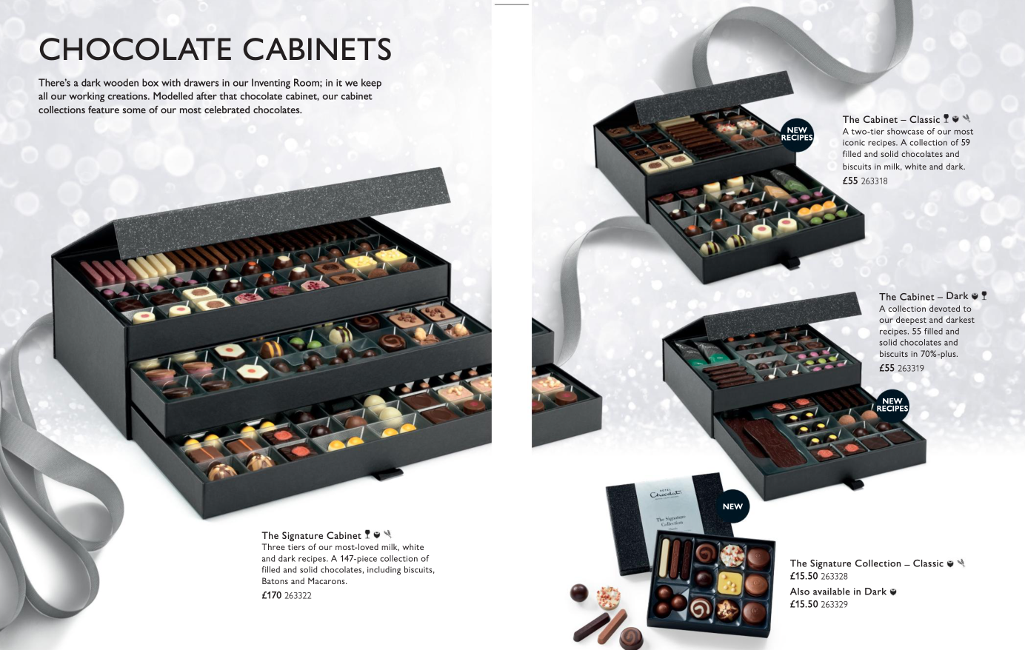
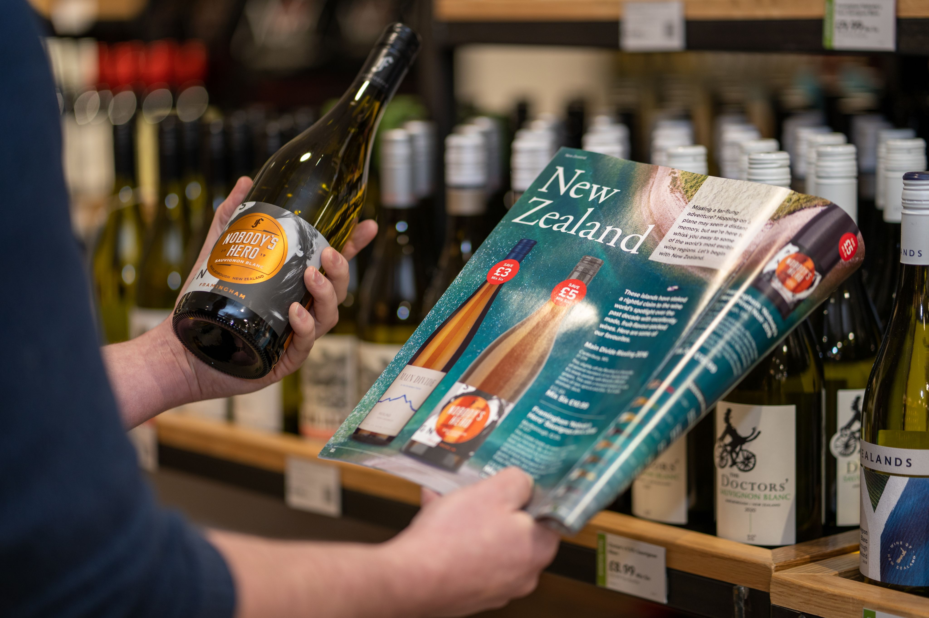
What catalogues are eligible?
Any retail offer or travel company sending product information can benefit using this new product at the improved price point
But the catalogue cannot contain a high proportion of editorial content and must be focused on selling product
Terms & Conditions explained:
The mailing primarily comprises a list of goods and/or services, together with a description, image and price;
The goods and/or services are sold directly from the page at the prices listed; and
The editorial and other content of the mailing is minimal.

Slide 7
Catalogue pricing
New pricing available from 1st July 2024
Prices shown in pence | 0-100g | 101-110g | 111-120g | 121-130g | 131-140g | 141-150g | 151-250g | 251-750g | 1g + 251g
Access Advertising Mail Mailmark™ Economy Letter | 21.061
Access Advertising Mail 70 Catalogue Mailmark™ Economy Letter | 20.684
Access Advertising Mail 70 Catalogue Mailmark™ Letter | 24.253
Access Advertising Mail 70 Catalogue Letter | 30.418 | 32.150 | 33.881 | 35.612 | 37.343 | 39.074
Access Advertising Mail 70 Catalogue Large Letter | 37.218 | 39.596 | 41.974 | 44.352 | 46.730 | 49.108 | 51.223 | 36.883 | 0.0956
Access Advertising Mail 70 Catalogue Mailmark™ Large Letter | 30.784 | 32.752 | 34.720 | 36.688 | 38.655 | 40.623 | 43.233 | 32.073 | 0.0744
NEW PRODUCT
Base Price
Incremental unit price for each 1g over 251g
The product will be VAT rated

Slide 8
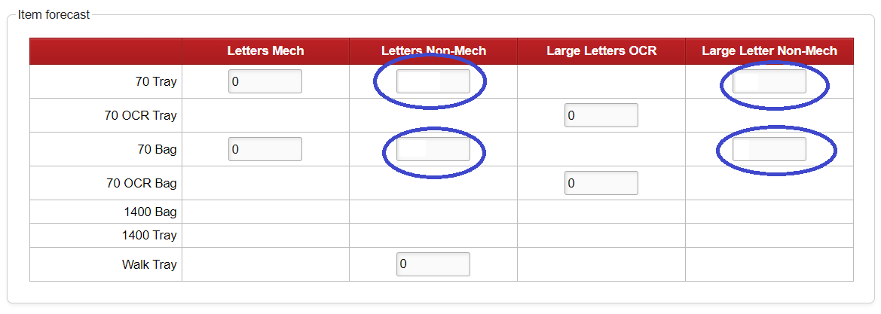
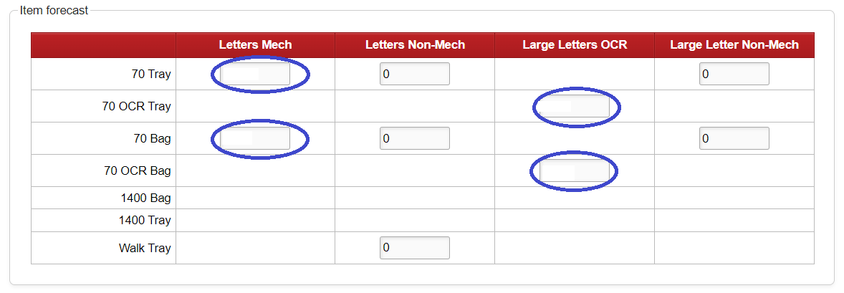
Docket hub traffic forecast
Illustration for Manual Catalogue forecasting
450000
300000
10000
18000
Illustration for mech forecasting
Use OCR for LL
The new 70 Catalogue products forecast will show under the existing appropriate selections on the traffic forecast screen for standard Letters and Large Letters contract.
250000
8
500000
10000
10000

Slide 9
Mailmark catalogue pricing
New Catalogue service codes:
DMA | 70__LETTER CATALOG EIB TRAY N
ZNN | 70__LETTER CATALOG EIB TRAY Z
DMC | 70__LETTER CATALOG EIB BAG N
ZNO | 70__LETTER CATALOG EIB BAG Z
DME | 70__LETTER CATALOG ECON EIB TRAY N
ZNP | 70__LETTER CATALOG ECON EIB TRAY Z
DMG | 70__LETTER CATALOG ECON EIB BAG N
ZNQ | 70__LETTER CATALOG ECON EIB BAG Z
DMI | 70__ LRG LTR CATALOG EIB TRAY N
ZNR | 70__ LRG LTR CATALOG EIB TRAY Z
DMK | 70__ LRG LTR CATALOG EIB BAG N
ZNS | 70__ LRG LTR CATALOG EIB BAG Z
Existing codes now become VAT rated:
DAJ | 70__ LETTERS CATALOG MAN BAGS N
DAK | 70__ LETTERS CATALOG MAN TRAY N
DAP | 70__ LRG LTR CATALOG MAN BAGS N
DAQ | 70__ LRG LTR CATALOG MAN TRAY N
ZBI | 70__ LETTERS CATALOG MAN BAGS Z
ZBJ | 70__ LETTERS CATALOG MAN TRAY Z
ZBO | 70__ LRG LTR CATALOG MAN BAGS Z
ZBP | 70__ LRG LTR CATALOG MAN TRAY Z

Slide 10
Emanifest and barcode selection
 | Class | Format (eMHS & 4STATE Barcode) | ResponseMailType (eMHS) Service Type (2D Barcode) | Mail Type (eHMS only)
Economy Mailmark Catalogue Letter (eMHS) | E – Economy | 1 – Letter | 0 - Mailmark Letter | 1 – Advertising
Economy Mailmark Catalogue Letter (2D and 4-state)
Standard Mailmark Catalogue Letter (eHMS) | 9 – Standard |  |  | 1 – Advertising
Standard Mailmark Catalogue Letter (2D and 4-state)
Standard Mailmark Catalogue Large Letter (eHMS) |  | 2 – Large Letter | 1- Mailmark Large Letter | 1 - Advertising
Standard Mailmark Catalogue Large Letter (2D and 4-state)

Slide 11
Catalogue content guidelines
Examples of types of mailings
Explanation
A mail order company sending its new or seasonal catalogue to an existing customer base
This qualifies as it is a list of goods or services and direct sell from the page
A mail order company sending its new or seasonal catalogue to a prospective customer base
This qualifies as it is a list of goods or services and direct sell from the page
A mail order company sending a postcard with a discount code to a customer
This is not a list of goods or services
A travel company sending its new or seasonal holiday brochure to an existing or prospective customer base
This qualifies provided the brochure is primarily a list of holidays and options with prices clearly displayed
A tourist office promoting a holiday destination by mailing a brochure to an existing or prospective customer base
The brochure is promoting a country or a region. It is not primarily a list of goods and services
A brochure in support of a new car launch and drive to car dealership
This isn’t a list of goods or services; the prices are illustrative ranges. It isn’t directly selling from the page and pushes to car dealerships.

Slide 12
FURTHER INFORMATION
For more information contact your Royal Mail Wholesale Account Director

