Slide 1
Using mail to drive donations
How TO USE MAIL TO GET CONSUMERS TO engage and act
May 2020
YOUR LOGO HERE

Slide 2
The back drop

Slide 3





What are consumers feeling?
38%
34%
50%
People are worrying slightly less about their disposable income 38% (April 42%) reporting they had less disposable income, but 12% saying they had seen a rise (Savanta)
But 34% of people say they had donated to charity in April, up from 30% in March (CAF)
CAF and YouGov poll late March 22% would give more 14% less. By 20-23 April 26% would give more and 11% less
Notes:
At the beginning of the pandemic people were slightly more concerned about their disposable income and this had a direct effect on their charitable giving and potential to give, this seems to have reverted somewhat during April.

Slide 4




And how is this affecting who they give to?
In the four weeks up to 20 April 35% who had given to charity in past four weeks gave to hospitals and hospices, normal average is 21%
Those giving to animal charities down from 31% in March to 23% in April
Those supporting children’s charities declined from 26% average to 18% in April
Other causes like NHS charities, donations to feed NHS staff and supporting Captain Tom Moore, new examples of causes given to
Source: CAF
Notes:
What’s interesting is people are looking closer to home on who they are likely to give to.
This is hardly surprising at the NHS staff are so much in the spotlight and every Thursday we go out of our houses to clap, bash pans and make noise to support them. It is the charities that have needs oversees or that look after animals who are likely to suffer in the short term.

Slide 5
How is the charity sector responding
Say letting furloughed employees return as volunteers would help their charity survive
Plan to use the Business Rate relief
Plan to use the job retention scheme
When asked how long they could operate in their current form without help, either from the Government or elsewhere, just over half (54%) said 12 months or less. Around a third of charities said they would be using the Government’s job retention scheme.
Source: CAF Fieldwork 16-17 April, n=408 charities
Notes:
18% plan to use the business Rate relief.
1 in 3 charities likely to take advantage of Government furlough scheme or have already done so.
Many agree that their organisations would be helped to survive it their staff could return from furlough and volunteer with them.

Slide 6
And they are having to do more with less
Q: Thinking about the crisis caused by the global coronavirus outbreak (also known as Covid-19), please tell us to what extent you agree or disagree with the following statement
“
“
We have a greater need for our services now and are in more need for funding to sustain our services.
“
Our income has reduced overnight as we can no longer hire out our premises, while the demand for pastoral services has soared. We cannot use the Government’s job retention Scheme because people need pastoral care, especially at times of crisis and so our ministers will keep working as long as possible.
Have seen increased demand for services
“
“
“
The biggest impact on our funds is the fall in our investments. In addition, we are receiving high requests for grants from the elderly community.
Source: CAF Fieldwork 31 March to 1 April, n=539 charities

Slide 7
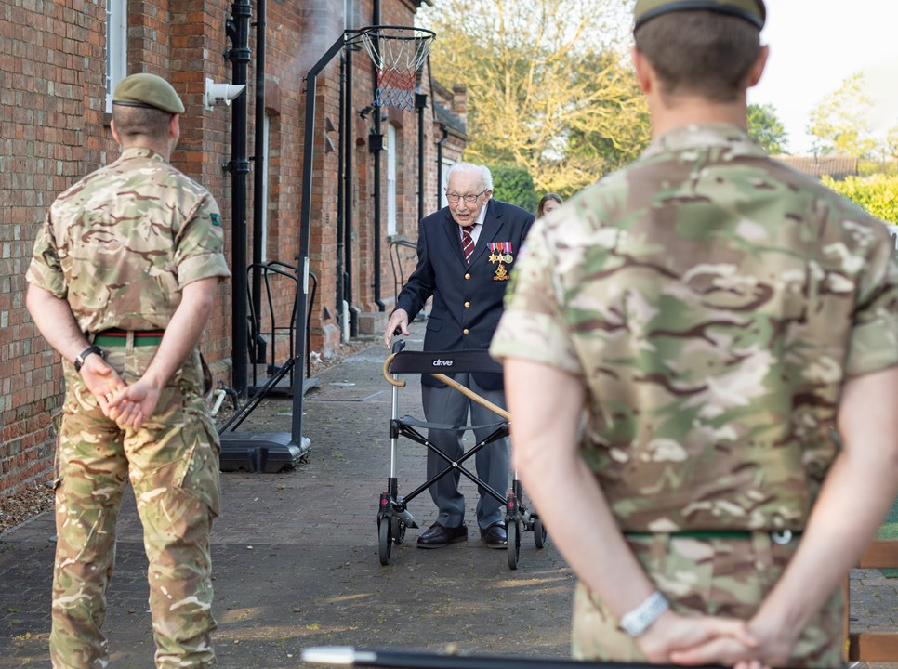


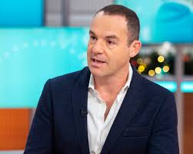

Some of the inspirational ideas
Captain Tom Moore raises over £32m by walking round his garden for the NHS
Ryan Jones (former Wales rugby captain) ran a marathon in his garden £8,000 for local hospital
Idea of 27-year-old Olivia Strong - Run 5 Donate 5 Nominate 5, “Run for Heroes” over 100k already run with help from famous on Instagram
Martin Lewis launched a £1m fund to provide grants to small and local charities who are directly helping with Covid-19 response
Has raised over £10m for 3,961 charities and replaced the 40th London Marathon.
Notes:
There are huge and inspirational charity fundraising initiatives which have caught the attention of consumers.

Slide 8
How mail can drive donors to give to your cause

Slide 9

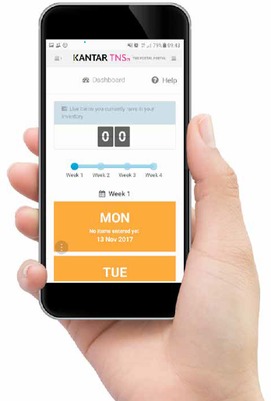
Jicmail gives us gold standard data
That shows exactly how consumers interact with Charity mail
Mail is collected in the first week and recorded, then that week’s mail is tracked over 28 days
People record what they do with their mail physically
They tell us the type of mail, i.e. is it addressed or unaddressed to them or someone else.
Opened it
Read / looked at / glanced at it
Put it on display e.g. fridge / noticeboard
Passed it on / left out for the person it’s for
Put it aside to look at later
Threw it away / recycled
Took it out of the house e.g. to work
Used / did something with the information
Put it in the usual place
They capture what business sector the mailing or door drop comes from.
They record the contents; is it information, special offer, etc. You can tick all that apply here.
Notes:
JICMAIL data has been available since the second quarter of 2017, it now contains over 92,000 individual mail packs across all the main industry sectors. It has been designed to create Gold Standard for the industry so that mail and door drop can be planned alongside other media in exactly the same way as all other channels.
A panel of 1,000 households each month collect their mail and door drop for the first 7 days of each month. They then track that content over a full 28 day period and tell us what they did with it physically ie opened, read and passed it on. But in addition they record any commercial actions, such as going online, calling the sender or using a voucher or discount code.

Slide 10
Engagement rates with charity mail
STRONG across the board
96% of all charity mail is engaged with ie mail is processed in some way (opened, read, sorted, put aside)
77% of all charity mail is opened
69% of all charity mail is read / looked at / glanced at
Source: JICMAIL Q2 2017 – Q1 2019 Addressed or Business Mail, Charity n=3,322
Notes:
Consumers engage with charity mail at good rates, 96% of people engage in some way, the 4% that don’t recycle immediately without any form of engagement.
Open rates are good and bear in mind not all charity mail (like a postcard) would need to be opened.
Nearly 70% of all charity mail is read, looked at or glanced at.

Slide 11
What are charities sending?
Not surprisingly 53% of contents are a request for a donation but with a broad range of other content types
Source: JICMAIL Q2 2017 – Q1 2019 Addressed or Business Mail, Charity, n=3,322
Any type of content with 1% or less has been removed
Notes:
Not surprisingly the largest declared content the panel record is “request for a donation”. Followed by information about products and services and news/updates/magazine articles.
Respondents on the panel tick all of the contents that they think apply. Importantly 20% say that the mail piece contains the sender’s contact details, so as most are asking for a gift this makes sense (one might expect it to be a bit higher).

Slide 12
physical actions
Physical interactions with charity mail are strong
Source: JICMAIL Q2 2017 – Q1 2019 Addressed or Business Mail, Charity n=3,322
Any type of content with 1% or less has been removed
Notes:
Physical actions are the things that people do with their mail when the mail is actually in their hand or right there in front of them – so we call these physical actions.
The frequency we talk about in the presentation is based on just the physical actions.
The highest of all are opening and reading, 54% are thrown away or recycled, but not before they’ve been processed.
A third of items get put aside to look at later, this generally means someone intends to consider the content.

Slide 13
MAIL DRIVES COMMERCIAL ACTIONS
charity mail driving slightly weaker commercial engagement (av = 32%)
But when it contains certain content it really does perform well
Overall resulting commercial actions with charity mail
787
83
750
1,627
136
248
336
112
523
306
Source: JICMAIL Q2 2017 – Q1 2019 Addressed or Business Mail, Charities, n=3,322
Notes:
Commercial activity is what people do outside of physical actions, JICMAIL captures this data in addition to frequency data as we know that mail is a channel that drives behaviour.
This chart looks at the different type of mail content and what commercial activity this drives when it is received by consumers from the charity sector.
Overall charity is slightly lower than all sectors combined, achieving a 25% overall score – ie 25% of all people receiving charity mail go on to do something of a commercial nature. Again respondents can tick of the actions that apply, so some will do one thing and others more than one.
In this instance you can see that 49% of all respondents receiving a notification or reminder go on to do something commercial, Those with a postal reply and content about local services are also higher than average. So when the right contents are sent your mail could be achieving higher than average commercial interactions ie almost half of your audience could be doing something commercial.

Slide 14






All SORTS OF GROUPS ENGAGE WITH MAIL
charity mail is engaged with by all types of consumer
The average frequency of exposure for all sectors is 4.3
FREQUENCY OF EXPOSURE
MALES ABC1
SOCIAL
GRADE B
TV AREA: CENTRAL SCOTLAND
HH WITH KIDS
PARENTS 55+
ACORN: POORER FAMILIES
4.9
4.93
5.48
4.62
5.71
ADVERTISING AND BUSINESS MAIL
Source: JICMAIL Q2 2017 – Q1 2019 Addressed and Business Mail, Charity n=3,322
Notes:
We’ve looked at advertising mail and business mail together to see if there are some groups of people who have a higher frequency, or return to their mail more than others.
You can see from this slide that ABC1 males go back to a charity mail piece nearly 5 times, the average for all charity mailings is 4.1.
If you belong to social grade B, this goes up to 4.93.
The Scots have a high propensity to return to charity mail at 5.48 and older parents with kids still at home.
The Acorn Group “Poorer Families” has the highest frequency of all at 5.71.

Slide 15
All age groups engage with mail
Frequency – HAS A SWEET SPOT FOR THOSE AGED BETWEE 45 AND 64
Source: JICMAIL Q2 2017 – Q1 2019 Addressed Mail, Charity n=3,322
Notes:
Whilst there’s no denying younger groups engage a little less with their mail, the reality is they get much less of it. The groups who have more disposable income and may well have families younger and older haem the highest engagement rates. This falls with the over 65s.

Slide 16
frequency above average
The average frequency in all sectors is 4.3 (and reach 1.13) so charity mail is higher in most instances
Look at how different content drives very different engagement rates, it seems important to include a postal reply to get even higher frequency and your contact details too.
n=3,322
n=787
n=83
n=750
n=1,627
n=136
n=248
n=336
n=112
n=523
n=306
Source: JICMAIL Q2 2017 – Q1 2019 Addressed and Business Mail, Charities n=3,322
Notes:
Again it is really interesting to look at the different content types of charity mail to see if they drive more or less interactions and they do.
If the piece contains a postal reply the frequency goes up to a significantly higher 5.3. And sender’s contact details reaches a frequency of 5, think back to slide 11 where respondents said that 20% of their mail contained the sender’s contact details. Are the charities using mail making sure that there is always a clear call to action and there’s always clear ways to get in touch to donate?
Notifications and reminders and invitations to specific events like coffee mornings and so on all perform above average.

Slide 17
Actions per thousand are impressive
If you send a postal reply to someone 287 people out of that 1,000 will make a donation and also 299 will post a reply to the sender
Actions per thousand mail items
Source: JICMAIL Q2 2017 – Q1 2019 Addressed and Business Mail, Charities n=3,322
Notes:
And finally within the JICMAIL data we are able to look at how many people who take a commercial action, so for charities 25%, how many go on to act and what do they do.
So of the 25% of people who do something commercial, over and above physical actions 287 people out of every thousand will go on to make a donation, 299 consumers from every 1000 will post a reply to the sender.
Information about products and services prompts the highest discussion, getting your brand talked about.
And again back to the sender’s contact details being clearly contained in the mailing, this prompt 226 people per thousand to make a payment.

Slide 18
Who’s mailing right now and what are they sending

Slide 19
Save the children
Refugee camps and here at home
Sweet letter talks about “the rainbows in my neighbours’ front window remind me how children are facing up to this”
Appeals for money for refugees, where they are transforming empty buildings and putting up tents
In the UK they are helping parents with emergency grants so they can get food and some books and toys to make the lock down bearable
Practical asks for handwashing kits, books and toys at different donation amounts £40/£60/£250
And they’ve included a useful reply envelope!

Slide 20
Asthma uk
Nicely thought through appeal
Talks about the fact their services are stretched as they are experiencing 8 times more calls during Covid-19 pandemic
Gives advice on how to control your asthma and cut the risk, from a specialist Doctor
Helps donors (who with this charity are more likely to be sufferers) to help them recognize the symptoms
Gives great testimonials and examples of what your money will do
Includes that all-important reply envelope

Slide 21
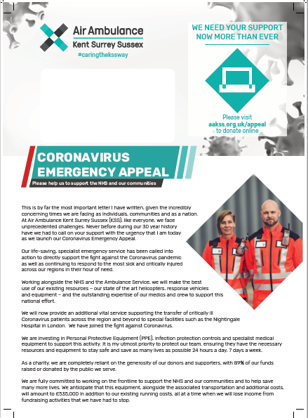
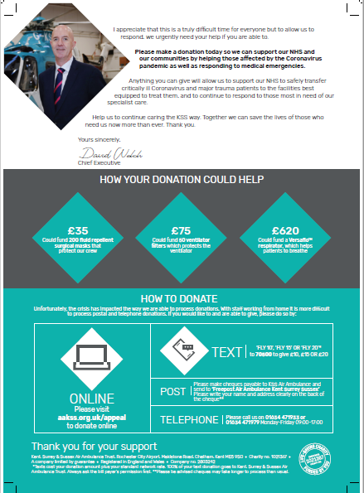
Air ambulance
Good letter, with a heartfelt tone of voice
Highlight how they are working alongside the NHS
Say how they are helping transport critically ill Coronavirus patients across the region
And now they need to invest in PPE
Clear ways to pay
And clear asks for what your donation will provide

Slide 22
conclusion
CHARITY
People are still giving and there is significant innovation in the market
DONORS
Worried about their disposable income but still giving but changing the focus of their gifts
AUDIENCE
All types of audiences engage with mail from charities and have high frequency / engagement
MAIL
With the right content drives high levels of interaction and action
PHYSICAL
Mail is able to set out a clear story and clear call to action

Slide 23
YOUR LOGO HERE

