Slide 1
The role mail has to play in driving retail business
How mail has a role to play in getting consumers to engage with mail order and online retailers
May 2020
YOUR LOGO HERE

Slide 2
The back drop

Slide 3
Online retail sales over the last 12 months
It’s been a very changeable period but April sees a recovery
Source: IMRG Capgemni Online Retail Sales Index, May 2020
Notes:
The online retail membership organisation keeps monthly data for online retailers. You can see that March saw a contraction but April recovered well.

Slide 4
sectors showing positive performance
With a particular emphasis on garden, gardening, Home & garden in April
Source: IMRG Capgemni Online Retail Sales Index, May 2020
Notes:
Some sectors have enjoyed quite a bounce back, like Homes and Garden and Garden. But clothing is still suffering and furniture too.

Slide 5




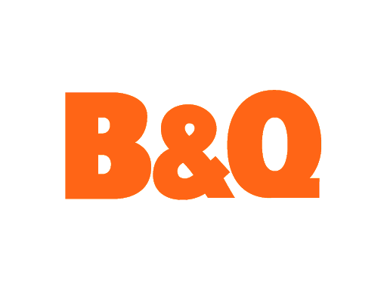




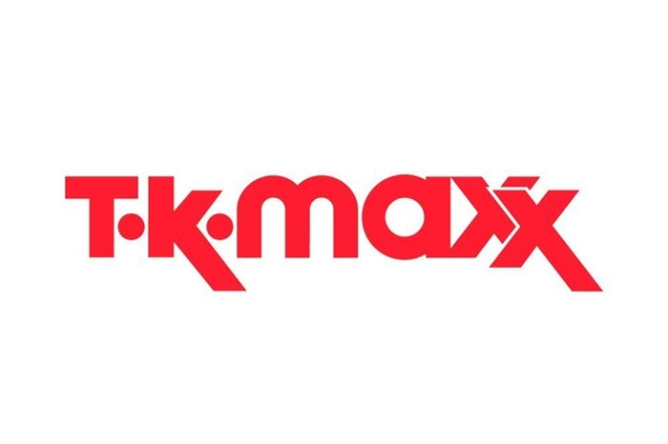










Three types of retailers during pandemic
FLEXING TO THE TIMES
ADAPTING TO SURVIVE
FREEZE / MOTH BALL
Shuh and Next stopped trading and then began trading again having made changes
Notes:
Some high street brands are open for business and are doing well. Lidl and Aldi have seen very strong performance. Tesco says their profits should not be overplayed as they have had to take on more staff and therefore have more overhead.
Where they are deemed as essential retailers their traffic is slowed only by limits on numbers in any store at one time.
Other brands are switching how they do things. Screwfix is only doing click and collect with strict pick up protocols. H&M have closed stores but are heavily promoting their online store.
WH Smith issued a profits warning in March as travel restrictions triggered by the coronavirus pandemic led to a significant drop in shoppers at its airport outlets, initially in the Asia Pacific region, which accounts for 5% of its travel division’s revenues. The company stated that its annual profits would be half the £80m previously forecast. WH Smith is currently operating about 30% of its UK stores but has reported a “significant decline in passenger numbers” because of the nationwide lockdown, which has resulted in the temporary closure of all of its stores at British airports and railway stations.
McColls (1,500 convenience stores) working with Deliveroo to do home delivery from 120 stores within half an hour.
Hayes Garden World is offering an online personal shopper services and is doing entirely online trading.
Shuh, the footwear retailer has re-opened its website a week after it closed down its warehouse due to concerns over staff welfare during the Covid-19 epidemic. The Schuh management team has now put in place extensive welfare measures to ensure the safety of its employees working in its eCommerce operations.
Poundland is temporarily reducing its store count by 32 during the coronavirus crisis. These stores include those situated in retail parks and shopping centres and those with multiple stores in one area. It also includes stores which are unable to open due to a lack of staff. Poundland staff will be paid 80% of their wages in lines with the government retention payment scheme.
TK Maxx stop taking online orders or taking returns.
Next originally pulled out of deliveries online but returned but had to set limits on the number of orders in order to ensure they could meet demand.

Slide 6
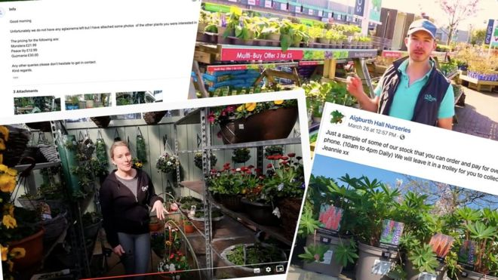







A look at how some brands are reacting
How some have risen to the challenge
7 April
Creating pop-up store at Nightingale Hospital for NHS staff
April
Offer NHS staff 200 bikes to get to work safely and then launch direct delivery for first time
April
Employs 100,000 more staff worldwide
Garden centres offering virtual plant tours to keep afloat
31 March
Yorkshire factory making non-surgical gowns for patients
3 April
Increase delivery and click and collect from 370,000 to 600,000 in just 2 weeks
Uses fast bike service to delivery more orders
April
Launches box service for NHS staff
Offers free ‘punk’ hand sanitiser
1 April
Re-open Croydon store to serve food to vulnerable and key workers
28 March
Rolling out Covid-19 testing facilities for NHS workers
Notes:
Brands have been responding in a myriad of ways to either help during the ppandemic or allow people to engage with them in new or different ways.

Slide 7
Consumers’ shopping behaviour
Has changed and trust cannot be relied on… it has to be earned
Agree they are willing to spend time shopping around to get the best value
Said they would switch to a brand’s competitor within a week of having a negative experience
Claim to buy from brands they know even when they know they could be getting a cheaper deal elsewhere
BUT
Would purchase elsewhere if their preferred method of delivery wasn’t available
Source: DMA, Kibo, Vendasta H
Notes:
And loyalty counts for a lot when making purchasing decisions. 55% are more likely to buy from a brand they know, even if they think they’ll get it cheaper elsewhere.
However there are significant numbers who will be influenced by value and will shop around and the brand experience has to be consistently delivered – if it isn’t 79% of consumers say they’ll switch if anything negative in those customer interactions happens.
And with online shopping the method of delivery ie giving a trusted partner to deliver goods is of importance.

Slide 8
Trust, the added dimension to brand loyalty
AND THE GOOD NEWS IS THAT RETAIL DOES QUITE WELL
AGREEMENT WITH A BRAND THAT I TRUST FOR BRANDS IN THE FINANCIAL SERVICES, BEAUTY AND PERSONAL CARE, DRINK, RETAIL AND FOOD SECTORS, NOVEMBER 2015-MAY 2018
Food does well at 39%
Followed by beauty and personal care
Retail scores slightly lower in trust than these other two but fares better than financial services at just 19% trust
Source: Lightspeed/Mintel. Base: internet users aged 18+ who have heard of the brand
Notes:
Retail brands clearly score higher than the financial services sector in brand trust.

Slide 9
How mail can drive commercial engagement and action

Slide 10

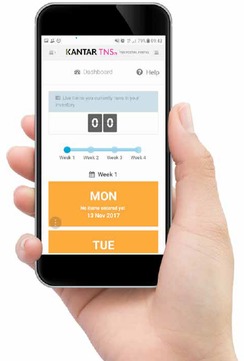
Jicmail gives us gold standard data
That shows exactly how consumers interact with retail mail
Mail is collected in the first week and recorded, then that week’s mail is tracked over 28 days
People record what they do with their mail physically
They tell us the type of mail, i.e. is it addressed or unaddressed to them or someone else.
Opened it
Read / looked at / glanced at it
Put it on display e.g. fridge / noticeboard
Passed it on / left out for the person it’s for
Put it aside to look at later
Threw it away / recycled
Took it out of the house e.g. to work
Used / did something with the information
Put it in the usual place
They capture what business sector the mailing or door drop comes from.
They record the contents; is it information, special offer, etc. You can tick all that apply here.
Notes:
JICMAIL data has been available since the second quarter of 2017, it now contains over 92,000 individual mail packs across all the main industry sectors. It has been designed to create Gold Standard for the industry so that mail and door drop can be planned alongside other media in exactly the same way as all other channels.
A panel of 1,000 households each month collect their mail and door drop for the first 7 days of each month. They then track that content over a full 28 day period and tell us what they did with it physically ie opened, read and passed it on. But in addition they record any commercial actions, such as going online, calling the sender or using a voucher or discount code.

Slide 11
Engagement rates with retail mail
High across the board
93% of all mail order/online retail mail is engaged with ie mail is processed in some way (opened, read, sorted, put aside)
66% of all mail order / online retailer mail is opened
63% of all mail in this sector is read / looked at /glanced at
Source: JICMAIL Q2 2017 – Q1 2019 Addressed or Business Mail, Mail Order/Online Retailer n = 6,909
Notes:
Mail order/online retail mail enjoys high levels of engagement. 66% of it is opened and 63% of it read, looked or glanced at.

Slide 12
What are Mail order retailers sending?
They are mainly sending information about products and services, followed by special offers (likely to be catalogues or product leaflets)
Source: Kantar TNS, JICMAIL, Addressed Mail and Business Mail, Mail Order/Online Retailer Q2 2017 – Q1 2019, Total base: 6,909
Any type of content with 1% or less has been removed
Notes:
Mail order/online retailers are mailing sending information abut products or services but 28% have a special offer, 12% the sender’s contact details and 10% vouchers/coupons.

Slide 13
physical actions
Physical interactions with mail order/online retail are strong with good open and reading rates
Source: Kantar TNS, JICMAIL, Addressed Mail and Business Mail, Mail Order/Online Retailer Q2 2017 – Q1 2019, Total base: 6,909
Any type of content with 1% or less has been removed
Notes:
Open rates are high, it is clear that people take notice of FS mail. Reading is high but also filing at 39% is higher than nearly all other sectors. Recycle rates are lower at 32%.
Many put aside to look at later or put in the usual place.

Slide 14
MAIL DRIVES COMMERCIAL ACTIONS
When it contains different content it drives different levels of commercial interaction
%
Resulting commercial actions with mail order / online retail mail
4,621
,741
668
113
55
40
114
Source: JICMAIL Q2 2017 – Q1 2019 Addressed or Business Mail, Mail Order/Online Retailer n = 6,909
Notes:
Commercial activity is an interesting one with the mail order/online retail sector. The physical actions with mail make up the frequency numbers we use to help plan mail as a channel. On top of this, we know that mail drives people to do commercial things, they may not be holding the mail pack but they will take all sorts of actions.
Aligned to this we can see what types of mail drive different levels of commercial behaviour and mail order and online retail mail if you send a loyalty reward statement 65% of people go on to do something commercial, over and above the average across all mail content types of 28%, financial statements and vouchers drive commercial actions of 40%.
So think about what you send to people and what you want them to do as a result of your communication it could really drive the levels of interaction.
As a reminder commercial actions are:
Went online for more information
Discussed with someone
Bought something/made a payment or donation
Called the sender
Visited the sender’s web site
Used a tablet or smart phone
Used a voucher/discount code
Visited a sender’s shop/office
Planned a large purchase
Ordered a catalogue
Looked up my account details
Posted a reply to the sender

Slide 15






All SORTS OF GROUPS ENGAGE WITH MAIL
MAIL ORDER AND ONLINE RETAIL ENGAGEMENT RATES ARE GOOD ACROSS A RANGE OF GROUPS
FREQUENCY OF EXPOSURE
GEN Z
3+ IN HOUSE
SOCIAL GRADE C2
FEMALE 55+
OWN HOME 3-5 YRS
3.47
4.38
4.46
3.69
4.49
ADVERTISING MAIL
Source: JICMAIL Q2 2017 – Q1 2019 Addressed Mail, Mail Order/Online Retailer n=8,946
Notes:
The average frequency is 4.3. But there are groups that are higher for the frequency of exposure.

Slide 16
frequency above average
Mail drives high frequency but varies by type of content
If the contents have news/update or magazine article or they are a financial statement then the interactions rise some 17% over and above the average for mail order/online retailer
Base: 6,909
Base: 4,633
Base: 1,749
Base: 668
Base: 344
Base: 673
Source: Kantar TNS, JICMAIL, Addressed and Business Mail, Mail Order/Online Retailer Q2 2017 – Q1 2019, Total base: 6,909
Notes:
The mail order sector enjoys above average reach and frequency across certain mail content types. The average frequency is 4.1 and some contents clearly achieve higher levels of revisiting.
Reach is how many people are reached by a single mail piece, so for every 100 mail items another 12 people will see each piece.

Slide 17
Content type drives all sorts of actions
The types of commercial actions that are driven by different types of mail vary a lot by the type of content but all mail order/online retail mail drives significant online behaviour and buying behaviour
Actions per thousand by mail type
Source: Kantar TNS, JICMAIL, Addressed and Business Mail, Mail Order/Online Retailer Q2 2017 – Q1 2019
Bases: Information about products/services 4,633, Special offers or discounts 1,749, Vouchers / coupons 668, News / update / magazine articles / 344, Financial statement / bill / update 673
Notes:
Over and above the physical interactions with mail that you’ve seen earlier there’s a whole host of commercial actions that are being driven and you can see a wide range of actions per thousand. If you send a voucher for example 187 people per thousand will use it. Information about products and services will drive 98 people to go to the sender’s web site, which rises to 139 per thousand if the content is news/update or magazine article.
Giving consumers reasons to engage gets them to act on the information they receive.

Slide 18
What retailers are sending at this time

Slide 19
THIS PIECE IS HELPFUL AND TRANSPARENT
Cox and Cox have delivered a simple letter with a rebate against the value of my spend with them
The letter talks about this supporting their staff and suppliers “You’ve supported our business so it’s only right that we look after you too”
And taps into the sense of making home a better place whilst we’re all stuck at home “I daresay we could all do with some cheering up”

Slide 20
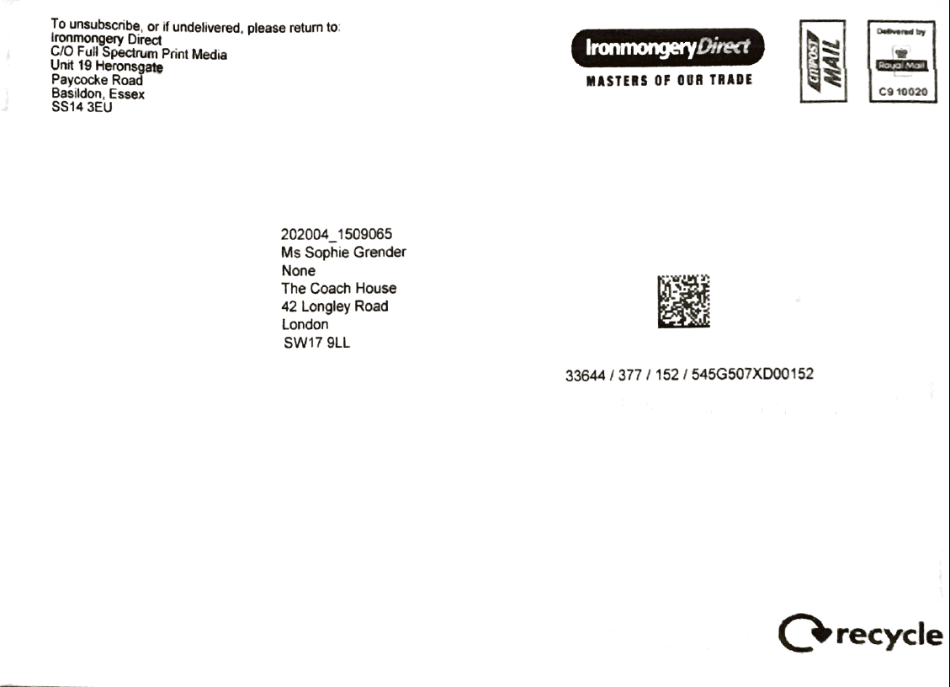
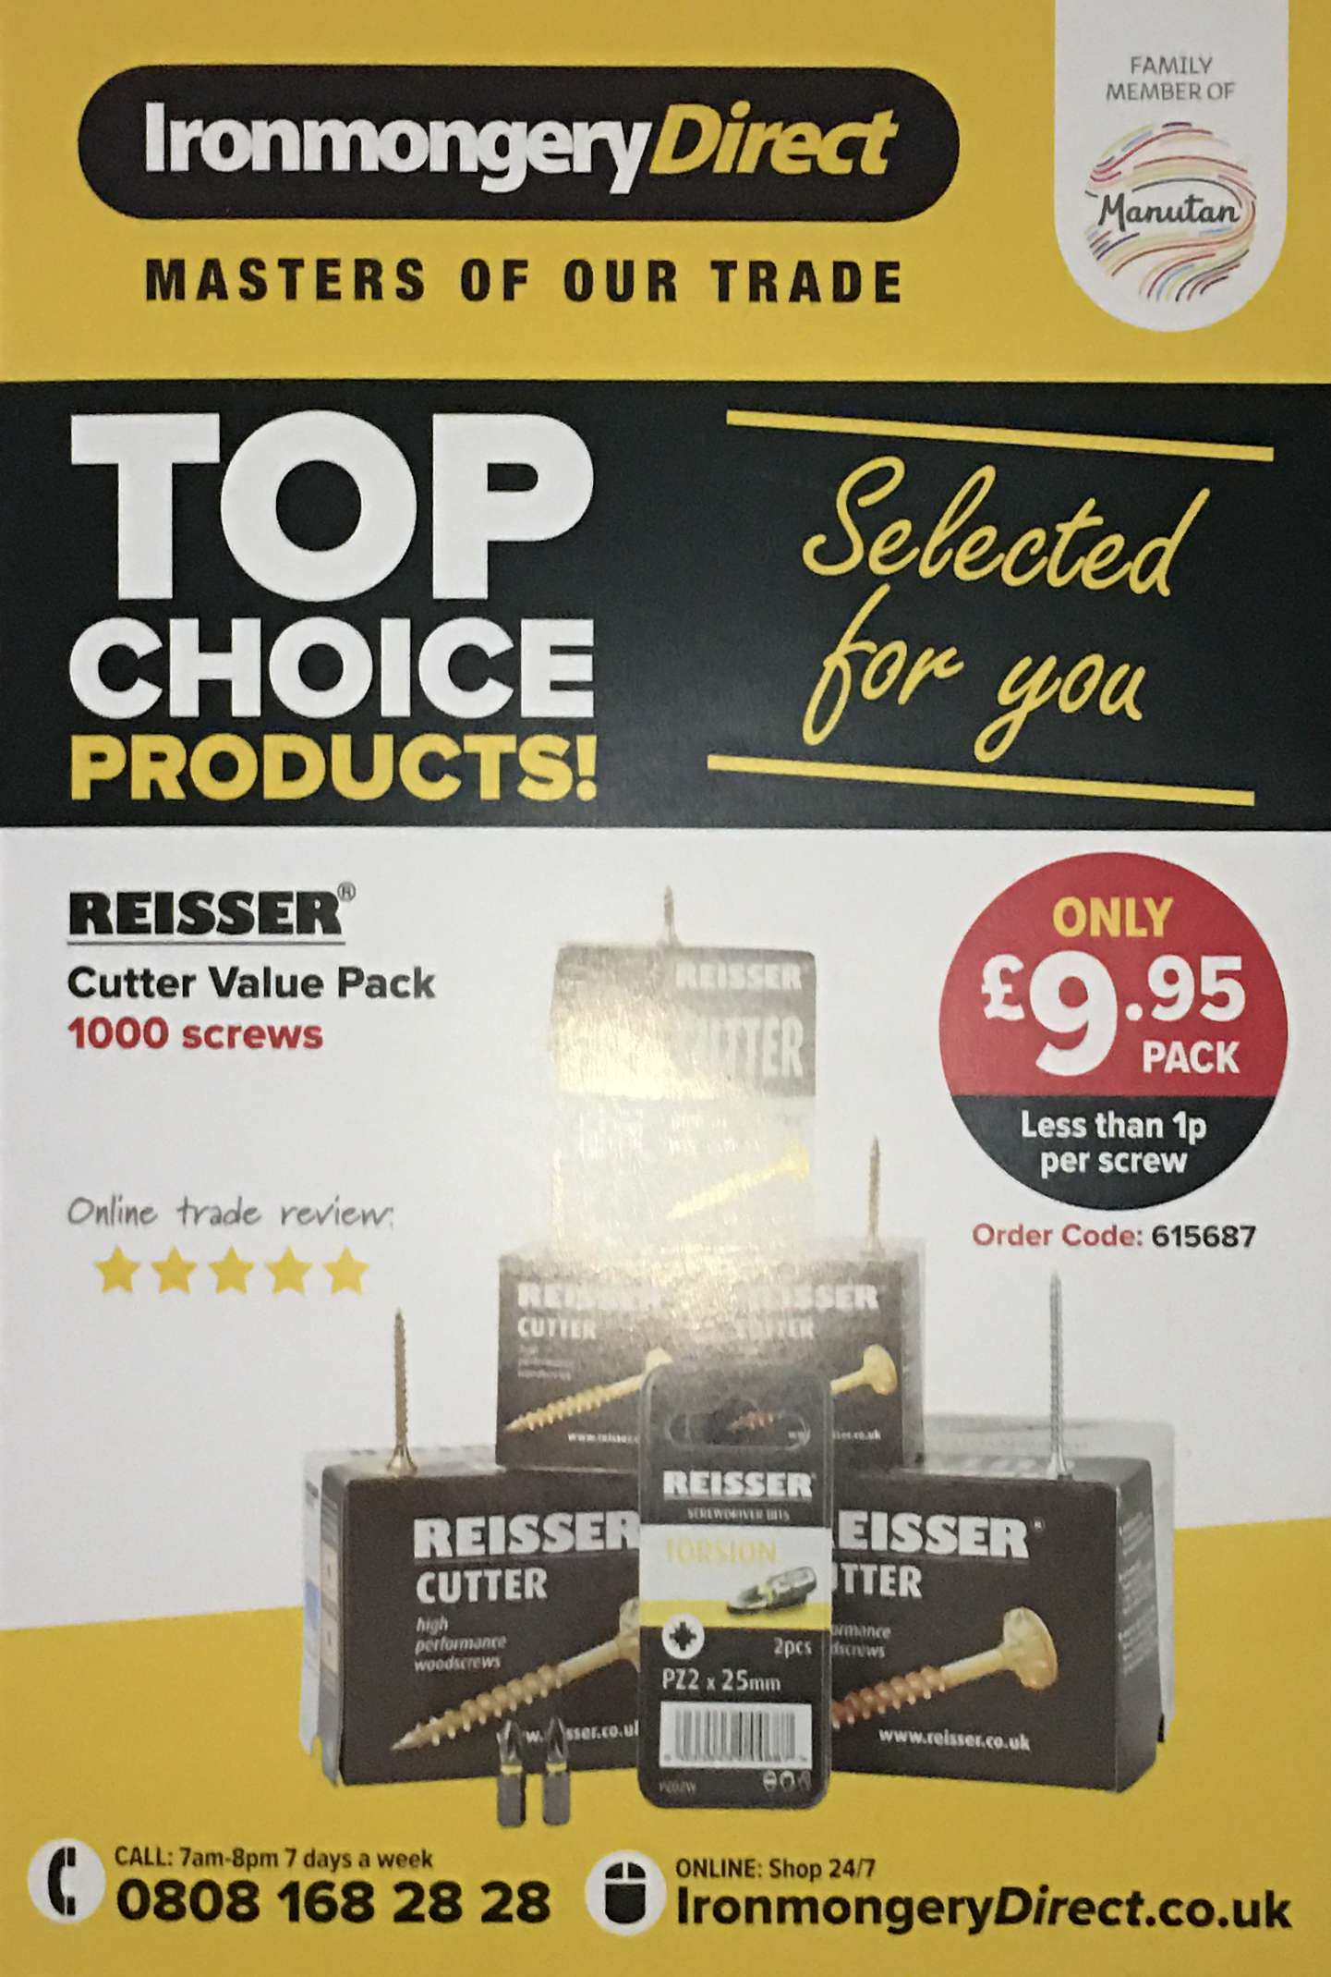
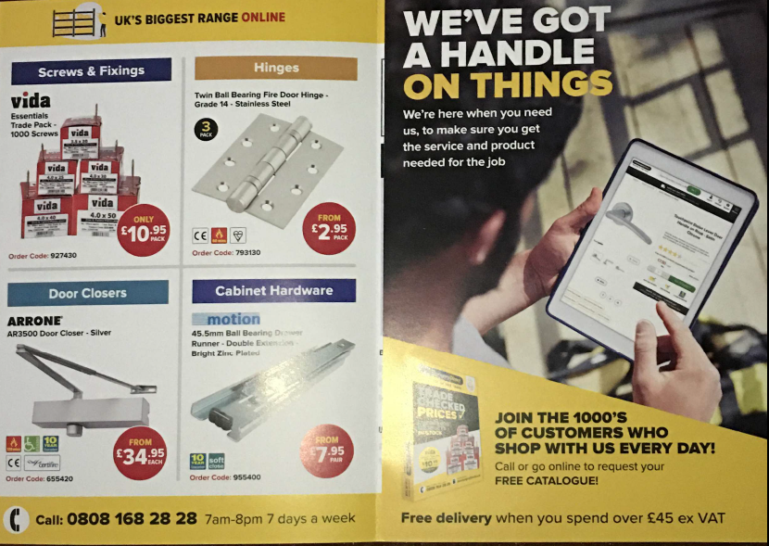
Ironmongery direct
STRIKE A NICE TONE AND APPEAL TO THOSE STUCK AT HOME
Ironmongery Direct have sent this mailing out to their customers with a captive audience at home
They make a general but very soft nod to the pandemic - “We’ve got a handle on things”
Timely reminder that they are there

Slide 21
Cox & cox
Actively promoting the concept of the importance of home in the lock down
Introduced Klarna so you can enjoy your purchases now but pay for them in instalments
“Here are the feel-good things, from Cox & Cox – stay safe, and sizzle with home style this summer”
First section of catalogue all about outdoor living
And they are offering 20% off across their entire range

Slide 22
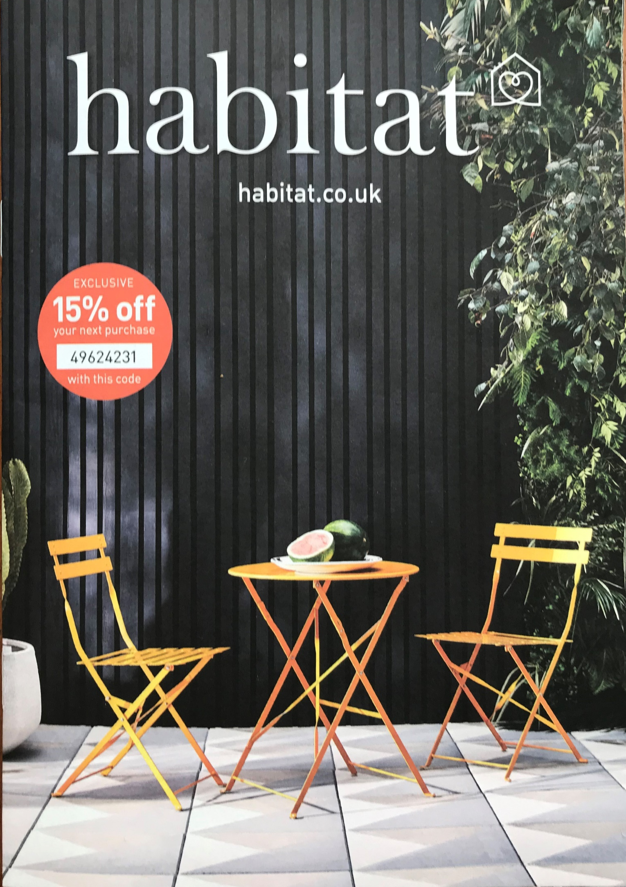
Good seasonal offer
Habitat seem to be capitalising on the strong sales of garden furniture by featuring this image of outdoor table and chairs on their catalogue front cover

Slide 23
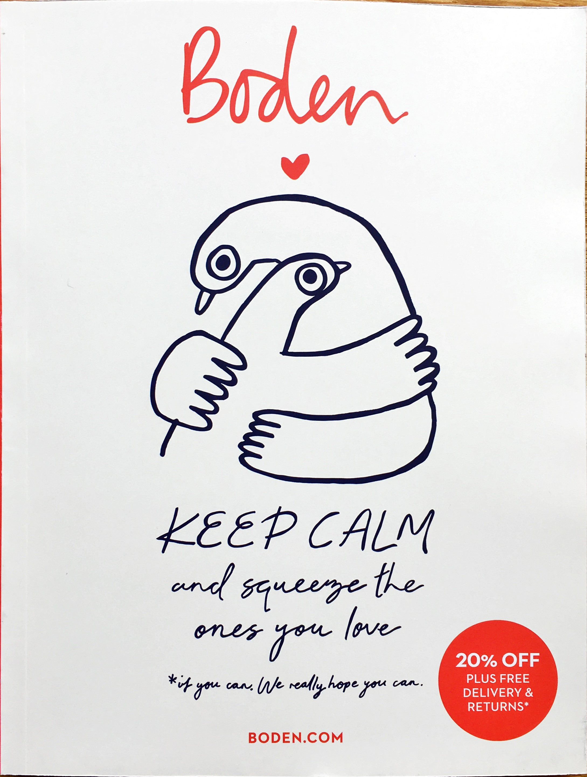
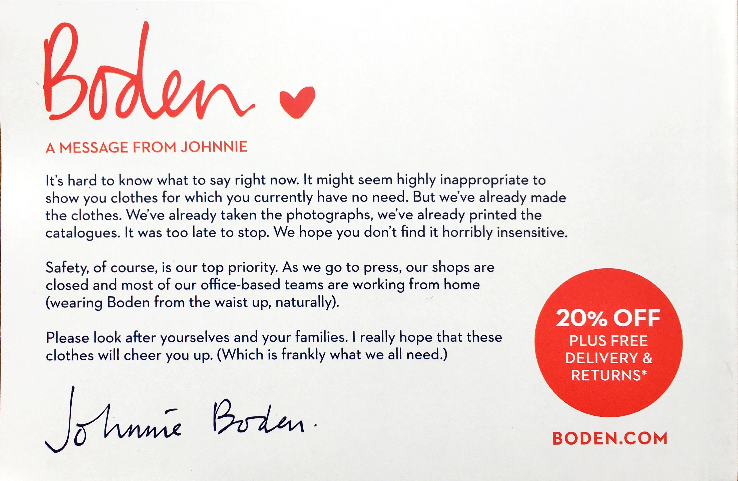
Boden postcard
WOULD THIS HAVE WORKED AS WELL AS AN EMAIL?
This simple postcard explains what Boden is doing to keep business open but is clear
But as ever they strike the Johnnie Boden tone of voice spot on and even manage to get a small joke in that the office staff are working from home “wearing Boden from the waist up”
It’s really simple but it shows that you value me as a customer

Slide 24
conclusion
RETAIL
Undergoing very challenging times but possibly already showing some signs of returning to normal
CONSUMERS
Increasingly harder to gain their loyalty and every little interaction counts
MAIL
Is engaged with at high rates, it’s valued and drives commercial interaction at many levels
ONLINE
It is able to drive new or existing customers to engage online in a time when you may want to drive more online
ENGAGE
Make sure your content engages – see how other brands have used mail to get their message across

Slide 25
YOUR LOGO HERE

