Slide 1
ADVERTISING MAIL TEST AND INNOVATE INCENTIVE PUBLISHING
Magazine subscription incentive offer
May 2024

Slide 2
Advertising mail
Test and Innovate Incentive for magazine subscriptions
15%
WHO IS IT FOR?
CREDIT
TO QUALIFY
TO APPLY
For when you try something new with your advertising mail activity.
A postage credit is available on eligible Advertising Mail.
The minimum volume is 4,000 items.
For more information and to apply go to www.royalmailwholesale.com
Full terms and conditions apply

Slide 3
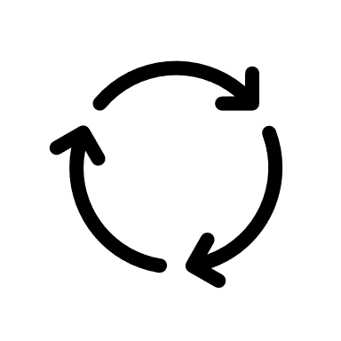
Mail gets you noticed
Of mail from a publisher is engaged with: opened, read, sorted, put aside, put on display or in the usual place.
98%
1.27
Every 100 mail packs sent by a publisher reach another 27 individuals.
5.8
Each piece of publishing mail is revisited 5.8 times by individuals.
Source: JICMAIL, Addressed Mail, Publishing, Q2 2017-Q2 2023, n=1,543

Slide 4
Mail from publishers drive commercial engagement
22%
Take a commercial action
Discuss, look up account details, visit sender’s web site, go online, make a payment, use a tablet or smart phone, call the sender, visit sender’s shop/office, plan a large purchase
Source: JICMAIL, Addressed Mail, Publishing, Q2 2017-Q2 2023, n=1,543

Slide 5
Publishing mail drives significant commercial engagements
5%
2%
10%
Buy something or make a payment
… take online actions
visit sender’s web site, go online, use a tablet or smartphone
… call the sender
have a discussion about the mail with someone else in the household
Source: JICMAIL, Addressed Mail, Publishing, Q2 2017-Q2 2023, n=1,543

Slide 6
JICMAIL CAMPAIGN CALCULATOR
Demonstrates the media multiplier effect of a typical campaign a publisher could enjoy with such reach and frequency
1.27
Item reach
5.8
Item frequency
7.82
Lifespan (days)
Input number of mail items
1,266,743
Campaign reach
7,289,063
Campaign impacts
1,000,000
Send 1,000,000 Advertising mail items items and your campaign reach will be well over a million ie you will reach another 266,743 individuals
And your impacts will be 7,289,063 higher than the 1m you bought
Source: JICMAIL, Addressed Mail, Publishing, Q2 2017-Q2 2023, n=1,543

Slide 7
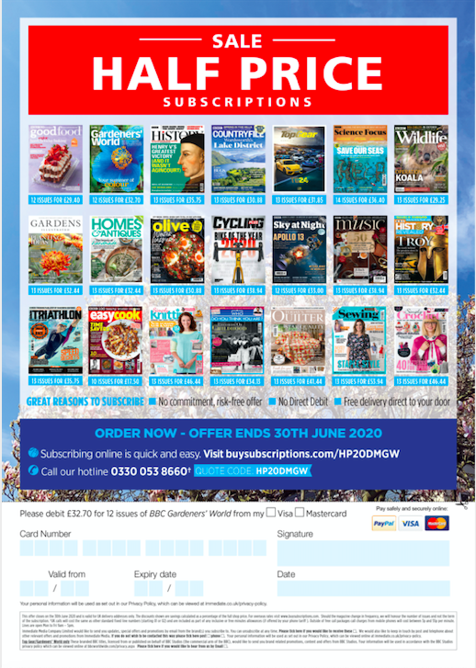
MAIL HELPED CREATE NEW HOBBIES DURING LOCKDOWN
Background
During lockdown Immediate Media saw new customers discover new hobbies The publisher set out to entice lapsed customers - who had time on their hands - back to re-discover old hobbies.
Solution
Immediate Media created a new model that selected customers based on their value as a subscriber and how much they had spent in their lifetime – regardless of when they had lapsed.
As most lapsed subscribers had cancelled because of price, the offer ‘Half price subscriptions’ was compelling and simple. Instead of selling the concept of the magazine, Immediate Media let them know how they could help them make the most of their time at home and improve their well-being
Results
With a response rate of 3.8% and a cost per acquisition of £9 this was Immediate Media’s best ever mail campaign.
Source: DMA Awards Best Use Of Mail

Slide 8
ENTRY REQUIREMENTS
1
2
3
4
Test addressed Letters or Large Letter format items sent using Advertising Mail.
Measure the performance of the test and share the results with us so we can understand whether the tests we invest in achieve their objectives.
To qualify, test mailings must include a minimum of 4,000 advertising mail items and a maximum of 1m items over the incentive period.
Submit your application form 10 days before the start date of your test.
Full terms and conditions apply
Notes:
This template was inserted from Power-user, the productivity add-in for PowerPoint, Excel and Word.
Install Power-user to access thousands of templates, icons, maps, diagrams and charts with Power-user.
Visit https://www.powerusersoftwares.com/
©Power-user SAS, terms of license: https://www.powerusersoftwares.com/terms

Slide 9
OFFER DATES
9 October
2023
13 December
2024
27 December
2024
Applications open
Last application
Last posting date

Slide 10
Postage credits
30%
Get postage credit of up to 30% on incremental advertising mail
Full terms and conditions apply

Slide 11
The APPLICATION AND CREDIT process
Offer open for postings mailed by 27th December 2024
Go to the application form here
GET IN TOUCH
Speak to your Account Manager to make sure you are applying for the best incentive for your needs and to check that you meet the requirements.
WE’LL GET IN TOUCH
To discuss your application and check all the detail with you.
VOLUME NOTIFICATION
When you have completed your activity you will need to apply to Royal Mail for your credit
REDEEM YOUR
CREDIT
Receive your credit as a voucher or have it paid into a Royal Mail postage account. Credit vouchers are valid for 12 months.
APPLY ONLINE
Use the link to the online application. Your application can also be completed by an agent.
POST YOUR MAILINGS
Start posting your volume
Full terms and conditions apply
Notes:
This template was inserted from Power-user, the productivity add-in for PowerPoint, Excel and Word.
Install Power-user to access thousands of templates, icons, maps, diagrams and charts with Power-user.
Visit https://www.powerusersoftwares.com/
©Power-user SAS, terms of license: https://www.powerusersoftwares.com/terms

Slide 12
The more detail the better!
The more information you can provide will help us process your application
Why are you testing?
What are the details of the test?
How are you measuring the results?
Can you tell us about the objectives and strategy for your new subscription mail this Christmas
Could you explain how this is something new to your marketing plan
Outline the strategic thinking on why you are including mail in your plans now
Who are you targeting and why?
What targeting strategy have you used e.g. profiling? existing customer base
What test cells are in your plan?
Are you testing different creative routes and if so why?
If you have a test matrix please do include it.
Please tell us the volumes you are testing
What are the main KPIs for this campaign – predicted response rate, sales, ROI
Is there anything else you want to achieve with the campaign? Drive to digital, QR code use or other softer brand measures, for example?

Slide 13
FREQUENTLY ASKED QUESTIONS
Can I send manual mail items and qualify for postage credits?
If there’s a specific reason you want to use manual sortation please contact us to discuss the reason and we can consider inclusion of this campaign.
Can I use postcard formats?
Traditional postcards are not eligible, please see the Machinable Postcard and One Piece Mailer Guide for options to use with incentives at www.royalmailwholesale.com/incentives
What will happen if my actual TIS volume is less than 4,000 items?
You will not receive any postage credit if your actual TIS volume is less than 4,000 mailing items.
How long will my postage credit vouchers be valid for?
Postage credit vouchers are valid for 12 months from date of issue.
Full terms and conditions apply

Slide 14
THANK YOU

