Slide 1
Royal mail group seasonal incentive
black Friday and Christmas incentive
30th July 2019

Slide 2
contents
What is the significance of Black Friday & Christmas trading period?
The key metrics for your sector
The offer details
The practicalities for applying
Appendix

Slide 3
Significance
of
Black friday

Slide 4
Black Friday as a retail event is here to stay
39% of internet users bought something during Black Friday
Given that it was a normal working day purchases were heavily skewed towards online. 33% bought online (85% of buyers) and only 11% (a third of buyers) bought in-store. Half of the online buyers bought from Amazon (see Amazon: A Shopper’s Perspective – UK, January 2019)
Black Friday is predominantly an electricals event – half of all shoppers had bought electrical products
67% of those who bought something over Black Friday said they bought something as a gift while the consumer research shows that 27% of internet users bought at least one gift over Black Friday and this was skewed towards those who gave electricals as gifts
Source: PwC Consumer Survey - October 2018.

Slide 5
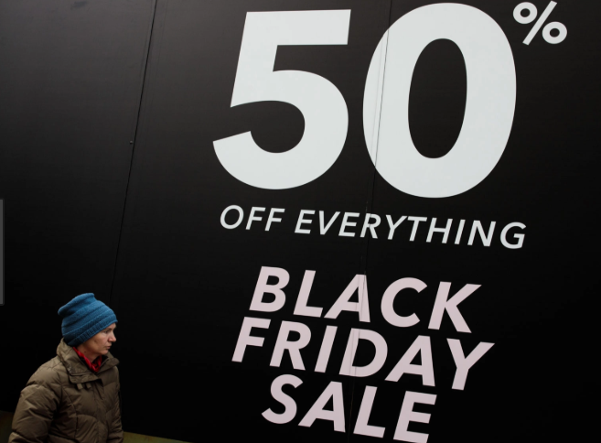
Black Friday Signs of disillusionment?
MINTEL found that 45% of those who bought something on Black Friday 2017 thought that the discounts weren’t as good as in the previous year (ie November 2016). In 2018 57% of buyers thought they weren’t as good as in 2017
In 2018 Black Friday took a bigger share of retail sales than in 2017. Scepticism among consumers did not stop people going out and buying any more than it’s stopped retailers taking part
Retailers plan for Black Friday well in advance and MINTEL found that the majority of offers, especially in electricals, are of special purchase merchandise rather than core merchandise
Source: PwC Consumer Survey - October 2018.

Slide 6
Black Friday no risk of crowds on the high street?
Only a quarter of all Black Friday spending is expected to take place in physical stores
Perhaps not surprisingly, those least likely to be spending on the High Street are the time pressured families, particularly 35-44 year olds, who expect less than a fifth of their Black Friday spending to be in physical stores
Over a third of 35-44 year olds’ spend overall will be via mobile, and a third of that mobile spend is expected to be through retailer apps rather than their general web browser
So, who will be spending on the High Street? It looks set to be a meeting of young and old, with the highest proportions of in-store spending amongst under 25s and over 55s. However, even amongst over 65s, over 60% of their spending is expected to be online, albeit overwhelmingly via desktop or laptop, rather than by mobile
How much of your Black Friday / Cyber Monday spending will be via these channels?
Source: PwC Consumer Survey - October 2018.

Slide 7
Black Friday spending hits the regions
The shoppers of London are planning to spend the most this Black Friday (2018), with almost one in ten Londoners saying they’ll spend over £1,000 this year
By contrast, the most careful shoppers are from East Anglia and Wales, both regions where consumers say they’ll spend less this year (2018)
Only a quarter of all Black Friday spending is expected to take place in physical stores
How much did / will you spend on Black Friday /Cyber Monday?
Source: PwC Consumer Survey - October 2018.

Slide 8
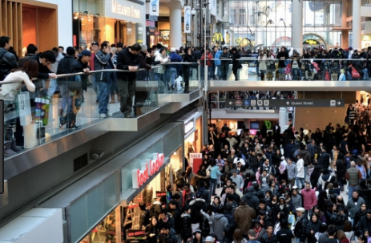
Black Friday where next?
There is clear disillusionment with Black Friday but that did not stop people from buying. In fact 58% of Black Friday buyers delayed making a purchase until they had seen the promotions
MINTEL research concluded that the fear of losing sales in today’s highly competitive market is the driving force. Retailers seem to feel that they can’t afford to stand aside. Even Asda joined in in 2018, having stood aside for the previous three years (the event was called ‘Green is The New Black’ but Asda promoted heavily at the end of November)
So, for better or worse, Black Friday looks set to be a feature of the retail landscape for some time to come
Source: PwC Consumer Survey - October 2018.

Slide 9
Significance Christmas gift and card sending

Slide 10
Christmas gift buying happens on and off line
In-store and online used almost equally
While 77% of Christmas gift buyers opted to make a purchase in-store, the proportion buying online was almost exactly the same (76%) highlighting the importance of a multichannel approach for almost any retailer. In fact, 54% of gift buyers made a purchase both online and in-store
Smartphones are becoming more important
For online shoppers smartphones are becoming increasingly important, particularly among the young, with 40% of 16-34 year olds using their phone to make a purchase while this figure also peaks among commuters into the city, of whom 37% made a purchase on their smartphone
Source: Christmas Gift Buying - UK - February 2019.

Slide 11
How much is spent and by whom
Gift buyers spend an average of £339
The level of spending differed from how much consumers spent in 2017 compared to 2018 and a fifth said they had spent more than previously. This figure was down from 24% when the same question was asked in 2017, with more people describing their spending as ‘about the same’ (56% last year)
45-54 year-olds buy for the most people
Family dominates Christmas shopping with over half of all buyers shopping for their partner and/or their children and grandchildren. 45-54 year-olds buy for the widest range of people and this is reflected in the fact that this age group also spends the most money on gifts
Source: Christmas Gift Buying - UK - February 2019.

Slide 12
When do consumers plan for christmas
November is the most popular time to start shopping
The most popular single month in which to start shopping for Christmas gifts is November, although by this time 40% of people say they have already purchased something
Women opt to start shopping earlier, with 28% having started their Christmas shopping before the start of October compared to just 16% of men. By contrast men are much more likely to leave it late, with 31% saying they didn’t make any purchases before the start of December
Londoners are also significantly more likely to leave their shopping to the last minute with 37% not starting until December, compared to just 19% of those living in the North East and North West
Source: Christmas Gift Buying - UK - February 2019.

Slide 13
Consumers are looking for a bargain
Shoppers believe that they should get a bargain
The damage done by discounting is demonstrated by the 60% of gift buyers who believe you don’t need to pay full price for gifts, with agreement peaking among 16-24 year-olds (70%)
Young people are most likely to see visiting shops as a good way to get into the festive spirit. The over-65s are most likely to think it’s important to support British business when buying gifts, highlighting the way struggling high streets can reach out to different demographic
Source: Christmas Gift Buying - UK - February 2019.

Slide 14
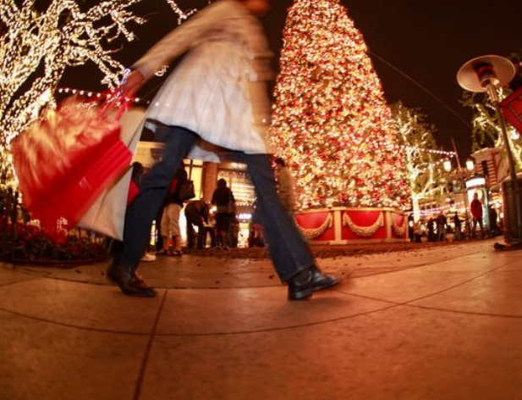
A chance to reach new shoppers at christmas
Shoppers buy things they wouldn't usually choose for themselves
The nature of gift buying means that shoppers tend to be looking for gifts that fall outside of the items they would generally purchase for themselves. As a result, 36% of gift buyers say they made a purchase from a retailer that they wouldn’t usually visit for themselves
This highlights the importance in the lead-up to Christmas of retailers ensuring that their shopping experience is sufficiently tailored to those who may be less knowledgeable about their products
Source: Christmas Gift Buying - UK - February 2019.

Slide 15
What is it looking like for Christmas 2019?
What is 2019 looking like?
Consumer demand is holding up, even though the final quarter was the weakest of 2018. People may be worried about Brexit, but real incomes are still rising and inflation is, if anything, edging downwards. On the minus side there’s the threat of rising interest rates and a weak housing market
2019 will not be a great year in terms of demand and the difficult trading conditions will continue. The pressure on retailers is to develop their own-brands. Debenhams has long had the right idea, but now its own-brands need rethinking and reviving
The challenge of 2019 will be to establish a point of difference which will allow retailers to avoid having to cut prices to shift stock
MINTEL research shows that the mid-range of forecasts should be for modest growth in both value and volume terms for Christmas 2019
Source: Christmas Gift Buying - UK - February 2019.

Slide 16
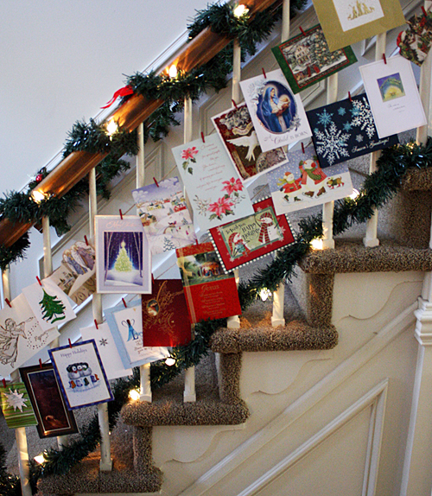
Sending of Christmas cards
Sales of greetings cards generally remain very buoyant in the UK, according to Mintel the retail greetings card market was worth £1,867m in 2018
Christmas cards remain the second most buoyant segment in the market behind birthday cards (according to Mintel in April 2019)
Whilst we don’t have figures which separate out business and consumer spending on Christmas cards don’t forget that it’s a great time to send your customers a special seasonal message or offer to help drive loyalty

Slide 17
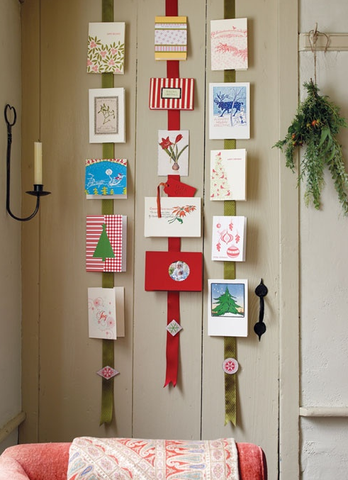
Why send cards to clients at Christmas?
The sending of Christmas cards is strongly and culturally engrained into our Christmas tradition
A corporate Christmas card is a great way to show customers and suppliers you value them and their business
It cuts through in a way that even an animated email can’t
It has a long and prominent shelf life and is a subtle reminder of your brand throughout December
A reminder of your brand is also a way of generating business
And finally it is a nice way of showing that you are real people, if you make it personal as well, this will really enhance the authenticity of your heart-felt message

Slide 18
Key metrics for core sectors

Slide 19
MAIL ORDER / ONLINE RETAILER
Interactions WITH MAIL
Average engagement = 92%
Engaged
Minimally processed
7
Addressed mail
Time in the home
ENGAGED: % of mail processed in some way including – opening, reading, sorting, put aside for later, filed, put on display, put in the usual place.
MINIMALLY PROCESSED: % of mail thrown away only.
Source: Addressed advertising and mail order / online retailer. JICMAIL Q2 2017 – Q1 2019. Base: 5,952.

Slide 20
MAIL ORDER / ONLINE RETAILER
ADDITIONAL COMMERCIAL ACTIONS
25% of those receiving mail order / online retailer mail go on to do one of these commercial actions
Per 1,000 actions
Source: Addressed advertising and mail order / online retailer. JICMAIL Q2 2017 – Q1 2019. Base: 5,952.

Slide 21
Retailer – clothing / household / electrical
interactions WITH MAIL
Average engagement = 93%
Engaged
Minimally processed
8.2
Addressed mail
Time in the home
ENGAGED: % of mail processed in some way including – opening, reading, sorting, put aside for later, filed, put on display, put in the usual place.
MINIMALLY PROCESSED: % of mail thrown away only.
Source: Addressed advertising and retailer (e.g. clothing, household, electric, etc). JICMAIL Q2 2017 – Q1 2019. Base: 7,757.

Slide 22
Retailer – clothing / household / electrical
ADDITIONAL COMMERCIAL ACTIONS
32% of those receiving general retail mail go on to do one of these commercial actions
Per 1,000 actions
Source: Addressed advertising and retailer (e.g. clothing, household, electric, etc). JICMAIL Q2 2017 – Q1 2019. Base: 7,757.

Slide 23
Supermarket or grocery store
interactions WITH MAIL
Average engagement = 98%
Engaged
Minimally processed
9.9
Addressed mail
Time in the home
ENGAGED: % of mail processed in some way including – opening, reading, sorting, put aside for later, filed, put on display, put in the usual place.
MINIMALLY PROCESSED: % of mail thrown away only.
Source: Addressed advertising and supermarket or grocery store. JICMAIL Q2 2017 – Q1 2019. Base: 3,230.

Slide 24
Supermarket or grocery store
ADDITIONAL COMMERCIAL ACTIONS
52% of those supermarket or grocery mail go on to do one of these commercial actions
Per 1,000 actions
Source: Addressed advertising and supermarket or grocery store. JICMAIL Q2 2017 – Q1 2019. Base: 3,230.

Slide 25
TV / Broadband / landline / mobile
interactions WITH MAIL
Average engagement = 89%
Engaged
Minimally processed
7.5
Addressed mail
Time in the home
ENGAGED: % of mail processed in some way including – opening, reading, sorting, put aside for later, filed, put on display, put in the usual place.
MINIMALLY PROCESSED: % of mail thrown away only.
Source: Addressed advertising and TV / broadband / landline / mobile. JICMAIL Q2 2017 – Q1 2019. Base: 2.346.

Slide 26
TV / Broadband / landline / mobile
ADDITIONAL COMMERCIAL ACTIONS
22% of those receiving telco mail go on to do one of these commercial actions
Per 1,000 actions
Source: Addressed advertising and TV / broadband / landline / mobile. JICMAIL Q2 2017 – Q1 2019. Base: 2.346.

Slide 27
Financial and insurance services
interactions WITH MAIL
Average engagement = 98%
Engaged
Minimally processed
7
Addressed mail
Time in the home
ENGAGED: % of mail processed in some way including – opening, reading, sorting, put aside for later, filed, put on display, put in the usual place.
MINIMALLY PROCESSED: % of mail thrown away only.
Source: Addressed advertising and financial and insurance services. JICMAIL Q2 2017 – Q1 2019. Base: 9,930.

Slide 28
Financial and insurance services
ADDITIONAL COMMERCIAL ACTIONS
25% of those financial and insurance services mail go on to do one of these commercial actions
Per 1,000 actions
Source: Addressed advertising and financial and insurance services. JICMAIL Q2 2017 – Q1 2019. Base: 9,930.

Slide 29
The offer detail

Slide 30
The special offer
Advertising MAIL, RESPONSIBLE mail & Partially Addressed Mailmark in trays offer prices at a glance
Note to Media Specialists:
For use with Wholesale
Delete as appropriate
FORMAT
WEIGHT
UNIT PRICE
LETTER
Up to 100g
12p
LARGE LETTER
Up to 100g
21p*
LARGE LETTER
101-250g
25p
*offer price is higher than the Partially Addressed rate card price.

Slide 31
The special offer
Advertising mail, SUSTAINABLE MAIL & Partially addressed ECONOMY Mailmark in trays discountS at a glance
CREDIT ADVERTISING
MAIL
CREDIT SUSTAINABLE
ENTRY
CREDIT SUSTAINABLE
INTERMEDIATE
FORMAT
WEIGHT
LETTER
Up to 100g
5.209p
4.709p
4.209p
LARGE LETTER
Up to 100g
1.220p
0.720p
0.220p
Note to Media Specialists:
For use with Retail
Delete as appropriate
LARGE LETTER
101-250g
6.181p
5.681p
5.181p
FORMAT
WEIGHT
CREDIT
PARTIALLY ADDRESSED LETTER
Up to 100g
1.209p
PARTIALLY ADDRESSED LARGE LETTER
Up to 100g
0p
PARTIALLY ADDRESSED LARGE LETTER
101-250g
4.181p

Slide 32
Key dates
Black Friday
01 September 2019
15 November
2019
11–30 November
2019
OPENING DATE
APPLICATION
DEADLINE
VALID DATES

Slide 33
Key dates
christmas
13 December
2019
11 November -
27 December
2019
01 September 2019
OPENING DATE
APPLICATION
DEADLINE
VALID DATES

Slide 34
Black Friday and Christmas offer
Possible business case for wholesale national price plan
 | BASE LINE @ RATECARD | INCREASED TEST VOLUME
VOLUME | 65,000 | 115,000
RESPONSE RATE | 1.00% | 1.00%
RESPONSES | 650 | 1150
POSTAGE | £0.172 | £0.120
PRINT AND PRODUCTION | £0.20 | £0.20
COST PER ITEM | £0.37 | £0.32
TOTAL COST | £24,180 | £36,800
AVERAGE CONTRIBUTION PER RESPONSE | £50 | £50
TOTAL CONTRIBUTION | £32,500 | £57,500
INCREMENTAL REVENUE | £8,320 | £20,700
Additional spend volume of 50,000 increases spend by just over £12k but might deliver additional revenue of £12,380

Slide 35
The practicalities of applying

Slide 36
Mandatory requirements
High level requirements for entry to black Friday and christmas
For Mailmark Advertising Mail & Partially Addressed Letters and Large Letters up to 250g
Post at least 50,000 incremental items to qualify for this incentive
No postcards.
(Single piece mailers are allowed)
11 November 2019 to
27 December 2019
Trays only.
Letters must be submitted in trays to ensure sorting is quick and easy
Discounts are paid as postage credits that will be valid for 12 months

Slide 37
The application process
APPLY ONLINE FOR YOUR CREDIT AND RECEIVE YOUR DISCOUNT
Once your mailing has been sent, you will receive your discount in the form of postage credits
12 MONTHS
You have 12 months to redeem your credits
ROYAL MAIL CONFIRM YOUR ACCEPTED VOLUME
COMPLETE ONLINE APPLICATION FORM AND SUBMIT EVIDENCE
Fill out the application form attached with your information, company details, proposed volume and product specification
POST YOUR COMMUNICATIONS
Print your communications
REDEEM ON FUTURE MAILINGS
Use your postage credits on any future mailings

Slide 38
The validation process
1
4
Sales team meet prospective customer and provides guidance regarding evidence of incrementality
Post your incentive mailing and apply for your credit
2a
2
Further information may be required to validate the base line
Customer submits evidence with completed application forms online
3
Customer application approved and confirmation emailed from Royal Mail

Slide 39
How to apply for the special offer
Apply yourself or through an agent both through online application
https://www.royalmail.com/advertising-mail-black-friday-and-christmas-incentive-application
2. Royal Mail may request additional documentation to provide evidence of incremental volume:
12-month mailing/campaign plans dated before and after the announcement of the incentive showing volume that was in the plan
Dated internal communication showing the decision-making process agreeing to use the incentive; or internal business case showing an increase in advertising budget to accommodate more volume
If you do not have any of the above, we require an email from a director of the company confirming that the volume is incremental and exceeds the volume posted in the corresponding period in 2018 and is only being posted because of the incentive.

Slide 40
APPENDIX

Slide 41
What are the most popular Christmas gifts
45-54 year-olds buy for the most people
In total, 49% of buyers said they bought gifts for non-family members peaking among females aged 16-24 (63%). Just 13% buy presents for their work colleagues and these people tend to be younger and more affluent than the average population, reflecting the fact they are working rather than retired or at college
Clothing is the most popular gift purchase
89% of all gift givers opted to buy a physical present, although 26% gave a non-physical gift such as digital content, experiences, charitable donations, cash or gift cards (with cash/gift cards dominant among these)
continued…
Source: Christmas Gift Buying - UK - February 2019.

Slide 42
What are the most popular Christmas gifts
Clothing the most popular gift purchase
Following clothing the most popular gifts were:
Beauty and personal care products
Books
Food and drink
Gift cards / vouchers or cash
Other entertainment products
Toys and games
Source: Christmas Gift Buying - UK - February 2019.

Slide 43
Christmas is becoming an ethical event
Shoppers are increasingly concerned about the environment
Environmental concern has been a key trend of 2018 and so it has impacted consumer attitudes towards gift buying. Demand for products generating less waste peaks among women (71%) and the over-65s (71%). Meanwhile, younger shoppers are more concerned about the ethical implication of their purchases (52%)
Mintel research shows that 29% bought a gift with a lower environmental impact, while 38% bought ethically sourced gifts, but fully 65% agree that retailers should make more effort to promote gifts that generate less waste
It’s also important to note that this is not just a concern of a niche set of consumers. 71% of 16-24 year old's and 71% of those over 65 agree that more thought should be on the environmental impact and promoting gifts that generate less waste, showing that this needs to be taken seriously by all retailers, no matter their target market
Source: Christmas Gift Buying - UK - February 2019.

