Slide 1
How retail mail engages customers at every level
Using mail to drive sales
March 2020
YOUR LOGO GOES HERE

Slide 2
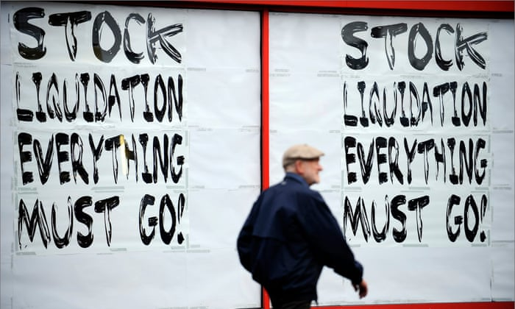
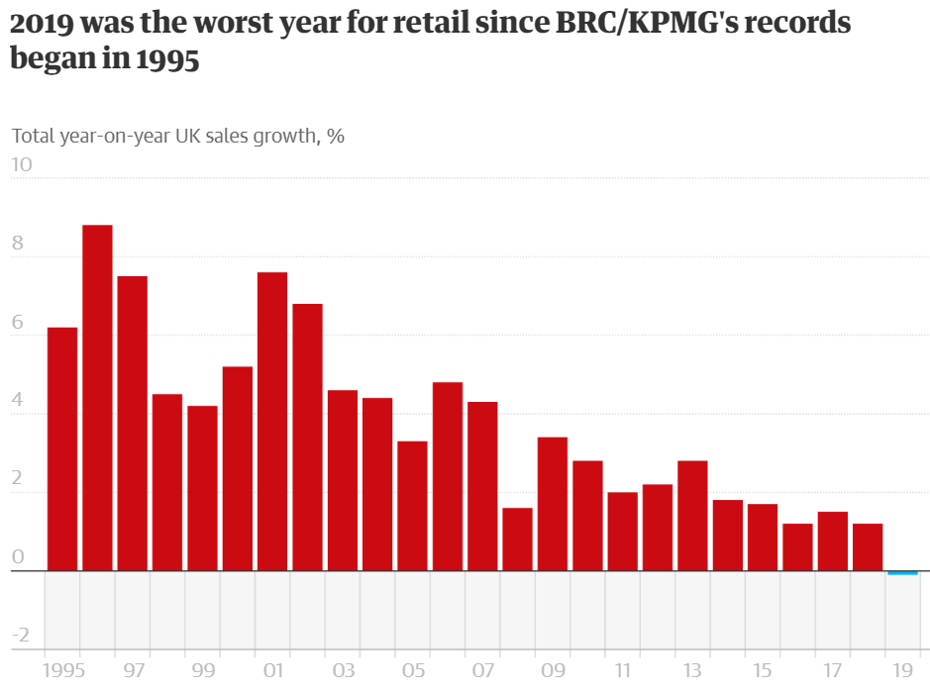
The state of retail in the UK
The retail sector is having a hard time
Total sales slipped by 0.1% in 2019, according to the British Retail Consortium (BRC) and advisory firm KPMG, the lowest since they began monitoring the sector in 1995
The downturn was influenced by a 0.9% fall in sales in the crucial final two months of the year when many retailers get most of their annual profits
That decline was partly driven by online sales rising by 2.6% in November and December
Source: British Retail Consortium and KPMG, January 2020
Notes:
Last year was the worst on record for British retail, with sales falling for the first time in 24 years as a dire performance on the high street dragged down the industry.
Total sales slipped by 0.1% in 2019, according to the British Retail Consortium (BRC) and advisory firm KPMG, the lowest since they began monitoring the sector in 1995.
The downturn was influenced by a 0.9% fall in sales in the crucial final two months of the year when many retailers get most of their annual profits. That decline was partly driven by online sales rising by 2.6% in November and December.
“2019 was the worst year on record and the first year to show an overall decline in retail sales,” said Helen Dickinson, the chief executive of the BRC.
Dickinson said: “Twice the UK faced the prospect of a no-deal Brexit, as well as political instability that concluded in a December general election, further weakening demand for the festive period.”
Retailers were facing the challenge of the shift to online shopping and more cautious spending, triggered by economic uncertainty and concerns about the environment, she said.
The shift towards renting and a soft housing market, as well as the trend towards buying and owning less “stuff”, also hit retail.

Slide 3
Consumers’ shopping behaviour
Has changed and trust cannot be relied on… it has to be earned
Agree they are willing to spend time shopping around to get the best value
Said they would switch to a brand’s competitor within a week of having a negative experience
Claim to buy from brands they know even when they know they could be getting a cheaper deal elsewhere
BUT
Would purchase elsewhere if their preferred method of delivery wasn’t available
Source: DMA, Kibo, Vendasta H
Notes:
And loyalty counts for a lot when making purchasing decisions. 55% are more likely to buy from a brand they know, even if they think they’ll get it cheaper elsewhere.
However there are significant numbers who will be influenced by value and will shop around and the brand experience has to be consistently delivered – if it isn’t 79% of consumers say they’ll switch if anything negative in those customer interactions happens.
And with online shopping the method of delivery ie giving a trusted partner to deliver goods is of importance.

Slide 4
Engagement rates with mail are high
Across all retail sectors for addressed mail, but especially supermarkets
Engaged
Minimally processed
Retailer
(eg clothing /
electrical)
n=7,757
Supermarket
or
grocery store
n=3,230
Mail order / online retailer
n=5,952
  ENGAGED: % of mail processed in some way including – opening, reading, sorting, put aside for later, filed, put on display, put in the usual place.
  MINIMALLY PROCESSED: % of mail thrown away only.
Source: Addressed mail, JICMAIL Q2 2017 – Q1 2019. Retail Engagement
Notes:
Engagement rates with mail in the retail sector are strong.
From JICMAIL data we can see that all types of retail mail drive good engagement rates, with supermarkets being the highest at 98%.
The supermarket chains have invested heavily in loyalty schemes (not all of course) and this does seem to drive the fact that very little of their mail is only minimally processed.
As you can see in the slide we are counting engagement as being opening, reading, sorting mail or putting aside for later, filing, putting on display or putting in the usual place.

Slide 5
All types of retail mail are interacted with
People typically returning to a piece more than four times
For every 100 packs mailed another 10 people will engage with it
These are the physical actions people take with mail: opening, reading, putting aside, filing, doing something with the information.
N=6,909
N=8,505
N=3,603
Source: Kantar TNS, JICMAIL, Addressed/Business Mail, Q2 2017 – Q1 2019
Notes:
Reach is the number of people that the mail will reach. So for every 100 mail packs that are being sent by retailers another 10 people will see the mail and interact with it in some way.
Frequency is the number of physical interactions each person has with their mail. The average frequency for all mail is 4.2, so you can see that retailers perform slightly higher than this average.

Slide 6
Retail mail drives commercial action
The average for mail driving commercial actions is that 32% of all people across all sectors go on to do something commercial with their mail
Mail order /
online retailer
Retailer
e.g. clothing / electrical
Supermarket
Notes:
Of those consumers who engage physically with a mailing pack, such as opening, reading, sorting and filing a significant proportion of them go on to do something JICMAIL calls a commercial action. By commercial actions we mean things like:
Went online for more information
Discussed with someone
Bought something/made a payment or donation
Called the sender
Visited the sender’s web site
Used a tablet or smart phone
Used a voucher/discount code
Visited a sender’s shop/office
Planned a large purchase
Ordered a catalogue
Looked up my account details
Posted a reply to the sender
You don’t necessarily have to be physically handling the mailing pack when you do these things with the mailing.
There are things that you are more likely to do with retail mail, depending on the type of content contained within that mailing.

Slide 7
What commercial actions are the taking?
These are the main types of mail content they are engaging with
%
AVERAGE ALL
SECTORS = 32%
4,633
5,079
868
1,749
2,525
1,038
668
2,034
2,206
344
369
172
673
379
76
63
247
495
Source: Kantar TNS, JICMAIL, Addressed/Business Mail, Q2 2017 – Q1 2019
Notes:
Commercial actions on different types of mail content show that interactions with special offers and discounts and vouchers and discounts are interacted with at a high level. Whilst retailers are sending fewer financial statements/bills and updates these drive high levels of engagement, alongside loyalty statements, which have also seen a decline.
So mail drives all kinds of commercial engagement, and can, if the content is right get people to act. Compare this to average click through rates to an email of 0.9% to 2.4% (according to Campaign Monitor who analysed billions of emails sent from the UK between January and December 2019) you can see that mail is driving high levels of engagement. With a physical mail piece you can achieve high rates of action.

Slide 8
Which ages receive mail
Number of mailing packs received by age group each week
If you are under 30 you are much more likely to be receiving no mail or just 1-2 pieces of mail a week. But by the age of 25-29 this starts to change as you get more established in your own household
In the older cohort you are much more likely to receive more than 15-19 for those over the age of 75. You have been at your address much longer (20 years +) and have deeper brand connections
Anything above 120 is significantly over-index and 80 under-index
Source: GB TGI 2018 Q4 (July 2017-June 2018) – GB TGI + JICMAIL 2018 Q2 Fusion. Base 24,587
Notes:
18-24 year olds are the least likely to be receiving mail. They are often still likely to be living at home or moving between home and college so are the most transient group of all. However they are also the least likely group to be targeted with mail.
By the time you reach 25, whilst you are still more likely to be getting no mail or just 1 or 2 pieces there is a proportion who index at 139 for getting 11-14 pieces of mail a week.
The older age groups are clearly being targeted with mail with high indices for those receiving 15-19 pieces a week for both the over 65s and over 75s.
Essentially what this shows us is that young people are not getting nearly as much mail – probably not a great surprise.
Anything above 100 is signifanct

Slide 9
What do they do with it
What different age groups do with their mail
The younger age groups interact with mail in a broadly similar way to older groups but are more likely to put off dealing with it by putting it aside to look at later and significantly more likely to take it out of the house
The older group look like they deal with their mail more decisively with more recycling and less putting aside
Source: GB TGI 2018 Q4 (July 2017-June 2018) – GB TGI + JICMAIL 2018 Q2 Fusion. Base 24,587
Notes:
What might surprise though is how they interact with their mail.
Let’s face it this is pretty similar except for their likelihood of dealing with it, ie putting it aside and putting it on display for the 18-30 year olds and the highest index of all – taking it out of the home.
You can see the older groups dealing with it, with higher incidence of throwing it away or recycling it, which becomes even more significant for the oldest cohort.
This suggest that mail is much more of a novelty for the younger groups, partly because they don’t get much. It also suggests that they take longer to process mail than the older groups who have, over the years, built up an approach to dealing with the mail that they receive.

Slide 10







Mail is relevant at all points
Of the customer journey because it drives behaviour
KEY TRADING PERIODS
The role for mail to drive business at key times of the trading calendar
BILLS / STATEMENTS
How simple communications can drive additional activity
WELCOME
How mail works to activate new customers and engage them in the right way right from the start
CHURN REDUCTION / WIN BACK
How simple communications can drive additional activity
ENGAGING CONTENT
Catalogues work hard to drive engagement and purchase
ACQUISITION / CONSIDERATION
Using door drop or partially addressed to drive acquisition and consideration
RETENTION / CROSS SELL / UP SELL
How mail can keep customers and engage them in more ways with your brand
Notes:
Retail mail is great for all types of consumer touchpoints and can work to drive sales at pretty much any stage of the customer journey.
JICMAIL data also includes the Mail Examples database, which gathers mail the consumers on the panel record so you can look at individual customer journeys.
These are just snapshots of what an individual household do with their mail and the ones we’ve selected show different points within the customer journey.

Slide 11
























Exclusive invitation
Gets the other half involved in buying
AUG/SEPT 2018
SOCIAL GRADE: DE
YOKSHIRE
29
1
ITEM ARRIVES
FEMALE
25-34
HHC
MALE
25-34
FEMALE
35-44
MALE
25-34
MALE
0-16
REACH = 5
FREQUENCY = 15
COMMERCIAL ACTIONS = 15
STI IN THE HOME
Source: JICMAIL Examples Database Q2 2017 – Q3 2018
Notes:
This catalogue mailing from Studio arrived in this household on the 29th August. We’ve colour coded all the individuals here to show who interacted with it.
There was a big flurry of activity on the day it arrived. The household co-Ordinator (the person who sorts the post) interacted with it the most.
After it’s arrival she, opened it, read it, put it aside to look at later, used it/did something with the information. She also put it in the usual place, went online twice and made two purchases. The first male in the household read it and made a purchase on the same day. The second male in the household also read it and made a purchase. The older woman in the household read it. And finally on the 29th of August the youngest in the household also made a purchase.
Just a day later the household co-Ordinator opened it again, read it, put it in the usual place, discussed it with someone, went online, used a voucher and bought something. Alongside another three purchases from 3 other members of the household.
This examples shows that all members of this household interacted with the catalogue in some way, four of them went on to buy something.
The physical interactions total 15 and the commercial actions total 15. Obviously not every household will interact with the mailing like this but this looks like the timing of this offer reached this household at the exactly the right time.

Slide 12





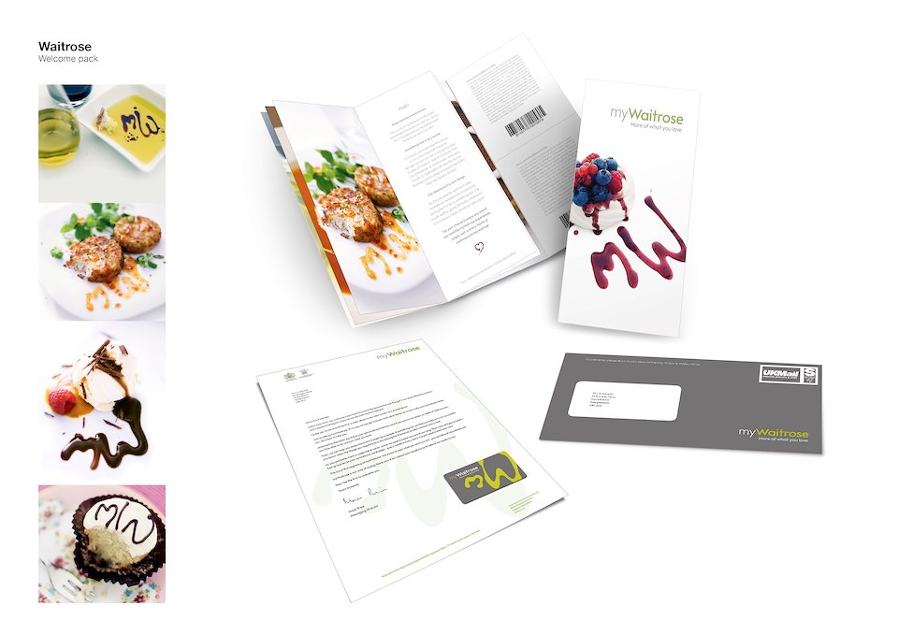
welcome pack engages
Both with reading and commercial action
SEPT/OCT 2019
SOCIAL GRADE: C1
NORTH WEST
25
1
ITEM ARRIVES
FEMALE
23-34
HHC
MALE
35-44
4
13
FEMALE
0-16
MALE
0-16
REACH = 2
FREQUENCY = 9
COMMERCIAL ACTIONS = 4
Pack representative of final pack received by the customer
Source: JICMAIL Examples Database Q2 2017 – Q4 2019
Notes:
This household of four spent a bit longer considering this welcome pack. The female in the household who is also the household co-Ordinator opened the mail, read it, discussed it and then put it aside for later.
Six days later she and her partner read the mailing and then discussed it.
In another three days this mailing piece (or part of it) is taken out of the house, to the sender’s shop where they use a voucher and make a purchase.

Slide 13

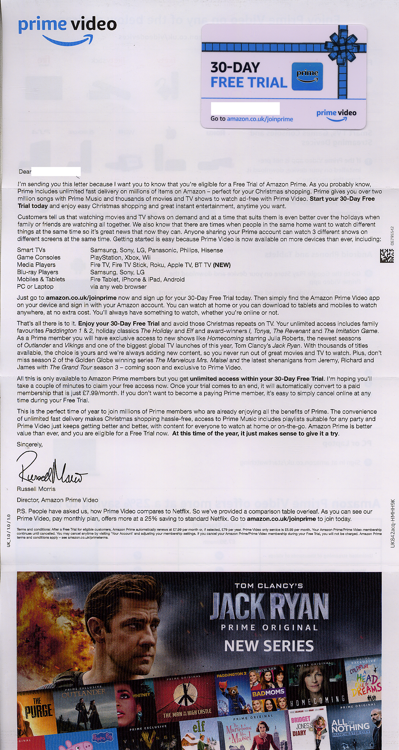
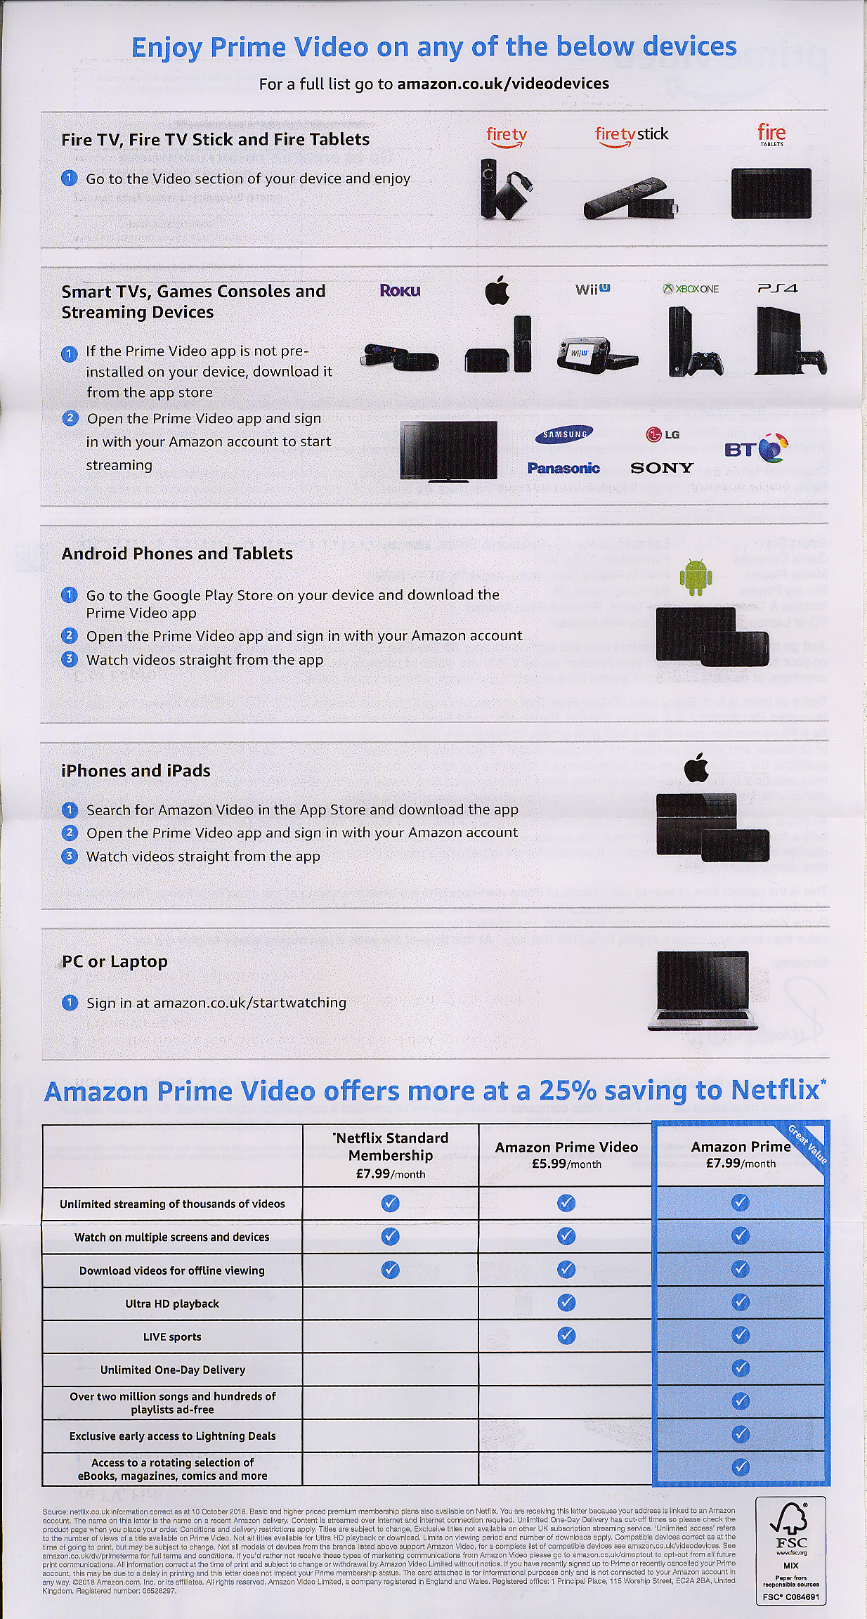




A big flurry gets an upgrade
With this simple upgrade
NOV 2018
SOCIAL GRADE: B
MERIDIAN WEST
30
ITEM ARRIVES
MALE
35-44
HHC
FEMALE
35-44
FEMALE
0-16
MALE
0-16
REACH = 2
FREQUENCY = 10
COMMERCIAL ACTIONS = 3
STI IN THE HOME
Source: JICMAIL Examples Database Q2 2017 – Q4 2019
Notes:
This Amazon customer who is the mail in the household and passes the mail on to his partner who the mail is for. He does this twice and puts it in the usual place, he also talks to someone about the mailing.
On the same day as the arrival of the mail she opens it, reads it, discusses it and puts it aside for later.
This piece is still live in the home after 28 days, as we know with mail it tends to have a long response curve so this piece could still be acted on.

Slide 14
YOUR LOGO GOES HERE

