Slide 1
MAKING THE MOST OF MAILMARK DIRECT DATA
12 August 2021

Slide 2




Supply chain to consumer
A seamless way to track your mailing campaigns
A barcode standard for Business Mail, Advertising Mail, Subscription Mail and Publishing Mail
At different stages within the supply chain data is captured for each piece of mail
The Mailmark Reports provide information on mail processed and seen in the system
This means we can see what mail is coming in, when it has been processed and the last scan date before delivery

Slide 3





What do mailmark barcodes look like
Know where your processed mail has been seen in the supply chain
Reliable information about where and when your mail has been processed
When it due to be delivered
With the right analysis or software provider it will allow you to see where and when it predicted to land geographically
It can indicate potential delays in the supply chain
Certain (2D) barcodes allow you to append additional data to it as you wish for more tracking information

Slide 4

How the system works
MAILMARK MANAGEMENT SYSTEM
E-MANIFEST CREATION
E-MANIFEST UPLOAD
E-MANIFEST
(DOCKETHUB)
SORTATION
SCID and item IDs allocated
REPORTING
DATA STRING CREATION
BARCODE GENERATION
MAIL PRODUCTION
MAIL PROCESSING
CUSTOMER AND SUPPLY CHAIN SYSTEMS
ROYAL MAIL SYSTEMS
Data can be accessed daily via Secure File Transfer Protocol

Slide 5
Data available at HOUSEHOLD LEVEL
A daily snapshot of current postings. The data shows a summarised view of the posting volumes and predicted landing date
You can see the data down to individual household level and see where each mailing piece is due for delivery
With the right software people are using the data to give robust fall to earth predictions at household level

Slide 6
Improving business performance
Helping to improve efficiency over time
Improving data quality – less wastage
2
3
Checking that your supply chain is effective at every point
Drive business insight into mail performance
1
4

Slide 7
How you can use this data

Slide 8

Delivery verification
For every mailing communication
Time and date items are processed on Royal Mail’s machines
It will show you if you have any duplicated items
Allows you to see what is delivered by day – know where your mail is
Items incorrectly addressed and therefore are undeliverable
Items presented against the wrong service, class or format
Will tell you the number of missorts

Slide 9
Business management impacts
Using mailing patterns over time to manage customer experience
Managing performance of your supply chain to improve efficiency
Improving attribution or econometric models
Better and cleaner data, less wastage
Ability to plan and stagger drop dates to suit capacity by using cumulative data
Improve mailing performance with better data around drop dates

Slide 10
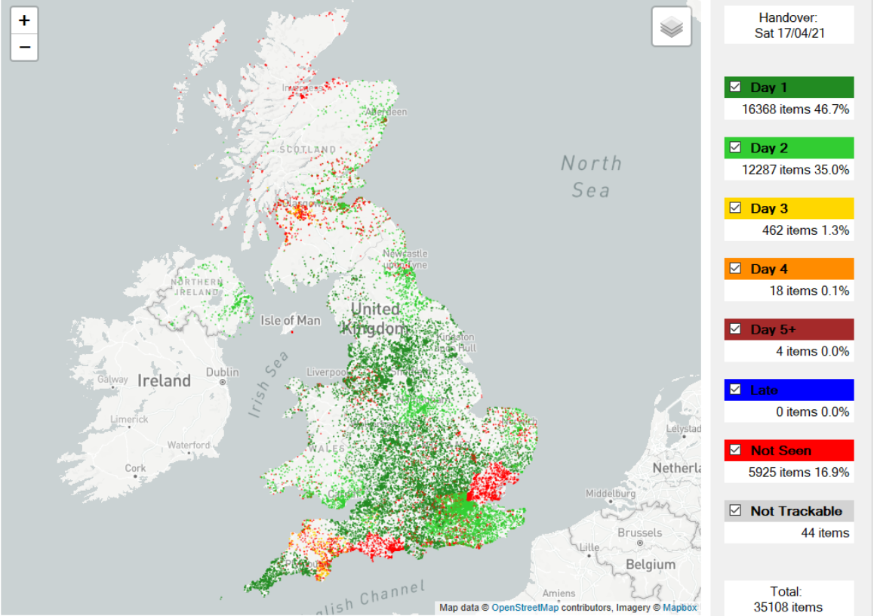
Daily delivery data
The ability to see at a glance when your mail is landing from day 1 from the handover day
From this example you can see nearly 47% of this mailing landed on day 1 and 35% on day 3
All based on what’s been seen in the supply chain and the predicted delivery date
Any issues on areas with slower deliver will be highlighted
Source: BBS, Intelligent Data Solutions, 2021

Slide 11
Potential innovations using mailmark direct data

Slide 12
predict delivery date of economy product
Anticipated drop of economy product
Introduces delivery window of between 1 and 4 working days from handover to Royal Mail
Mailmark technology will enable us to defer an Economy item until such time as we know we are delivering another item to the same address
The price is circa 3% less than the standard service
From 5 April 2021 this service became VAT-Exempt following Ofcom’s consultation
Access slots, Mailmark uploads, User Guide and specifications all in line with existing standard services

Slide 13
MARKETING AUTOMATION INTEGRATION
Using Mailmark delivery data to drive better integrated communications:
Knowing when your mail has landed gives you more opportunities
Combine other touchpoints with your mail to improve performance: SMS, email, etc
Test performance of different channel combinations
Better reporting and attribution becomes possible with more informed mail data

Slide 14

Attribution modelling
For those operating in the world of direct response, the question that JICMAIL often raises is one of why practitioners should worry about making mail analysis more sophisticated in attribution models when clients largely measure mail themselves via a trackable URL, code or phone number
Measuring via a trackable URL, code or phone number is useful but can be a bit like “last click” attribution as applied to digital media.
JICMAIL complements this perspective because it paints a broader and more complex picture of mail effectiveness

Slide 15

Refined media planning
With undeliverable volumes built in to your metrics your media agency can work out accurate CPTs
This can be used to compare to other channels used as part of an overall plan
With a greater understanding of when your mail drops could this help to refine the other media you are buying
If you know that 80% of your mail drops by day 2, do you want to upweight other media channels to support e.g. TV, radio or other broadcast media to enhance the response to mail

Slide 16

Econometric modelling
Since JICMAIL’s launch in 2017 it has been steadily building a reputation as an indispensable source of planning insight for the advertising mail industry
With over 160,000 mail items now captured within the data set there has never been a richer source of mail interaction data on which to both shine a light on the role of mail in the media mix
With Mailmark Direct Data media agencies building econometric models now have access to two vital data sets: mail circulation figures for a brand and the predicted day the mail drops on the mat
This gives them full visibility of the mail volumes but also the day it reaches the consumer
And of course they can add the key metrics for Reach and Frequency to give them the true impact of mail on consumers

Slide 17

Interaction rate modelling
Frequency of interaction differs by day of week: this could be a crucial planning consideration
In the world of mail where delivery date is a controllable factor
Finance direct mail interaction tends to be highest at the beginning of the week, while for supermarkets direct mail interaction is highest at the weekend
Day of week and week and month analysis can be observed right down to the individual physical interaction or commercial action level – for example, consumers are more likely to be prompted to go online when mail is received at the weekend, but pick up the phone and call an advertiser when received on a Thursday or Friday.

Slide 18
THANK YOU

