Slide 1
E-Invoicing for Network Access Customers
In Commercial Confidence
November 2017

Slide 2
Royal Mail is looking to provide the option for customers to receive their invoices in an electronic format.
We have invested in a secure online storage portal for both live and copy invoices.
The portal is called Trust Web.

Slide 3
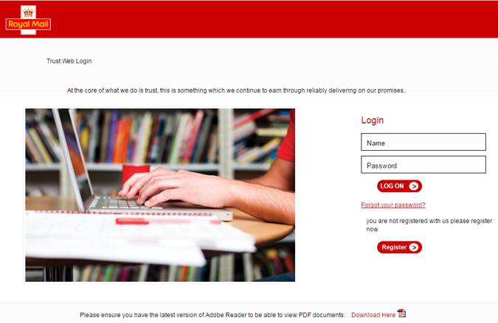
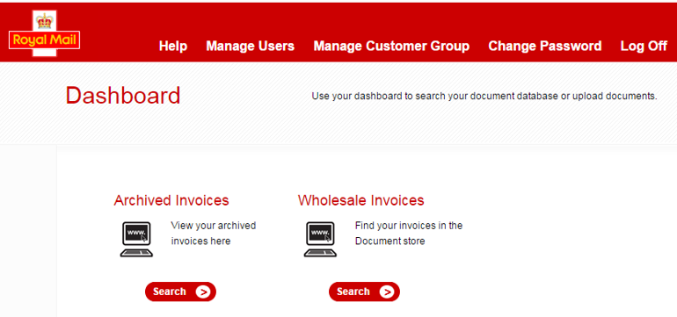
Invoices can be reached by logging into a secure online portal, Trust Web.
ACCESS AND LOGIN
The following URL launches the log in page:
https://www.opustrustweb.co.uk/royalmail/LogonNew1.aspx
Access to the site is via secure log on.
DASHBOARD
The dashboard includes access to:
live invoices under ‘Wholesale Invoices’ and
copy invoices under ‘Archived Invoices’
Copy invoices are stored for the current year and six previous years.

Slide 4
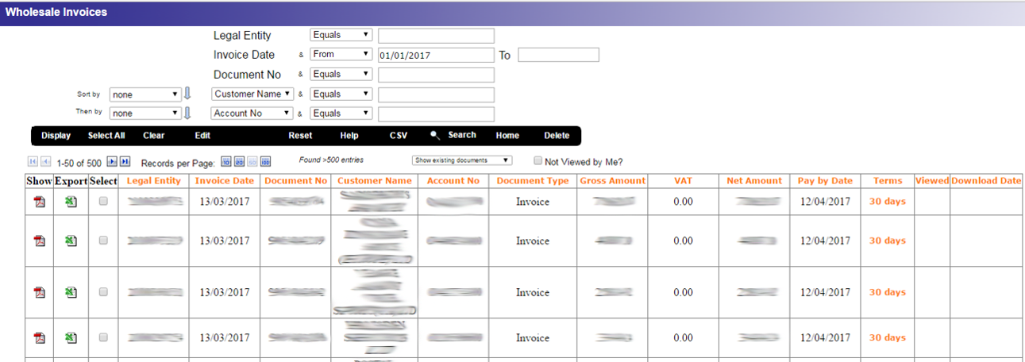
The interface allows you to search for invoices using a number of criteria. Invoice files can be downloaded as pdf or csv files.
REPORT INTERFACE
DRILL DOWN VIEW

Slide 5
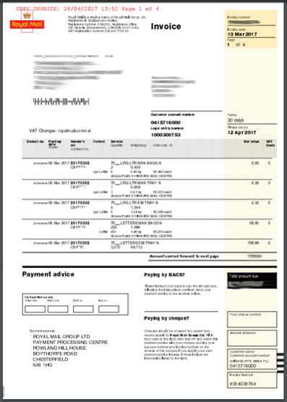
A PDF copy of your invoice can be printed or exported and saved as required
PDF DOCUMENT VIEW
The following URL launches the log in page:
https://www.opustrustweb.co.uk/royalmail/LogonNew1.aspx
Access to the site is via secure log on.

Slide 6
Your nominated contact will be notified of new invoices via email.
When a new invoice is ready to view an email will be sent to you to inform you that a new invoice is ready for you to view. The email includes high level details of the invoice: account number, value, due date.
If an invoice has not been viewed a document reminder email will be sent to you. This advises you that you have a new invoice not yet viewed and that the due date is imminent.
Each “customer” is defined by a discrete legal entity.
For Access operators managing agency customers’, the legal entities of agency customers can be added to the operator’s platform.

Slide 7
Timelines for deployment of the new system
Royal Mail has started the build and testing is due in February 2018
You will be able to access the new solution from March 2018
We propose interested customers “test” in the live environment, and provide us with an implementation timeline for when to stop sending the paper invoices i.e. allows you to work up your internal process for receiving electronic invoices before switching off paper copies.

Slide 8
Interested?

