Slide 1
Using mail to drive commercial outcomes with subscriptions
How TO USE MAIL TO GET CONSUMERS TO ACT ON THE CONTENT
May 2020
YOUR LOGO HERE

Slide 2
The back drop

Slide 3
On and offline subscriptions remain stable
From June 2018 to January 2020 subscription rates consistent over time
Mintel Media Trends Spring - UK - March 2020, Media Subscriptions

Slide 4
Purchasing of print subscriptions
Print magazine purchasing, august 2019
“Did you buy any of the print magazines that you have read in the last 6 months? Please select all that apply.”
Source: Lightspeed/Mintel, Base:1,029 internet users aged 16+ who have read print magazines in the last six months

Slide 5
Physical publications valued
60% of people said that reading print magazines is more enjoyable
Source: Lightspeed/Mintel, Base:2,000 internet users aged 16+

Slide 6
Dominic Mills in mediatel
4 may 2020 – THINGS HAVE CHANGED
I was surprised — and a little bit impressed — to find a Conde Nast leaflet inviting me to subscribe to one of its titles for the bargain price of £1 per printed issue.
Good for them. In what is clearly a terrible climate for newsstand sales — what newsstand, you might say — you’ve got to do something.
But it seems the UK is indeed discovering (or rediscovering) the magazine subs habit, according to Magnetic’s Sue Todd: 7,250 new subs to The Week Junior in April; Bauer’s online subs purchase up 70% this year; and a 100% increase for Hearst in the second half of March.
I totally get it. I subscribe to one weekly and one quarterly. The quarterly is due soon, hotly anticipated, and the arrival of the weekly on a Friday is a highlight. Only four days to the next.

Slide 7
Print subscriptions more popular
Than digital during lock down
Although take up in digital subscriptions has risen, interest in print subscriptions has risen by at least twice as much as digital since the start of the lock down
All print magazine categories have shown significant increases in page views, with the biggest growth seen in Kids (502%!). Home and Gardening (403%), and Women’s (325%).
Even sport has seen improved performance – suggesting readers are still keen to keep up-to-date, despite no sport taking place at the moment
Source: The Jelly Fish Group, May, 2020
Source: magazine.co.uk, YOY increases in page views 23 March to 26 April

Slide 8
How mail can drive commercial value to you

Slide 9
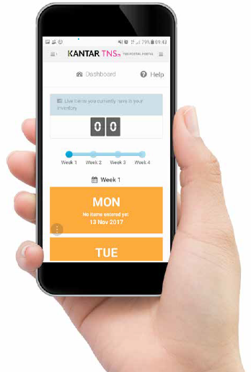
Jicmail gives us gold standard data
That shows exactly how consumers interact with publishing mail
Mail is collected in the first week and recorded, then that week’s mail is tracked over 28 days
People record what they do with their mail physically
They tell us the type of mail, i.e. is it addressed or unaddressed to them or someone else.
Opened it
Read / looked at / glanced at it
Put it on display e.g. fridge / noticeboard
Passed it on / left out for the person it’s for
Put it aside to look at later
Threw it away / recycled
Took it out of the house e.g. to work
Used / did something with the information
Put it in the usual place
They capture what business sector the mailing or door drop comes from.
They record the contents; is it information, special offer, etc. You can tick all that apply here.
Notes:
JICMAIL data has been available since the second quarter of 2017, it now contains over 92,000 individual mail packs across all the main industry sectors. It has been designed to create Gold Standard for the industry so that mail and door drop can be planned alongside other media in exactly the same way as all other channels.
A panel of 1,000 households each month collect their mail and door drop for the first 7 days of each month. They then track that content over a full 28 day period and tell us what they did with it physically ie opened, read and passed it on. But in addition they record any commercial actions, such as going online, calling the sender or using a voucher or discount code.

Slide 10
Engagement rates with publishing mail
STRONG across the board
91% of all publishing mail is engaged with ie mail is processed in some way (opened, read, sorted, put aside)
65% of all publishing mail is opened (a postcard doesn’t need to be opened)
63% of all publishing mail is read / looked at / glanced at
Source: JICMAIL Q2 2017 – Q1 2019 Addressed or Business Mail, Magazine, Newspaper Publisher, n=3,070
Notes:
Engagement rates with mail from publishers is on a par with all other sectors.

Slide 11
What are publishers sending?
They are mainly sending information about products and services, followed by information about products/services
Source: JICMAIL Q2 2017 – Q1 2019 Addressed or Business Mail, Magazine, Newspaper Publisher, n=3,070
Any type of content with 1% or less has been removed
Notes:
Predominantly people say that the content is largely a news/update or magazine article.
But also information about products and services at 18% or about entertainment or events, obviously another important strand of some publishers’ business models – shows and events.

Slide 12
physical actions
Physical interactions with publishing mail are strong
Source: JICMAIL Q2 2017 – Q1 2019 Addressed or Business Mail, Magazine, Newspaper Publisher, n=3,070
Any type of content with 1% or less has been removed
Notes:
Physical actions are those actions that consumers take which means they have to have the pack present when they are doing it, it is the sorting, reading, putting aside and so on.
A very large proportion of publishing mail is put aside to look at later, much higher than average. It’s only 25% for all other sectors.
So initial physical engagement is strong.

Slide 13
MAIL DRIVES COMMERCIAL ACTIONS
Publishing mail is not driving good commercial engagement (av = 32%)
But when it contains certain content it really does perform well
%
Resulting commercial actions with publishing mail
531
238
103
2,439
367
64
267
82
Source: JICMAIL Q2 2017 – Q1 2019 Addressed or Business Mail, Magazine, Newspaper Publisher, n=3,070
Notes:
It is disappointing to see that publishing mail does not perform as well as the other sectors combined in driving commercial activity. But actually when you delve a bit deeper the worst performing categories are within news/updates and magazine articles ie more general pieces of mail don’t seem to be motivation commercial engagement. But when there is an offer this rises to 29% but when there’s a physical coupon in the mailing pack it shoots up to 51%. Invitations to specific events seem to perform well too, which supports the use of mail for getting subscribers to attend live events.

Slide 14
All SORTS OF GROUPS ENGAGE WITH MAIL
Publishing mail is engaged with by all types of consumer
The average frequency of exposure for all sectors is 4.3
FREQUENCY OF EXPOSURE
MILLENIALS
OWN HOME 3-5 YRS
SOCIAL GRADE C1
FEMALE 55-64
MOSAIC: CITY PROSPERITY
4.63
5.97
5.22
6.10
6.41
ADVERTISING & BUSINESS MAIL
Source: JICMAIL Q2 2017 – Q1 2019 Addressed, Magazine, Newspaper Publisher, n=3,070
Notes:
But if the average frequency of exposure is 4.2 there are certain groups who are returning to publishing mail again and again. Even younger groups perform better than average. But those in the Mosaic group “City Prosperity” drive over 6 returns to each piece of mail.

Slide 15
All age groups engage with mail
Frequency – consistently above average apart from 35-44 year olds
Source: JICMAIL Q2 2017 – Q1 2019 Addressed, Magazine, Newspaper Publisher, n=3,070
Notes:
And it is only the 55-64 year olds who achieve a frequency of 6 or above but the other age groups are all above average or just above average.

Slide 16
frequency significantly above average
The average frequency in all sectors is 4.9 and reach is 1.13
Look at how different content drives very different engagement rates, this is more marked in publishing than it is in most other sectors with special offers performing really well and information about entertainment and activities
Base: 3,070
Base: 531
Base: 238
Base: 103
Base: 2,439
Base: 367
Base: 64
Sample small
Base: 82
Sample small
Source: JICMAIL Q2 2017 – Q1 2019 Addressed, Magazine, Newspaper Publisher, n=3,070
Notes:
And when we look at this across the different content types that consumers select are contained in the mailing pack, there are some quite marked differences in the exposure frequency.
But also too higher than average reach, reach is the number of people seeing an induvial mail pack. The average across all sectors is 1.13, for publishing it is 1.27, so that means for every 100 mail packs sent another 27 people will see each one. This rises to an additional 47 people when the content contains information about entertainment or activities.
And frequency is really strong across nearly all content types for mail from publishers.

Slide 17
What are brands sending at the moment

Slide 18
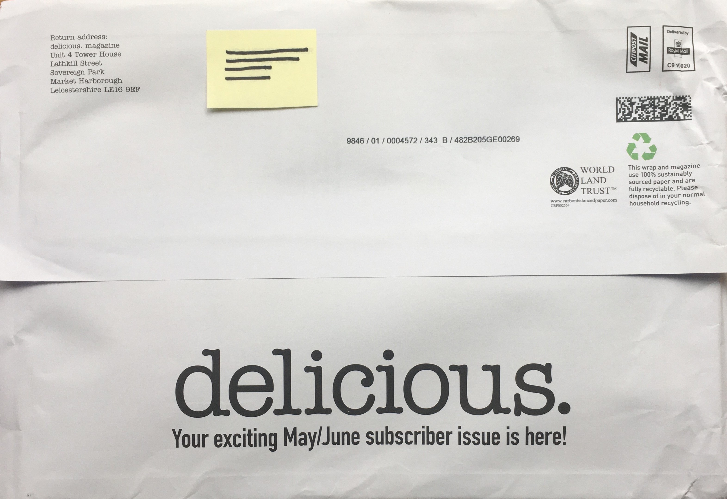
This sub taken out in lock down
Delicious is from Eye to Eye Media who produce food content but only have one magazine title
This subscription was taken out because they received a special offer of 3 copes for £3 versus 3 for £6
The paperwrap allows them to put a really strong message on their to thank the NHS
It arrived on the 11th May

Slide 19
Hearst magazines
IS INTERACTED WITH BY THIS HOUSEHOLD NUMEROUS TIMES
INCOUDING PLANNING A LARGE PURCHASE ON 3 OCCASIONS
FEBRUARY 2019
MARCH 2019
C1
SENIOR SECURITY
HTV WALES
VOUCHER/COUPON
26
27
6
17
18
ITEM
ARRIVES
22
MALE
35-44
HHC
FEMALE
17-24
REACH = 2
FREQUENCY = 10
COMMERCIAL ACTIONS = 13
LIFESPAN = 26 DAYS
Source: JICMAIL Examples Database Q2 2017 – Q1 2019
Notes:
Contents:
Advertising mail
Business mail
Information about products/services
Financial statement/bill/update
Sender’s contact details
Administrative information e.g. account details

Slide 20
YOUR LOGO HERE

