Slide 1
ADVERTISING MAIL TEST AND INNOVATE INCENTIVE
Wholesale
January 2024

Slide 2
Advertising mail
Test and Innovate Incentive
15%
WHO IS IT FOR?
CREDIT
TO QUALIFY
TO APPLY
For when you try something new with your advertising mail activity.
A postage credit is available on eligible Advertising Mail.
The minimum volume is 4,000 items. The maximum test period is 6 months.
For more information and to apply go to www.royalmailwholesale.com
Full terms and conditions apply

Slide 3
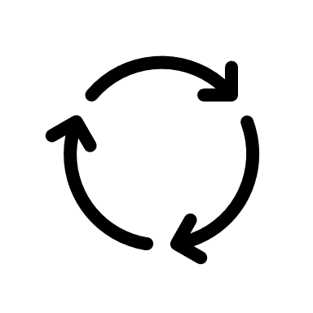
Mail gets you noticed
Of mail is engaged with: opened, read, sorted, put aside, put on display or in the usual place.
96%
1.15
Every 100 mail packs sent reach another 15 individuals.
4.4
Each piece of mail is revisited 4.4 times by individuals.
Source: JICMAIL, Addressed Mail, Q2 2017-Q3 2022, n=115,208

Slide 4
Mail drives high engagement
Across all sectors: driving buying behaviour, discussion and online activity
COMMERCIAL ACTIONS
Bought something, made a payment or donation
Used a voucher or discount code
Planned a large purchase
Discussed with someone
Ordered a catalogue
Visited sender’s shop/office
Visited sender’s web site
Went online for more information
Looked up my account details
Used a tablet or smartphone
Called the sender
27%
47%
33%
23%
n=8,884
n=6,810
n=18,487
n=6,094
Charity
Local and Central Government
High Street
Retailer
TV/Broadband/
Landline/Mobile
27%
26%
53%
33%
n=24,163
n=18,688
n=6,962
n=3,825
Financial and Insurance
Services
Mail Order/Online Retailer
Supermarket
Retailer
Utilities Provider
Source: JICMAIL, Addressed Mail, Q2 2017-Q3 2022, n=115,208

Slide 5
ENTRY REQUIREMENTS
1
2
3
4
Test addressed Letters or Large Letter format items sent using Advertising Mail and Partially Addressed Mail.
Measure the performance of the test and share the results with us so we can understand whether the tests we invest in achieve their objectives.
To qualify test mailings must include a minimum of 4,000 advertising mail items and a maximum of 1m items over the 6 month period.
Submit your application form at least two weeks before the start date of your test.
Full terms and conditions apply
Notes:
This template was inserted from Power-user, the productivity add-in for PowerPoint, Excel and Word.
Install Power-user to access thousands of templates, icons, maps, diagrams and charts with Power-user.
Visit https://www.powerusersoftwares.com/
©Power-user SAS, terms of license: https://www.powerusersoftwares.com/terms

Slide 6
Postage credits
Get postage credits if you test something you have not tried previously in our channels.
For ‘Always on Tests’ We will offer postage credits at the standard rate unless they qualify as an “Exceptional” test.
Standard Test = 10% discount
Exceptional Test = 15% discount
Full terms and conditions apply

Slide 7
Always on Exceptional tests qualify at a higher rate
EXCEPTIONAL TESTS | EXAMPLES
A brand new or incremental mailing | A brand new communication using mail that you have not tried before or an extension of an existing mailed communication to reach a brand new audience
Increase to your postage costs | Increasing the size of your item from Letter to Large Letter format or material increased weight as a result of additional pages
New use of emerging technology | Test the use of voice activation or use augmented reality with your mailing.
We normally support up to 100k items for an individual test. However, dependent on the details provided we will support up to a maximum of 1m items.
TEST VOLUME | EXAMPLES
Up to 100k | Testing a new campaign or change to existing campaign
Up to 1m item | Test includes new incremental volume and is based solely on the use of the incentive and not pre planned volume prior to the submission of your application
Full terms and conditions apply

Slide 8
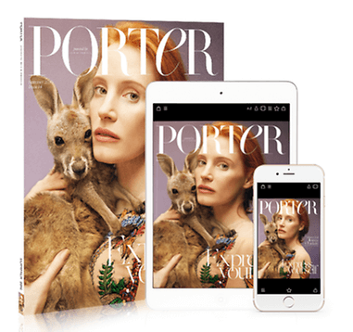
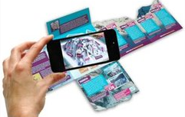
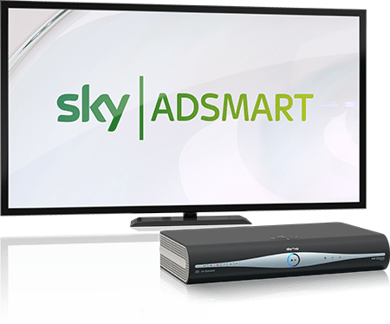
Test new technology to get the higher incentive rate
Test image recognition technology which takes a consumer from physical to digital.
One drinks company made their print edible so you could sample their new flavor by tearing a piece of paper off and eating it!
Test the use of voice activation in your mailing to drive people to online content/data capture.
Use augmented reality or near–field reality to create a truly immersive customer experience.
Test programmatic mail where you can re-target someone visiting your web site with a timely mail piece to remind them to buy.
Use smell, a pet insurer used smelly mail to reach dog or cat owners with packs their pets could literally smell.
Test mail with addressable TV or Partially Addressed.
Make the most of developments in Artificial Intelligence, use it to tailor your mail to different audiences.

Slide 9
What some brands have done with innovation
A predominantly online cosmetics company used programmatic mail to re-target a group of people browsing some of their top brow products on their web site. 37% uplift in sales of eyebrow products online with an average transaction value of over £40. Incremental visits were up and engagement levels had risen to over 28% as a result of activity.
A pet insurer wanted to reach online enquirers about their pet insurance quickly – before they bought elsewhere - to convert them to purchase.​ They sent ‘smelly packs’ (peppermint for cats, bacon for dogs) and created a story about how their pet knew a good thing when they saw it – or smelt it. ​ Sales during the campaign rose by 21% achieving an ROI of 3.8:1.
A high street children’s toy retailer integrated a smart app and free print cataologue. When the special children’s retailer icon was activated with a smart phone or tablet, it delivered an engaging digital experience for the children (and their parents).

Slide 10
The APPLICATION AND CREDIT process
Offer open until March 28th 2025
Go to the application form here
GET IN TOUCH
Speak to your Account Manager to make sure you are applying for the best incentive for your needs and to check that you meet the requirements.
WE’LL GET IN TOUCH
To discuss your application and check all the detail with you.
VOLUME NOTIFICATION
When you have completed your activity you will need to apply to Royal Mail for your credit.
REDEEM YOUR
CREDIT
Receive your credit as a voucher or have it paid into a Royal Mail postage account. Credit vouchers are valid for 12 months.
APPLY ONLINE
Use the link to the online application. Your application can also be completed by an agent.
POST YOUR MAILINGS
Start posting your volume.
Full terms and conditions apply
Notes:
This template was inserted from Power-user, the productivity add-in for PowerPoint, Excel and Word.
Install Power-user to access thousands of templates, icons, maps, diagrams and charts with Power-user.
Visit https://www.powerusersoftwares.com/
©Power-user SAS, terms of license: https://www.powerusersoftwares.com/terms

Slide 11
The more detail the better!
The more information you can provide will help us process your application
Why are you testing?
What are the details of the test?
How are you measuring the results?
Can you tell us about the objectives and strategy for your new mailing activity
Could you explain how this is something new to your plan
Can you explain what the test is designed to achieve over and above existing activity
Who are you targeting and why?
What targeting strategy have you used e.g. profiling? existing customer base
What test cells are in your plan?
Are you testing different creative routes and if so why?
If you have a test matrix please do include it.
Please tell us the volumes you are testing
What are the main KPIs for this campaign – predicted response rate, sales, ROI
Is there anything else you want to achieve with the campaign? Drive to digital, QR code use or other softer brand measures, for example?

Slide 12
FREQUENTLY ASKED QUESTIONS
Can I send Standard Advertising Mail Mailmark items and qualify for postage credits?
You can use Standard Advertising Mail for items that at are Large Letter format. By exception, we may support Standard Advertising Mail Letter format. For more details, please contact groupincentive@royalmail.com.
Can I use postcard formats?
Traditional postcards are not eligible, please see the Machinable Postcard and One-Piece Mailer Guide for options to use with incentives at www.royalmailwholesale.com/incentives
What will happen if my actual TIS volume is less than 4,000 items?
You will not receive any postage credit if your actual TIS volume is less than 4,000 mailing items.
Can I test Partially Addressed?
If you have not previously used Partially Addressed, you can qualify for support of your first campaign activity.
How long will my postage credit vouchers be valid for?
Postage credit vouchers are valid for 12 months from date of issue.
What is a Timebound test?
A timebound test will link to a specific type of mailing test. Full details of eligibility, the volume supported, and credit rates available will be shown in the TIS Eligible Services and Credit Document.
Full terms and conditions apply

Slide 13
THANK YOU

