Slide 1
General Large Letters Pricing Access Letters Contract
Flatline GLL prices

Slide 2
Proposal Summary
Background
Four flat rate GLL price steps 0-100g, 101-250g, 251-500g, 501-750g.
Proposal
This is more in line with market pricing for fulfilment items (single price).
Retains mixed weight across the 3 weight bands as now but with just 4 prices i.e. 251g+ is one weight band as now with 2 prices (instead of 500 prices at 1g increments).
Current GLL pricing has two initial steps 0-100g, 101-250g, plus a further 500 steps from 251-750g in 1g increments. A total of 502 price steps per service per delivery zone.
Customer feedback has suggested that the 1g increments are unhelpful.
Royal Mail Wholesale is looking to simplify our pricing, which will facilitate DSA contract holders in reducing the complexity of their customer rate cards.
Reduces the number of GLL price points from c.50k to c.400 across all price plans
2

Slide 3
Flatline General Large Letters prices
There will be no pricing formulae for GLLs, simply four price steps:
Weight Band
Price Step
Price
}
0-100g
0-100g
X
101-250g
101-250g
Y
NO CHANGE TO THE WEIGHT BANDS
}
251-750g
251-500g
Z
NEW price steps rather than 1g increments
501-750g
Aa

Slide 4
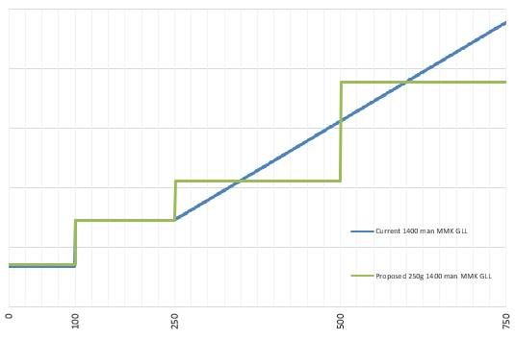
Price Lines: Current and New
The flatline structure is designed to be revenue neutral by sortation (1400 or 70) and overall

Slide 5
Timeline
Customers advised of changes
4th April 2022
22nd September 2021
GLL flatline pricing structure implemented
Royal Mail are not proposing to change other large letter pricing structures at this time e.g. Advertising, Business or Magazine Subscription

Slide 6
Appendix A: Product Codes
General Large Letters
National Code | Revenue Management National Description
DZQ | 1400 LRG LTR GENERAL MAN BAGS N
DZR | 1400 LRG LTR GENERAL MAN TRAY N
DZS | 1400 LRG LTR GENERAL MAN TRAY N PRM
DL6 | 1400__ LRG LTR GEN MN EIB BAGS N
DL4 | 1400__ LRG LTR GEN MN EIB TRAY N
DL3 | 70__ LRG LTR GEN MN EIB BAGS N
DL1 | 70__ LRG LTR GEN MN EIB TRAY N
DCF | 70__ LRG LTR GENERAL EIB BAGS N
DYY | 70__ LRG LTR GENERAL EIB TRAY N
DYZ | 70__ LRG LTR GENERAL EIB TRAY N PRM
DZJ | 70__ LRG LTR GENERAL MAN BAGS N
DZC | 70__ LRG LTR GENERAL MAN TRAY N
DZF | 70__ LRG LTR GENERAL MAN TRAY N PRM
DZI | 70__ LRG LTR GENERAL OCR BAGS N
DZD | 70__ LRG LTR GENERAL OCR TRAY N
DZE | 70__ LRG LTR GENERAL OCR TRAY N PRM
Zonal Code | Revenue Management Zonal Description
ZMK | 1400 LRG LTR GENERAL MAN BAGS Z
ZML | 1400 LRG LTR GENERAL MAN TRAY Z
ZMM | 1400 LRG LTR GENERAL MAN TRAY Z PRM
ZQ1 | 1400__ LRG LTR GEN MN EIB BAGS Z
ZL8 | 1400__ LRG LTR GEN MN EIB TRAY Z
ZL7 | 70__ LRG LTR GEN MN EIB BAGS Z
ZL5 | 70__ LRG LTR GEN MN EIB TRAY Z
ZJ4 | 70__ LRG LTR GENERAL EIB BAGS Z
ZKS | 70__ LRG LTR GENERAL EIB TRAY Z
ZKT | 70__ LRG LTR GENERAL EIB TRAY Z PRM
ZMD | 70__ LRG LTR GENERAL MAN BAGS Z
ZKW | 70__ LRG LTR GENERAL MAN TRAY Z
ZKZ | 70__ LRG LTR GENERAL MAN TRAY Z PRM
ZMC | 70__ LRG LTR GENERAL OCR BAGS Z
ZKX | 70__ LRG LTR GENERAL OCR TRAY Z
ZKY | 70__ LRG LTR GENERAL OCR TRAY Z PRM

