Slide 1
Machinable postcards and one piece mailing guide
Wholesale
December 2020

Slide 2
Advertising mail test and innovate scheme
Machinable Postcards and 3 lightweight formats available to use
1
MACHINABLE POSTCARD
(2/3 ply postcard) (RECOMMENDED)
2
3
4
ONE PIECE PAPER WRAP MAILER
FEATURE MAILER
COUPON MAILER
Full terms and conditions apply

Slide 3
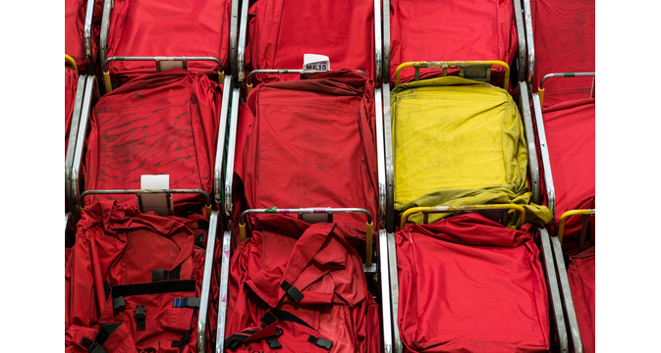
Why use a Machinable postcard or lightweight format

Slide 4
A versatile format A machinable postcard and lightweight format can help with any message
CRITICAL
SUPPORTIVE
ON HOLD
Put critical information into people’s hands – short updates
Provide information about store opening times, support available
Communicate what changes you’ve made and convey the customer benefits
Give details on how to access your services and who it is helping
Show you are committed to your customers and give them an offer when the crisis is over
Discount voucher or preferential booking
Guide people to online options
Use QR codes to make it easy to find the information or guides for older audiences
Remind lapsed audiences of what you offer
Give updates on services or news to engage them
Update on how the brand is responding for staff
Making services available and when
Deliver targeted messages to key audiences – highly tailored
Provide benefits to loyal customers and ways to use rewards/benefits
Offer new reasons to consider your brand, special offers, drive traffic
Home delivery, online content, what’s critical to you now e.g. donations
Messages about how you are supporting the community; fundraising, delivering, volunteering
Full terms and conditions apply

Slide 5
Consumers want brands to support them
Only 8% of consumers think brands need to stop advertising right now but they want them to behave in a certain way
Believe brands should help them in their daily lives
Said brands should inform people of what they’re doing
Said companies should not exploit the situation
Source: Kantar Global Survey March 2020 (35k consumers)

Slide 6
Mail drives profitable outcomes One third of people take some form of commercial action
33%
Commercial Actions include:
Buying something/making a payment
Using a voucher/discount code
Planning a large purchase
Discussing with someone
Visiting the sender’s shop office
Going online for more information
Looking up their account details
Using a tablet or smartphone
Calling the sender
Source: JICMAIL Q2 2017 – Q1 2019, Business Mail & Advertising Mail, n=72595

Slide 7
Mail has high engagement rates Across all sectors
Engagement = % of mail processed in some way ie opened, read, sorted, put aside for later, filed, put on display or put in the usual place
Source: JICMAIL Q2 2017 – Q1 2019, Business Mail & Advertising Mail

Slide 8
Mail drives commercial actions People act on mail they receive from all sectors
Source: JICMAIL Q2 2017 – Q1 2019, Business Mail & Advertising Mail

Slide 9
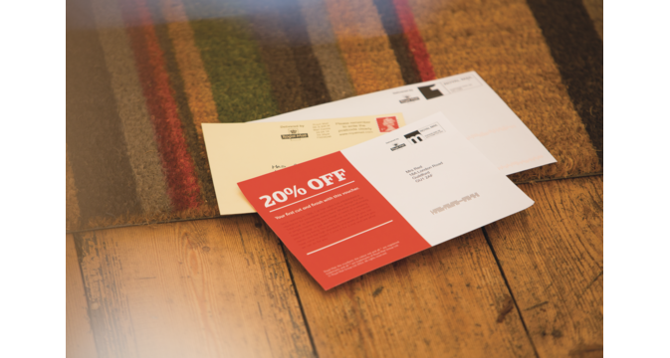
The details

Slide 10
The formats to choose from
MACHINEABLE POSTCARD (2/3PLY)
INSERT | None
SHAPE | 3 ply thickness
FOLDS | 2 folds
REFERENCE / BOTTOM EDGE | To be a fold
DIMENSIONS | Length: minimum 140mm, maximum 240mm Width: minimum 90mm, maximum 165mm
ITEM WEIGHT | Maximum weight 100g
PAPER WEIGHT | 120gsm – 150gsm (150gsm recommended)
PAPER THICKNESS | 2ply = minimum of 0.18mm, 3 ply = minimum of 0.27mm
FLAP SIZES | Not applicable
SEALING | Continuous seal of glue on unfolded edges
FINISH | Matt is preferred
ONE PIECE PAPER WRAP MAILER
INSERT | Paper only
SHAPE | Rectangular or square
FOLDS | Long edges fold, short edges sealed
REFERENCE / BOTTOM EDGE | To be a fold
DIMENSIONS | Length: minimum 140mm, maximum 240mm Width: minimum 90mm, maximum 165mm
ITEM WEIGHT | Maximum weight 100g
PAPER WEIGHT | Minimum 100gsm
PAPER THICKNESS | Not applicable
FLAP SIZES | To be a minimum of 25mm high, less than 40mm from the bottom and can run along the long edge and can be on the front or back
SEALING | Continuous seal if inserts included, spot or continuous if no inserts
FINISH | Matt is preferred
Full terms and conditions apply

Slide 11
The formats to choose from
FEATURE MAILER
INSERT | None
SHAPE | Rectangular or square
FOLDS | Maximum of 2 folds
REFERENCE / BOTTOM EDGE | To be a fold
DIMENSIONS | Length: minimum 140mm, maximum 240mm Width: minimum 90mm, maximum 165mm
ITEM WEIGHT | Maximum weight 100g
PAPER WEIGHT | Minimum 150gsm – 190gsm
PAPER THICKNESS | 0.13mm – 0.175mm recommended minimum
FLAP SIZES | Not applicable
SEALING | Continuous or spot
FINISH | Matt is preferred
COUPON MAILER
INSERT | Paper booklet only, no more than 85mm x 130mm, affixed to the inside
SHAPE | Rectangular only
FOLDS | 3 folds required
REFERENCE / BOTTOM EDGE | To be a fold
DIMENSIONS | 165mm x 145mm (+ / - 5mm)
ITEM WEIGHT | No more than 20g
PAPER WEIGHT | Minimum 115gsm
PAPER THICKNESS | Not applicable
FLAP SIZES | Folded 3 times
SEALING | Continuous seal of glue on unfolded edges
FINISH | Matt is preferred
Full terms and conditions apply

Slide 12
Specifications Finish for digitally printed postcards
When digital printing is used for mail the pigment may rub off , transfer to adjacent surfaces, crack and become marked both during the manual and automated handling processes.
The application of an ultra violet (UV) cured varnish has been found to reduce the wear to digitally printed mail items.
This provides a protective coating over the pigment. It should only be applied to the non-addressed side of the postcard, as the characteristics of the varnish may make the mail unmachinable, if applied to both sides.
The pressure exerted on the postcard during automated processing may cause colour offset on digitally printed items. Therefore, it is recommended that there should be no off-set print or colour transfer when the item is exposed to a pressure of 3.43kPa (35g per cm²). This equates to a weight of 8.5kg spread over the surface of a DL envelope, and 13.5kg for C5 envelopes.
Full terms and conditions apply

Slide 13
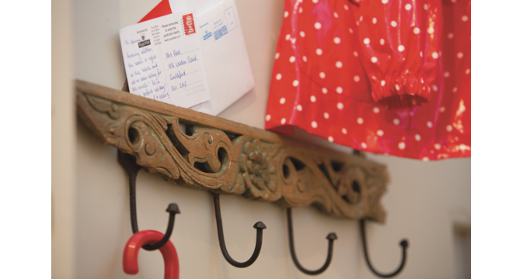
Thank you
Phone number here
Email address here
LinkedIn address here
Twitter ID here

