Slide 1
Using mail to drive commercial outcomes for your business
How mail gets customers to take action
May 2020
YOUR LOGO HERE

Slide 2
The back drop

Slide 3
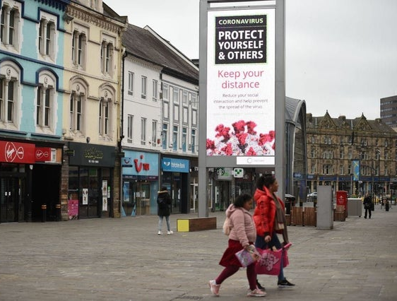
The state of the high street
Overall footfall dived by 44.7% in March due to the government-mandated lockdown
The British Retail Consortium said that UK footfall declined by 17.7% in the three weeks before the lockdown was enforced on March 23
In the two weeks after lockdown was announced, footfall sank by an average of 83.2% after non-essential shops closed and people were told to stay at home
High streets saw footfall decline 41.8% in March compared with the previous year, as increased use of convenience stores provided a rare positive
Shopping centres were harder hit by the lockdown, reporting a 43.6% dive in footfall for the month
Meanwhile, retail parks saw footfall decrease by 23.5% in March
Source: British Retail Consortium, May 2020

Slide 4
Online retail sales over the last 12 months
It’s been a very changeable period but April sees a recovery
Source: IMRG Capgemni Online Retail Sales Index, May 2020
Notes:
IMRG capture online sales and you can wee from this chart that March dropped quite dramatically but increased by over 23% points in April.
We are all hearing in the news that the categories which have been worst affected are clothing, surprisingly some things like lingerie have had a boom.

Slide 5
What’s changed in buying behaviour
And what’s likely to continue after covid-19
Bought for the first time due to Covid-19
If you bought for the first time, how likely are you to buy again in the next 12 months
Source: Nielsen Covid-19 Dipstick in March 2020
Notes:
Buying behaviours have changed quite considerably in the period and people have been shopping in ways that they haven’t done before. In most recessions or pandemics though, like after SARS in 2003 shopper behaviour returned to normal pretty quickly.

Slide 6
Consumer typologies in a recession
THE SARS OUTBREAK IN HONG KONG AND CHINA IN 2003 HAD SHORT & LONG TERM EFFECTS ON SOME BEHAVIOURS
Health and well-being – higher consciousness hygiene, fitness, vitamins
Working patterns returned to normal after SARS
Less out of home entertaining and in the home (dining out recovered quicker)
Shopping for non-essentials rose
TV, entertainment consumption increased in home
Shopping online did go up but fell back after the outbreak
Travel came to a standstill but revived as soon as the outbreak was over
WHILST THERE’S A TENDENCY TO SAY THE WORLD WILL BE DIFFERENT THE REALITY IS WE ARE CREATURES OF HABIT
Notes:
These are the consumer typologies that emerged after the SARS outbreak in Hong Kong and China.

Slide 7
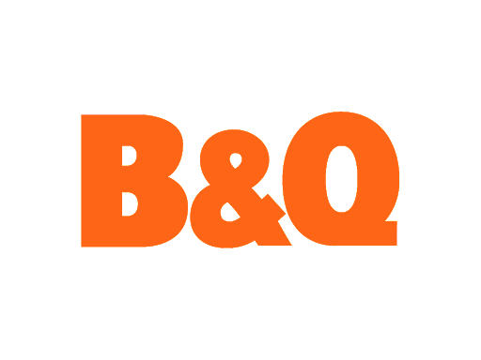
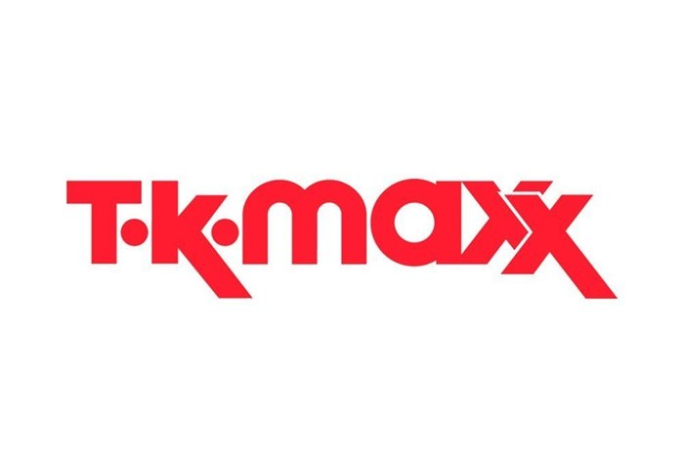
Three types of retailer in this crisis
FLEXING TO THE TIMES
ADAPTING TO SURVIVE
FREEZE / MOTH BALL
Shuh and Next stopped trading and then began trading again having made changes
Notes:
Some high street brands are open for business and are doing well. Lidl and Aldi have seen very strong performance. Tesco says their profits should not be overplayed as they have had to take on more staff and therefore have more overhead.
Where they are deemed as essential retailers their traffic is slowed only by limits on numbers in any store at one time.
Other brands are switching how they do things. Screwfix is only doing click and collect with strict pick up protocols. H&M have closed stores but are heavily promoting their online store.
WH Smith issued a profits warning in March as travel restrictions triggered by the coronavirus pandemic led to a significant drop in shoppers at its airport outlets, initially in the Asia Pacific region, which accounts for 5% of its travel division’s revenues. The company stated that its annual profits would be half the £80m previously forecast. WH Smith is currently operating about 30% of its UK stores but has reported a “significant decline in passenger numbers” because of the nationwide lockdown, which has resulted in the temporary closure of all of its stores at British airports and railway stations.
McColls (1,500 convenience stores) working with Deliveroo to do home delivery from 120 stores within half an hour.
Hayes Garden World is offering an online personal shopper services and is doing entirely online trading.
Shuh, the footwear retailer has re-opened its website a week after it closed down its warehouse due to concerns over staff welfare during the Covid-19 epidemic. The Schuh management team has now put in place extensive welfare measures to ensure the safety of its employees working in its eCommerce operations.
Poundland is temporarily reducing its store count by 32 during the coronavirus crisis. These stores include those situated in retail parks and shopping centres and those with multiple stores in one area. It also includes stores which are unable to open due to a lack of staff. Poundland staff will be paid 80% of their wages in lines with the government retention payment scheme.
TK Maxx stop taking online orders or taking returns.
Next originally pulled out of deliveries online but returned but had to set limits on the number of orders in order to ensure they could meet demand.

Slide 8
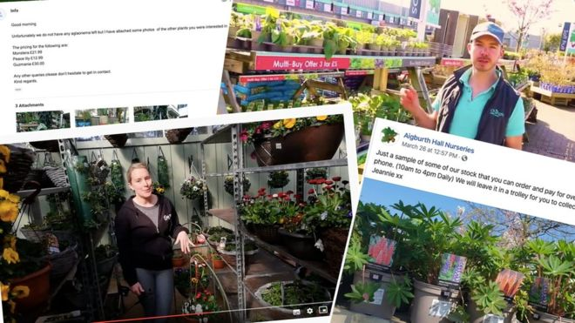
Initially brands responded to need
They are now beginning to adapt and innovate
April
Offer NHS staff 200 bikes to get to work safely and then launch direct delivery for first time
April
Employs 100,000 more staff worldwide
7 April
Create pop-up store at Nightingale Hospital for NHS staff
Garden Centres to re-open, some offered online personal shopping
7 May
Develop beauty business, sign flexible leases with Hammerson “The Beauty Hall from Next” in ex Debenhams stores
May
Offer video eye consultations
Re-open further shops across and outside London for takeaway and deliver – 100+ stores now open
May
Team with Deliveroo to offer wider range of food plus beer and wine
6 May
Opens small number of drive throughs near large hospitals, order via Uber Eats
May
Offer safe space for victims of domestic abuse
Notes:
A lot of brands have found ways to innovate to survive. Adapting their business models to respond to the consumer need or offering charitable help as well.

Slide 9
How mail can drive commercial value to you

Slide 10
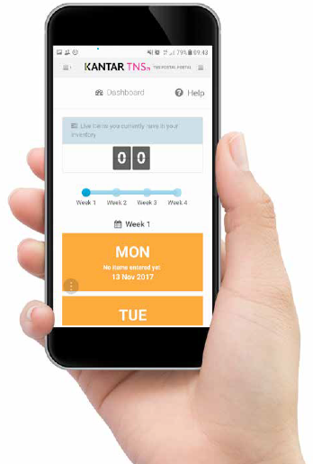
Jicmail gives us gold standard data
That shows exactly how consumers interact high street
retail mail
Mail is collected in the first week and recorded, then that week’s mail is tracked over 28 days
People record what they do with their mail physically
They tell us the type of mail, i.e. is it addressed or unaddressed to them or someone else.
Opened it
Read / looked at / glanced at it
Put it on display e.g. fridge / noticeboard
Passed it on / left out for the person it’s for
Put it aside to look at later
Threw it away / recycled
Took it out of the house e.g. to work
Used / did something with the information
Put it in the usual place
They capture what business sector the mailing or door drop comes from.
They record the contents; is it information, special offer, etc. You can tick all that apply here.
Notes:
JICMAIL data has been available since the second quarter of 2017, it now contains over 92,000 individual mail packs across all the main industry sectors. It has been designed to create Gold Standard for the industry so that mail and door drop can be planned alongside other media in exactly the same way as all other channels.
A panel of 1,000 households each month collect their mail and door drop for the first 7 days of each month. They then track that content over a full 28 day period and tell us what they did with it physically ie opened, read and passed it on. But in addition they record any commercial actions, such as going online, calling the sender or using a voucher or discount code.

Slide 11
Engagement rates with retail mail
High across the board
93% of all retail mail is engaged with ie mail is processed in some way (opened, read, sorted, put aside)
64% of all high street retail mail read / looked at / glanced at
59% of all high street retail mail is opened (a postcard doesn’t need to be opened)
Source: JICMAIL Q2 2017 – Q1 2019 Addressed or Business Mail, High Street Retailer e.g. Clothing, Household, Electrical n=8,505
Notes:
High Street retail mail enjoys high engagement rates. 64% of all retail mail is read and 59% of it opened (remember not all of it needs to be opened if it is a postcard!).

Slide 12
What are Mail order retailers sending?
They are mainly sending information about products and services, followed by special offers (likely to be catalogues or product leaflets)
Source: JICMAIL Q2 2017 – Q1 2019 Addressed or Business Mail, High Street Retailer e.g. Clothing, Household, Electrical n=8,505
Any type of content with 1% or less has been removed
Notes:
Information about products and services is the highest recorded mail content that consumers on the JICMAIL panel record followed by special offers or discounts and voucher’s and coupons.
The other content types are very low.

Slide 13
MAIL DRIVES COMMERCIAL ACTIONS
When it contains different content it drives different levels of commercial interaction
%
Resulting commercial actions with high street retail mail
5,079
2,525
2,034
369
379
247
107
Source: JICMAIL Q2 2017 – Q1 2019 Addressed or Business Mail, High Street Retailer e.g. Clothing, Household, Electrical n=8,505
Notes:
33% of all people receiving retail mail go on to do something commercial. These are the key types of mail that drive commercial actions. Look at how high financial statement/ bills or updates are – 59% of consumers go on to do something commercial, followed by 51% who receive a loyalty reward statement. But vouchers and coupons are also high at 50%. In the context of the retail sector people also respond well to mail that contains something that contains local information.
Commercial actions are recorded separately from physical interactions, as you can’t be certain the mail pack is physically present when consumers do something. If you think about the average commercial actions being 32% retail mail enjoys high levels of additional engagement over and above physical actions.
As a reminder commercial actions are:
Went online for more information
Discussed with someone
Bought something/made a payment or donation
Called the sender
Visited the sender’s web site
Used a tablet or smart phone
Used a voucher/discount code
Visited a sender’s shop/office
Planned a large purchase
Ordered a catalogue
Looked up my account details
Posted a reply to the sender

Slide 14
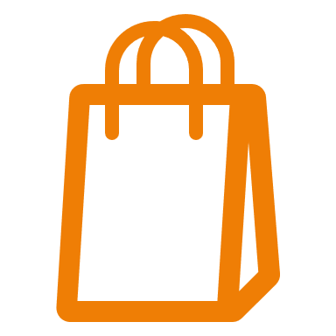
All SORTS OF GROUPS ENGAGE WITH MAIL
High street retail mail is engaged with by all types of consumer
FREQUENCY OF EXPOSURE
MILLENIALS
6+ IN HOUSE
SOCIAL GRADE C2
FEMALE 55+
OWN HOME 1-2 YRS
3.53
3.7
4.19
4.36
4
ADVERTISING & BUSINESS MAIL MAIL
Source: JICMAIL Q2 2017 – Q1 2019 Addressed and Business Mail, High Street Retailer e.g. Clothing, Household, Electrical n=8,505
Notes:
Mail engagement is pretty ubiquitous across age groups and demographics. The average frequency of exposure – the number of times someone physically returns to mail is 4.2. Here you can see that certain groups of consumers enjoy far higher rates of frequency. Think abut this when considering your targeting.

Slide 15
All age groups engage with mail
Frequency - older age groups engage at slightly higher rates
Notes:
And despite what we might all think younger people do engage with retail mail at higher than the average of. 4.2 With the greatest frequency rates amongst those aged 45 plus.

Slide 16
frequency above average
Mail drives high frequency but varies by type of content
If the content has a voucher or coupon, contains a financial statement, loyalty statement or is about local information the frequency is higher than the average for mail, which is 4.1
Base: 6,909
Base: 5,079
Base: 2,525
Base: 2,034
Base: 369
Base: 379
Base: 247
Base: 107
Source: Kantar TNS, JICMAIL, Addressed and Business Mail, Mail Order/Online Retailer Q2 2017 – Q1 2019, Total base: 6,909
Notes:
The retail sector content type drives different levels of engagement.
The reach is the number of people reached with one mailing pack. You can see the average is 1.13, so that means for every 100 mail packs sent another 13 people will be exposed to it. In the case of information abut local services this rises to 1.24 so an extra 24 people will see each 100 packs.
Different content drives more or less frequency. Again financial statements or loyalty rewards enjoy the greatest hare of engagement.

Slide 17
Content type drives all sorts of actions
Consumers to on to interact with mail from retailers in many ways. 300 people per thousand of those getting mail with a voucher or coupon in it go on to do something with that mail.
Actions per thousand by mail type
Source: Kantar TNS, JICMAIL, Advertising mail, Mail Order/Online Retailer Q2 2017 – Q1 2019
Bases: Information about products/services 5,079, Special offers or discounts 2,525, Vouchers / coupons 2,034, News / update / magazine articles / 369, Financial statement / bill / update 379, Information about local services 107, Loyalty reward statement 247
Notes:
Over and above the physical interactions with mail that you’ve seen earlier there’s a whole host of commercial actions that are being driven and you can see a wide range of actions per thousand. A financial statement will drive 322 people out of every 1000 to go on and buy something. Vouchers and coupons will et 300 consumers out of every 1000 to use that voucher.
Giving consumers reasons to engage gets them to act on the information they receive.

Slide 18
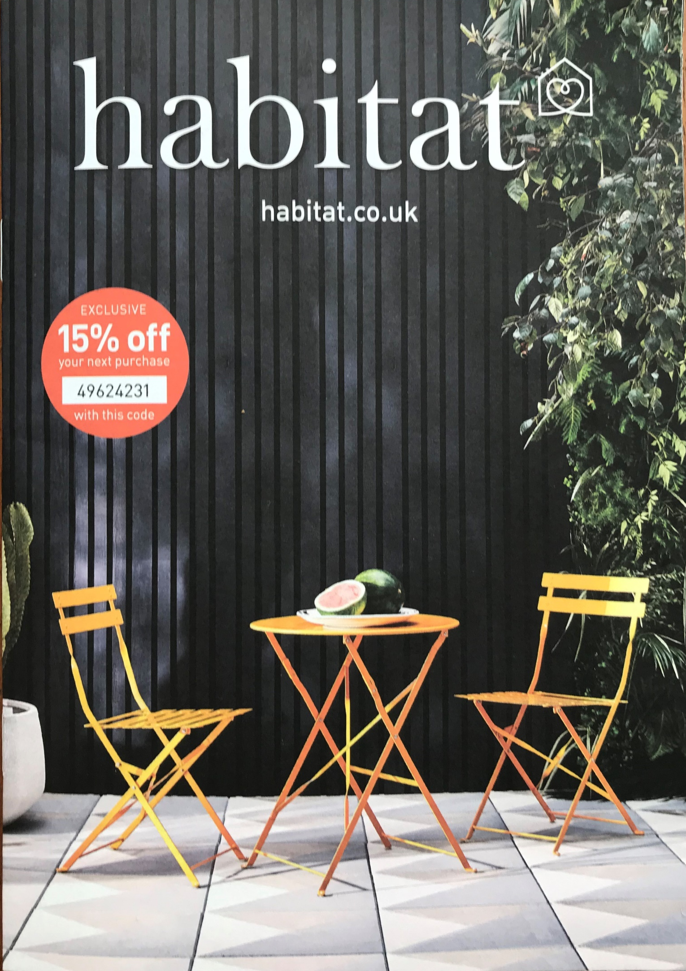
Good seasonal offer
Habitat seem to be capitalising on the strong sales of garden furniture by featuring this image of outdoor table and chairs on their catalogue front cover

Slide 19
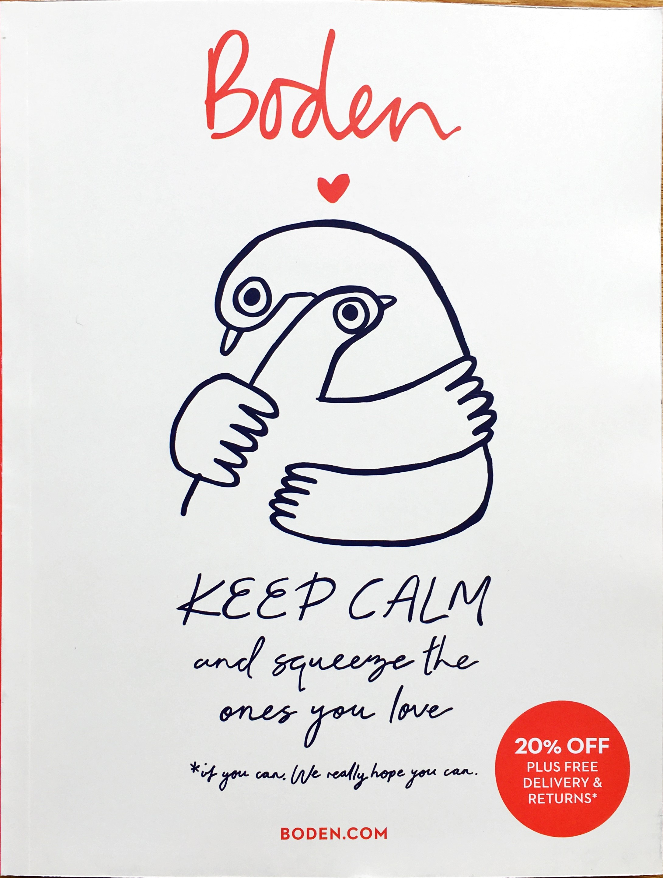
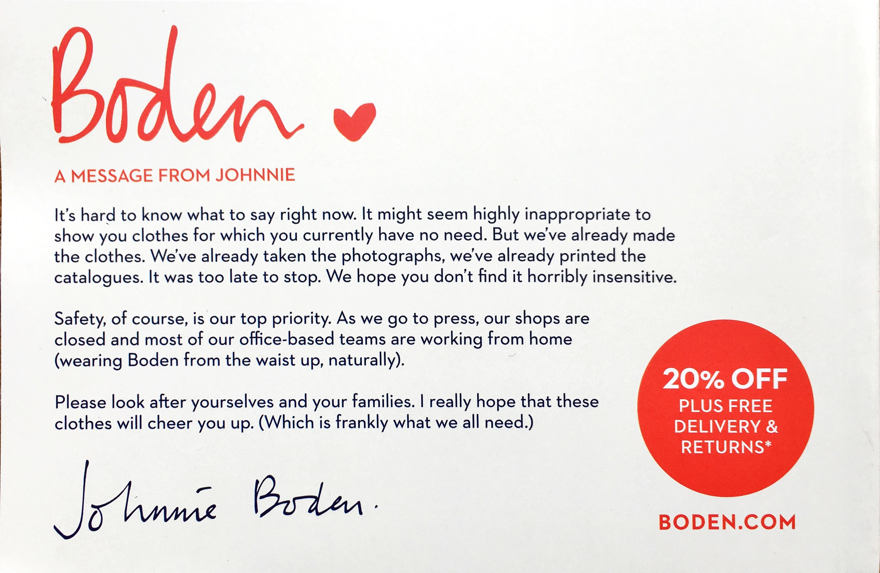
Boden postcard
WOULD THIS HAVE WORKED AS WELL AS AN EMAIL?
This simple postcard explains what Boden is doing to keep business open but is clear
But as ever they strike the Johnnie Boden tone of voice spot on and even manage to get a small joke in that the office staff are working from home “wearing Boden from the waist up”
It’s really simple but it shows that you value me as a customer

Slide 20
YOUR LOGO HERE

