Slide 1
How mail can help you build business
The role for mail in building business for general insurers
May 2020
YOUR LOGO HERE

Slide 2
What’s happening in insurance

Slide 3
What’s happening in the insurance industry
Estimates from the ABI indicate that its members expect to pay out over £1.2 billion in claims to support businesses and individuals affected by Covid-19 - this covers payments on business interruption, travel insurance, weddings policies and cancelled school trips
Insurers have been managing an unprecedented level of activity in response to Covid-19 with some insurers reporting a 200% rise in call volumes into their call centres
Insurers have agreed customer pledges on home, motor, travel, private medical, protection, and pet insurance to give added support to customers – including home insurance policies (covering those working from home), motor insurance policies (extended to cover NHS volunteers) and travel insurers
Insurers are offering policy extensions, waiving restrictions and supporting customers across the full range of insurance products and only 4% of products were withdrawn in March 2020
Source: Association of British Insurers, May 2020
Notes:
Pay outs look like they are going to be huge - this is on a scale with the 9/11 events in 2001.
The insurance industry has been working to support insurers and the insurance industry has been helping consumers in showing they understand that car insurers won’t see as many claims and therefore some are reducing premiums/giving money back.

Slide 4
what insurances do consumers hold?
Source: Consumers and General Insurance, Mintel, December 2019
Notes:
By far the biggest insurance categories are car and home contents, closely followed by buildings.
Travel is likely to see a very large drop off in policies being taken out.

Slide 5

What are people looking for?
RANKED AS FIRST PRIORITY
Lowest price
57%
Highest level of cover
14%
UK based call centre
9%
Easy access to customer service
5%
Source: Consumers and General Insurance, Mintel, December 2019
Notes:
Consumers are most interested in being rewarded for their loyalty: Insurance policyholders show most interest in being rewarded for their loyalty. Only 30% claim to feel loyal towards their insurance provider with only 19% say they feel valued by their insurer. (Mintel Home Insurance 2017) . This indicates the majority of people would prefer to simply stay with their current insurer, but feel they must shop around, not necessarily to get a better deal but to avoid being or feeling worse off.
When asked “Which of the following extras would you most like an insurance provider to offer? Please rank up to 3 with 1 being the extra you would most prefer.”
Consumers answered: Specific rewards for continuous renewal 54%. Introductory offers 37%. Ongoing rewards redeemable at retail / leisure outlets 35%
(Source Mintel Lightspeed Base: 1,951 internet users aged 18+ Consumers and Insurance Innovation - UK - December 2018)
Price Guarantees: Price guarantees are most likely to improve retention. Brands that make longer term price promises will not only benefit from increased perceptions of trust / transparency but should also have a greater chance of improving customer retention levels. Over half (56%) of policyholders say they would be more likely to renew with an insurer if offered a price fix guarantee (e.g. for 2 years), whilst 51% would be swayed by a price-matching scheme (i.e. against leading players in the market). 33% say an increase in price makes a financial services provider untrustworthy. (Source: Mintel Consumers and General Insurance 2017)

Slide 6
LOYALTY A KEY BATTLE GROUND
And in a time of uncertainty how might this impact
ACQUISITION
VALUE
REPEAT BUSINESS
RETENTION
Price-sensitive customers have a defection rate of 2.6 times that of other customers.¹
Around 6m motor and home insurance policyholders are paying as much as £1.2bn more than they need due to “loyalty penality”²
Loyalty higher among consumers who value “peace of mind” over and above price alone.³
84% of consumers shop around at motor renewal and 53% stay with current insurer.⁴
Acquiring a new customer is anywhere from 5 to 25 times more expensive than retaining an existing one
Sources:
Bain & Company: Customer Behaviour and Loyalty in Insurance 2016
FCA, Oct 2019
Bain & Company. Admiral Insurance insured more than 3m cars through family multi-policy in 2005 alone
Consumer Intelligence: Insurance Behaviour Tracker, 2019
Notes:
Loyal customers represent the greatest value to any brand.
Depending on which study you believe, and what industry you’re in, acquiring a new customer is anywhere from five to 25 times more expensive than retaining an existing one. It makes sense: you don’t have to spend time and resources going out and finding a new client — you just have to keep the one you have happy. If you’re not convinced that retaining customers is so valuable, consider research done by Frederick Reichheld of Bain & Company (the inventor of the net promoter score) that shows increasing customer retention rates by 5% increases profits by 25% to 95%.
Customer loyalty leads to profits. Increasing customer retention by just 5 percent boosts profits by 25 to 95 percent, according to the advisory firm Bain & Co.

Slide 7
Mail can be an important touchpoint at every point of the customer journey

Slide 8








How can you influence the journey
SEASONALITY
Identify gap in policy holding. Opportunity to sell additional cover e.g. winter: hail, flood, ice. Winter sports. Or summer holiday travel, other
RENEWAL
Provide quote with discount for loyalty.
Use opportunity to reduce churn and / or win back
POLICY / WELCOME DOCUMENTS
How mail works to activate new customers and engage them in the right way right from the start
CLAIM
Settle a claim. Use opportunity to cross / up sell
Mail in the insurance sector has a role to play at many points of the potential customer journey to ensure you gain the trust and loyalty of your customers
TERMS & CONDITIONS CHANGES
Clear & transparent to avoid disappointment with a claim. Use opportunity to sell in benefits of changes. Opportunity to cross / up sell
REWARDS
Rewards redeemable at retail or leisure outlets. Money off next product take up or at renewal
ACQUISITION / CONSIDERATION
Using mail to drive acquisition and consideration
RETENTION / CROSS SELL / UP SELL
Additional products: travel, home contents, buildings, car, gadget, phone, other
Notes:
Most people will have little or no dealing with their insurer’s customer service team and/or the claims department during the course of their annual policy, giving insurer’s little opportunity to engage with or impress their customer base.
Whilst longer term price promises/guarantees will help insurers to extend customer lifecycles, insurers need to establish more regular touchpoints and a better customer experience with consumers who may even have more interaction with price comparison websites than they do with their eventual policy providers.
There are potential touchpoints where a customer may engage with the brand – allowing ongoing communication to engage with the customer and to establish the brand. Such a communication strategy may differentiate the brand from the competition in a market where there is little or no engagement.
More customer data may allow cross and upsell of products during the policy lifetime - multiple holdings may further tie the customer in at renewal time.
Seasonality may also provide important opportunities for insurers armed with customer data where insurers could offer summer or winter holiday single or family travel cover or car cover for example depending on the customers lifestyle or family circumstances. A knowledge of a customers sport activities may also allow additional sales opportunities.
The provision of rewards such as money off may engender loyalty at renewal time and can be communicated during the policy lifetime rather than just at renewal when perhaps the customer is looking around for a better deal (7 out of 10 consumers with motor insurance shopped around the last time they arranged or renewed their policy (Consumer & Insurance Innovation UK Dec 2018).
There are now companies such as Gobsmack (https://gobsmack.co.uk/) which have launched a market leading reward and loyalty platform for clients including MORE TH>N and Admiral Insurance. Helping to combat the increasing dominance of the PCWs.
Even the communication of changes in Terms and Conditions plays an important role in customer experience. Only 57% of insured people say they read the detailed T&Cs. Lack of engagement is the key reason. Shorter T&Cs with less jargon would improve customer engagement and it is in the best interests for insurers that customers understand their T&Cs to avoid disappointment when a claim is made. Disappointment with a claim erodes trust and impacts customer satisfaction. An insurer that manages to come up with a simplified solution will definitely stands out from the crowd. .
Several leading insurers have made customer service/experience a strategic priority, as they look to reduce high levels of customer churn. Many, such as Admiral, have pointed out that a positive claims experience results in higher levels of customer retention (95% of Admiral’s customers having renewed following a claim).
The rise in third party apps is also providing the opportunity to collect and share customer data, however mobile apps have limited appeal in the GI sector, perhaps further supporting the need for a more personalised and 121 relationship with the insurer. In fact only 17% of consumers say policy access or management through an app would make them very likely to choose a particular provider over another. And 78% of consumers delete apps they are not using very much. (Consumer & Insurance Innovation UK Dec 2018).

Slide 9
How is gi mail currently performing?

Slide 10

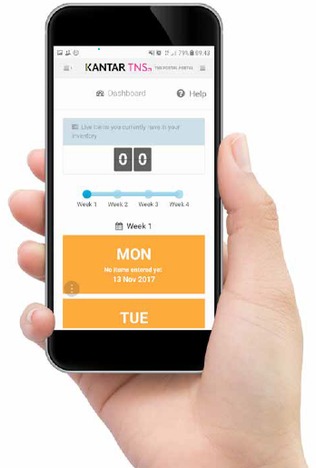
A SOURCE OF GOLD STANDARD DATA
jicmail data comprehensively gathers all mail activity
Mail is collected in the first week and recorded, then that week’s mail is tracked over 28 days
People record what they do with their mail physically and commercially
They tell us the type of mail, i.e. is it addressed or unaddressed or business mail
Opened it
Read / looked at / glanced at it
Put it on display e.g. fridge / noticeboard
Passed it on / left out for the person it’s for
Put it aside to look at later
Threw it away / recycled
Took it out of the house e.g. to work
Used / did something with the information
Put it in the usual place
They capture what business sector the mailing or door drop comes from.
They record the contents; is it information, financial statement. You can tick all that apply here.
Notes:
JICMAIL data has been available since the second quarter of 2017, it now contains over 92,000 individual mail packs across all the main industry sectors. It has been designed to create Gold Standard for the industry so that mail and door drop can be planned alongside other media in exactly the same way as all other channels.
A panel of 1,000 households each month collect their mail and door drop for the first 7 days of each month. They then track that content over a full 28 day period and tell us what they did with it physically ie opened, read and passed it on. But in addition they record any commercial actions, such as going online, calling the sender or using a voucher or discount code.

Slide 11
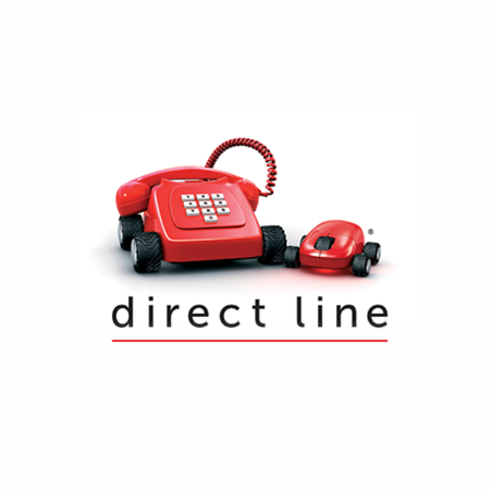

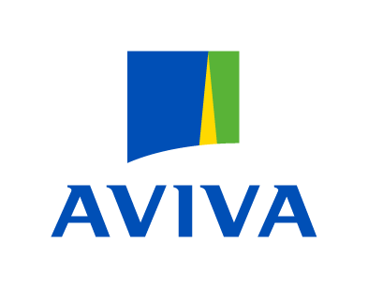






INSURERS INCLUDED IN THIS STUDY
We combined these big insurers from the financial services sector in jicmail data to give us just data for gi
232
162
34
23
100
58
99
32
93
Source: JICMAIL Q3 2018 – Q2 2019. Sample: General Insurance 579
Notes:
Within JICMAIL data we asked consumers to help us compile the industry sectors and how these would work. When they did that they put General Insurance and Finance into one sector. So we don’t separate out the sectors.
So for this study we have taken some of the largest insurance brands and just looked at the data for these, to see what differences there might be from the overall Financial Services sector. These findings come from the brands here and the combined sample size these provided.

Slide 12
MOST GI MAIL IS FIRST DEALT WITH BY A WOMAN
71% of gi mail is dealt with the hhc first and 71% of them are women
56% of all physical actions are undertaken by the HHC
They also undertake 67% of all commercial interactions
Source: JICMAIL Q3 2018 – Q2 2019. Sample: General Insurance 579
Notes:
The Household Co-Ordinator is the person who takes charge of sorting the mail in their households. In some shared households this is a shared responsibility but mostly it is one person.
In GI 71% of mail is dealt with by the HHC and 71% of them happen to be women.
They go on to interact most with the mail. But will also pass it on to the person it is for if they don’t go on to process the mail piece.

Slide 13
General insurance mail content
47% of all content contains information about products and services
JICMAIL does not currently capture policy documents.
As a proxy for this use “information about products”, “financial statement or administrative information”
Source: JICMAIL Q3 2018 – Q2 2019. Sample: General Insurance 579
Any content type with lower than 1% has been removed
Notes:
47% of GI mail content contains information about products and services and then next is a financial statement/bill/update. As you can see JICMAIL does not capture mail content that might be a policy document so we take these two mail types as a proxy for this content. In addition some people might have used the category of administrative information.

Slide 14
Business & Ad mail drive highest re-visits
Those pieces of mail classified as business mail and a combination get greater levels of engagement
831
Source: JICMAIL Q3 2018 – Q2 2019, Sample: General Insurance 831
Notes:
Within JICMAIL they collect both advertising mail and business mail.
Advertising mail is obviously containing advertising content, like:
Sales message, magazine news article and so on.
Business mail includes a financial statement bill/update, notification or reminder.
But quite often consumers will select that a piece contains both, so it might have a selling message alongside some account information, for example.
When people say that it contains both of these types of mail, the reach and frequency increases. Suggesting that people engage more with their mail the broader the content.

Slide 15
physical actions
High opening rates (against 82% all financial services)
High reading rates (against 64% for all financial services)
Source: JICMAIL Q3 2018 – Q2 2019, Sample: General Insurance 579
Notes:
Physical actions are really high, who people take notice of mail from General Insurers. 80% of people open the mail and 70% read, look or glance at it.
Filing rates for insurance are higher than average for most other categories but on a par with FS generally with is 36%.
12% of those household co-ordinators pas it on to the person is was addressed to.

Slide 16
COMMERCIAL ACTIONS
Gi MAIL DRIVES DISCUSSION BUT ISN’T MOTIVATING much OTHER ENGAGEMENT
We’ve compared it to supermarket mail
Of people receiving mail do something commercial
Notes:
The other data that JICMAIL collects is what they call commercial data.
Commercial activity is an interesting one with GI. The physical actions with mail make up the frequency numbers we use to help plan mail as a channel. On top of this, we know that mail drives people to do commercial things, they may not be holding the mail pack but they will take all sorts of actions.
Insurance mail drives 28% of people to do something with the mail. Insurance mail is not driving very much commercial engagement, we put the supermarket category in here so we could show you an extreme contrast. Whilst we wouldn’t expect people to respond to insurance mail in the same way, there is very low buying behaviour but much more discussion, strong online behaviour and 18% of people look up their account details.
With this information you might want to think abut what you use your mail to communicate to your customers and how / if you want them to act.

Slide 17
Mail content drives different frequency
GENERAL INSURANCE MAIL PERFORMS ABOVE AVERAGE two types of content – financial statement and administrative information
AVERAGE FREQUENCY
ALL SECTORS = 4
n=391
n=222
n=209
Source: JICMAIL Q3 2018 – Q2 2019, Sample: General Insurance 579
Notes:
If the average reach is 4.2, you can see that when GI brands send a financial statement or administrative information the frequency, i.e. the number of times each person interacts with the mail pack rises to 4.7 and 4.8 respectively.
So people really engage with GI mail.

Slide 18
65% of gi mail is dealt with in first 7 days
37% of GI mail is filed so is still live in the home
It is dealt with decisively but a lot of GI mail stays in the home and is filed safely away
Source: JICMAIL Q3 2018 – Q2 2019, Sample: General Insurance 579
Notes:
Whilst a lot of GI mail is dealt with in the first week. JICMAIL records the time elapsed between the first and last recorded action. 35% of GI mail is dealt with in the 8 to 28 day period. JICAIL records data for just 28 days but we know even though the mail has been processed that 37% of it is till in the home, which ties back to the 37% of people who file their GI mail.

Slide 19
Who is sending what right now?

Slide 20
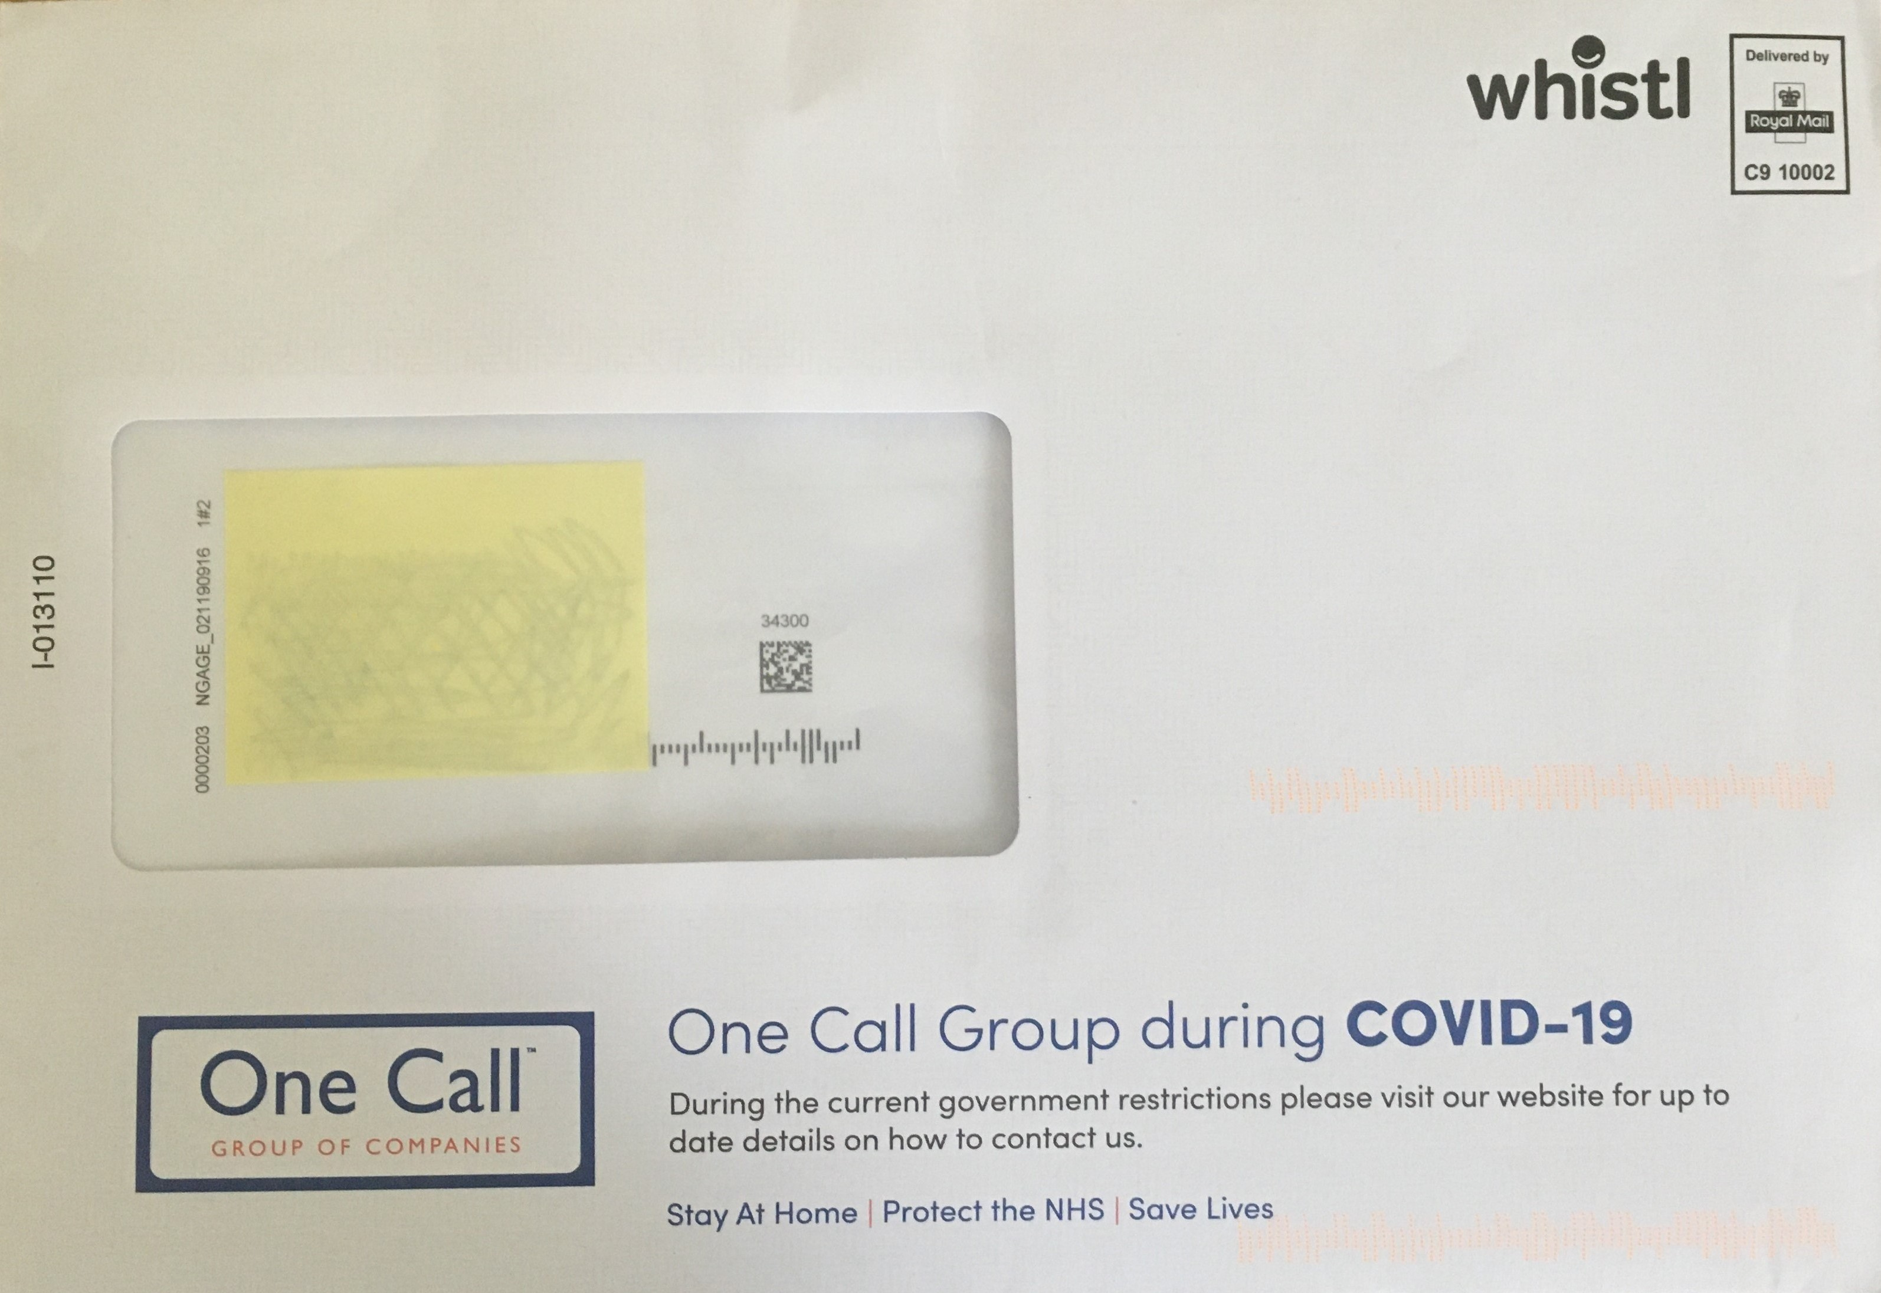
One call
Provide customer care
One Call writes to its customers to tell them how they can get in touch should they need to
Nice, reassuring message
Notice they have picked up the Government message on the outer envelope

Slide 21
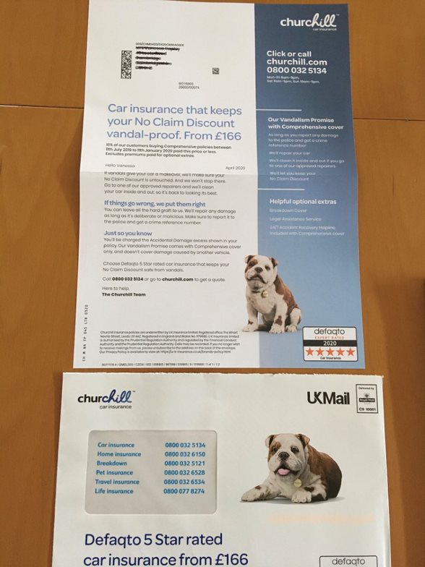
Churchill pack
Looks like business as usual
Although received at the end of April, there’s little to differentiate this and no link to Covid
It looks like their standard banker pack
Perhaps missing something when big brands like Churchill have a an opportunity to reassure people because of their place in the market

Slide 22
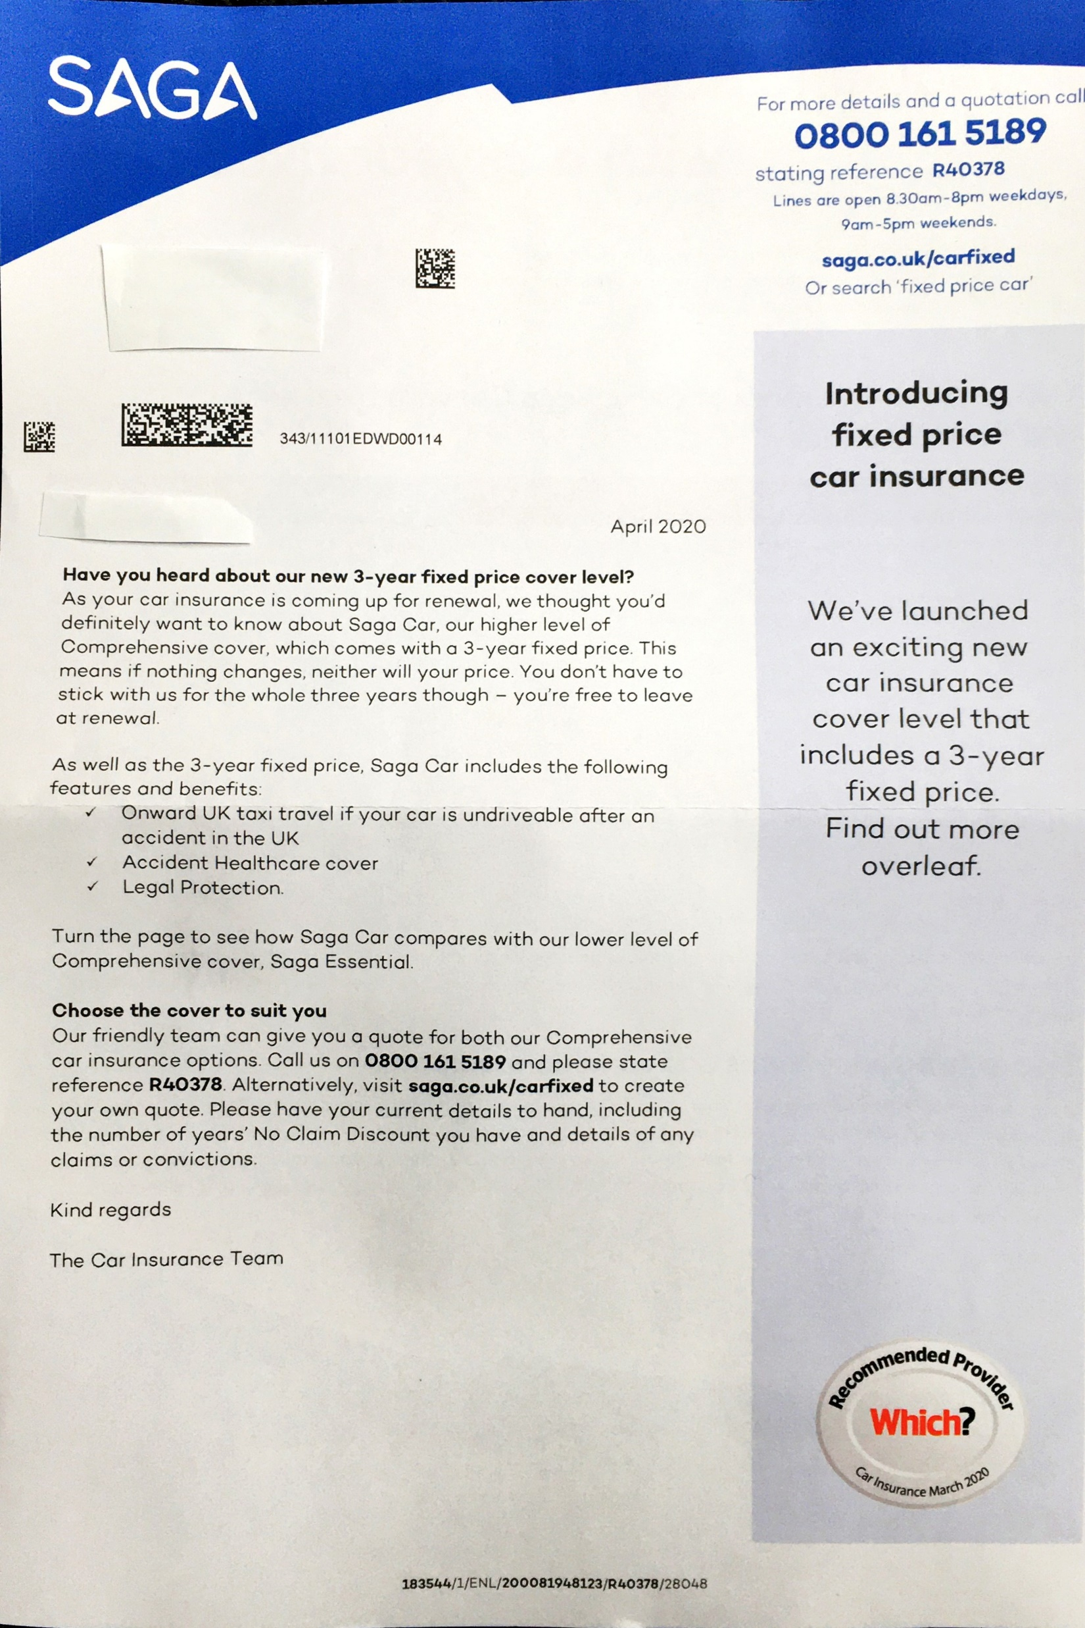
saga
Introducing a new product at a fixed price for 3 years, seems timely but it was probably developed pre-Covid
Writing to the customer at renewal
You are able to switch within the 3 year period
Use the recommended Which? seal of approval
Not the most exciting creative

Slide 23
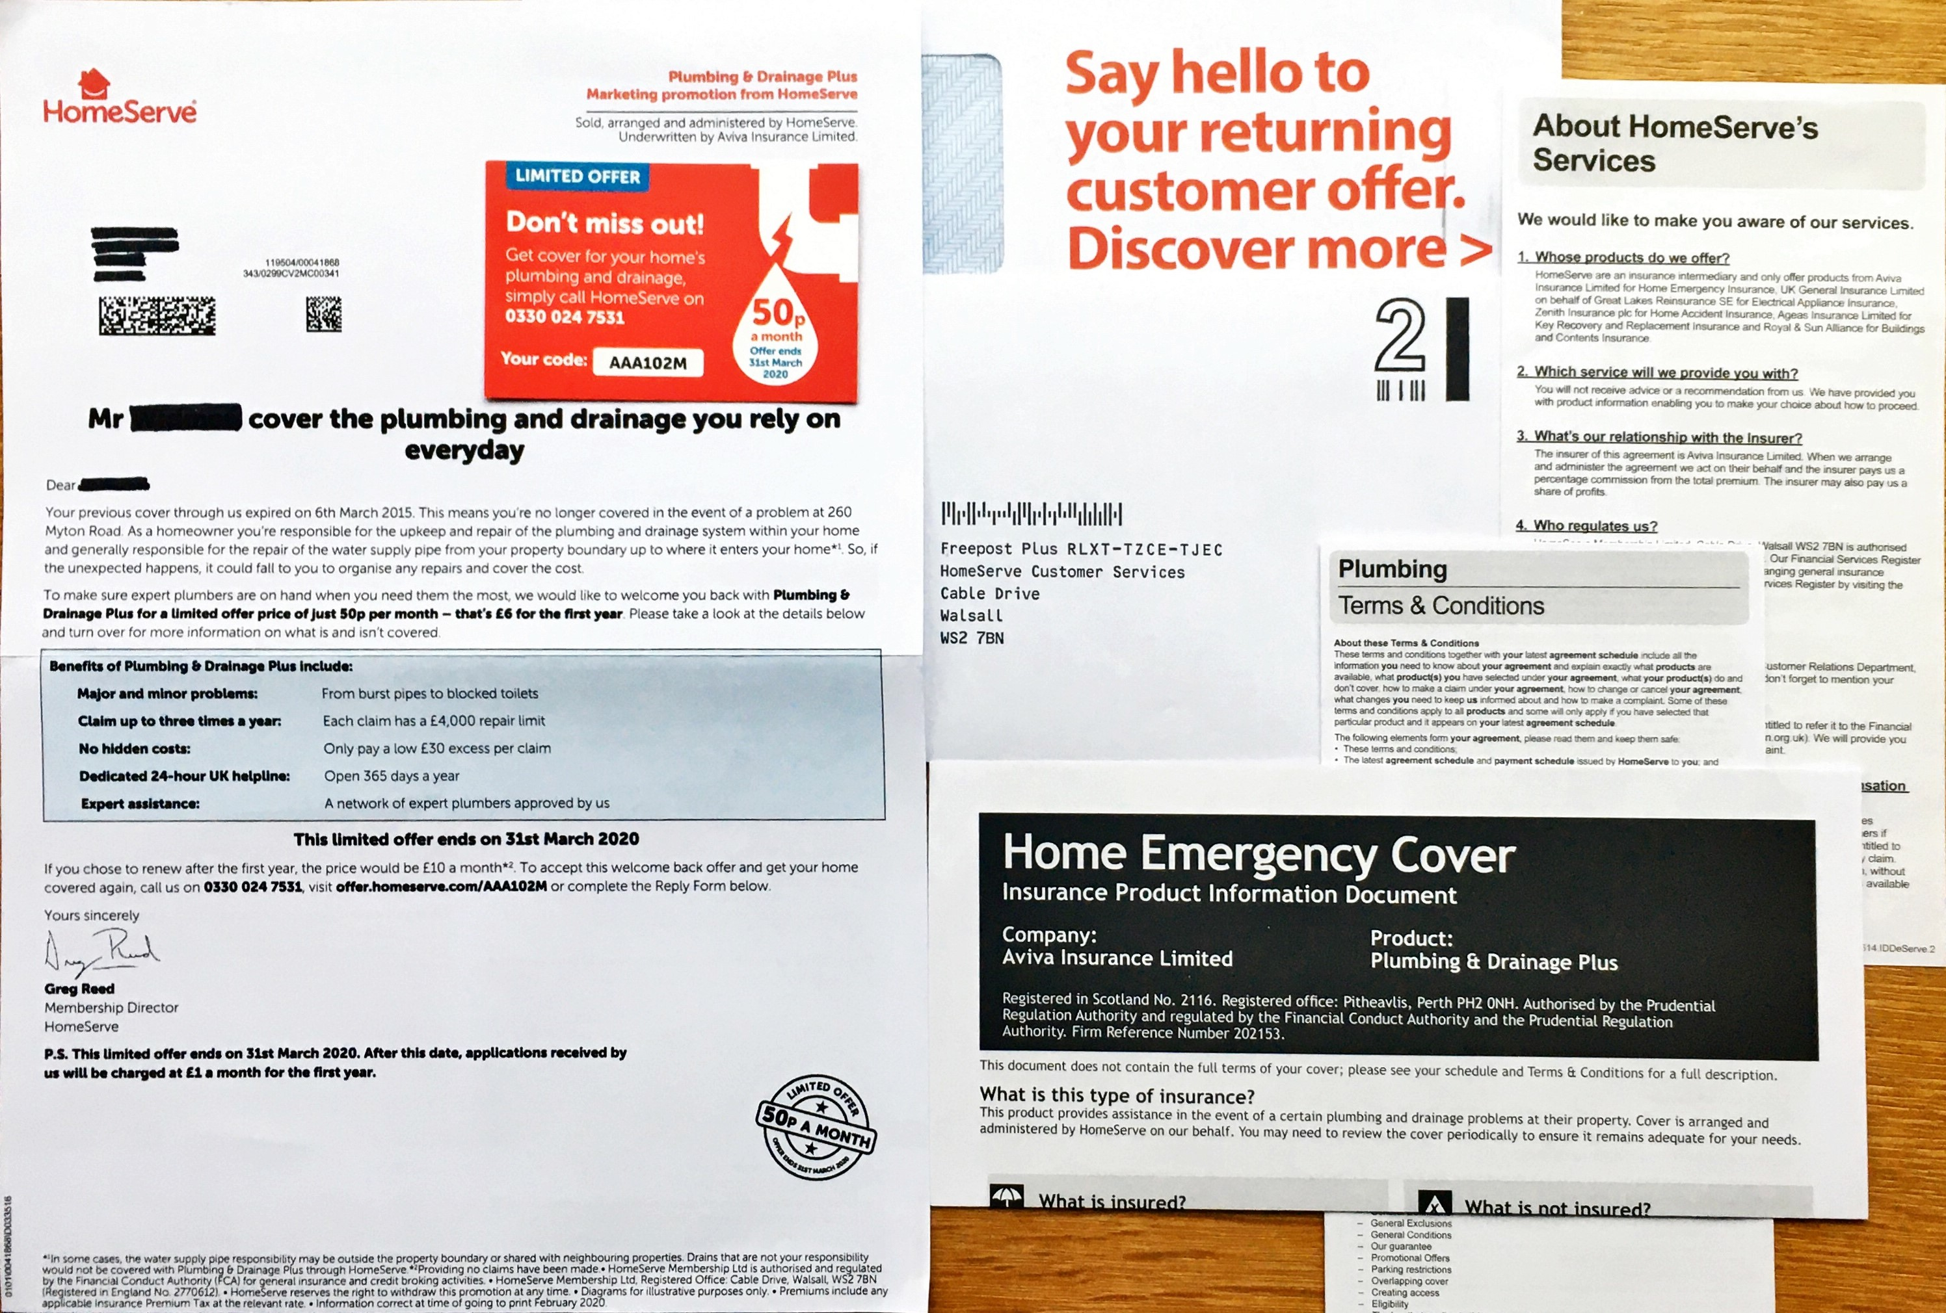
Homeserve
A lapsed customer offer for plumbing and drainage
Lots of inserts, suggesting this is a tried and tested banker pack, using a tip on card with a code and visual of 50p a month
No reference to the current pandemic

Slide 24
conclusion
THE MARKET
Price plays such a strong role in choices loyalty and retention are hard to achieve in this sector
THE JOURNEY
Mail has a role to play to engender loyalty at every point of the customer journey
MAIL
Has high levels of engagement but isn’t engaging as strongly as it should with commercial actions
CONTENT
When it contains financial statement or administrative information e.g. renewal it drives higher levels of frequency
INSURANCE MAIL
Ensure your mail works as hard as it can to engage with your customers to improve loyalty

