Slide 1
The importance of having circulation data for mail
Making mail planning better for the future
April 2021

Slide 2
What is circulation data & why is this changing

Slide 3
Jicmail circulation data changes
In 2018, at the request of JICMAIL, Royal Mail agreed to amend its Advertising Mail terms and conditions to allow the sharing of volume posting data, by brand, with Nielsen, a global measurement and data analytics company
The purpose of sharing this data is to provide insight information to the market on advertising trends in line with other media channels
The sharing of this data operates on the basis of a brand having the ability to opt out if they wish to do so
Following feedback from the industry on the process and the accountability of capturing opt out data, with input from the industry we redesigned the process which meant that accountability for capturing opt out requests moved to the access contract holders and that opt out requests could be made and last for a period of 12 months rather than taken on a per posting basis.
This change came into effect in April 2021 as set in out in the Royal Mail terms and conditions.

Slide 4




Mail’s place in the media world
Over
40million
letters delivered each day
Mail is the third largest media channel behind only Google and ITV
Delivering to every UK household 6 days a week
Relevant in a digital world
Mail is a significant media channel
But we don’t have all the same metrics as the others
So we are not able to gain the same commercial traction
Notes:
It may surprise you to know that mail is still the third largest media channel in the UK, overall – it is still a significant volume of advertising.
And its performance shows that it is engaged with and returned to again and again – with reach of 1.2 (meaning that every 100 mail packs sent another 20 people will see it) and frequency of 4.2, meaning that each pack is returned to over 4 times by an individual. It gets cut through in ways other channels can’t.

Slide 5

A competitive arena for channel choice
The choice of media channels has proliferated at a dramatic rate
Making it harder to get mail on the agenda when people are planning their communications
Therefore having the tools to help aid those decisions is vital in an omni-channel world
The tools that are ubiquitous in the rest of the industry are new to direct mail
BARB (the JIC for TV) has run for over 30 years and JICMAIL has been live since 2017
The use of JICMAIL has permeated the industry but it’s sill missing one vital pillar
Source: IPA Touchpoints 2020

Slide 6
The three building blocks of any JIC
1
2
3
REACH
FREQUENCY
CIRCULATION
How many individuals are exposed to your channel e.g. how many people are watching a TV programme at the same time
How many times are people exposed to your ad in that channel
The volume that is distributed within a media channel ie how many is it circulated to
Delivered through JICMAIL – transforming the way mail is planned and bought
Notes:
In order for media agencies or clients (who are increasingly taking media planning decisions in house) to make informed decisions about the channels they choose to build their brands they rely on industry standard data.
The three key building blocks are outlined in this slide – reach, frequency and circulation.
JICMAIL went live in 2017 and now has over 151,000 mail items within the data set. The reach and frequency data has now become a core part of mail planning for many but it still lacks one vital element – circulation.
Data currently is available for mail and is estimated volumes, based on a panel of consumers who collect their mail and send it in retrospectively to Nielsen who then estimate a volume for mail.
All other channels have some form of circulation measurement which is added to a system and then shared with Neilsen, allowing planning to be based on accurate media purchasing by brand, sub brand, creative and to some extent targeting.

Slide 7

Let’s take a real example
I WANT TO RUN A tv CAMPAIGN AND I’M A PLANNER IN AN AGENCY
The brand is a leading General Insurance business
REACH
FREQUENCY
CIRCULATION
I can see how many people my advertising will reach will reach
I can understand how many times people will see my ad
I can see what my competitors are spending, how much volume they bought and creative they ran

Slide 8

I can see clearly what my competitors do
When I look in planning tools like Nielsen this is the data I can see for all other channels
Where are they advertising – which geographical region
Is their advertising heavier in one region than another.
What they are spending, this won’t be a final negotiated rate but will be a ratecard price
Who are they targeting – if you can see the programmes they are selecting you have a broad target audience
TV spots are added to a system so that you can see which ad ran in which ad break by brand
With TV you can see what date the ad ran and how long it was, were they testing different formats like a 60 with a 10 trailer at the end of the ad break (a reminder)
Which channels are being used as well as TV, and what is their spend, distribution, creative treatment and dates of exposure

Slide 9
How does this benefit your client’s media planning

Slide 10
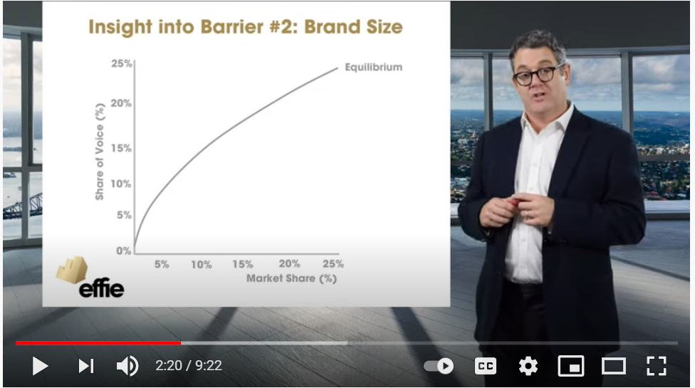
The importance of share of voice
Market share and share of voice
Mark Ritson explains that market share and share of voice are directly correlated for brands – ie the business with 25% share of voice in media will have 25% of market share
Mail currently has no accurate share of voice measurement
Watch the video in full. Mark Ritson on how Lidl grew their SOV: https://www.youtube.com/watch?v=bb-6PCbsdyc
Notes:
One of the most influential marketers in the UK market is Mark Ritson.
He highlights the importance of share of voice in brand building, share of voice that we can’t currently see for mail as we don’t have circulation data.
If I currently make a significant spend in mail in the market I don’t have a reliable or accurate way of seeing if I am punching above or below my weight compared to key competitors.

Slide 11
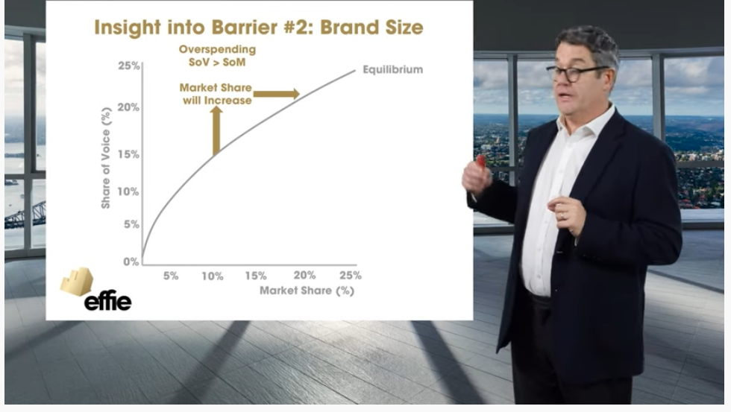
To change your sov you need to adjust your spending
Brand growth aligned to buying SOV
If you want to grow your market share you have to spend more to achieve an increase ie increase your SOV
With mail, there’s no way of calculating how much more your volume will need to increase to achieve this growth
Watch the video in full. Mark Ritson on how Lidl grew their SOV: https://www.youtube.com/watch?v=bb-6PCbsdyc
Notes:
And if brands want to grow it is common marketing practice to say that to grow market share you have to increase your share of voice.
Brands therefore looking to expand need to know what their competitors are spending in order to calculate this sort of investment with any accuracy.

Slide 12
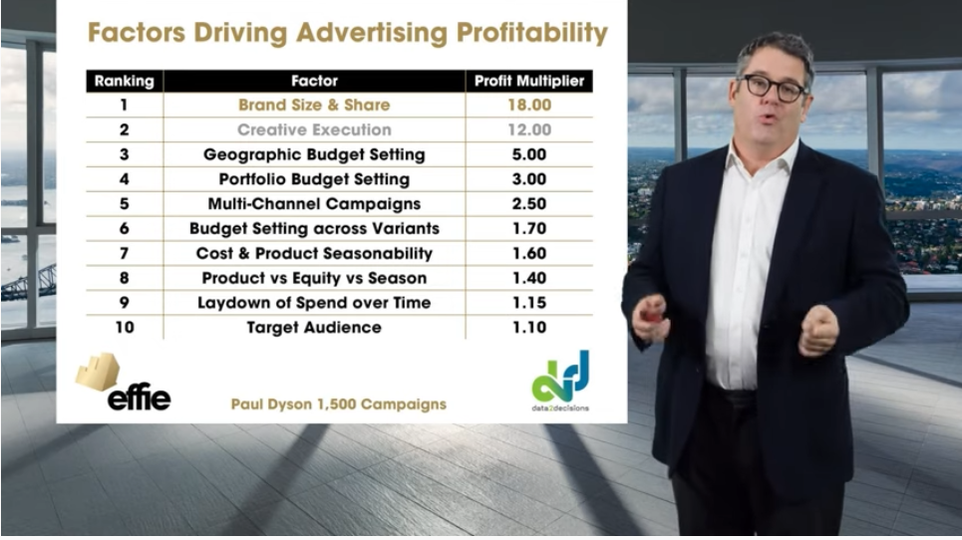
Without mail circulation
some of the main levers of profitability can’t be leveraged
Brand size really matters, it’s the thing that will drive advertising profitability by 18 times, followed by creative execution
But geographic budget setting and multi-channel campaigns have a big impact too and add to that the laydown of spend over time
None of which can be applied to mail as a channel without circulation
Watch the video in full. Mark Ritson on how Lidl grew their SOV: https://www.youtube.com/watch?v=bb-6PCbsdyc
Notes:
And the main levers of profitability are affected by where brands are spending, the use of multi-channel campaigns.

Slide 13
And mail has the ability to transform a campaign when included in the mix
Peter Field and Les Binet have shown that campaigns featured in the IPA Effectiveness databank were more likely to be successful if mail was part of the media channel choices both in the short-term and long-term
% reporting very large sales growth
Campaign duration
Notes:
If you take the data analysed by Peter Field and Les Binet using the awards entries submitted to the IPA Effectiveness awards (which takes place every 2 years and is considered the gold standard marketing awards for campaign effectiveness) campaigns which use mail are not only more effective in the short term but also in the longer term.

Slide 14
What is the benefit to your business

Slide 15
What can I do competitively with circulation data?
If my competitors are spending £1m on TV, what do I need to spend to gain the same share of voice or greater share of voice
If you are aware of your customers spend, relative to others, it can help you make a case for changing budget allocation, targeting and creative recommendations for mail
If my competitors campaign is weighted towards different geographic areas where should I be spending to make my budget go much further
Do my competitors have audiences they are focused on and can I differentiate my spend by reaching a core audience which is more relevant for my brand
Can I differentiate my creative message to get me stand out in the market place and give me a competitive advantage
Notes:
This template was inserted from Power-user, the productivity add-in for PowerPoint, Excel and Word.
Install Power-user to access thousands of templates, icons, maps, diagrams and charts with Power-user.
Visit https://www.powerusersoftwares.com/
©Power-user SAS, terms of license: https://www.powerusersoftwares.com/terms

Slide 16
Without circulation
I only have approximate mail circulation numbers – I cannot accurately see what my competitors are doing
Without circulation it is harder to make recommendations to your customers on how they can be more effectively investing in mail
I only have approximate spend – I don’t know what my competitors are spending
I have no geographical data currently about where my competitors are spending
I have limited availability of the creative messages my competitors are using – using mainly logic or guesswork

Slide 17
What’s the value to your business?
Visibility of competitors
Greater visibility of brands that are mailing and what volume they are sending
Deeper insight
With greater visibility you have more insight on your customers’ competitors – what volume, geographical distribution and dates they mail
Adding value to your customers
Giving you greater ability to shape the mail investment strategies for your customers, driving better performance and adding value
Informed planning
With this greater insight you can make informed recommendations on mailing volumes, targeting and creative message – potential to increase mail volume

Slide 18
What do you need to do?
Speak to your customers about opting in and sharing their data and the benefits it will give them by doing so.
Think about getting JICMAIL accredited with their Bronze, Silver and Gold Accreditation
If you have any queries speak to Tara Pickles at JICMAIL tara@jicmail.org.uk
Start getting ready to access the new data when it becomes available to the market
Help your clients understand what their competitors are doing so they can gain the same share of voice

Slide 19

Thank you

