Slide 1
In a time of crisis how mail can get vital messages across
Communicating to citizens for local authorities
April 2020

Slide 2

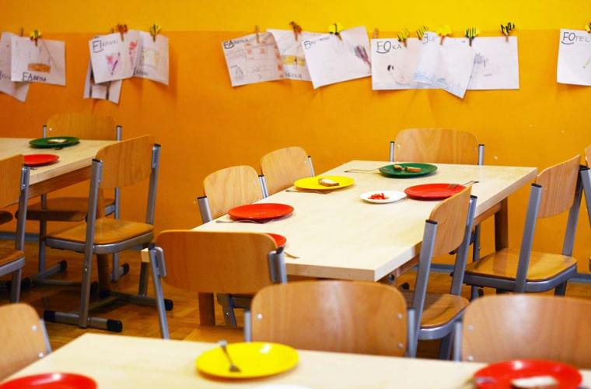
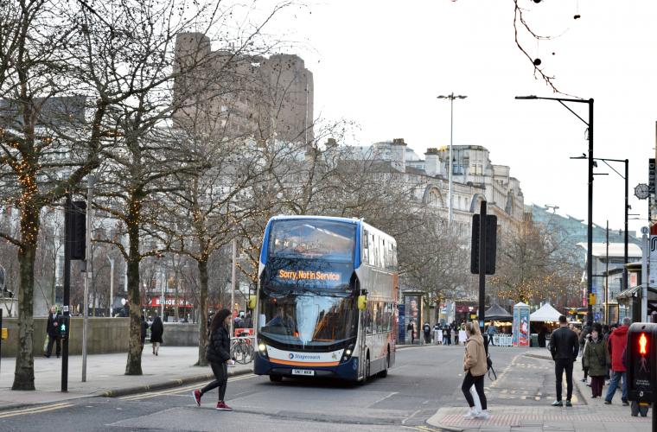
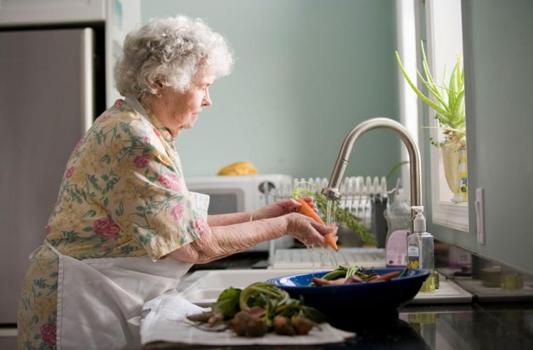
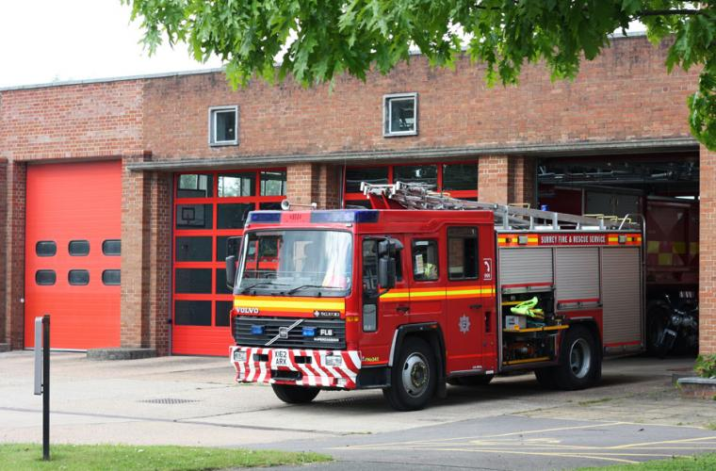
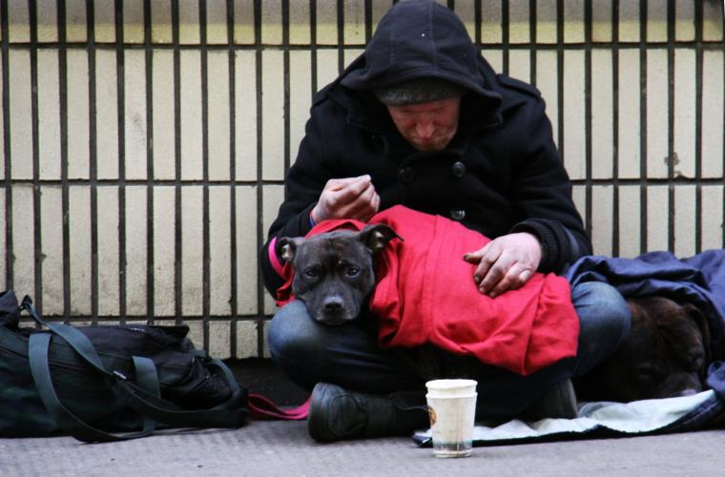
Local councils are responding
To a huge humanitarian crisis at many different levels
Hardship fund for most disadvantaged
Supermarket vouchers for those getting free school meals
Fall in passengers mean bus services may need to be rescued
Providing food parcels to the vulnerable
Diverting key workers to provide other services
Trying to get rough sleepers off the street
Source: Local Government Association, March 2020
Notes:
Local Authorities no longer holding Council meetings but making decisions remotely
Councils are category one responders under the Civil Contingencies Act 2004, which sets out the legislative framework for responding to emergencies such as the COVID-19 outbreak. As part of the local resilience forum (LRF), councils work with local partner organisations to plan and activate their emergency responses
Councils across the country are leading local efforts to support communities through the coronavirus crisis and are helping government provide essential food parcels to vulnerable and isolated people on an unprecedented scale (LGA)
Firefighters to deliver food and medicine and drive ambulances
Chairman of the Local Government Association, said: “Councils have been working hard to identify rough sleepers and homeless people, get them off the streets and into suitable accommodation and help protect them from the coronavirus. “This will be a huge task given the shortage of accommodation available with many councils now affected by the recent closures of hotels and the difficulties some have faced where rough sleepers refuse to engage or take up the offer of help.

Slide 3
Highest causes for concern
When thinking about Coronavirus which of the following, if any are you most worried about? Please tick all that apply.
% | COUNTRY |  |  | DEMOGRAPHIC |  |  |  | INCOME
 | ALL | US | UK | 16-23 | 24-37 | 38-56 | 57-64 Years | <£24k | >£60k
The speed at which the virus is spreading | 54 | 55 | 45 | 52 | 51 | 58 | 51 | 56 | 52
My family/friends catching the virus | 53 | 52 | 56 | 52 | 52 | 55 | 51 | 53 | 38
Risks to the elderly/people who are already sick | 49 | 47 | 56 | 42 | 44 | 52 | 60 | 47 | 42
Not having a vaccine available yet | 47 | 48 | 38 | 52 | 41 | 51 | 42 | 50 | 45
Myself catching the virus | 45 | 45 | 41 | 51 | 46 | 41 | 42 | 46 | 33
Hospitals not being properly equipped to manage/control the virus | 43 | 45 | 40 | 42 | 42 | 45 | 45 | 45 | 30
Inaccurate information about the virus | 40 | 44 | 37 | 37 | 38 | 44 | 34 | 38 | 37
The lack of research/unknowns surrounding the virus | 35 | 40 | 31 | 32 | 36 | 35 | 35 | 35 | 29
Failure of medical providers to do sufficient testing of people who might be sick | 32 | 34 | 23 | 29 | 30 | 35 | 33 | 31 | 27
Shortages of medical supplies (e.g. face masks) | 32 | 34 | 23 | 27 | 33 | 33 | 31 | 30 | 25
Risks to healthcare professionals | 30 | 33 | 27 | 22 | 28 | 36 | 29 | 30 | 31
Countries not being able to work together to fight the virus | 28 | 31 | 23 | 28 | 28 | 28 | 24 | 26 | 24
The impact it might have on my personal finances | 20 | 29 | 19 | 12 | 25 | 20 | 20 | 15 | 20
People’s concerns are broadly the same across all measures but note that those with higher incomes are more positive about all measures than the less affluent and any age group, suggesting that income is a bigger differentiator than age.
The only thing the affluent are more concerned with is the impact on their personal finances.
Source: Globalwebindex, March 2020

Slide 4
The message is getting across
But not all sectors of the population
What changes have you made to your personal behaviour? Tick all that apply.
% | COUNTRY |  |  | DEMOGRAPHIC |  |  |  | INCOME
 | ALL | US | UK | 16-23 | 24-37 | 38-56 | 57-64 Years | <£24k | >£60k
Washing my hands more frequently | 58 | 58 | 57 | 60 | 49 | 64 | 59 | 58 | 63
Trying not to touch my face | 36 | 37 | 31 | 40 | 37 | 44 | 32 | 34 | 46
Not directly touching public surfaces (e.g. door knobs, elevator buttons) | 29 | 30 | 24 | 25 | 26 | 35 | 30 | 27 | 34
Changed my daily routines to avoid crowds/rush hour | 18 | 19 | 11 | 10 | 20 | 21 | 16 | 17 | 15
Started wearing a face mask | 11 | 13 | 3 | 15 | 13 | 12 | 0 | 11 | 21
Working from home more often | 10 | 11 | 5 | 5 | 14 | 9 | 9 | 6 | 11
Changed the way I commute to work (e.g. avoided busy trains) | 7 | 8 | 4 | 5 | 13 | 6 | 2 | 5 | 8
I’ve not made any changes as a result of COVID-19/Coronavirus | 18 | 16 | 25 | 12 | 15 | 20 | 25 | 21 | 9
Less than half of 24-37 year olds say they are washing their hands more. And fewer people across all age cohorts are avoiding touching their faces. And those people who are most resistant to changing their behaviour are the 57-64 year olds – 25% say they have not changed a thing.
Source: Globalwebindex, March 2020

Slide 5
Mail’s strengths in a crisis
REACHES EVERYONE
Mail can be targeted to individuals of any demographic at an individual or household level. It is a good way to reach the vulnerable or key groups of people.
GIVES REASSURANCE
Mail is a trusted and a secure way to deliver important messages from Local Government – Government mail has the highest engagement rates at 99% engagement¹
PHYSICAL IMPACT
Not only is mail from Government opened is returned to 4.9 times and stays in the home longer than other mail, 9.3 days²
DRIVES INTERACTION
Mail gets people to act on the contents, 47% of health mail drives interactions, 1 out of every 4 health mailings are discussed²
GETS PEOPLE ONLINE
45% of Government mail gets people to act on it, with 16% going online to look for more information³
Source: JICMAIL Q2 2017 – Q1 2018. Commercial actions, Business and addressed mail. Base 33829

Slide 6
Mail overcomes barriers
MAIL IS MORE LIKELY TO BE READ IN FULL EVEN IF YOU ARE NOT ENGAGED WITH THE CONTENT
Extent to which communication has been read / consumed which somewhat / strongly differed from my views.
Source: Communications in Electoral Engagement, Royal Mail MarketReach, Illuminas 2017
Base: All answers on communications which somewhat / strongly differed from views by media (excluding leaflets & magazines)

Slide 7
Engagement high
Government door drops are engaged with at a higher rate than any other sector, they get citizens’ attention
The average engagement rate for all other sectors with door drops is 73%
Government
Door Drop
Source: JICMAIL Q2 2017 – Q1 2019. Base: Door Drops/Government/council; n=402

Slide 8

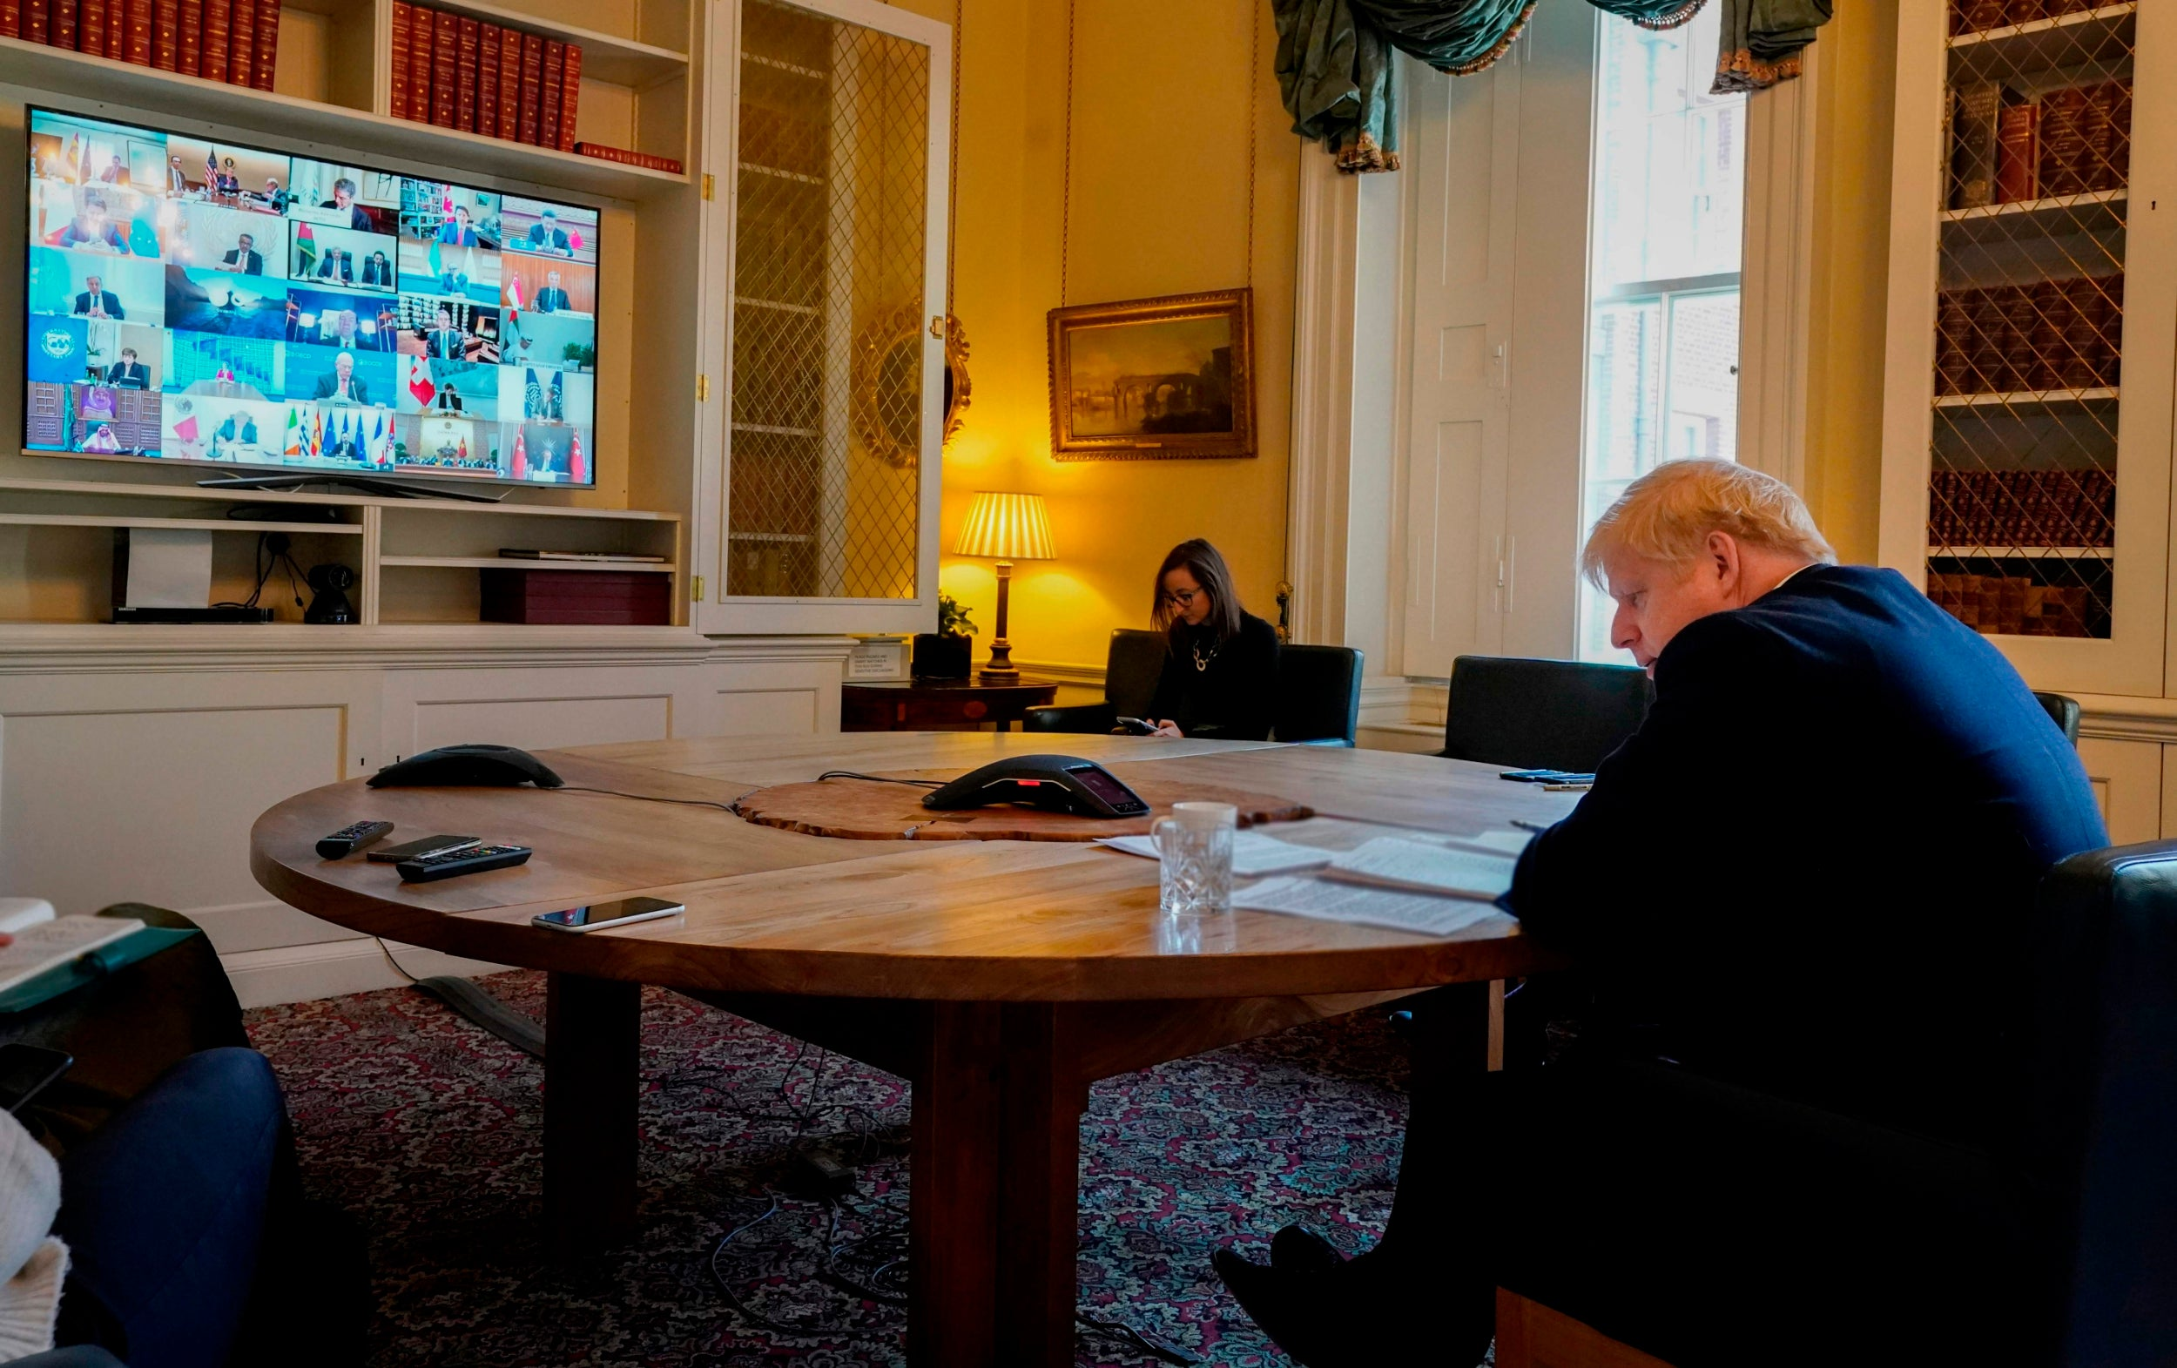
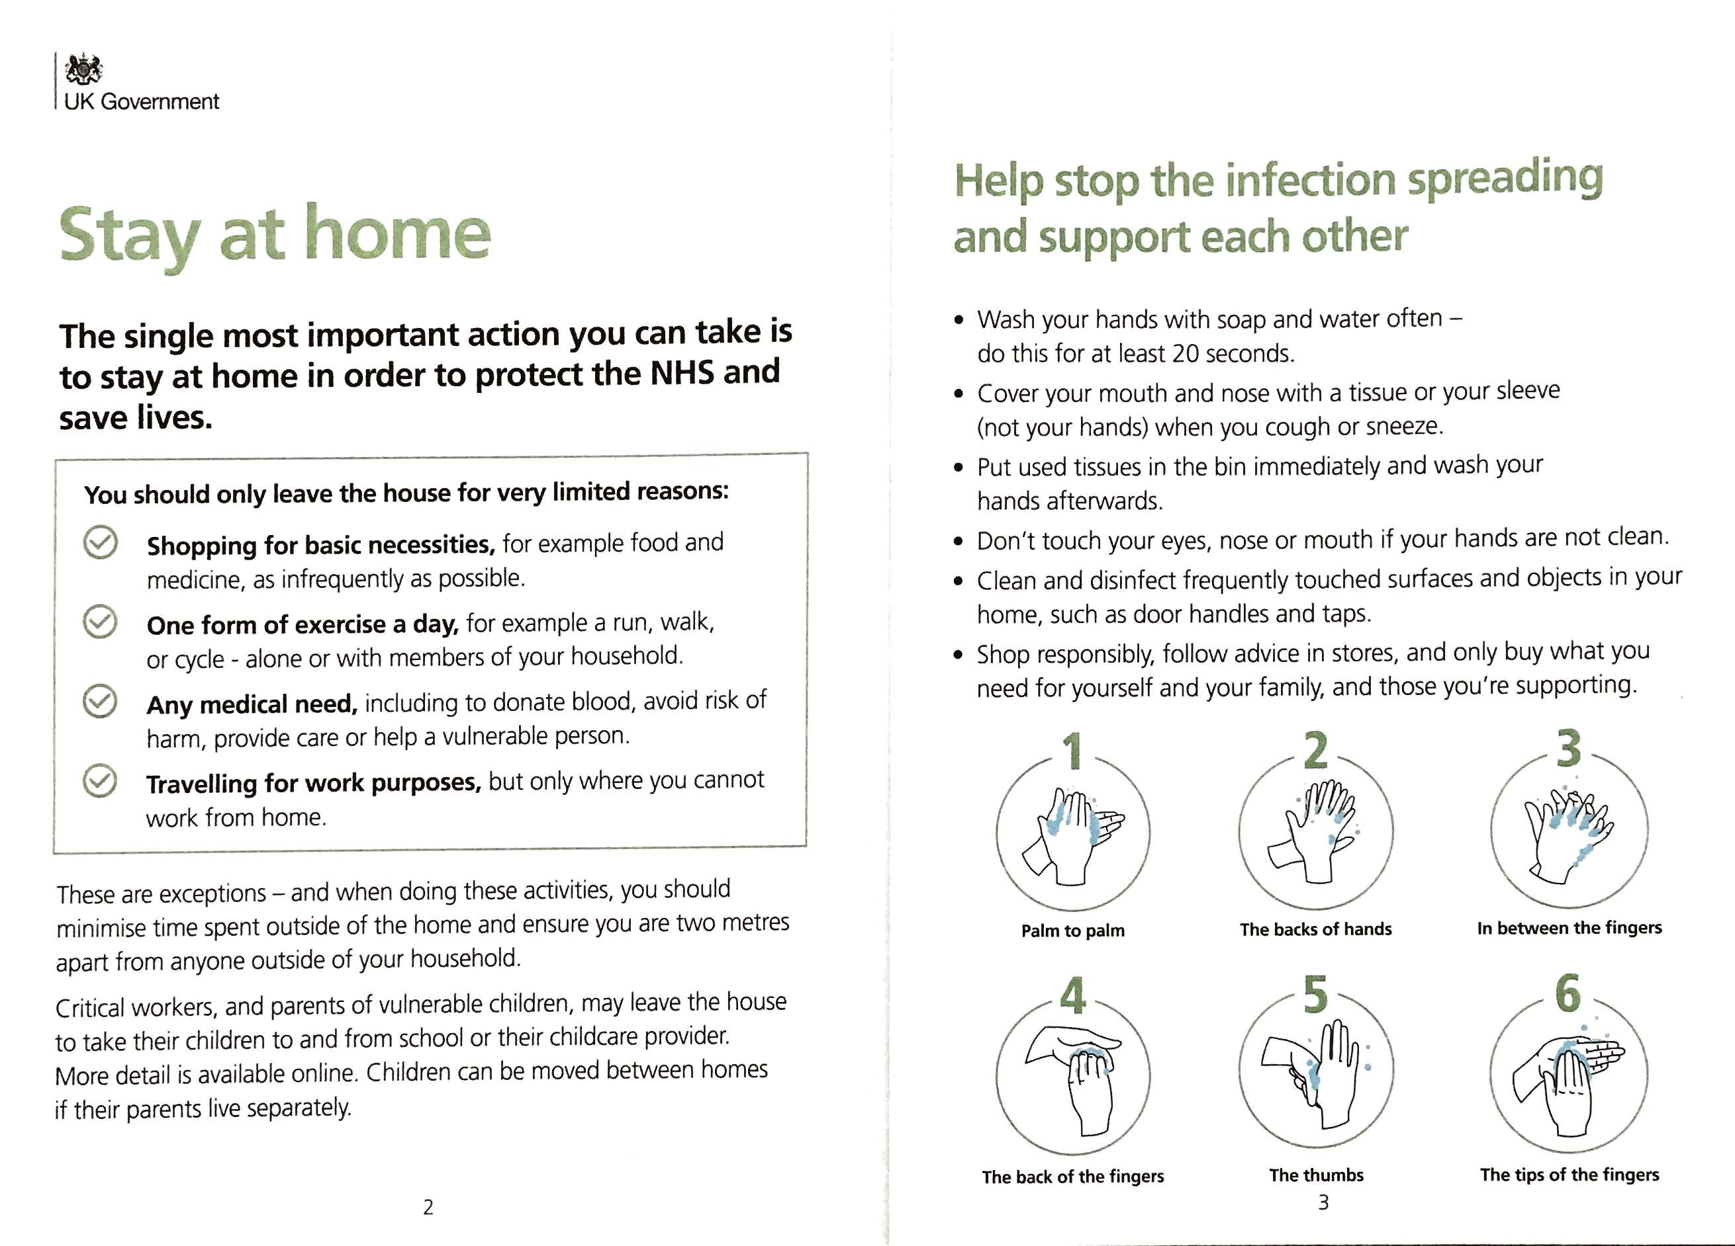
Boris has written to the nation

Slide 9









How you can use mail
To really get the message across
Getting people to engage with important health messages
Helping people access the right benefits or understand what they can get
Engage with the vulnerable who have special needs
Engage with essential workers who are at the front line of fighting the virus
Get citizens to get into social media to keep updated or join vital support groups
Show people where they need to go to access help for specific needs
Door drop can reach people when other media aren’t going to be seen (posters, newsprint, etc)
Mail is a great way to get a message out that people will refer to again and again

Slide 10
Mail and social media work together
People spent +30% longer looking at social ads if they saw mail first.
Social media advertising : single-image ads with text, appearing in participants’ Facebook news feed.
Source: Royal Mail MarketReach, Neuro-Insight, 2018

Slide 11

HYBRID MAIL capability
OFFERS COST EFFECTIVE AND FLEXIBLE SOLUTION
You simply upload your data and letter/creative
Data is encrypted and is totally secure
If you don’t already use hybrid it’s really simple to start
Any vital message printed and in the postal system in 24 hours
It’s available through many print partners
Your hybrid printer can normally take your data and print your items the same day
Speak to your Access Operator or rostered print provider

Slide 12
conclusion
ATTENTION
Mail gets people’s attention and is read and engaged with
GRAVITAS
Mail can get across important messages and is secure and targeted
ACTION
Mail is the channel to get people to do things, to act on important guidelines
READ IN FULL
People are more likely to read all the content, even if the message isn’t palatable
FLEXIBLE
Mail can be used in many communication scenarios to land different messages and with fast turnaround

