Slide 1


PROGRAMMATIC MAIL – RETARGETING, PERSONALISED MAIL FOR REAL PERFORMANCE
December 2024

Slide 2

“
Programmatic mail combines online and physical channels in a way that is likely to significantly improve ROI.
Mark Cripps, CMO
”
Source: Emailmonday “The Ultimate Marketing Automation Stats” (2019)

Slide 3
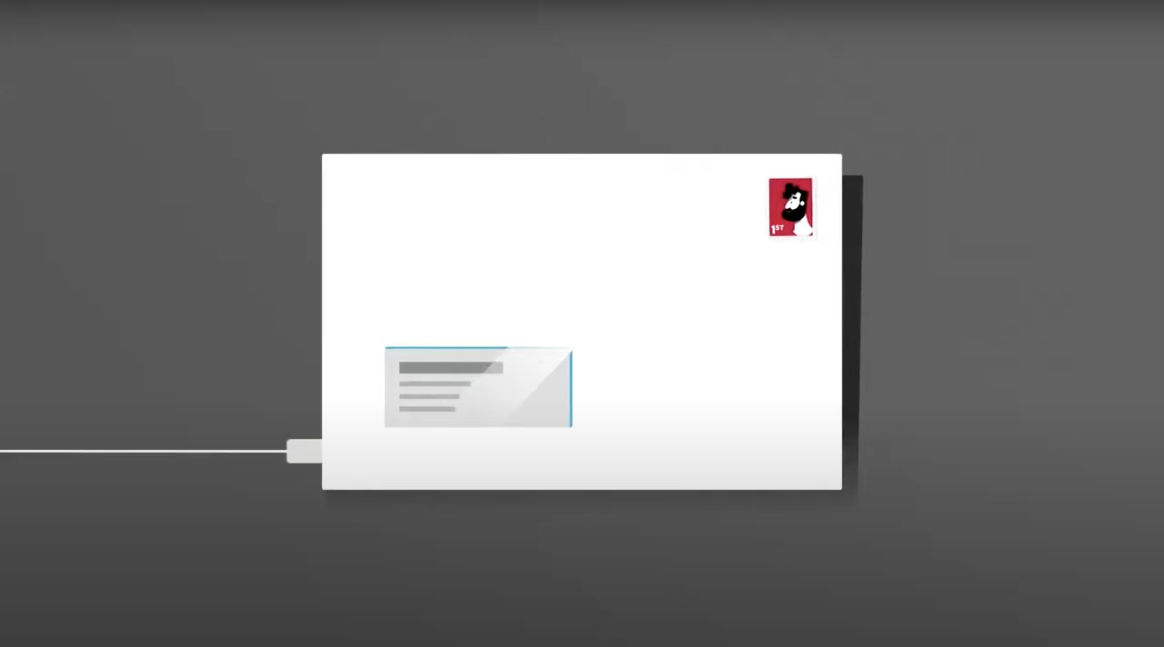

SO, DOES IT WORK?

Slide 4








IT CAN FULFIL MULTIPLE OBJECTIVES FOR BRANDS
From offline retargeting to lifecycle management
Browse Abandonment
Quote Abandonment
Next Best Product
Email Non-Responders
Email Non-Permissible
High Value Customers
Customer Milestones
Lapsed Customers

Slide 5






The end-to-end campaign process
Programmatic mail
Brand X determines & agrees campaign objective with programmatic mail partner
Programmatic mail partner sets up tagging on brand X website
Brand X 1st party data uploaded to a portal
Customer behaviour triggers timely, relevant & personalised mailing
Programmatic mail partner, reports on performance with detailed campaign analytics
OR
Tags capture customer information prior to abandonment

Slide 6

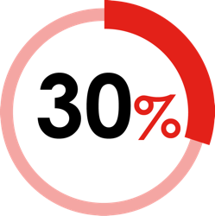
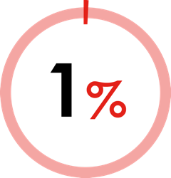
LEVERAGE YOUR FIRST-PARTY DIGITAL DATA
To activate more effective outcomes
90% of marketers say that first-party data is important to their marketing
But only 30% are collecting and integrating data across channels
Only 1% are using data to deliver a fully cross-channel experience for their customers
USING FIRST-PARTY DATA COMES WITH BUSINESS BENEFITS
up to
up to
2x
1.5x
incremental revenue
(from a single ad placement, communication, or outreach)
improvement in
cost efficiency
compared to companies with limited data integration
Source: Google / Boston Consulting Group, Responsible Marketing With First-Party Data 2020

Slide 7
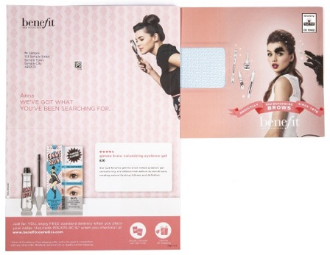
Retargeting WITH PROGRAMMATIC DM DROVE SUBSTANTIAL UPLIFT IN SALES FOR BENEFIT
BACKGROUND
SOLUTION
RESULTS
Leading women’s cosmetics brand, Benefit, had noted a high volume of web visitors who were only browsing products - not purchasing. With a growing range of eyebrow products being added to the product range, the company wanted to focus specifically on increasing conversions within that range.
Paperplanes partnered with Benefit to programmatically trigger personalised letters to be sent to customers that browsed the eyebrow product section of the website, but didn't make a purchase. The letters were designed to encourage customers to complete a purchase on the specific product they viewed, promoting free delivery for the customer to strengthen conversions. Unique shipping codes were applied to each individualised letter to track and monitor performance. The creative comprised of a double sided, full colour print A4 letter and a full colour C5 envelope with smart use of personalisation across both for maximum impact, brand recognition and awareness.
Campaign results revealed a 37% uplift in sales conversion of eyebrow products online with an average customer value of over £40. Results from the campaign also revealed that engagement levels had risen to over 28%.

Slide 8
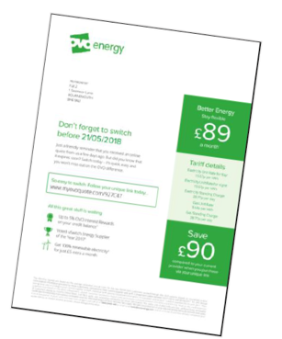
OVO ENERGY GENERATED AN ROI OF 15:1
From customers interested in energy services
BACKGROUND
SOLUTION
RESULTS
OVO is one of the fastest growing independent energy providers in the UK. When customers started a quote on the OVO site, but didn’t complete the buying process, they received a follow up email. Retargeted emails had a good return but it had become difficult to further improve the performance.
OVO partnered with Paperplanes to target non-converters with highly personalised programmatic direct mail. Mail retargeted and encouraged them to complete their energy switch, providing quote details they abandoned. The mail, delivered in 24-48 hours, was able to offer the same level of personalisation as email.
The campaign led to strong incremental uplift and ROI - £15 for every £1 invested. 5.5% overall conversion rate representing a 25% incremental uplift on conversion vs lookalike customers, and strong performance vs digital retargeting. The campaign continued to generate strong conversions well past the typical sales cycle of a 7 day quote, with uplift still noted up to 30 days after the campaign’s end.

Slide 9


Programmatic mail incentive - overview
30%
WHO IS IT FOR?
TO QUALIFY
CREDIT
TO APPLY
For consolidators and advertisers posting Programmatic Advertising Mail below the 4,000 daily minimum by brand.
Minimum of 50k per annum by consolidator. Post up to 1m items over 12 months.
Qualifying Programmatic items will earn a 50% credit off Business Mail rate card or can be posted using Adverting Mail product.
For more
information
and to apply go to www.royalmailwholesale.com
9
Full terms and conditions apply

Slide 10
Types of triggers eligible for offer
TYPE OF TRIGGER | DETAIL | TIMEFRAME
Abandoned basket | A customer puts an item or items in their basket but doesn’t complete their transaction – trigger to encourage checkout. | Up to 28 days
Next purchase – cross sell or up sell | A customer made a purchase and your data tells you they might be likely to go on and buy a complementary product – tigger a cross sell or up sell offer. | Up to 90 days
Product re-appraisal | A customer makes a purchase but has removed some of the items they had in their basket – trigger a reminder about those other items. | Up to 28 days
Browsed no check out | A customer browses a product or range of products but does not put anything in their basket – trigger a mailing to showcase that product or range. | Up to 90 days
Welcome upgrade | A customer subscribes to a basic subscription but there might be headroom to upgrade them and lock them into a more valuable subscription. | Up to 7 days
Paused subscription | A customer goes online and pauses their regular subscription – trigger a communication to try to resolicit their engagement with an offer. | Up to 7 days
Churned trigger from eCommerce subscription | Customer has paused or triggered a break in subscription or looks in danger of lapsing through behaviour tracked on the website. A trigger is introduced to encourage customer to stay active. | 180 to 360 days
Winback lapsers | Web tracking and/or data modelling determine customer has not returned to website in adequate time frame. Trigger to lock in return purchase. | 60 to 270 days
Subscription trigger upsell | A customer takes out a subscription to a magazine that might prompt the upselling to another title. Retarget with a complementary title they might subscribe to. | Up to 7 days

Slide 11
Validation process
Data sharing requirements
When eligible items are posted a weekly spreadsheet must be shared with Royal Mail in a format we will provide to you which shows:
  the number of eligible Items posted on behalf of each brand
  the UCID and SCID used to post the Programmatic Advertising Mail
  unique reference identifiers that link to all eligible items posted
Upon request from Royal Mail this will need to be supported with A/B samples (seeds) of the creative which has been used in the Programmatic Advertising Mail posted
Please Note: Where customers are unable to meet the prescribed validation process, Royal Mail will engage with applicants to agree a workable process.
Full terms and conditions apply

Slide 12

OFFER DATES
29 July
2024
28 March
2025
27 March
2026
Applications open
Last application
Last posting
Full terms and conditions apply

Slide 13



The APPLICATION AND CREDIT process
Offer open to applications until 28 March 2025
Go to the application form here
WORK WITH AN
ACCESS PROVIDER
They will need to have signed a Programmatic Advertising Mail side-agreement with Royal Mail.
.
WE’LL GET IN TOUCH
To discuss your application and check all the detail with you.
VOLUME NOTIFICATION
We review our billing data monthly and pay out credits once a month which will be confirmed by email or utilise existing advertising mail product codes.
REDEEM YOUR
CREDIT
Receive your credit as a voucher or have it paid into a Royal Mail postage account. Credit vouchers are valid for 12 months.
APPLY ONLINE
Use the link to the online application. Your application can also be completed by an agent.
POST YOUR MAILINGS
Start posting your volume and provide the daily Programmatic supporting information
Full terms and conditions apply
Notes:
This template was inserted from Power-user, the productivity add-in for PowerPoint, Excel and Word.
Install Power-user to access thousands of templates, icons, maps, diagrams and charts with Power-user.
Visit https://www.powerusersoftwares.com/
©Power-user SAS, terms of license: https://www.powerusersoftwares.com/terms

Slide 14
FREQUENTLY ASKED QUESTIONS
What mail will qualify for the incentive?
You can send Letters or Large Letters up to 250g in trays that meet the definition of Programmatic Mail detailed in the terms and conditions.
Can I use postcard formats?
Traditional postcards are not eligible please see the Machinable Postcard and One-Piece Mailer Guide for options to use with incentives at royalmailwholesale.com/incentives.
What postal services are eligible?
Mailmark Advertising Mail and Business Mail, Mailmark Economy Adverting Mail and Business Mail. Items up to 250g posted in trays.
How do I apply for credits?
You do not need to apply for your credits. We will use the data provided in your accepted application to calculate the credits earned. Credits will be paid monthly.
Is there a volume requirement?
You must post a minimum of 50k eligible items over 12 months and we will support up to 1m mail items.
Full terms and conditions apply

Slide 15
THANK YOU
www.marketreach.co.uk

