Slide 1
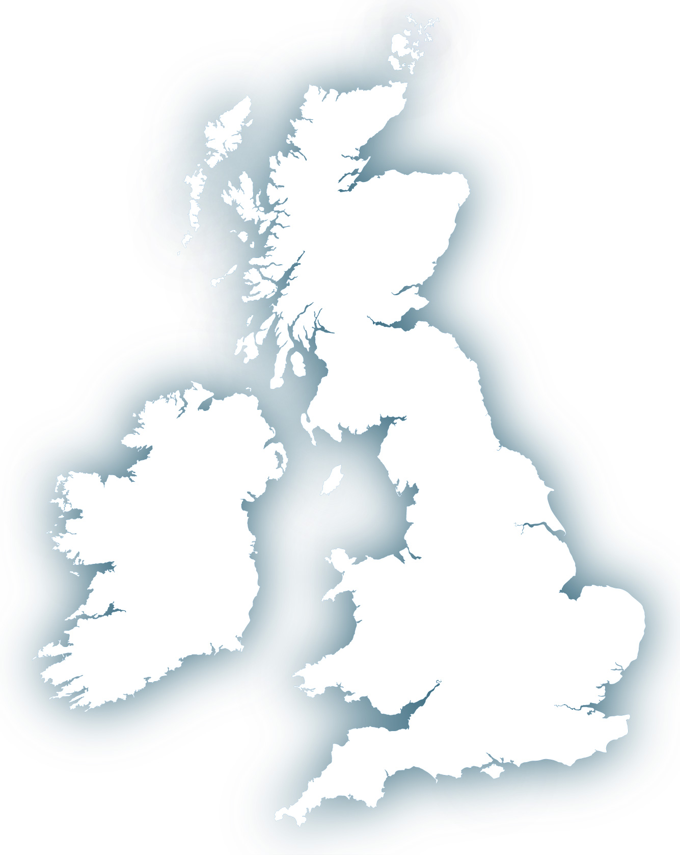
ENGAGE CITIZENS WITH MAIL
FOR LOCAL GOVERNMENT
Local Government has never been under more intense pressure to deliver more to its’ citizens for ever less money.
And with 58^{%1} of people concerned about how budget cuts will affect the community it is vital that Local Government messages help to build trust with their audiences.
¹APSE, Association for Public Service Excellence, 2017
HOW DOES MAIL HELP TO ENGAGE CITIZENS AND GET YOUR MESSAGE ACROSS?
MAIL AND DOOR DROP REACHES EVERYONE | There are still 10% of the population who haven’t used the internet for the last 3 months. Those in receiving housing benefit over-index for not having used the internet at home: index 149.² Door drops reach 98% of the population in the UK. ²TGI Q1 2020
MAIL HAS HIGH RECALL | 61% of people recall seeing mail from their Local Authority, second is 24% for door drop and the next nearest is 11% for local newspaper.³ ³Royal Mail Local Government Research, Illuminas, 2017
MAIL IS PREFERRED FOR LOCAL GOVERNMENT MAIL BY ALL AGE GROUPS | 16-29 year olds prefer mail (57%) over email (26%) and 65+ year olds prefer mail (71%) over email (28%).⁴ ⁴Royal Mail Local Government Research, Illuminas, 2017
GOVERNMENT MAIL OF ALL TYPES HAS HIGH ENGAGEMENT AND INTERACTION RATES | 99% of Government and Local Government mail is engaged with – only 1% is minimally processed, this is the highest for any sector using mail. And the mail they get is returned to, on average 4.8 times, again the highest sector.⁵ ⁵JICMAIL Q1 – Q4 2019
57%
16-29 year olds prefer mail for Local Government messages
99%
WANT TO LEARN MORE?
We have a full research report on our findings from an extensive study we undertook around how citizens interact with the communications they receive from Local Government, get in touch to find out more.
YOUR LOGO GOES HERE
Insert your contact details here

