Slide 1
Using mail to drive commercial outcomes for your business
How mail gets customers to take action on travel offers
May 2020
YOUR LOGO HERE

Slide 2
The travel market has obviously been badly hit
2

Slide 3
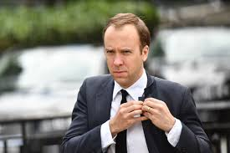
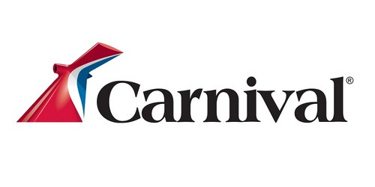
Some of the headlines
Make for rather alarming reading
12,000 BA workers facing redundancy
Had planned to start flights in June until quarantine announcement by Johnson
Cutting staff by about a third (3,150) and closing 15% of Travel Agents, rebrand of the rest
Travelodge put pressure on their landlords to slash rents or they may go under
Folds…
Chief Exec John Holland-Kaye says “social distancing won’t work in airports”
Health Secretary Matt Hancock says "big, lavish international holidays" are unlikely this summer
Announce financial losses of £750m+ and potential loss of 8,000 jobs worldwide
Announces a large number of job cuts

Slide 4
Businesses are innovating to survive
Lots of businesses are thinking up radical solutions
Cruise companies looking at versatile itineraries, adapting craft, ways of shielding
Some taking advance bookings to keep cash flow going
Budget hotels looking at ways they can re-open with new distancing in place
UK campsites are expecting bumper bookings this summer as the lock down loosens
UK hotels expect a surge in bookings too as social distancing is relaxed
Advance bookings across the industry appealing to those with an eye for a deal

Slide 5
But this is a serious time of uncertainty
“
The existing financial protection structures and regulations were not designed to cope with large-scale collapse of businesses
Mark Tanzer, Chief Executive of the Association of British Travel Agents
“
“
As we emerge from this crisis, the business travel supply chain will need to collaborate and work in harmony to enable British business to travel, to trade and to drive the UK economy forward
Clive Wratten, BTA chief executive
“

Slide 6
The good news
BRITONS have a strong desire to travel and won’t want things to get in the way – tourism contributes £213.8bn to GDp
2 out of 3 people are willing to travel abroad this year
(survey taken between 19 April and 3 May)
Source: Advantage Travel Partnership, sample size 4,228, May 2020

Slide 7
What’s changed in buying behaviour
And what’s likely to continue after covid-19
Bought for the first time due to Covid-19
If you bought for the first time, how likely are you to buy again in the next 12 months
Source: Nielsen Covid-19 Dipstick in March 2020
Notes:
Obviously overseas travel has been badly hit. But there is some optimism.
Some travel sectors think they may well benefit from a surge for people staying at home, things like glamping and campsites may have a boom. But this isn’t going to the case for all travel businesses especially for those who don’t operate from the UK.

Slide 8
How mail can drive commercial value to you

Slide 9
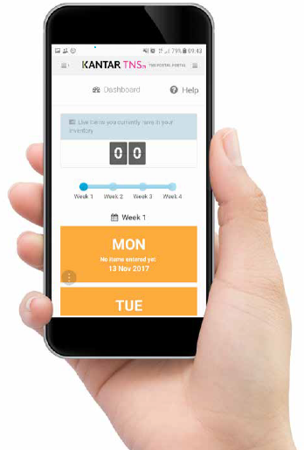
Jicmail gives us gold standard data
That shows exactly how consumers interact with travel mail
Mail is collected in the first week and recorded, then that week’s mail is tracked over 28 days
People record what they do with their mail physically
They tell us the type of mail, i.e. is it addressed or unaddressed to them or someone else.
Opened it
Read / looked at / glanced at it
Put it on display e.g. fridge / noticeboard
Passed it on / left out for the person it’s for
Put it aside to look at later
Threw it away / recycled
Took it out of the house e.g. to work
Used / did something with the information
Put it in the usual place
They capture what business sector the mailing or door drop comes from.
They record the contents; is it information, special offer, etc. You can tick all that apply here.
Notes:
JICMAIL data has been available since the second quarter of 2017, it now contains over 92,000 individual mail packs across all the main industry sectors. It has been designed to create Gold Standard for the industry so that mail and door drop can be planned alongside other media in exactly the same way as all other channels.
A panel of 1,000 households each month collect their mail and door drop for the first 7 days of each month. They then track that content over a full 28 day period and tell us what they did with it physically ie opened, read and passed it on. But in addition they record any commercial actions, such as going online, calling the sender or using a voucher or discount code.

Slide 10
Engagement rates with travel mail
High across the board
93% of all travel mail is engaged with ie mail is processed in some way (opened, read, sorted, put aside)
69% of all travel mail read / looked at / glanced at
62% of all travel mail is opened (a postcard doesn’t need to be opened)
Source: JICMAIL Q2 2017 – Q1 2019 Addressed or Business Mail, Travel/tourism/attractions, n=3483
Notes:
Engagement rates are on a par with all other sectors, but slightly higher for engagement (the average is 91%).

Slide 11
What are travel companies sending?
They are mainly sending information about products and services, but more likely to contain a broader range of contents than other sectors
Source: JICMAIL Q2 2017 – Q1 2019 Addressed or Business Mail, Travel/tourism/attractions, n=3483
Any type of content with 1% or less has been removed
Notes:
Travel company mail contents tend to have a slightly more diverse types of contents than other sectors.
But people mostly say their travel mail contains information about product/services or about entertainment and activities. But they also contain a number of other things like special offers.

Slide 12
physical actions
Physical interactions with travel mail are strong HIGH OPEN RATES AND READING RATES, MORE ARE PUT ASIDE THAN MOST OTHER SECTORS
Travel mail still live in the home after 28 days
Source: JICMAIL Q2 2017 – Q1 2019 Addressed or Business Mail, Travel/tourism/attractions, n=3483
Any type of content with 1% or less has been removed
Notes:
Open rates are high, it is clear that people take notice of mail from travel. 29% of travel mail is put aside to look at later, the average for all sectors is 25%. The recycle rates look a bit alarming but actually 49% of travel mail is still live in the home after 28 days. Panellists are only asked to record what they do with their mail for 28 days.
Travel mail therefore sticks around.

Slide 13
MAIL DRIVES COMMERCIAL ACTIONS
When it contains different content it drives different levels of commercial interaction
%
Commercial actions particularly high for vouchers/coupons, financial statements and administrative information
Resulting commercial actions with high street retail mail
1,908
655
130
400
69
821
424
155
Source: JICMAIL Q2 2017 – Q1 2019 Addressed or Business Mail, Travel/tourism/attractions, n=3483
Notes:
It drives commercial action – 28% of people receiving travel mail go on to do something commercial with that mail.
But look at how three types of mail in particular drive even higher engagement.
Just as a reminder commercial actions are over and above the physical actions people take that can’t necessarily be associated with what people do when they have the mal pack in their hand. The average commercial engagement rate across all sectors is 32%.
This might help you make decisions about what your mail contains to ensure you get the greatest engagement levels you can.
Went online for more information
Discussed with someone
Bought something/made a payment or donation
Called the sender
Visited the sender’s web site
Used a tablet or smart phone
Used a voucher/discount code
Visited a sender’s shop/office
Planned a large purchase
Ordered a catalogue
Looked up my account details
Posted a reply to the sender

Slide 14
All SORTS OF GROUPS ENGAGE WITH MAIL
Travel mail is engaged with by all types of consumer
FREQUENCY OF EXPOSURE
AGE 55-64
MALE 55+
SOCIAL GRADE C2
TV REGION
MIDLANDS
OWN HOME 6-10 YRS
4.31
4.83
4.8
5
4.8
ADVERTISING & BUSINESS MAIL MAIL
Source: JICMAIL Q2 2017 – Q1 2019 Addressed and Business Mail, Travel/tourism/attractions, n=3483
Notes:
All different types of groups engage with travel mail. Using JICMAIL might help you enhance your targeting.

Slide 15
All age groups engage with mail
Frequency - older age groups engage at slightly higher rates
Source: JICMAIL Q2 2017 – Q1 2019 Addressed and Business Mail, Travel/tourism/attractions, n=3483
Notes:
All age groups engage with mail from travel companies. The 55-64 year olds have the highest rates of engagement.

Slide 16
frequency above average
Mail drives high frequency but varies by type of content
If the content has a voucher or coupon, news/update or is a financial statement or administrative information then the frequency is significantly higher than the average.
Base: 1,908
Base: 1,908
Base: 655
Base: 130
Base: 400
Base: 69
Base: 821
Base: 424
Base: 155
Source: Kantar TNS, JICMAIL, Addressed and Business Mail, Travel/tourism/attractions, n=3483
Notes:
But if you look at exposure frequency for some mail contents they perform higher than average. Vouchers and coupons boost frequency to 4.7 and administrative information to 4.8.
Travel mail is on a par with reach data for all other sectors which is 1.13. But this means that for every 100 travel packs that are sent another 12 people will see it.

Slide 17
Content type drives all sorts of actions
Look how the inclusion of a voucher gets people to do something commercial like use the voucher, plan a large purchase or discuss with someone else
Actions per thousand by mail type
Source: Kantar TNS, JICMAIL, Advertising and Business Mail, Travel/tourism/attractions, n=3483
Notes:
Over and above the physical interactions with mail that you’ve seen earlier there’s a whole host of commercial actions that are being driven and you can see a wide range of actions per thousand. So for example if you send someone a voucher or coupon in a travel mail pack 322 people per thousand of those 28% that acted will go on to plan a large purchase. 202 per thousand will use a voucher if you send them a voucher and a financial statement prompts 245 people per 1000 to go on and buy something or make a payment.
Giving consumers reasons to engage gets them to act on the information they receive.

Slide 18
What are travel companies sending right now

Slide 19
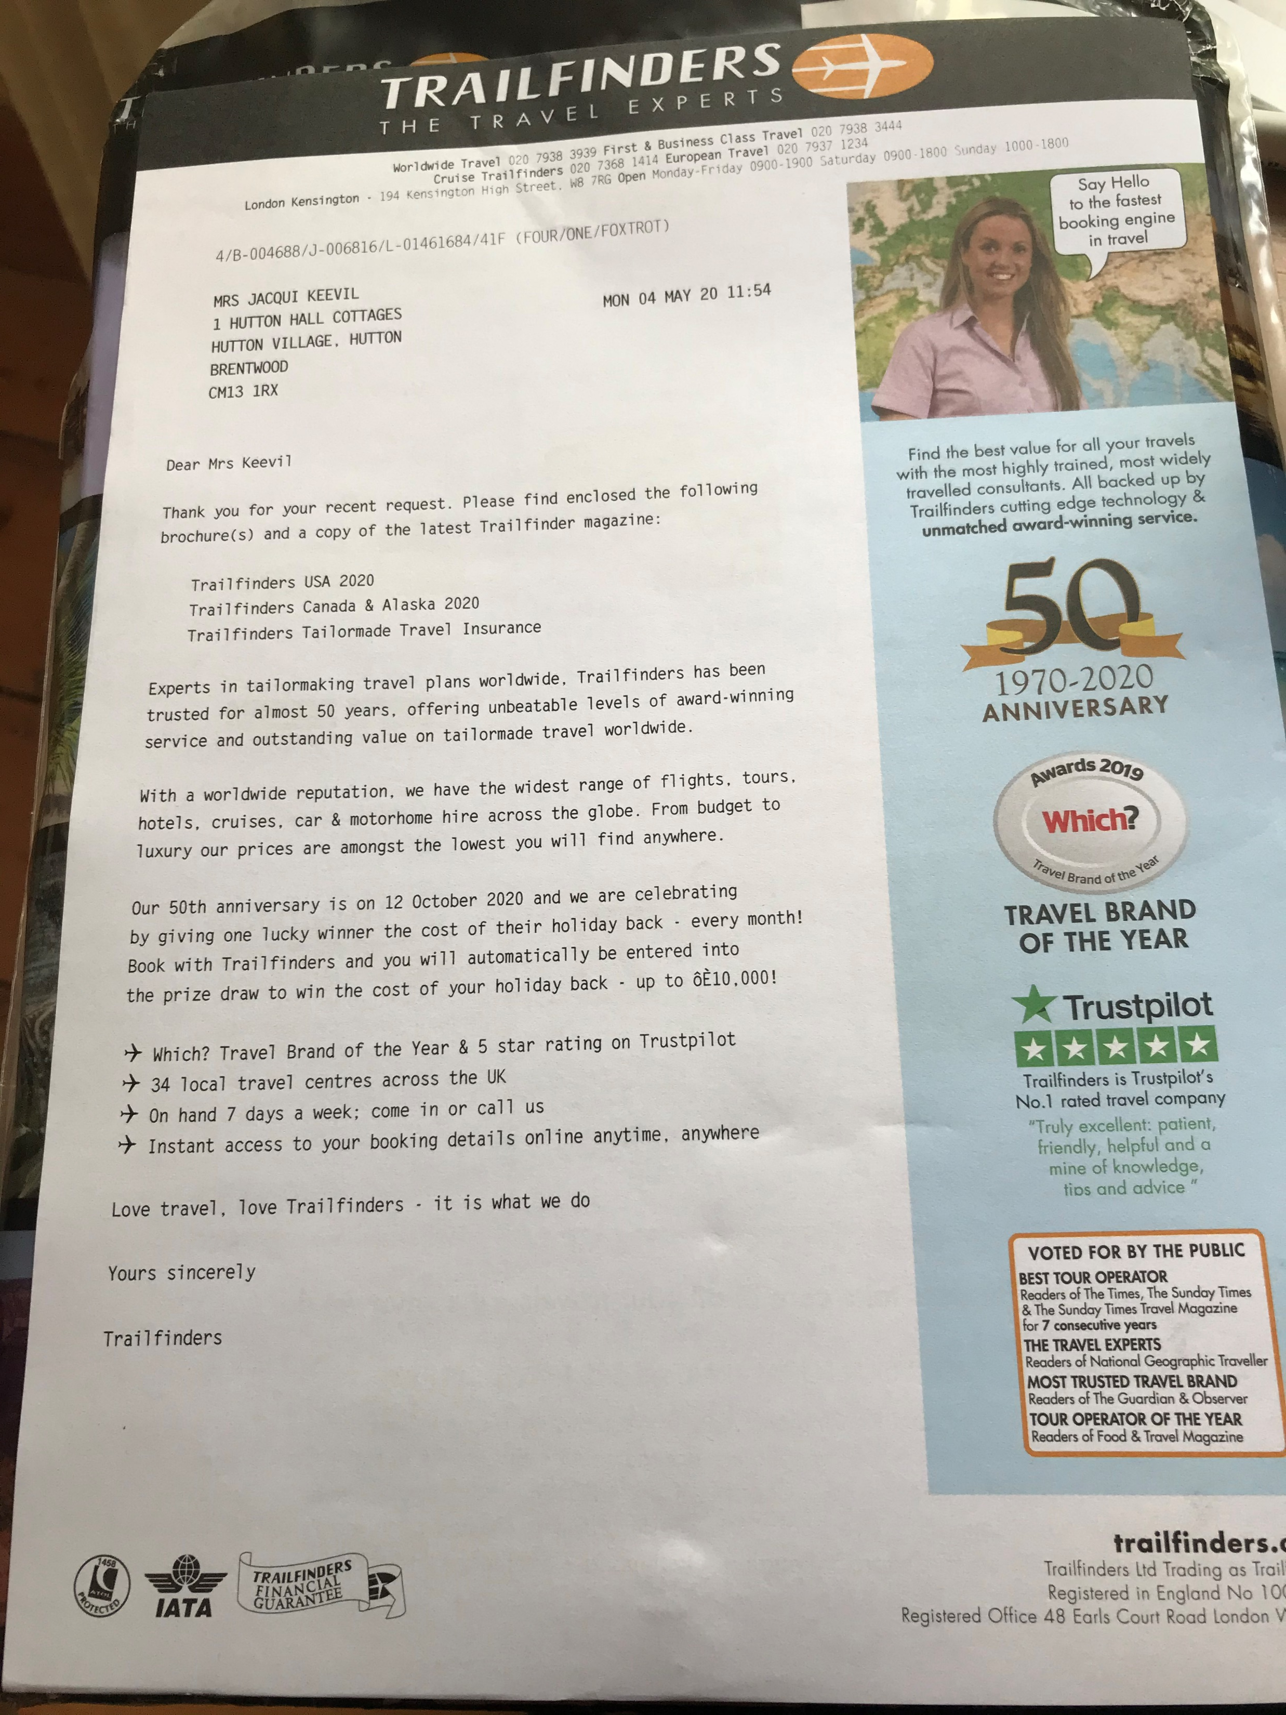
Trailfinders
Covid-19 communication from may
Fulfilment letter sent out with brochure
Focus on celebrating their 50th Anniversary in October and no mention of the current Covid issue
But they are offering automatic entry into their competition for a lucky individual to win back the cost of their holiday every month, worth up to £10,000

Slide 20
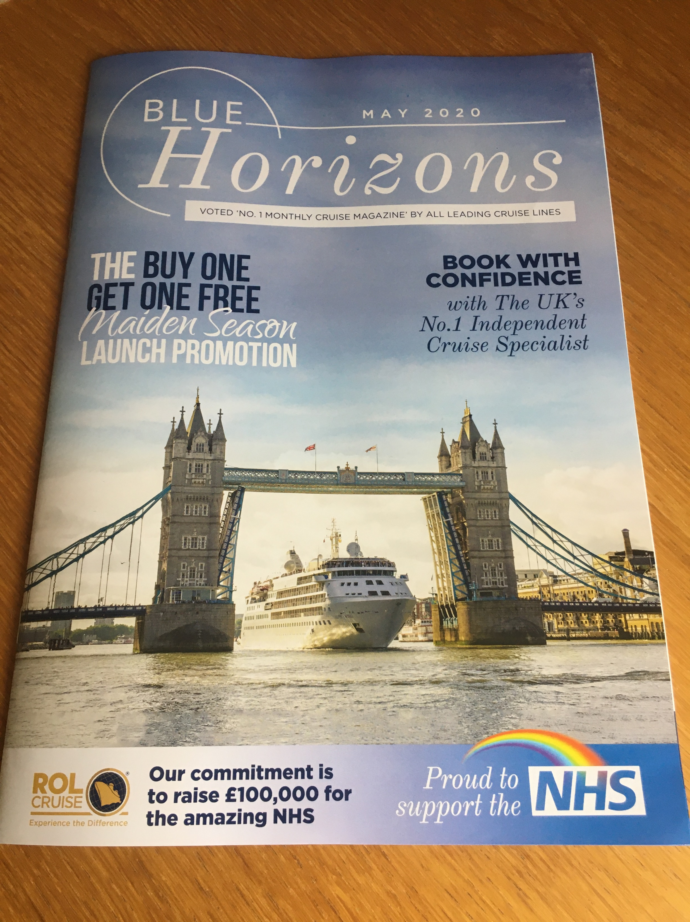
Rol cruise
Confident promotion sent in May
This piece from ROL Cruise not only provides a reassuring tone about being able to book with confidence
But they have also been prominent abut raising funds to support the NHS, featured prominently on the front right of the cover, with a rainbow, tying in with the rainbows in people’s windows

Slide 21
YOUR LOGO HERE

