Slide 1
THE ROLE OF CUSTOMER MAIL IN DELIVERING A REMARKABLE CUSTOMER EXPERIENCE (CX)
Notes:
The marketing communications world has been through rapid change in the last few years – digital and covid, being two major market changers.
It is more important than ever to ensure all marketing spend creates the right connection to customers, is designed for a specific role and delivers value
Customer Experience has become central to many brand’s approaches. It covers the full range of communications organisations have with their customers. A major channel for building strong customer experience is mail we call Customer Mail. This is the mail organisations send to people they have a relationship with to build value for that relationship.
Customer Mail makes up a significant portion of targeted personal communication, but Marketreach had never specifically explored the impact of this channel.
Given the growing importance of CX - it was time. So with the help of leading research company Trinity McQueen and Global Customer Experience expert Accenture, we considered the development of Customer Experience and the role of Customer Mail in it.

Slide 2
CUSTOMER EXPERIENCE (CX) IS INCREASINGLY IMPORTANT
Customers are in control
CX is the #1 priority
CX is good for business
CX is a key differentiator
Customers now judge brands based on how well they feel those brands meet their changing needs.
89% of companies surveyed by Gartner said CX is the new competitive battlefield.
CX leaders have higher revenue growth – as much as 4.4 x as CX laggards.
Businesses should want to leverage every opportunity to reinforce and enhance their relationship with customers.
Notes:
Customer Mail has become a major focus for organisations
Digital and Covid have put customers in control of their choices and relationships with brands
CX is recognised as a key requirement for brands
CX drives value when done well
But it has to be right for the brand and the consumer

Slide 3
But cx strategies aren’t delivering
Research conducted by Adweek and Accenture Interactive found
80%
8%
of their customers agree
of brands think they deliver a superior customer experience
Source: Adweek & Accenture
Notes:
This fascinating piece of research highlighted that there is a big chasm between what organisations think they are doing and what customers are experiencing. The challenge of having more touchpoints than ever before, means there is a big opportunity to get things wrong. The last touch is the one that’s fresh, if a customer has a bad experience it can quickly send them to a competitor.

Slide 4
Many companies have a limited view of CX
A good CX is multi-faceted. Viewing CX as only the digital journey is detrimental
CX must encompass all actions that connect a product or service with its customers
Including all customer communications
Not just the role of marketing or digital teams
Opportunity to combine the physical with the digital…
Notes:
Focus on CX has grown, but it isn’t simple
CX is not just digital – it is all touchpoints – advertising of course, but also shops, events and customer service. It brings together physical and digital touchpoints
Which means CX is not just a ‘marketing thing’. Decisions made for example in Finance, procurement and customer service can have a significant impact, so all parts of the organisation need to understand how their decisions impact a brand’s CX

Slide 5
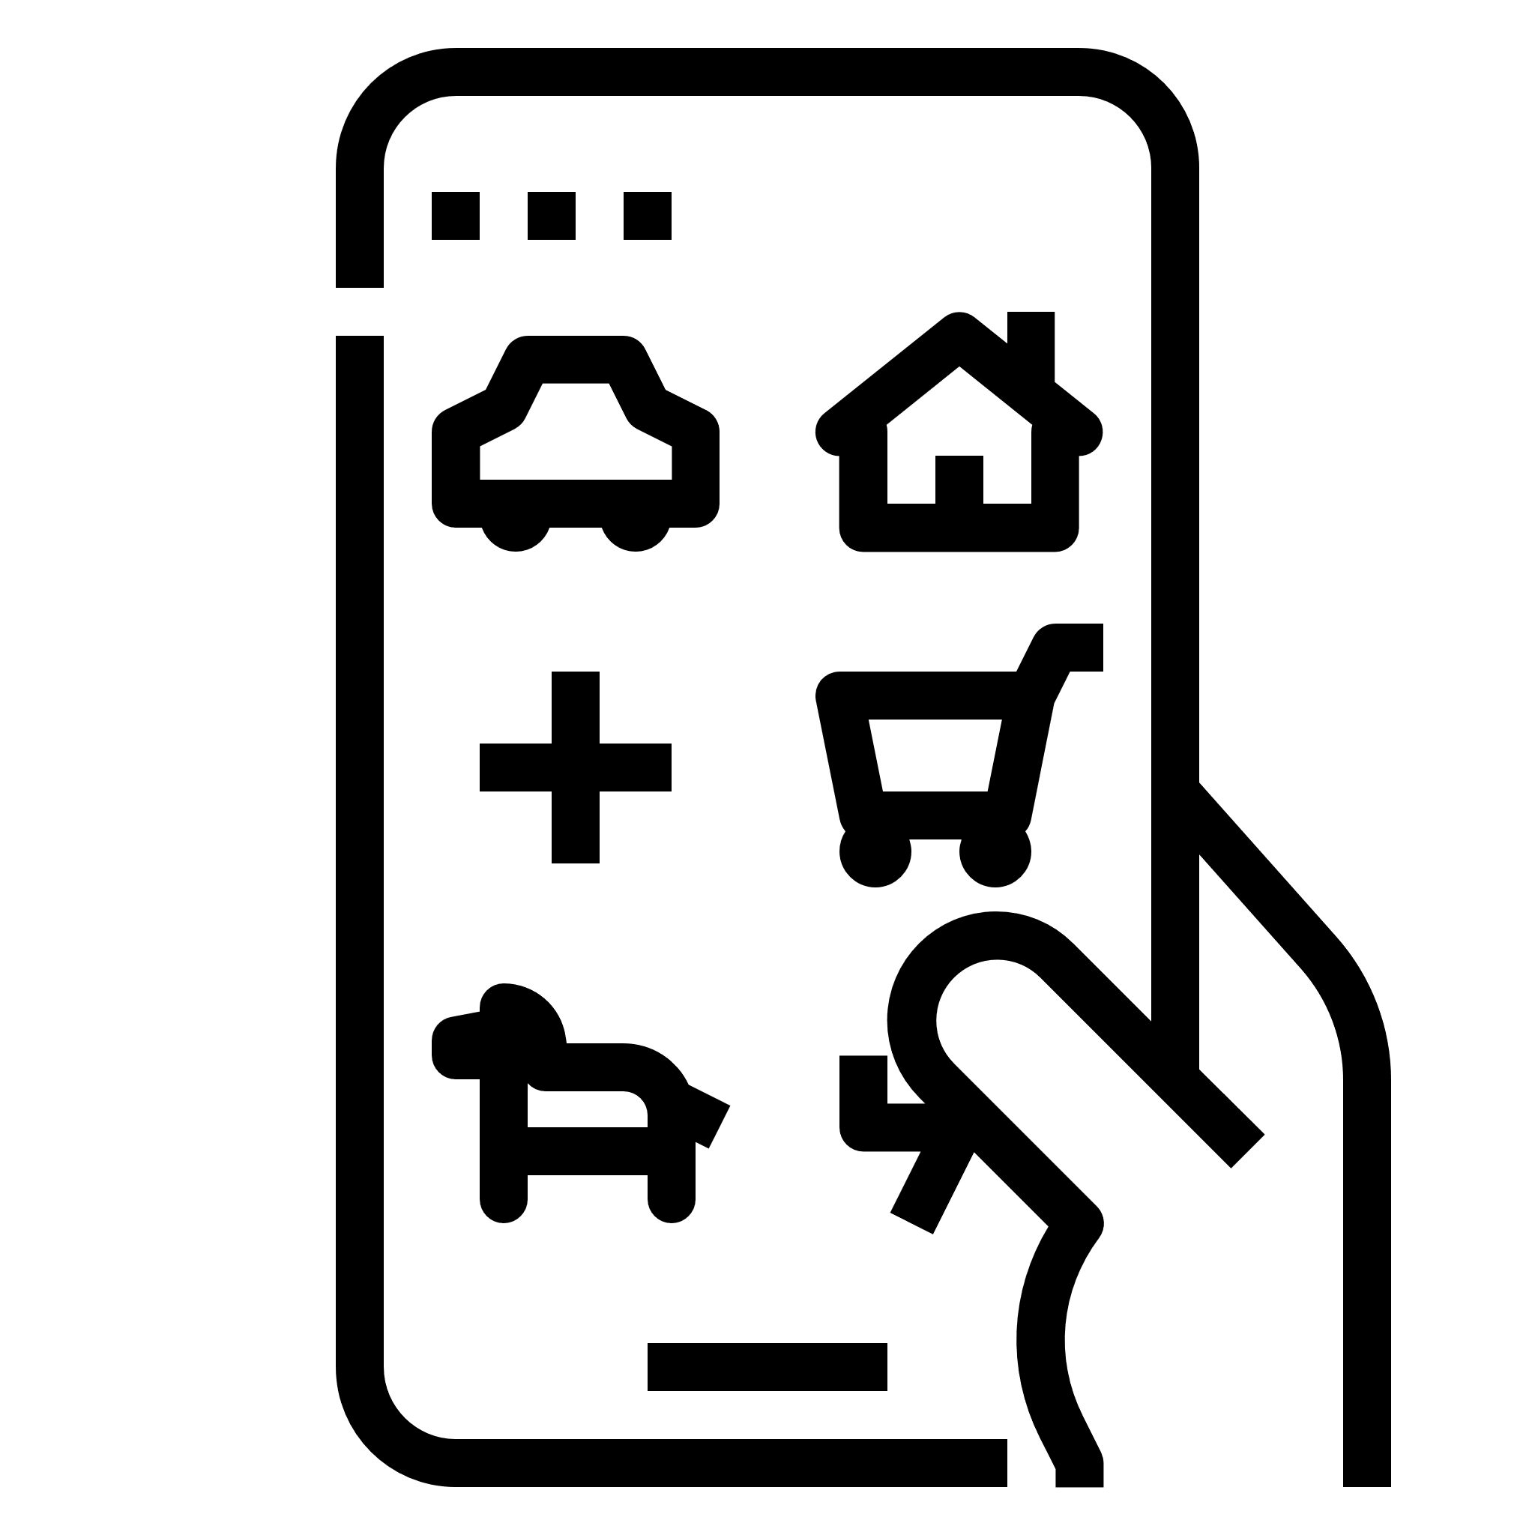
customers want the option of physical communications
Agree (Disagree)
Attitudes towards choice of comms / digital channels
83%
(3%)
28%
(47%)
67%
(10%)
People should have the choice of whether they get communications by mail or email
It’s right for companies to ask customers to pay more to get mail communications
Too many companies expect me to download their app
What role can Customer Mail play?
Source: Trinity McQueen 2021
Notes:
And one of the first big issues our research identified is that customers want CHOICE.
They want physical and digital communications – 8 in 10 people say they value both and expect organisations to know how each can support them.
They know paper based messaging costs more, but ¾ do not think they should have to pay to receive communication in the way they want – it isn’t right for brands to put the cost on their customers.
And 2/3 feel they have been pushed too much to communication via apps – they may use and even value some apps, but they are not looking to receive everything from an app.
Brands need to be careful that their communication choices are in fact driven by customer wants and needs. Brand’s plans to go ‘digital first/digital only’ are too often driven by cost cutting agendas and are not in fact customer focused.

Slide 6
Customer mail: a definition
Not all mail is the same!
Customer Mail is part of the ongoing relationship with the product or service, it is not ‘selling’ (which is the role of advertising mail)
It is sent to a named addressee with whom there is an existing relationship
Its primary focus is to share information, offer support and develop relationships using e.g. bills, statements, appointments, welcome packs.
Notes:
So what is Customer Mail?
Not a perfect definition – but clear. It was confirmed with Accenture
The research was conducted using the term Business Mail which we had explained using the definition above. But the term Business Mail refers to a mail tariff and we wanted to explore mail’s role for customers in a way they would recognise – and customers don’t recognise tariffs.
Also, we discovered in our interviews that most businesses don’t think in terms of tariff either, they consider communication in terms of need and requirement. Cost is of course important, but tariff isn’t the main driver at the start of the conversation.
By ‘Customers’ we mean – existing relationships. This includes things like students, supporters, customers, donors, citizens, members. If you contact them, they’re not surprised to hear from you. They don’t have to have purchased but need to have an existing relationship that they recognise as making it relevant for a brand to contact them as if they know them.
The reason Customer Mail would be used to get in touch is to build retention and advocacy, things that benefit and strengthen the relationship. Includes but not limited to CRM, welcome packs, bills, statements, annual reports, new card delivery, loyalty statements etc.

Slide 7
What is the role of customer mail in a good CX?
A two-year journey of discovery
Six-part research task conducted by award-winning research agency Trinity McQueen including in-depth interviews & co-creation workshops
Talking to both customers and business decision makers
How does mail add value to CX?
How can mail be implemented optimally as part of a full CX?
Marketreach has worked in collaboration with Accenture to create a ground-breaking report.
24 consumer observational interviews
Quantitative consumer survey: 6,300 online and offline interviews
18 decision maker depth interviews to explore response to key findings and messages
21 in-depth interviews with top mail decision makers in Financial Services, Retail, Government and Energy/Telco
4 co-creation workshops to develop best practice messaging
Customer in-home interviews to confirm mail usage & language
Notes:
Carefully crafted research so each phase would move onto the next to work together.
Consumer interviews started with a 2 week diary task to record all mailings, emails, sms etc. received. Followed up video interview deep dive into their behaviours and attitudes toward Customer Mail. The respondents combined a broad mix of life stages plus some respondents defined by life situations likely to create mail e.g. small business owners, mortgage applicants/moving home, shielding, key workers
Parallel to this we conducted 21 interviews with mail decision makers in financial services, retail, government, utilities across different roles – marketing, finance, procurement, production
The quantitative survey is the real heart of the research, conducted spring 2021. 6000 online. 300 less digital users by telephone. Nationally representative sample. The questionnaire was a mix of responses about Customer Mail alone, mail and digital and exploring best practice via matched poor and better mail examples.
Co-creation workshops looked at real mail examples by sector, defining what they look for, positives and negatives, how to make it better.
We then concluded with 18 further decision maker interviews to explore how they responded to consumer findings and evaluate power of different sales messages coming from the research
Finishing with video interviews done to confirm customer behaviour based on all research
This research was done during the pandemic, but we feel confident that did not influence how people responded. We separately did research about mail in covid and it’s impact and one of the key findings is that at it’s core consumers’ feelings about and use of mail hadn’t really changed. Mail become even more important with people at home so much, but actual behaviours didn’t change.

Slide 8
Mail can bolster the brand & connects with customers
How?
Notes:
The research showed that mail builds brands and connects with customers.

Slide 9
Mail enhances the brand
Mail is physically irresistible: a tangible object in our hands can evoke a wide range of sensory experiences through a considered and creative approach
The research shows that mail builds a positive impression of the sending organisation
Recipients appreciate the investment and thought that has been put in to sending mail.
Notes:
Our previous Marketreach research consistently highlights the power of mail and its physicality to build a brand.
This new research has reinforced and extended that insight – showing how mail creates a strong brand impact.
Consumers know that sending mail takes time and costs more (they see the difference between sending an email or a birthday card). And to them, that means the organisation cared enough to invest in their relationship.

Slide 10
Mail shows that companies are committed
Personalised mail lets customers know how important they are to a business
Our research shows that mail from companies makes them feel valued more (70%) than email (30%) does.
Source: Marketreach “Why Mail Cuts Through”
Notes:
Consumers see mail as showing a brand’s commitment – they cared enough to use mail. It makes them feel valued as a customer.

Slide 11
People engage with mail
Customer Mail receives more attention than equivalent digital messaging
99% of recipients interact with Customer Mail, from opening it, reading it, to storing it for later.
All physical actions (%)
99% of Customer Mail is engaged with
Source: JICMAIL
Notes:
69% of mail has a positive engagement – more than email at only 55%
Taking an action has been shown to increase recall of the content, it makes it feel more personal and relevant
99% of Customer Mail is engaged with – it is addressed to a person, it comes from a brand they recognise. They see mail as important and don’t just open it but go on to act on the message

Slide 12
Mail works across all age groups
Mail vs. emails – All, most or about half of them (%)
Despite conventional wisdom, mail works well with younger Millennials and Gen Z
They appreciate the personal touch that Customer Mail provides. They engage with it more than email: 85% of them open it; 65% store it for future reference; 49% put it somewhere to action later; and 40% show it to others in their household.
Positive engagement
77
67
Among
18-34’s
Question(s): D1. How much of this mail you receive do you …?, D7. How many of these emails you receive do you …?
Base: 18-34’s answering about mail (956), emails (961)
Source: Trinity McQueen 2021
Notes:
Young people get less customer mail, but they also recognise it as important and engage with it at similar levels to older audiences.
We see this consistently in all of our research. Mail cuts through and engages young people as well as older.

Slide 13
Mail is trusted
Completely trust the mail I receive
Agree or agree strongly (%)
Brand equity is largely about trust
Good relationships are built on trust. And more and more, the trust factor is what motivates consumers to do business with brands—and to stay loyal to them
Consumers consider mail as one of the most trusted communication channels across all sector categories.
Cross-category average
71%
Source: Trinity McQueen 2021
Notes:
What they get from mail is trust, 71% agree they trust the mail they receive
Note – there is no equivalent measure for digital in this research, but other data in the research shows that digital has now become more highly considered to be risky and likely to be a scam – which will lower the level of trust

Slide 14
Mail has commercial impact
Visit the company’s website
Because Customer Mail is looked at frequently and shared often, 1 million items posted results in 5.4 million opportunities to get the message seen
And JICMAIL research shows that mail leads to a wide range of concrete commercial actions 43% of the time.
Tell others about it
Buy something
43% commercial actions
Order a catalogue
Make a donation
Visit the company’s shop
Plan a large purchase
Use a voucher / code
Source: JICMAIL
Notes:
Mail isn’t just looked at once. It is opened, saved, read, returned to, acted on and shared. Each action is a reinforcement of the brand and the relationship.
The image shows the commercial actions taken with mail, these are the next steps from receiving Customer Mail that show the recipient is acting on the content and moving toward a stronger commercial relationship. Mail leads to a commercial actions 43% of the time.

Slide 15
Mail works well with digital
Mail and digital communications serve different purposes – but are highly effective working together
Each situation needs to be considered on its own merit – Physical can reinforce digital and vice versa
Working together, they can make messages stronger and more likely to be remembered
Multi-channel experiences are more effective.
Mail has a powerful impact on long-term memory encoding for social media advertising
+44% stronger when people had seen mail first
A reading of 0.70 and above indicates a response that is likely to be powerful enough to impact future behaviour.
* Source: Marketreach “Why Mail Cuts Through”
Notes:
Strong CX is about using the right channel to the customer. CX isn’t about independent touchpoints, but about the overall integrated experience from many connections. This research confirms the close partnership we have always seen between mail and digital – mail and digital together are more effective than either alone.
Previous neuroscience research showed mail with social media can make social 44% stronger than on its own.

Slide 16
Matching the message to the medium
6 occasions When to use customer mail
To deliver a powerful Cx
Notes:
Mail isn’t for everything, but there are 6 powerful reasons when It is likely to be the best channel to deliver strong CX.

Slide 17
1. when the communication needs to be read thoroughly
Across all sectors, people are more likely to read mail than digital communications.
Read all or some of it in detail - About a recent mail or email communication from category (%)
Source: Trinity McQueen 2021
Notes:
Mail is more likely to be read, and read more thoroughly than digital. Mail signifies importance and gets opened – so if you want your message to be read – mail should be your choice.

Slide 18
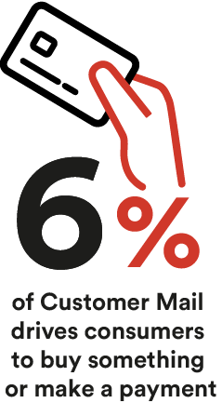
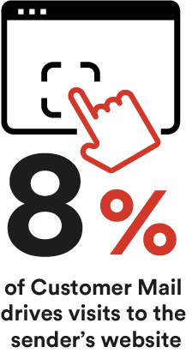
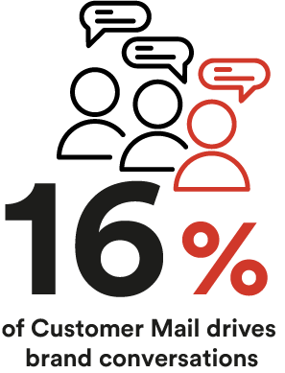
2. when the recipient needs to take action
Mail is more likely to result in an action than digital communications.
…particularly when there are multiple steps, a range of options, or for infrequent actions.
Applies more to mail or digital (%)
It’s likely to be something
I need to take action on
Source: Trinity McQueen 2021 & JICMAIL
Notes:
Customers respond to mail – they see it as a message they may need to take action on. Its physicality makes it easy to hold the message as a reminder to act. And it helps make clear what needs to be done – whether that is a financial action, visiting a website or discussing the content.

Slide 19
3. when the information is important
Twice as many people assume that information imparted through physical mail is important, compared to digital.
Applies more to mail or digital (%)
I would pay careful
attention to this
Source: Trinity McQueen 2021
Notes:
Mail is reported to be twice as important to customers as email.
Customers report that when something is mailed to them, they feel that it’s probably something important, something they need to pay careful attention to
If they miss it, it could lead to trouble – missed bill or appointment or the loss of a benefit – missed offer or voucher, customer event
The way this question is asked is relative - does it apply to mail or digital more? The middle ground is ‘it applies to both’ which accounts for the missing %

Slide 20
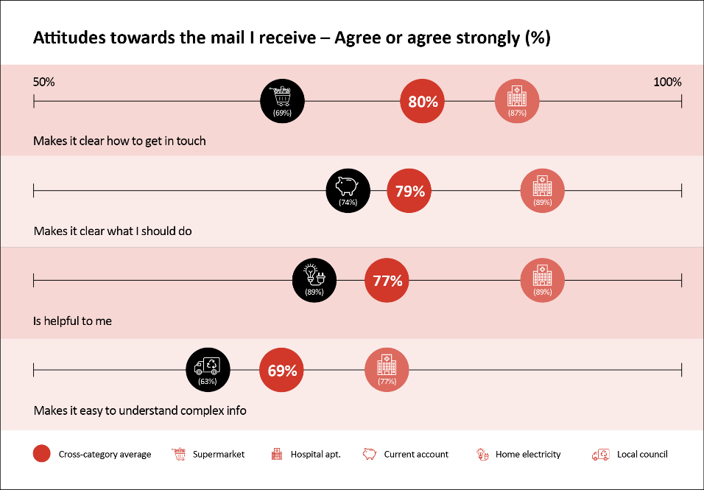
4. when the information is complex
People are twice as likely to say that they understand complex information when it is presented to them in physical mail (31%) compared to digital formats (16%).
Applies more to mail or digital (%)
A good way to help me
understand complex
information
Source: Trinity McQueen 2021
Notes:
Mail can clarify information. Tests have proved that content is easier to read and understand when delivered on paper versus screen
Mail can help people easily see what it is, what they need to do and how to do it.
However, not all mail is good mail. We encountered many examples of mail that could (and should) be made better by better design and structure
There is information available on what can make mail better later in this report

Slide 21
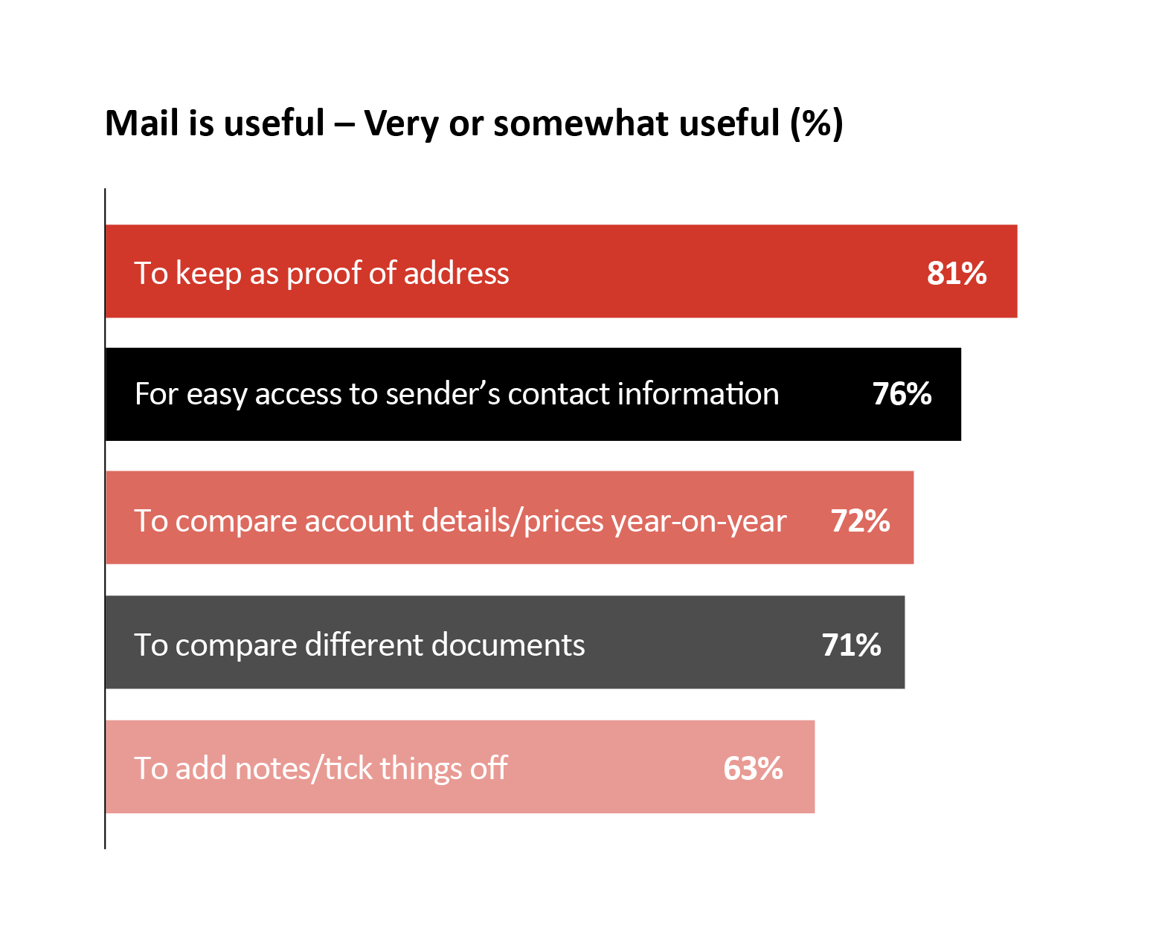
5. when the information needs to be kept
Consumers across all age groups appreciate physical mail for the ease of reference, the ability to organise and to make notes or comments. 54% say physical copies help them feel more organised.
Trinity McQueen full quant
Source: Trinity McQueen 2021
Notes:
Mail helps people feel organised and in control of their lives
Proof of address etc. makes life easier
Every age group believes mail is useful
Whether they have formal and organised files or a box of mail under their bed, people feel a need and benefit from saving/filing mail so they have ready access to it
Digital filing isn’t done to the same extent

Slide 22
6. when there are privacy or security concerns
More than twice as many people feel that physical mail is private and secure. More people associate scams with digital channels than physical ones, by a 4-to-1 margin.
Applies more to mail or digital (%)
Feels private and secure
Same
I would think it might be a scam
Same
Source: Trinity McQueen 2021
Notes:
Mail is seen as a trusted channel, private and secure
Mail is now perceived to be free of scams - unlike emails where consumers see serious danger

Slide 23
Too many organisations use customer mail poorly
5 ways to get the best out of customer Mail

Slide 24
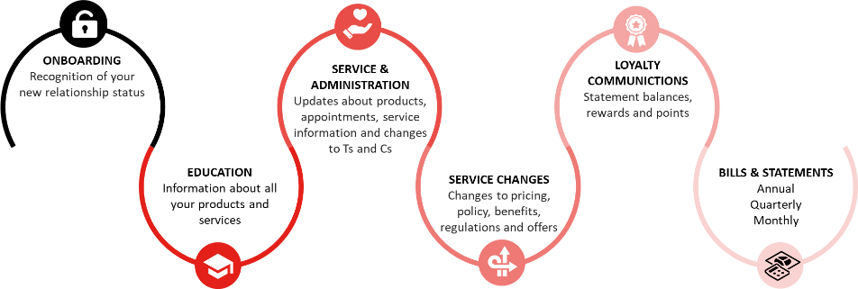
1. Know your customer and where mail can fit
Good CX demands being personal with customers, giving them what they need and want
This includes knowing how best to stay in touch – not too little, nor too much and what types of communication
Understanding the role mail is designed to play in the customer journey.
Notes:
Mail isn’t for every message.
Given that it signals importance, trust and a need to be opened ad actioned – you should use it when it will matter, and deliver the right results. There are opportunities at all moments across the customer journey when benefits can be achieved via mail. Identifying those moments of truth when mail is the best channel can have a strong impact on CX and brand strength.

Slide 25
2. Measuring it meaningfully
Customer Mail should be viewed as an investment in the broader CX approach, beyond specific costs
Don’t view it as part of an advertising budget or something that ‘had to be sent.
Every communication should have a role and that role can be measured.
Consider short term metrics such as QR code use or web visits. There are also broader KPIs such as brand recognition and lifetime value.
Notes:
Why would you have a conversation with a customer for no reason? How can you be sure that message had the right impact?
Mail can and should be measured. It can be measured via sales but it doesn’t have to be about buying. There are many choices of relevant measurements - brand engagement such as use of QR codes, web visits or account log ins or even looking at lower response such as fewer calls to the call centre or fewer missed appointments (which can have a significant impact on cost savings which is critical to measure).
It should also be considered in longer term measures such as ROI or Lifetime Value. And should also be included in econometric modelling using JICMAIL data.

Slide 26
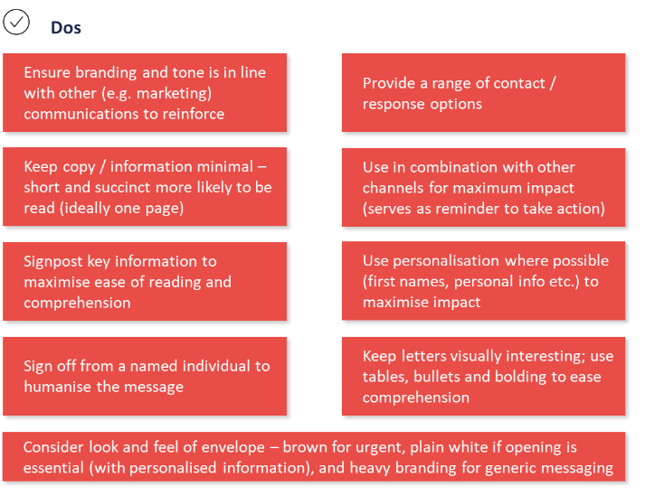
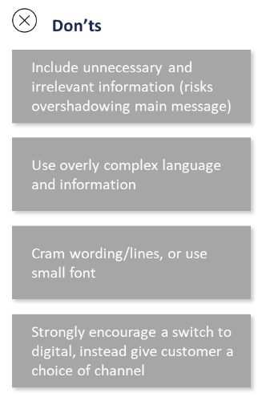
3. Design matters
Customer Mail should be treated with the same care and attention as every other element of the brand’s touchpoints
Make it clear and organise the information. Ensure the reader knows what they are expected to do
The language should be easy to understand and strike the right tone.
Source: Trinity McQueen 2021
Notes:
Organisations undermine their brand by not ensuring they design mail well. They spend loads on website design and optimisation, TV ads and branding - but then don’t translate it to mail.
Brands need to reflect their brand in mail. Why would you build a high quality brand and then undermine with badly designed mail on poor quality paper?
Customers want mail to be – clear, honest, understandable and actionable.
Keep it simple
Personalise where you can.
Explain why you are writing, what is important and what customers need to do – e.g. costs are going up and why bills are increasing and how to manage costs.
Don’t use anything unnecessary, right balance for amount of words
Don’t force me to do something I don’t want to do e.g. go paperless.

Slide 27
4. More than marketing
Every communication with a customer is an opportunity to build the brand and relationship with positive contribution to the CX
All areas of a firm should view Customer Mail in this manner, integrating best practice into activities
Our research shows many teams including finance and product get involved with mail and they may not automatically consider the broader implications for customers.
Notes:
CX is important to all parts of the organisation.
Not all mail is managed by marketing. So if the responsibility for example, for billing sits with Finance, they need to understand the role and value of mail on CX. A bill isn’t just something you HAVE to send – it is a customer connection, a chance to reinforce a brand. And, if done badly or replaced with an email, you need to have considered the impact – fewer fast payments, more missed payments as emails are missed or forgotten, calls going up as people are confused, impact on brand image.
Using mail or eliminating it is likely to have a significant impact that everyone should understand and consider.

Slide 28
Use it because you should not because you could
Customer Mail is not for everything, all the time
It is best deployed when it can address some its key strengths, as outlined in this document
Mail ensures customers feel valued and connected with businesses
Preferences are individual and context dependent, but most agree that mail should be used for important communications.

Slide 29
summary

Slide 30
summary
CX matters
CX should include physical communications
Mail has many CX strengths
It requires careful consideration
Companies investing in good CX generate better revenues as their customers like doing business with them.
Too often CX is reduced to the purely digital. But customers need and value the physical too.
With its physical nature and role in our homes and lives, mail is particularly useful for important information, when things are important, complex or there’s a need for security
To make the most of mail it should be considered in the same way that websites or other channels are thought about. Every touchpoint with a customer counts towards CX.

Slide 31
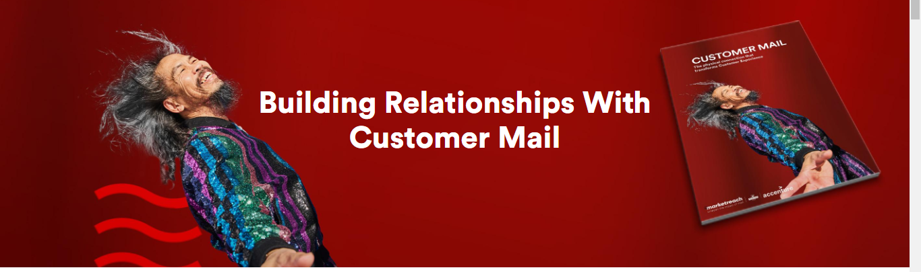
Download and read the full report today
The full report, from Marketreach written in collaboration with Accenture
Marketreach and Accenture report here today

Slide 32
THANK YOU

