Slide 1
USING IMAGE TECHNOLOGY IN MAIL TO DRIVE ONLINE BEHAVIOUR & CONSUMER ENGAGEMENT
The seamless connection from offline to online
3 August 2020

Slide 2
Mail drives high engagement
Getting people to take commercial actions and go online
97%
33%
14%
engagement
Commercial
action
Online
behaviours
Source: JICMAIL, Addressed Mail, Business Mail, Q2 2017 – Q4 2020

Slide 3
Using new technology to drive frictionless offline to online
87%
81%
Of adults own a
smartphone
In 2020
Search for Goods
And services
72%
Mobile internet
Penetration rate
In 2020
Source: Statista, 2020

Slide 4
There are a number of ways to drive print to pixels through imagery

Slide 5
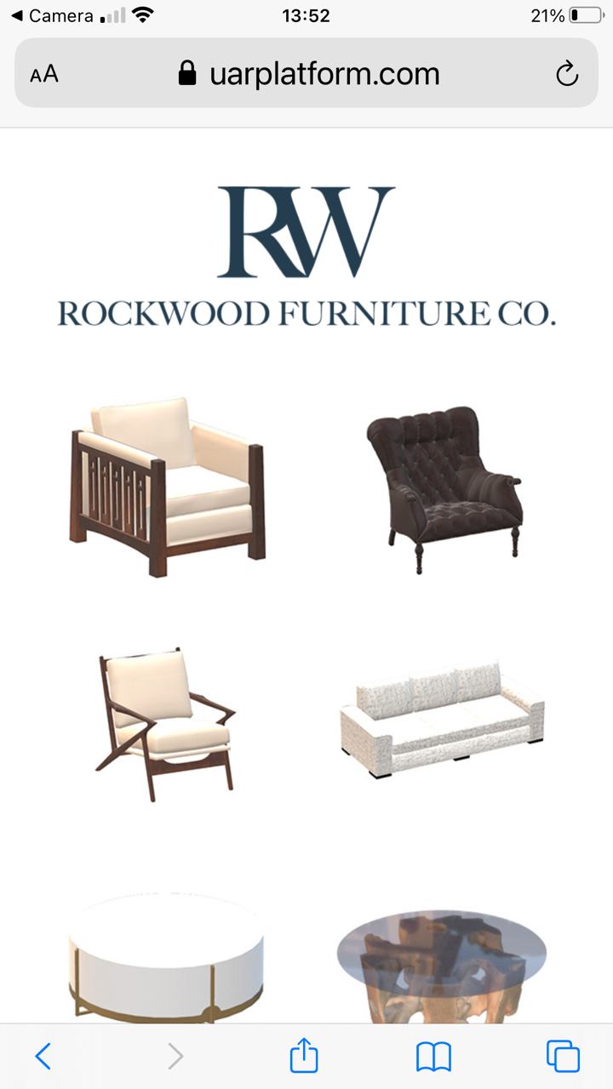
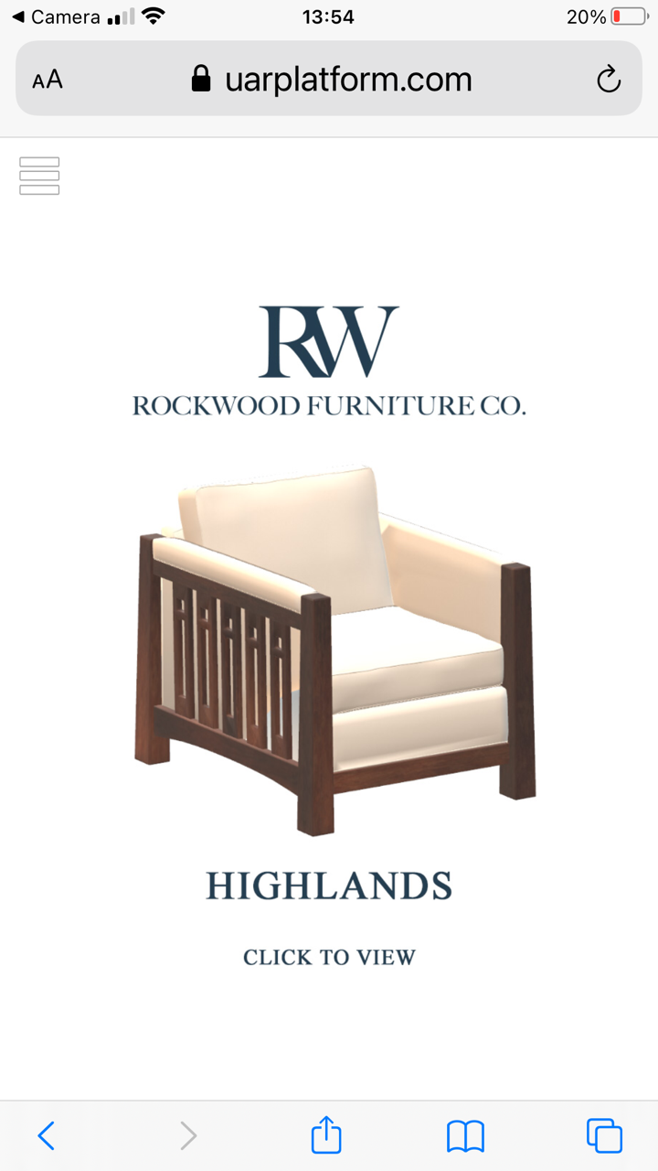
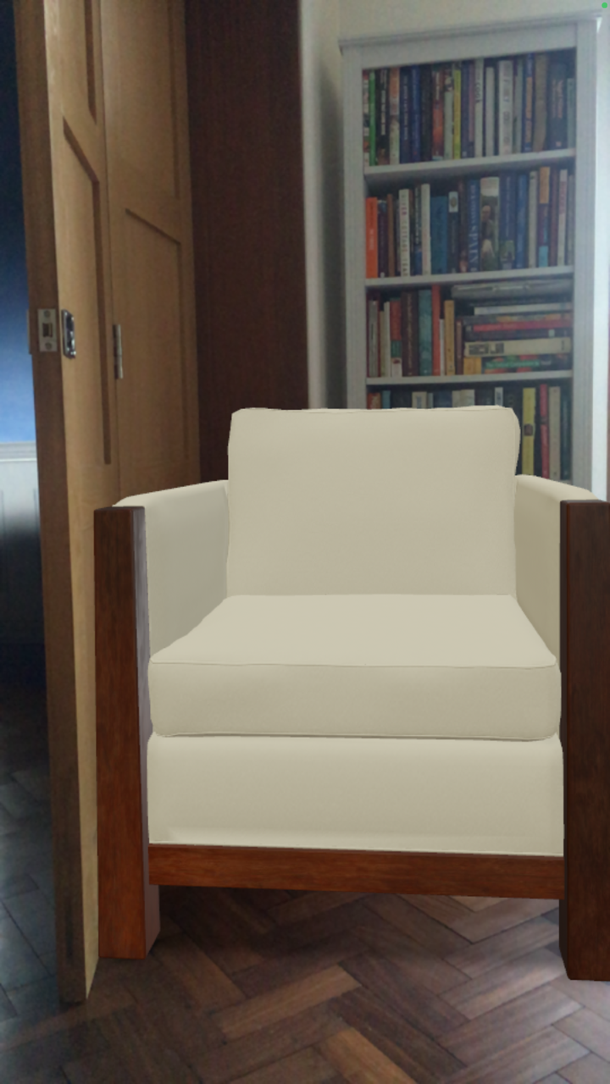
Augmented reality
This furniture retailer has given people the opportunity to see their up market furniture in situ
Put your camera over the QR code from a printed piece
It takes you to a produt overview page
Select the product you want to see
The selected chair is shown in front of the bookcase in the dining room!
Allows you to really see what products will look like in your home
But the possibilities are endless…
PUT YOUR PHONE CAMERA OVER THE QR CODE
5
Source: UnifiedAR Pty Ltd

Slide 6
Digital IMAGE RECOGNITION
Making print content shoppable
Heat magazine made their content completely shoppable
Using Phuzion’s image recognition platform Heat Magazine made the content fully shoppable
Obviously helping to drive affiliate revenue streams
Allowing readers to connect in an innovative and seamless way from print to digital
You simply point your mobile at any page and take a picture to be taken straight to purchase
Allowing you to take a consumer to products, without changing the editorial design or creative
CLICK HERE TO SEE IT IN ACTION
Source: Phuzion Media UK Ltd

Slide 7
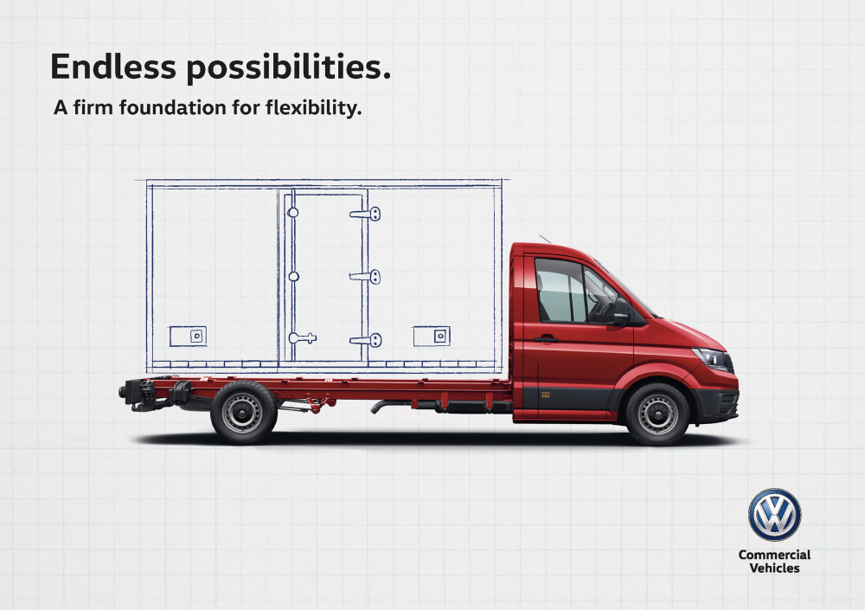
Animated video
Background
Volkswagen Commercial Vehicles (VW) launched the Crafter Chassis Cab - they needed to show how it was flexible enough for tradespeople to convert the vehicle to suit their line of work.
Strategy
VW created a slide out format mailing - under the headline ‘Craft it for your Business’ - to illustrate multiple conversion ideas in a tactile, bite-size way. It then cut to the chase with the facts and information needed. Echoing the advanced tech of the vehicle, the recipient could hold their phone over the pack to see even more options brought to life via animated video.
Source: Warc/DMA Winner 2018 (Bronze). Best use of mail.

Slide 8
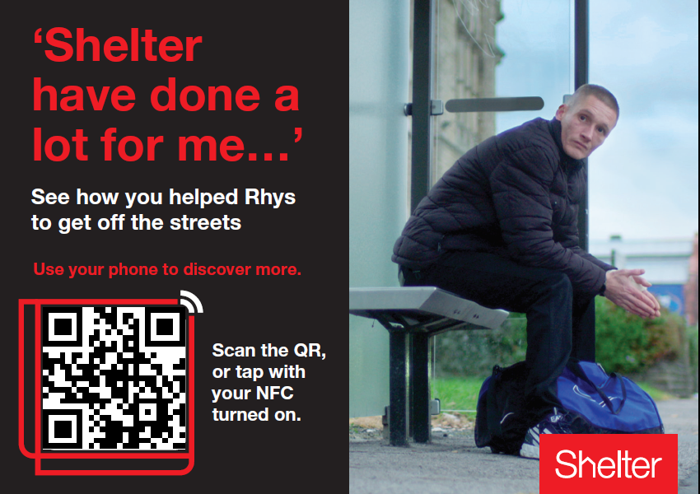
AN NFC Sticker BOUGHT HOMELESSNESS TO LIFE
Background
Shelter mail a newsletter twice a year to donors to build relationships. In 2020, they wanted to test a new approach in engaging a specific audience – Digital Savvy Donors; new regular givers who signed up online.
Solution
Shelter, working with the cashless donation specialists Thyngs, tested mailing an interactive postcard instead of the newsletter to their Digital Savvy Donors. The postcard included an NFC sticker/QR Code, when scanned, it led the donor to a bespoke page of the digital newsletter where Rhys, who had been street homeless explained how Shelter helped him find and keep a safe home.
Results
1.76% of Digital Savvy Donors scanned the code to read the case study and watch the video. Analysis showed that donors share the case study with others, helping to spread the message further.
Source: Claire Leslie, Senior Direct Marketing Executive, Shelter

Slide 9
“AS AN INITIAL TEST TO SEE IF PEOPLE WOULD INTERACT WITH AN NFC/QR CODE, WE WERE VERY HAPPY WITH THE RESULTS. IT SHOWS THAT PEOPLE ARE INTERACTING WITH SOMETHING YOU HAVE MAILED WHICH IS REALLY EXCITING”
Claire Leslie, Senior Direct Marketing Executive, Shelter

Slide 10
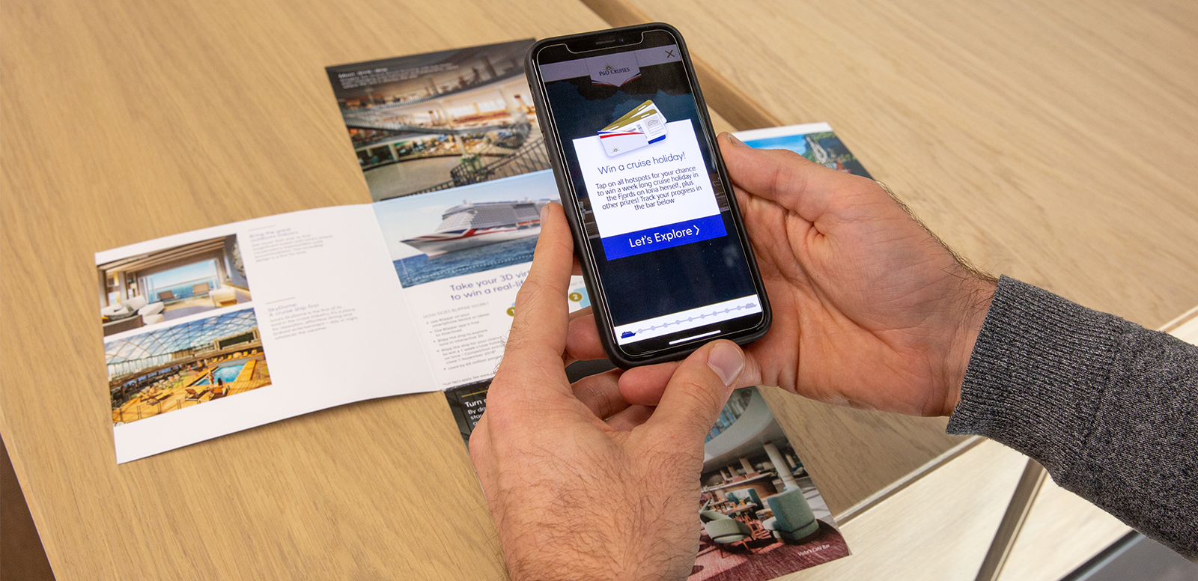
P&O USED AUGMENTED REALITY TO HELP THEIR NEW SHIP SAIL
Background
P&O Cruises wanted guests and travel agents to get excited about the launch of their most innovative, new cruise ship – The Iona – before it launched.
Solution
P&O Cruises sent an augmented reality mailing that gave recipients an interactive 3D experience of Iona.
By opening an app and holding the phone over the mailing, Iona burst into life and could be explored from bow to stern. ‘Visitors’ could win a cruise.
Results
A week after launch P&O Cruises beat their targets for number of
views and dwell time.
Source: Travelweekly.com

Slide 11
To sum up
1
2
3
4
5
Offline to online
Mail response
Attribution accuracy
Engaging & immersive
Brand experience
Creating a frictionless way to drive people online
Driving higher response rates as you’ve removed a barrier
Helping you to gain greater accuracy on where your responses are from
Getting consumers to be entertained and truly immersed in your brand story
Giving consumers a memorable and deeper brand experience

Slide 12
TESTING AND INNOVATION SCHEME
SAVE UP TO 15% OFF *
SAVE UP TO 30% OFF *
ADVERTISING MAIL
BUSINESS MAIL
Test image technology
Test image technology
To qualify you must carry out the test over a period of up to six months.
You can test as few as 10,000 mailing items
and as many as a million
To qualify you must carry out the test over a period of up to six months with the option to roll-out over a further six months.
You can test as few as 10,000 mailing items
and as many as a 10 million incremental items
For example: use image technology to link consumers to a digital experience
For example: use image technology to link consumers to a their account
* Full terms and conditions apply

Slide 13
THANK YOU

